Slide 1
DURABLE AGENTS
Crash lab
Same research agent. Two control planes. One kill -9.
github.com/ryanlingo/durable-research-agent
Notes:
Multi-step agents die when the process dies. Today we measure that with tokens, not slogans.

Slide 2
The failure we care about
Process dies mid-write: deploy, OOM, laptop sleep.
What is lost?
What is re-paid?
What is reused?
In-flight LLM result
Plan, write, judge…
Completed work, or not
Retries fix bad HTTP. They do not fix process death.
Durable agents crash lab · 2/12
github.com/ryanlingo/durable-research-agent
Notes:
Checkpoints help only as far as the recovery code you maintain.

Slide 3
Same agent, two stacks
 | Typical stack | Temporal
Control flow | asyncio | Workflow Execution
Retries | tenacity | Activity Retry Policy
State after crash | SQLite you maintain | Event History
Human approval | poll a DB row | Signal
Shared: tools, prompts, RAG corpus, judge, token counters. Only orchestration changes.
Durable agents crash lab · 3/12
github.com/ryanlingo/durable-research-agent
Notes:
If tokens diverge after a crash, that is the control plane, not a different model.

Slide 4
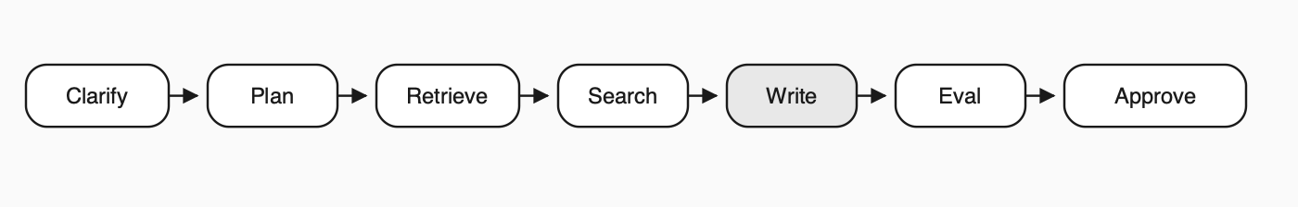
Pipeline (shared brain)
clarify → plan → retrieve → search (parallel) → write → evaluate → approve
Search is parallel on both sides on purpose (fair comparison).
Durable agents crash lab · 4/12
github.com/ryanlingo/durable-research-agent
Notes:
Ordinary agent work. If durability is messy here, it is messier in a larger system.

Slide 5
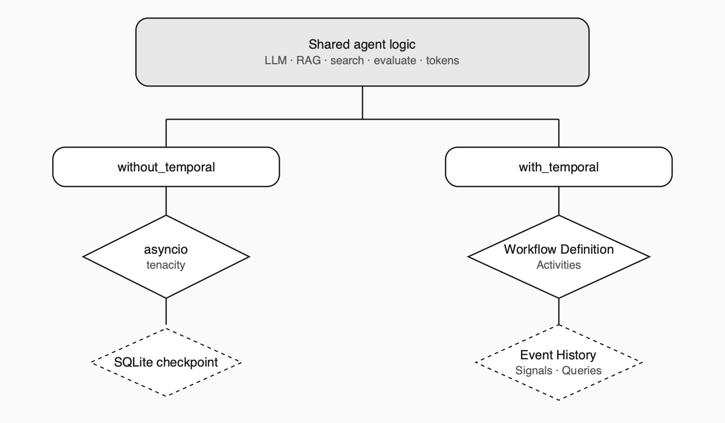
Architecture
Everything above the split is the experimental control. Below it is the product decision.
Durable agents crash lab · 5/12
github.com/ryanlingo/durable-research-agent
Notes:
Shared agent logic above. without_temporal left. with_temporal right.

Slide 6
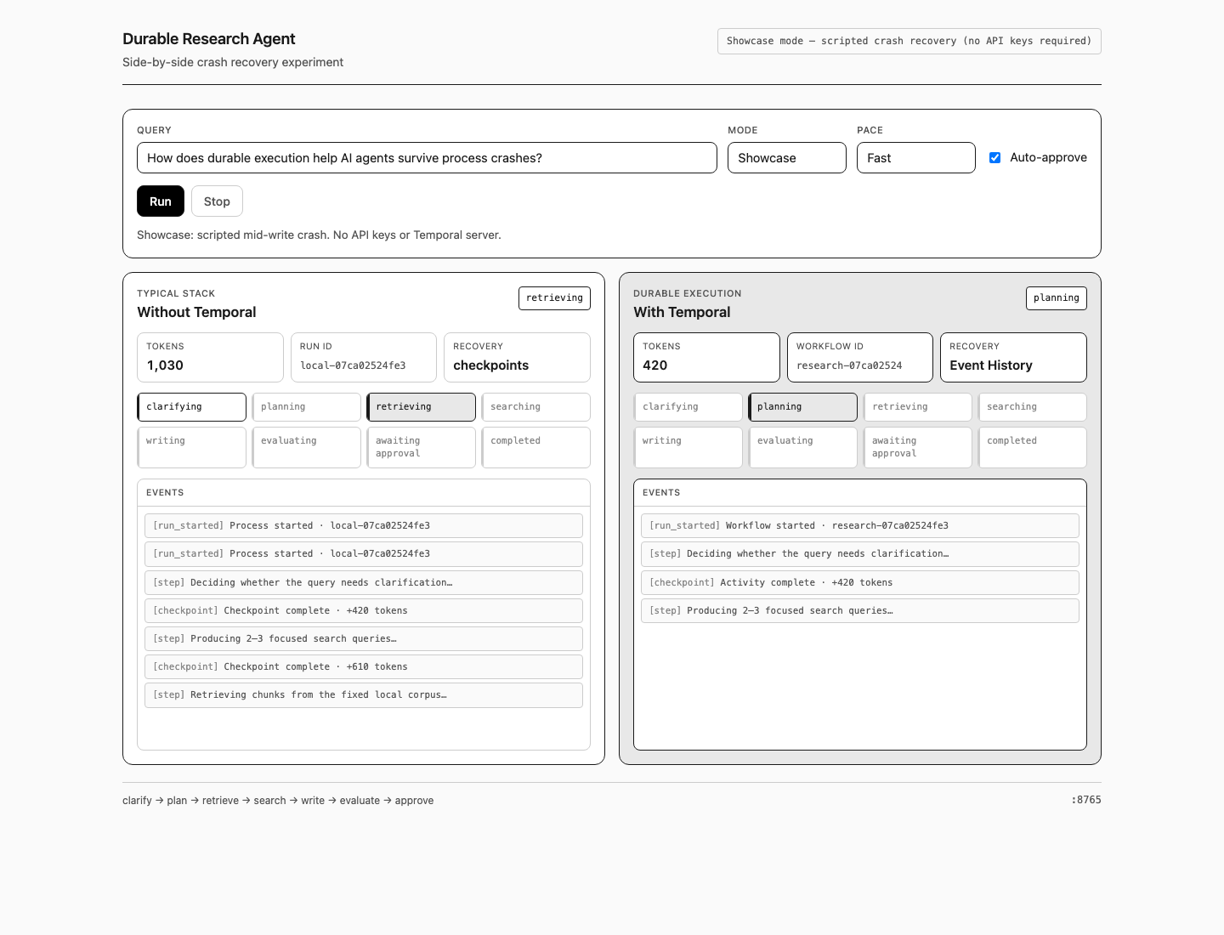
Demo: Showcase
Mode: Showcase · Crash at: writing · No API keys
Live: python -m ui.app or play the mp4
Durable agents crash lab · 6/12
github.com/ryanlingo/durable-research-agent
Notes:
Left: process + checkpoints. Right: Workflow Execution + Activities. Same crash point. Stop talking while pipelines move.

Slide 7
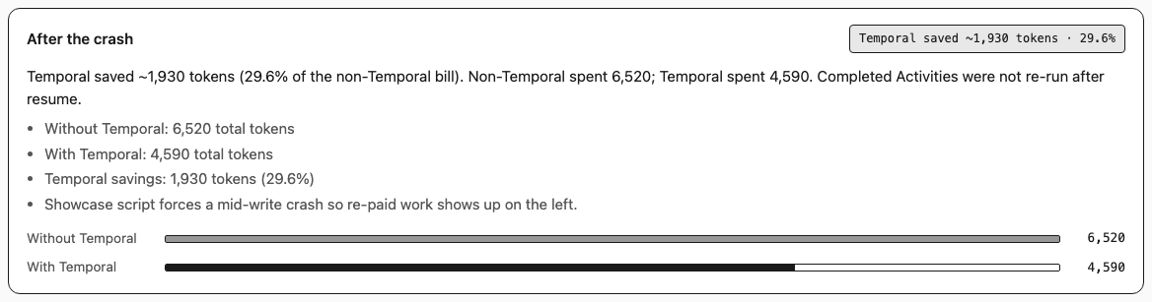
After the crash: tokens
Scripted Showcase (mid-write)
~6,520
~4,590
~29.6%
Without Temporal
With Temporal
Temporal savings
Durable agents crash lab · 7/12
github.com/ryanlingo/durable-research-agent
Notes:
Reliability shows up as money. The bill tracks how complete your resume path is. Savings ~1,930 tokens.

Slide 8
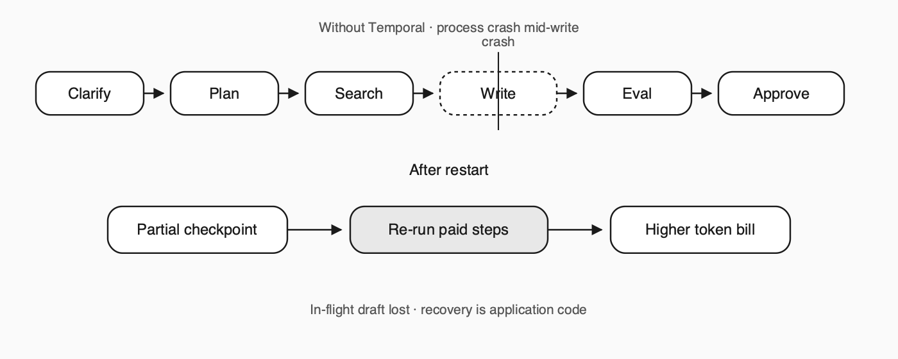
Without Temporal: what re-ran
In-flight draft not checkpointed → rewrite
Incomplete recovery can re-touch earlier steps
UI lists What re-ran + token deltas
Fair path: retries, checkpoints, approval; still re-pays
Durable agents crash lab · 8/12
github.com/ryanlingo/durable-research-agent
Notes:
Gaps are intentional: mid-gather, re-eval, coarse status. See content/concepts/recovery-gaps.md

Slide 9
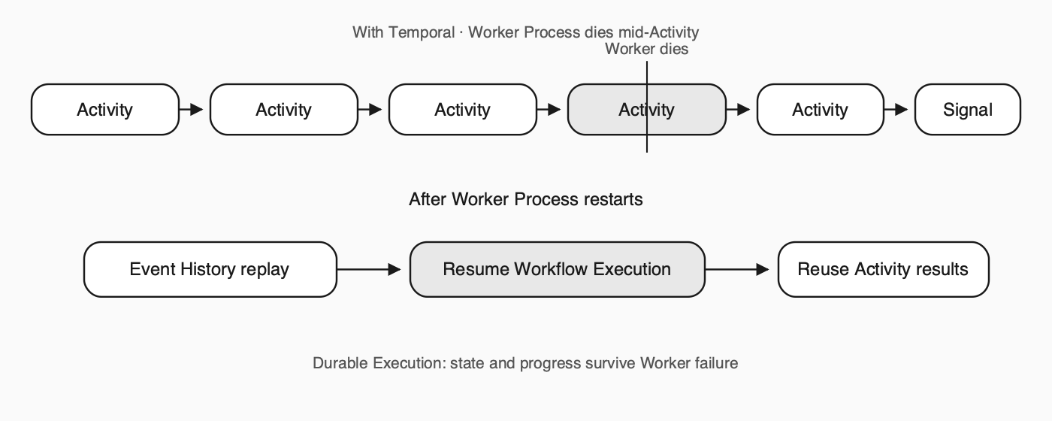
With Temporal: Worker vs Execution
Kill the Worker Process ≠ kill the Workflow Execution
Event History records completed Activities
On resume: replay history; completed Activities not re-run
Durable agents crash lab · 9/12
github.com/ryanlingo/durable-research-agent
Notes:
Durable Execution means the run keeps progress through failures. You design the agent; stop re-implementing a half workflow engine.

Slide 10
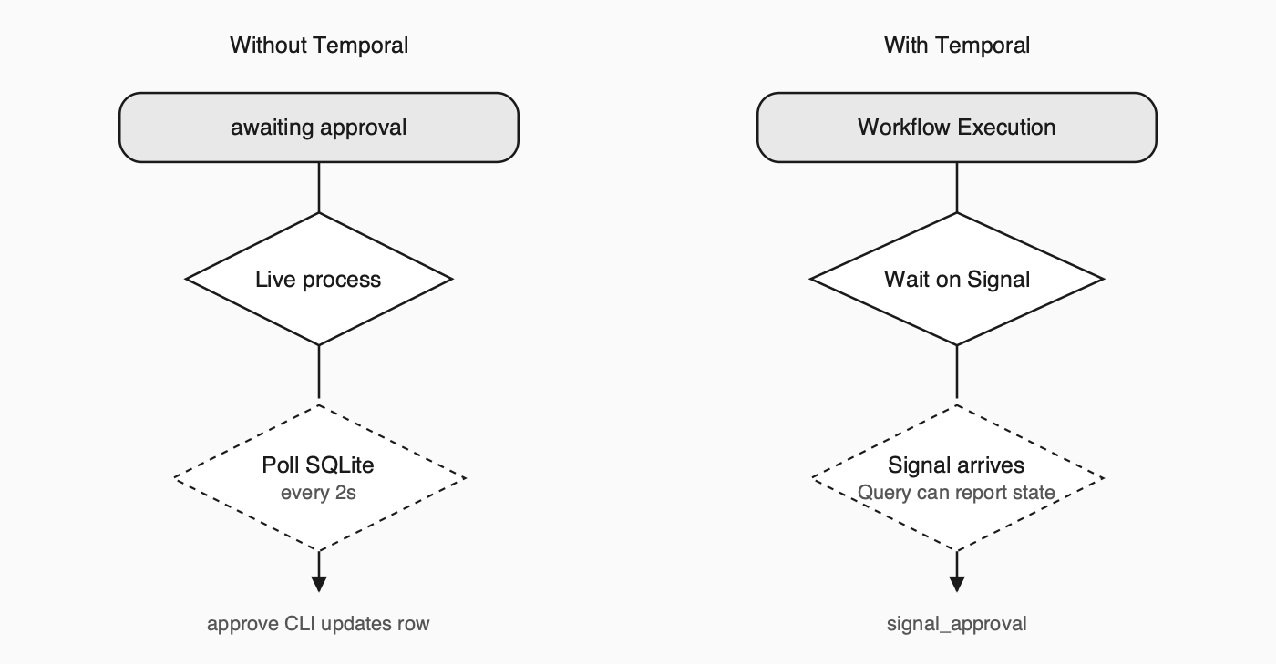
HITL: poll vs Signal
Human time is long. Polling processes charge you for waiting. Signals do not.
Durable agents crash lab · 10/12
github.com/ryanlingo/durable-research-agent
Notes:
Signal into Workflow Execution; Worker need not stay warm for the wait.

Slide 11
Fairness + intentional gaps
Fair
Intentional gaps
Same tools, parallel search, judge, tokens
Real checkpoints and approval on the left
Crash both at a named stage when measuring
Mid-write draft boundary
Mid-gather search batch
Coarse status resume
Re-eval after some resumes
Durable agents crash lab · 11/12
github.com/ryanlingo/durable-research-agent
Notes:
Closing every gap in-app is how teams invent a private Temporal with worse observability.

Slide 12
Try it
pip install -r requirements.txt
python -m ui.app # Showcase first
content/tutorials/ # step-by-step
If a crash doubles spend, the control plane is incomplete.
github.com/ryanlingo/durable-research-agent
Notes:
Start with Showcase. If the token gap is obvious without a lecture, the control plane was the product.

