Slide 1
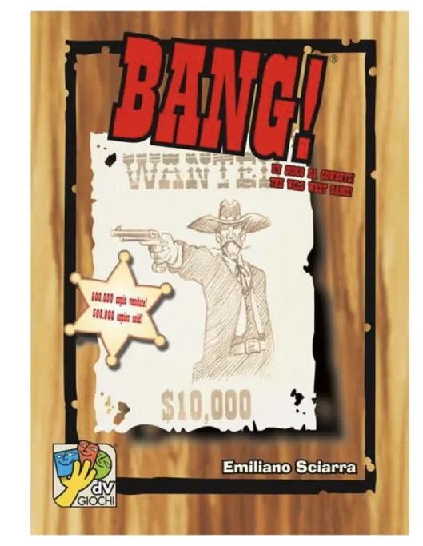
Computer Programming Final Project
Our “Bang” Game!

Slide 2
Bang!
"Bang!" is a faction-competition based game with the old-fashion western shoot-out theme. With many kinds of characters and items, you can plot your own strategies with your teammate to hunt down your targets!

Slide 3
Features
Surprise!

Slide 4
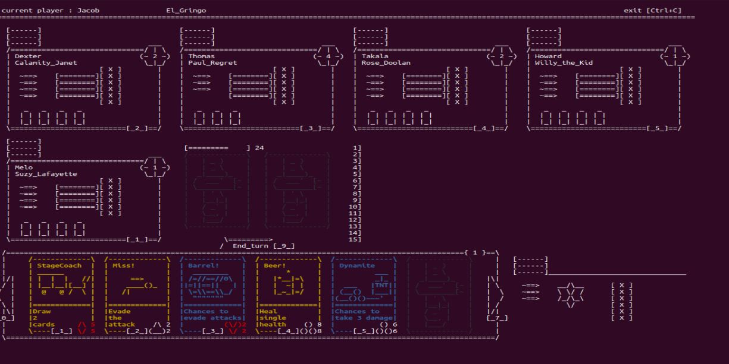
Our Features!
The user interface created with ASCII on Terminal!

Slide 5
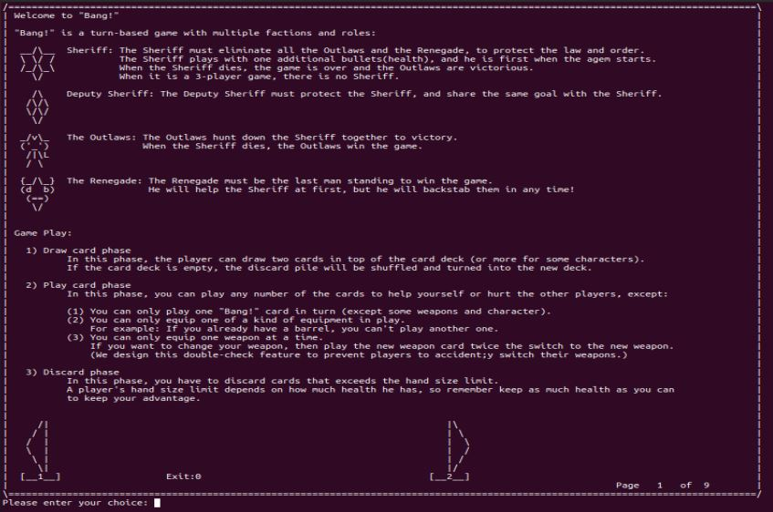
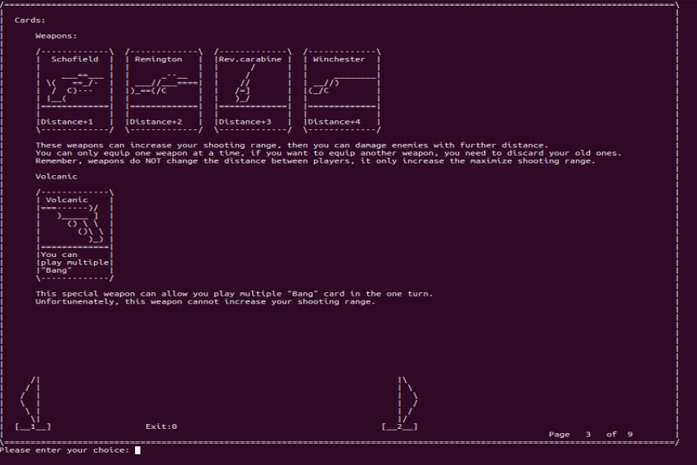
Our Features!
Completed rule book inside the game!

Slide 6
And More!
The amazing starting menu!
A western-theme back ground music!
20+ profile pictures on the display screen
Easter egg…?

Slide 7
Job assignment
林昕銳: 遊戲內部程式編輯、教我們使用 git (?
黃文雄: 封面圖設計、UI 設計、遊戲內部程式編輯
林柏佑: 簡報製作、規則說明書製作、起始頁面程式編輯

Slide 8
Showcase
It’s showtime!

