Slide 1
Final Project Slide Deck
IS 362
Ryan Morales

Slide 2
Final Project Goals
Create tables with the knowledge of SQL which displays car brands and sales within 2020
Create a CSV file after joining both tables which will be edited with Python
Use knowledge obtained within Python to import and edit the CSV file
Utilize Python to sort through and create graphs to display data which is presented

Slide 3
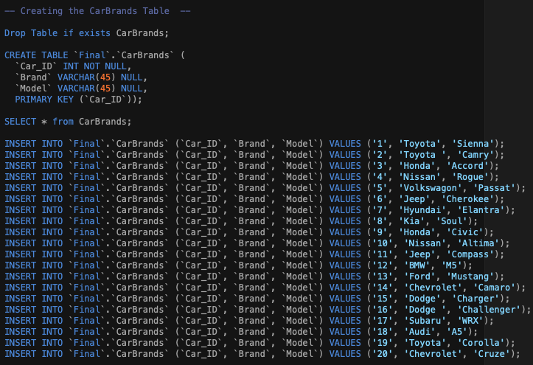
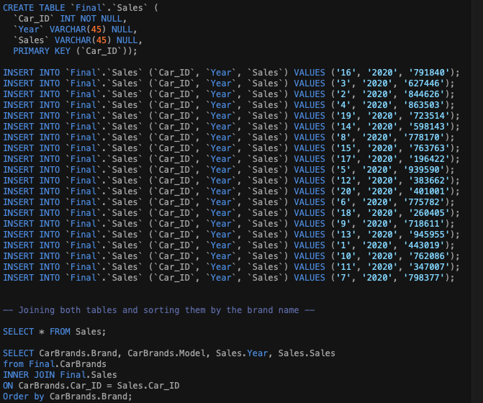
Creating Tables with SQL
In order to start this project, I decided to create a schema with two tables, CarBrands and Sales, which will be joined to maximize the provided data.

Slide 4
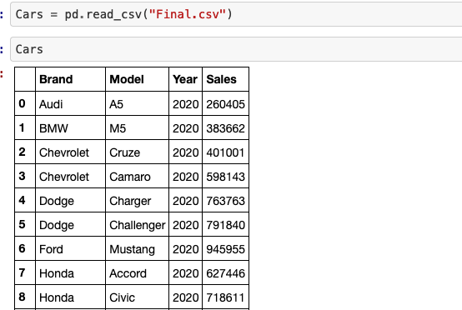
Creating Data Frames
After utilizing SQL to create my data sets, I exported the combined data into a CSV file labeled, Final.CSV. This file was then imported into a python notebook with the pd.read_csv() command.

Slide 5
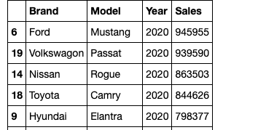
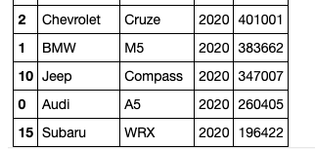
Python Sorting Technique
As the information was imported into a data frame, I decided to use my python knowledge to sort through this information. In order to do so, I used the .sort_values(by=[""], ascending=False) command. I decided to sort the data frame based off of sales. By doing this, I am able to display the top selling car on the top of the list and the least selling car on the bottom.

Slide 6
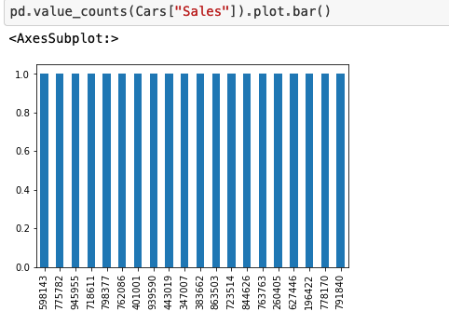
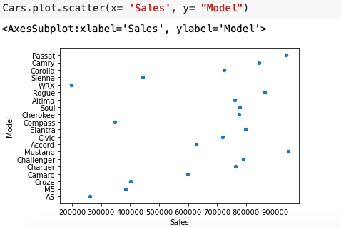
Creating Graphs
After sorting the data set by sales, I decided that it was time to visually display this information. First, I constructed a bar chart based off of sales alone. While it was helpful, it was more effective to construct a scatter chart. Within the scatter chart, the x axis = Sales and y axis = Model.

Slide 7
Conclusion
Methods used were sorting, importing/editing CSV files, building graphs with the data through python, creating data frames, and much more. After this project was executed, I was able to find the answer to my problem. The Ford Mustang was the top selling car within 2020, at an estimated $945,955 in sales. This is the leading car in sales within the provided data. The least selling car for 2020 appears to be the Subaru WRX at and estimated $196,422.

