Slide 1
CSCI 2930 Practical System Administration
Lecture 1: Introduction and System Administration Defined

Slide 2
Introduction
Kenneth Sisco
10 Years in the IT industry
Private Small Business, Higher Ed., Education, Consulting, Network Engineering
Specialize in Networking, Voice Over IP, Network and System Design, Administration, Project Management
Performed Network Design and Engineering for multi-national corporations and Air Force
A+, Security+, CCNA, CCNA-V, CCDA, MCP, Assorted Specialized Certifications

Slide 3





Introduction (Cont’d)

Slide 4
Spring 2014 Grading
Attendance 10%
Labs 10%
Homework 30%
Exams (2) 30%
Final Project 20%
No late home works will be accepted. If homework is not turned in on time you will receive a zero (0%) for that assignment.

Slide 5
Spring 2014 Schedule/Attendance
Tuesdays and Thursdays 6:30pm to 7:45pm
Attendance is mandatory
Unexcused absences will count against your final grade
For each of your first two un-excused absences you will receive -5% from you final grade. Upon your third absence you will receive an F for the class.

Slide 6
Definition: System Administration
The act of creating, maintaining and operating a multiuser computer environment
Typical Responsibilities:
Installing, maintaining and troubleshooting workstations, servers, OSs, software applications and other computing systems including networks
User account management
Storage administration
Physical and Network security
Disaster Recovery and Contingency Planning
Keep it COLD, CONNECTED and POWERED ON

Slide 7
Primary Skills
Analytical skills. Administrators need analytical skills to evaluate network and system performance and determine how changes in the environment will affect it.
Communication skills. Administrators work with many other types of workers and have to be able to describe problems and their solutions to them.
Computer skills. Administrators oversee the connections of many different types of computer equipment and must ensure that they all work together properly.
Multi-tasking skills. Administrators may have to work on many problems and tasks at the same time.
Problem-solving skills. Administrators must be able to quickly resolve problems with computer networks when they occur.
from the Occupational Outlook Handbook, 2010-11 Edition, which is in the public domain as a work of the United States Government

Slide 8
SysAdmin vs Developer vs Operators vs Security
SysAdmins are not coders. We are not responsible for creating new programs
SysAdmins DO need to be aware how programs work in order to install them and troubleshoot any issues that may arise
Developers typically do not understand the underlying infrastructure that their programs are running on
It is up to the SysAdmins to EDUCATE Developers about the server environment
It is up to the SysAdmins to WORK WITH Developers to right size the infrastructure for each project
Operators are typically specialized employees focused on monitoring and maintenance of a particular system and not the environment as a whole
Security teams must balance usability vs security

Slide 9
Organizational Role
Support the efforts of the organization and staff
Provide a competitive advantage to the company
Be aware of who uses what systems how and when
Help to create business policies
Provide business continuity

Slide 10
Departmental Structure
CEO
CIO / CTO
IT Manager
Architects
Engineers
Administrators
Operators
Help Desk

Slide 11
Code of Ethics
Professionalism
Personal Integrity
Privacy
Laws and Policies
Communications
System Integrity
Education

Slide 12
Training
University Degrees
Only a handful of Universities in the U.S. offer a degree program in System Administration
Typical Bachelors degrees include Computer Science, Computer Engineering and Management Information Systems
Technology changes too fast for typical course/curriculum creation
Most SysAdmins are self taught when they enter the field
Whitepapers
Selfstudy
Trial By Fire

Slide 13
Training
Certifications
Offer a way to prove a certain knowledge set
Be wary of “Paper Certified” professionals
Typically needed to fit minimum qualifications for many jobs
Examples:
Cisco: CCNA, CCDA, CCNP, etc (As well as specialized)
CompTIA: A+, Security+,
Microsoft: MCSA, MCSE, MCITP
Storage: SNIA, NetApp, etc…
VMware: VCP

Slide 14
Conferences
Educational Seminars
Opportunities for professional networking
May help you realize you are a Big Fish in a Small Pond back home
Examples:
Consumer Electronics Show (CES)
CeBIT
Storage Networking World (SNW)
VMworld
BlackHat

Slide 15
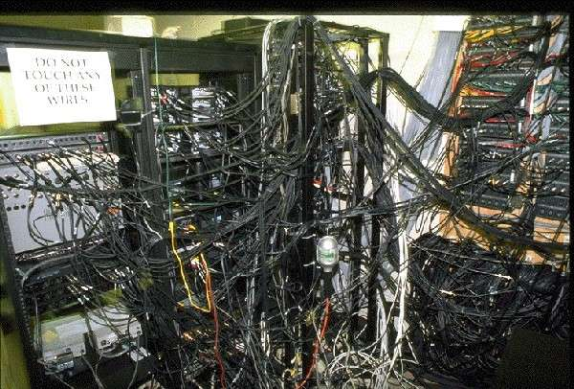
SysAdmin Day
SYSADMINDAY.COM
15th Annual on July 25th, 2014 (last Friday in July)

