Slide 1
CSCI 2930 Practical System Administration
Lecture 6: Infrastructure and Data Center Design

Slide 2
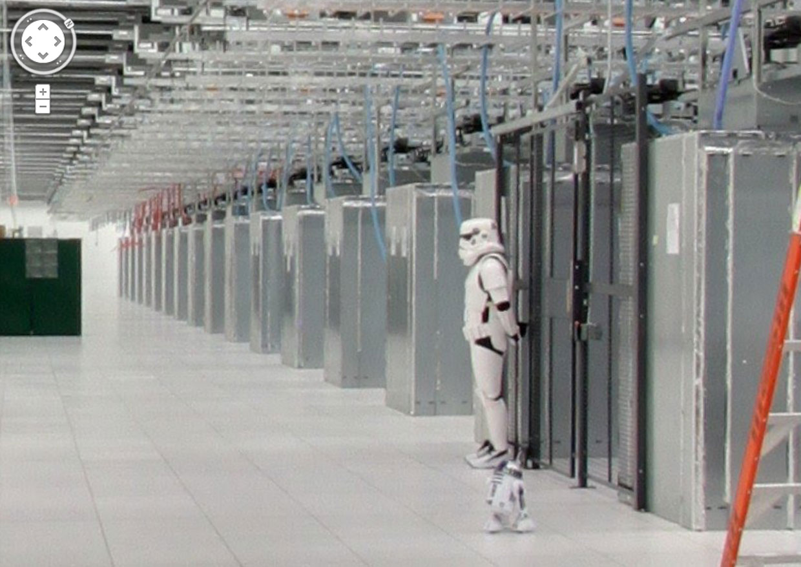
Power Space and Cooling
Top three concerns for systems
Poor design will affect:
System health
Scalability
Waste resources

Slide 3
Power
Power supplies typically work over a range of volts
120v – Desktops
208v – Server/Network equipment and smaller HVAC
480v – HVAC Equipment / Data center feeds
Notes:
Power factor 0.86

Slide 4
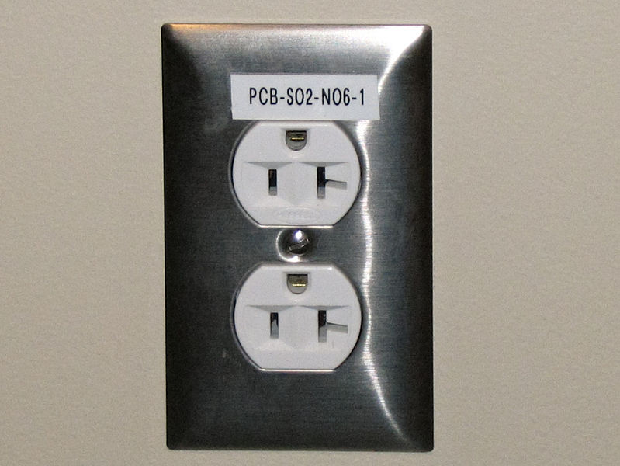
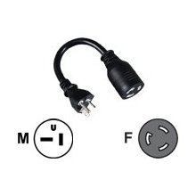
Power
NEMA Connectors
National Electrical Manufacturers Assoc.
NEMA 5 rated for 125v
NEMA 6 rated for 250v used for 208 and 240
6-15, 6-20

Slide 5
Power
NEMA Twist Lock Connectors
NEMA L5 rated for 125v
Single Pole
NEMA L6 rated for 250v used for 208 and 240
Two Pole
L6-20, L6-30
NEMA L21 120v/208v 3-phase

Slide 6
Power
Single phase
VA = Volt * Amps
Watts = VA * 0.86
Three phase
Watts = Sqrt(3) * 0.86 * V * A
Usage example:
120v PSU running at 200Watts uses 1.93 amps
208v PSU running at 200Watts uses 1.2 amps

Slide 7
Power
Single phase
VA = Volt * Amps
Watts = V * A * 0.86
Three phase
Watts = Sqrt(3) * 0.86 * V * A
Capacity Example – Customer needs 5000 Watts of power in one socket
L6-30 two pole provides 5366 Watts across two breakers
L21-30 three phase at 208v provides ~9300Watts

Slide 8
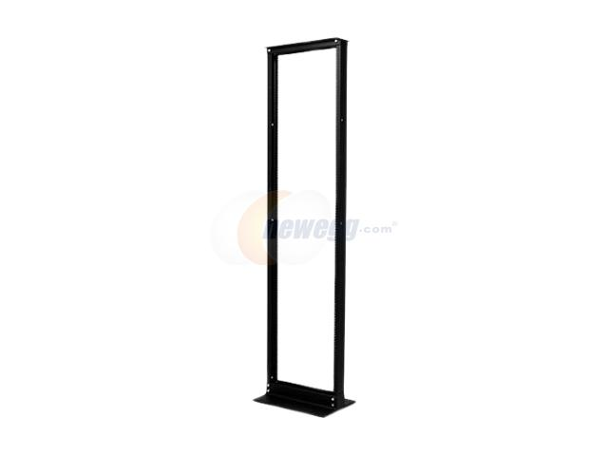
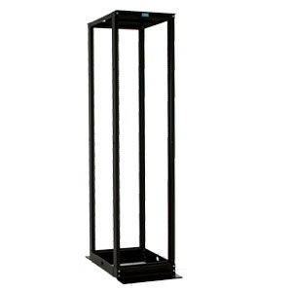
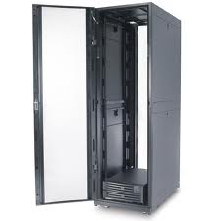
Space
Racks
Measured in Units (U)
42U standard rack
2 post
4 post
Standard server
Tools
Static load vs rolling

Slide 9
Cooling
Server equipment has a large range of operating environment variables
Typical is to run temp between 68 and 72 deg F
Humidity should be between 40% and 50% non-condensing
Too little humidity can cause static discharge and damage

Slide 10
Cooling
CRAC units sold based on Tons of cooling capacity
1 KWatt = 3413 BTU
1 Ton = 12000 BTU = 3516 Watts
Too large a unit will cause
Short cycling of the compressor(s)
Inability to dehumidify

Slide 11
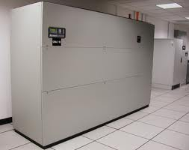
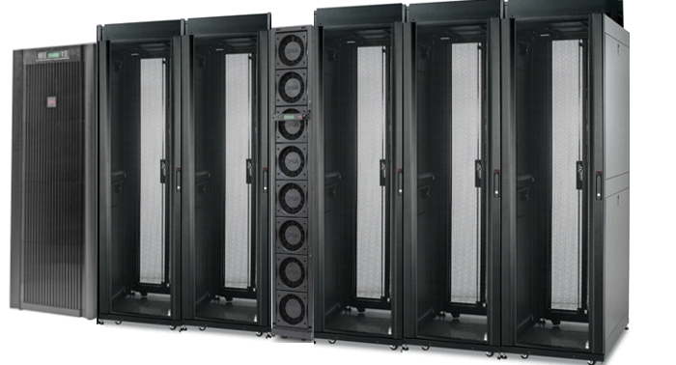
Cooling
Air cooled
Chilled water
In Row

Slide 12
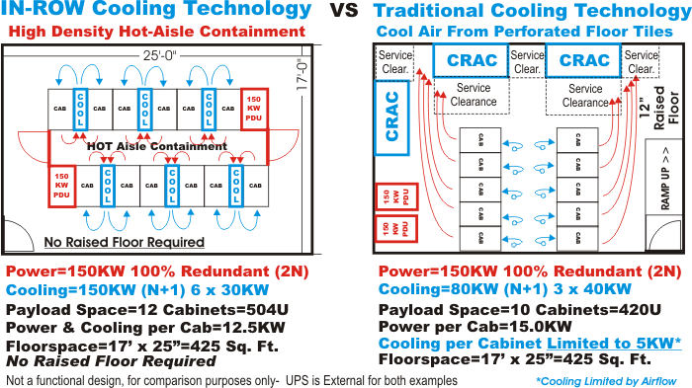
Cooling
Hot aisle Cold aisle
Servers take cold air in from the front
Blow hot air out the back
Arrange racks to provide proper flow
In Row More efficient if proper containment used

Slide 13
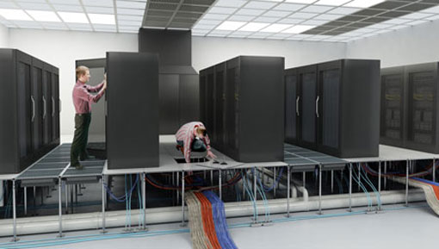
Data Center Design
Raised floor
Made up of solid and perforated tiles
Provides cold air distribution
Keeps equipment away from water leaks
Tiles have different Static loads and dynamic loads
Perforated tiles much lower max load

Slide 14
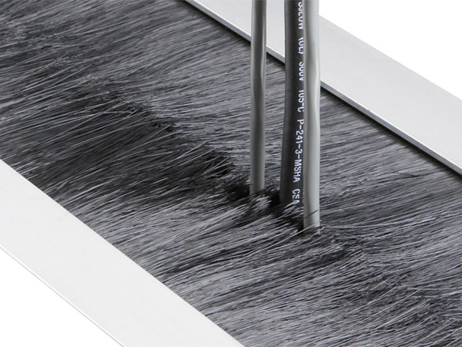
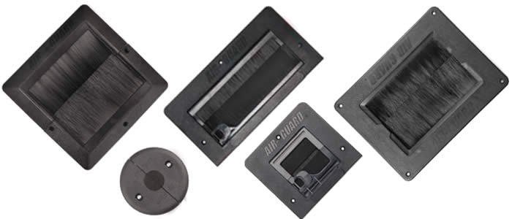
Data Center Design
Grommets
Seals air under raised floor
Provides more efficient cooling

Slide 15
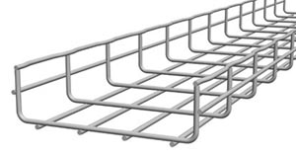
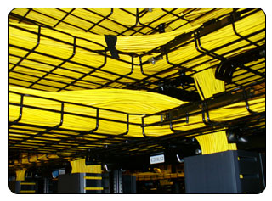
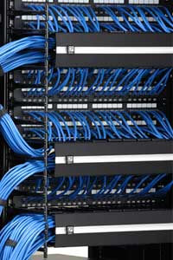
Data Center Design
Cable Management:
Proper cable management = Better airflow
Large cable bundles can cause alien crosstalk
Cable management trays
Power cable interference with copper cables
Always cross at right angles

Slide 16
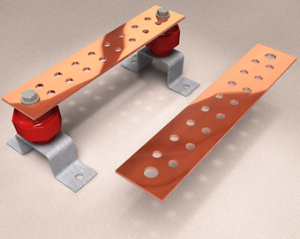
Data Center Design
Grounding/Bus bars
Provide common ground for all equipment
Helps to eliminate shorts and static build up

Slide 17
Data Center Design
Water drains – Make sure water runs towards them…
Fire suppression
Wet pipe (worst for data center)
Water is in the pipe under pressure
Dry pipe
Water is not present until the system is activated
Some delay but used in unheated areas
Pre-action (good when accidental activation is undesirable)
Similar to Dry pipe but requires a “preceding” fire detection event such as heat or smoke
Gas (best for data center)
Inert gas extinguishes the fire
Suffocation can result…be aware of oxygen mask locations

