Slide 1
CSCI 2930 Practical System Administration
Lecture 7: Network Infrastructure

Slide 2
Networking Models
Standard models make system interconnection easier for developers and vendors
TCP/IP Protocol Architecture
4 Layer
Defines collection of protocols that allow computers to communicate
Open System Interconnection (OSI) networking model
7 Layer
Used as a point of reference for discussing other protocol specifications
Notes:
TCP/IP department of defense project won out over ISO’s OSI model

Slide 3
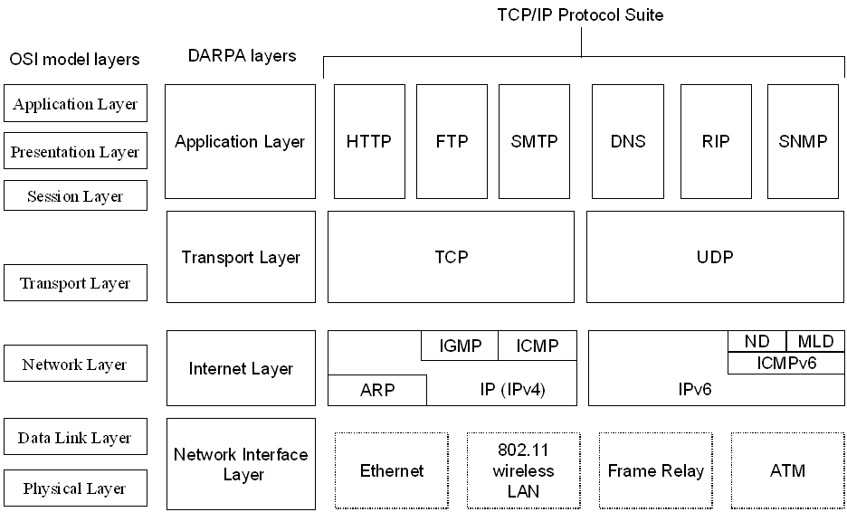
TCP/IP Protocol Architecture
Notes:
Classifies various protocols into different layers
Each layer provides a service to the layer above it

Slide 4
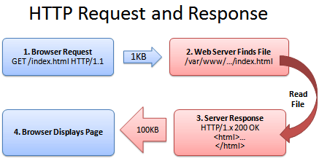
TCP/IP Application Layer
Provides an interface between software running on a computer and the network itself…it does not define the application
Headers are used to transfer data between the same layer on different computers
Notes:
Web client sends HTTP header with get request and the webserver send the return response…if page not found it sends a 404 error

Slide 5
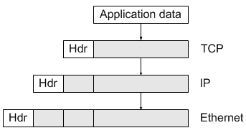
TCP/IP Transport Layer
Consists of two main protocols
Transmission Control Protocol (TCP) … HTTP, HTTPS, SSH
User Datagram Protocol (UDP) … DNS, VoIP, Steaming Video
TCP provides an error-recover feature to the application layer to guarantee delivery of data across the network
UDP faster because there is not error checking
Transport layer header and encapsulated data = TCP Segment

Slide 6
TCP/IP Internet Layer
Defined by the Internet Protocol (IP)
Defines logical addresses called IP addresses which allow IP hosts to communicate with each other
Defines the process of routing so that devices called routers can choose where to send packets of data so they are delivered to the correct destination
Works much like the US postal service by leveraging addresses to deliver data
TCP segment encapsulated by IP headers = IP Packet

Slide 7
TCP/IP Network Access Layer
Defines the protocols and hardware required to deliver data across some physical network
Example protocol:
Ethernet: Defines the required cabling, addressing, and protocols used for Ethernet LANs
Point to Point Protocol (PPP): WAN protocol
IP uses the Network Access Layer to deliver packets to the next router or host across the physical infrastructure
IP packet encapsulated by network layer headers (and trailers) = Frame

Slide 8
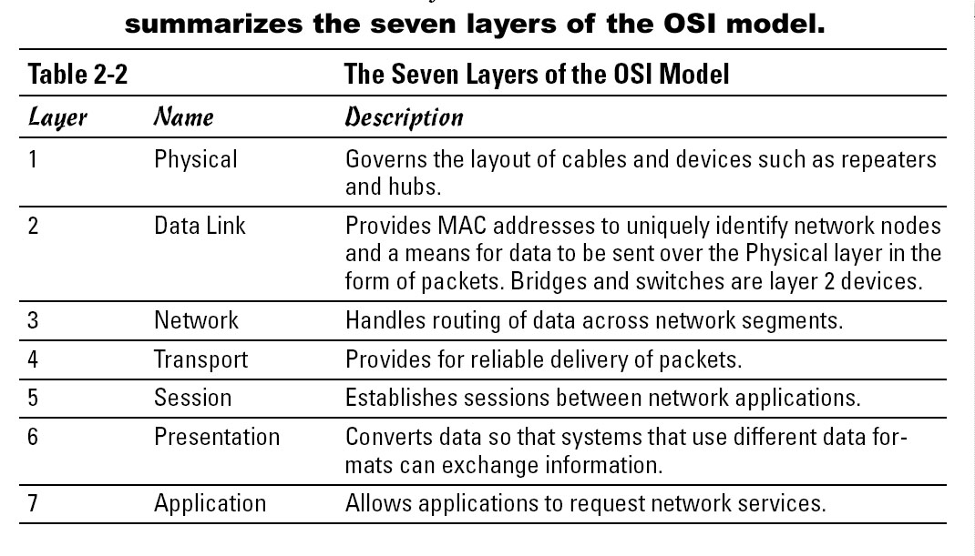
OSI Reference Model

Slide 9
OSI Reference Model
SysAdmins will reference the OSI model when speaking
“All People Seem To Need Data Processing”
“Please Do Not Throw Sausage Pizza Away”
Breaking up into layers provides:
Less complexity
Standard interfaces between layers
Easier to develop
Multivendor interoperability
Modular engineering

