Slide 1
CSCI 2930 Practical System Administration
Lecture 8: Network Infrastructure (continued)

Slide 2
Layer 1 – Physical Cables
IEEE 802.3 Ethernet defines standards for LANs
Transmission media
Copper
Coax
UTP or (Unshielded) Twisted Pair
Terminated by RJ-45 connector
Standard cables labeled by Category…CAT 5/5e, CAT 6, etc
Categories specify signal speed, pin outs, number of wires…
Typically only used up to 300ft (100 meters)

Slide 3
Layer 1 – Physical Cables
Fiber
DO NOT BEND PAST 30 DEGREES!
Multi mode (MM) – Short range LANs and Campus
Simpler and cheaper
Changing from LEDs to lasers
850 nm and 1300 nm wavelength
OM1 and OM2 use orange jackets while Aqua is recommended for 50/125 µm "laser optimized" OM3 and OM4 fiber
“Optical Multi-mode”
Notes:
LEDs have a maximum modulation rate of 622 Mbit/s because they can not be turned on/off fast enough

Slide 4
Layer 1 – Physical Cables
MM ISO Classification System
International Organization for Standardization
Transmission Standards | 100 Mb Ethernet | 1 Gb (1000 Mb) Ethernet | 10 Gb Ethernet | 40 Gb Ethernet | 100 Gb Ethernet
OM1 (62.5/125) | up to 2000 meters (FX) | 275 meters (SX) | 33 meters (SR) | Not supported | Not supported
OM2 (50/125) | up to 2000 meters (FX) | 550 meters (SX) | 82 meters (SR) | Not supported | Not supported
OM3 (50/125) | up to 2000 meters (FX) | 550 meters (SX) | 300 meters (SR) | 100 meters | 100 meters
OM4 (50/125) | up to 2000 meters (FX) | 1000 meters (SX) | 550 meters (SR) | 150 meters | 150 meters
Notes:
62.5 core/125nm cladding

Slide 5
Layer 1 – Physical Cables
Single mode (SM) – Long Range
1310 nm or 1550 nm and require more expensive laser sources
Core diameter between 8 and 10.5 µm and a cladding diameter of 125 µm
OS1 and OS2 are standard single-mode optical fiber used with wavelengths 1310 nm and 1550 nm (size 9/125 µm)
Used up to 50 miles or more with standard equipment
Notes:
state-of-the-art DWDM optical systems can span thousands of kilometers at 10 Gbit/s, and several hundred kilometers at 40 Gbit/s.

Slide 6
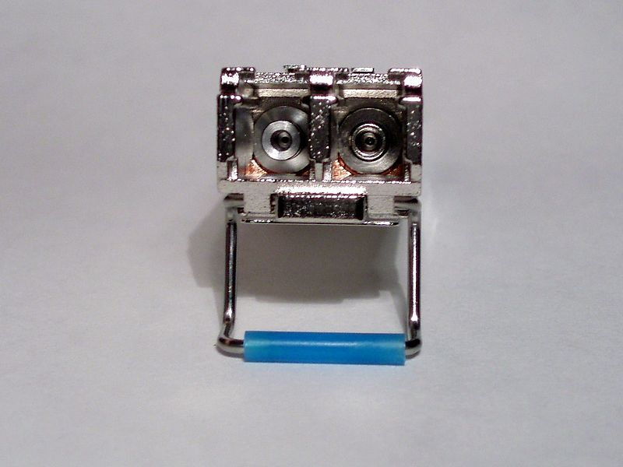
Layer 1 – Physical Cables
Small form-factor pluggable transceiver SFP/SFP+
Interface between the network device board and cable
Obsoletes the old gigabit interface converter (GBIC)
multi-mode fiber
SX - 850 nm, for a maximum of 550 m at 1.25 Gbit/s (Gigabit Ethernet) or 150m at 4.25 Gbit/s (Fibre Channel)
single-mode fiber
LX - 1310 nm, for distances up to 10 km
EX - 1310 nm, for distances up to 40 km
ZX - 1550 nm, for distances up to 80 km
EZX - 1550 nm, for distances up to 120 km
Notes:
state-of-the-art DWDM optical systems can span thousands of kilometers at 10 Gbit/s, and several hundred kilometers at 40 Gbit/s.

Slide 7
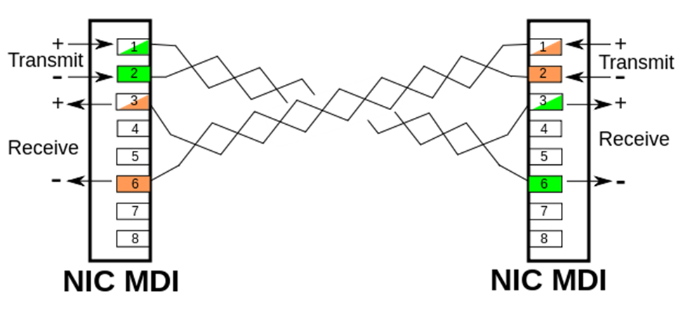
Layer 1 – Physical Cables
Crossover Cables
Used to connect similarly-pinned devices
Auto-MDIX (Medium Dependent Interface Crossover) in Gigabit Ethernet makes crossover cables unnecessary

Slide 8
Layer 1 – Physical Cables
Use straight-through cables for the following cabling:
Switch to router
Switch to PC or server
Hub to PC or server
Use crossover cables for the following cabling:
Switch to switch
Switch to hub
Hub to hub
Router to router
PC to PC
Router to PC

Slide 9
Devices
Hubs – Layer 1
Shared electrical bus
All data copied to all ports
Collisions occur when two systems try to talk at once
Switches – Layer 2
Processes data to transmit only to the device for which the data was intended
Systems connect at “full-duplex” w/o collisions

Slide 10
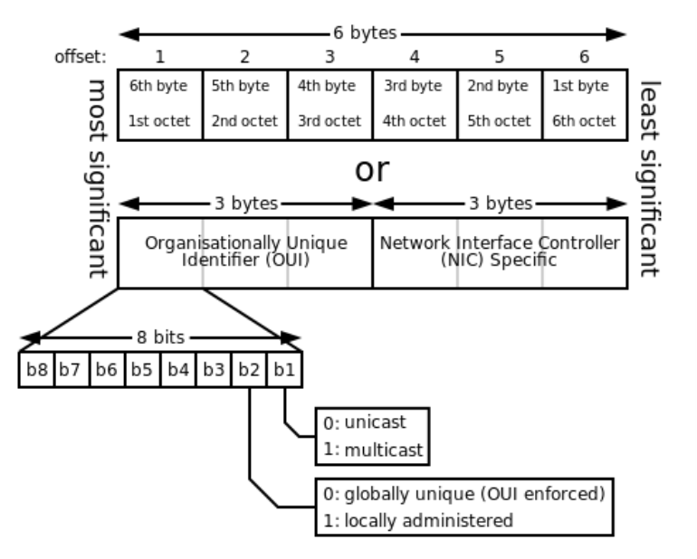
Layer 2 – Ethernet LAN Addressing
Media Access Control (MAC)
Unique identifier assigned to network interfaces for communications on the physical network segment
6 bytes / 48bits long written in Hex
(e.g. 01-23-45-67-89-ab or 01:23:45:67:89:ab )
Source MAC stored in a table on the switch when a frame enters a port
Forward, Filter, Flood
Notes:
Forward on to the destination based on the MAC address table
Filter if the switch know there is nothing it should do with the frame
Flood out all ports if it know nothing about the destination host

Slide 11
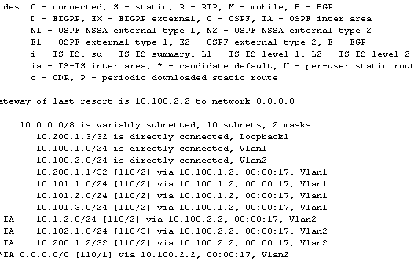
Devices
Routers/Multilayer Switches – Layer 3
Device that forwards data packets between different computer networks based on IP address
Uses routing protocol to learn routes
Learned routes stored in a Routing Table

Slide 12
Device Manufacturers
Dell/Force10
HP/3com
Cisco
Mellanox
IBM/BNT

Slide 13
Layer 3 Addressing – IPv4
32-bit number written in dotted-decimal notation
168.1.1.1 -> 1010100 00000001 00000001 00000001
Each decimal number is called an octet…another term for byte
Broken up into “Classes”
Class A, B, and C are for hosts
Class D are multicast addresses
Class E are experimental

Slide 14
Layer 3 Addressing – IPv4
All addresses in the same Class A, B or C network have the same numeric value for the network portion of the address…the rest of the address is call the host portion
Class A – 1-byte-long network part
Class B – 2-byte-long network part
Class C – 3-byte-long network part
Host portion loses two addresses for the Network address (first address) and Broadcast address (last address)

Slide 15
Layer 3 Addressing – IPv4
Sizes of Network and Host Parts of IP Addresses with No Subnetting
Any Network of This Class | Number of Network Bytes (Bits) | Number of Host Bytes (Bits) | Number of Addresses per Network*
A | 1 (8) | 3 (24) | 2²⁴ – 2
B | 2 (16) | 2 (16) | 2¹⁶ – 2
C | 3 (24) | 1 (8) | 2⁸ – 2
*There are two reserved host addresses per network.

Slide 16
Layer 3 Addressing – IPv4
List of All Possible Valid Network Numbers*
Class | First Octet Range | Valid Network Numbers* | Total Number of This Class of Network | Number of Hosts per Network
A | 1 to 126 | 1.0.0.0 to 126.0.0.0 | 2⁷ – 2 = 126 | 2²⁴ – 2 = 16M
B | 128 to 191 | 128.1.0.0 to 191.254.0.0 | 2¹⁴ – 2 = 16K | 2¹⁶ – 2 = 65k
C | 192 to 223 | 192.0.1.0 to 223.255.254.0 | 2²¹ – 2 = 2M | 2⁸ – 2 = 254
*The Valid Network Numbers column shows actual network numbers. There are several reserved cases. For example, networks 0.0.0.0 (originally defined for use as a broadcast address) and 127.0.0.0 (still available for use as the loopback address) are reserved. Networks 128.0.0.0, 191.255.0.0, 192.0.0.0, and 223.255.255.0 also are reserved.

Slide 17
Layer 3 - Subnetting
Splits up the massive Class networks into many smaller ones using Subnet Masks
Subnet masks perform a simple Boolean AND math operation
IP Address 8.8.0.4
Subnet Mask 255.255.0.0
00001000 00001000 00000000 00000100
11111111 11111111 00000000 00000000
Subnet = 8.8.0.0 /16 (Prefix notation)
Notes:
0 AND 0 = 0
0 AND 1 = 0
1 AND 0 = 0
1 AND 1 = 0
Prefix notation is another way to write the subnet mask. It is a slash followed by the number of consecutive 1’s in the binary representation of the subnet mask

Slide 18
Layer 3 - Subnetting
Class A
IP Address 8.8.0.4 /16
Subnet Mask 255.255.0.0
00001000 00001000 00000000 00000100
11111111 11111111 00000000 00000000
NNNNNNNN SSSSSSSS HHHHHHHH HHHHHHHH
Number of Subnets = 2^S
Number of Hosts = (2^H) - 2

Slide 19
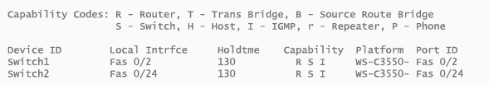
Protocols
Spanning Tree Protocol
Loop prevention by blocking some ports from forwarding frames
DHCP issues
CDP/LLDP
Good Layer 2 test
Displays information about neighbor devices
Chassis ID, Port ID, TTL, MAC

Slide 20
Protocols
EtherChannel/LACP (Link Aggregation Control Protocol)
Allows bonding of ports together to make logical bundles
Load balanced by Source and/or Dest MAC or IP
Etherchannel is Cisco Proprietary…bonded ports form a PortChannel
VLANS
Create virtual switches to segment hosts into different networks
Minimizes broadcast domains

Slide 21
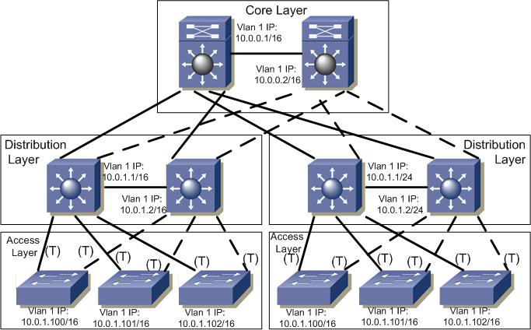
Cisco Three Tier Network Architecture
Core
Distribution
Access Layer

