Slide 1
CSCI 2930 Practical System Administration
Lecture 5: System Design

Slide 2
System Design – The Holistic Approach
System Design must be done with the whole system in mind not just pieces
PPDIOO Lifecycle
Top Down Design

Slide 3
Business Drivers
Business Forces
Return on Investment
Regulation
Competitiveness
Technology Related Forces
Removal of Borders
Virtualization
Growth of Applications
IT Challenges
Break down traditional silos to better leverage staff experience
Notes:
ROI: provide future competitiveness and improve productivity
Regulation: HIPPA, FERPA, Sarbanes Oxley must find innovative solutions to make sure company remains in compliance
Competitiveness: Integrate emerging technologies with business solutions
Borders:mobile workforces impact productivity
Virtualization: server consolidation to try to lower it costs
Growth of Apps: improve customer service, greater security all at lower costs

Slide 4
Benefits of Good Design Methods
Functionality – Support Requirements
Scalability – Supports growth and expansion
Availability – Provide service reliability, anywhere, anytime
Performance – Provides desired responsiveness, throughput, utilization
Manageability – Provide control, performance monitoring, and fault detection
Efficiency – Infrastructure with reasonable operational costs

Slide 5
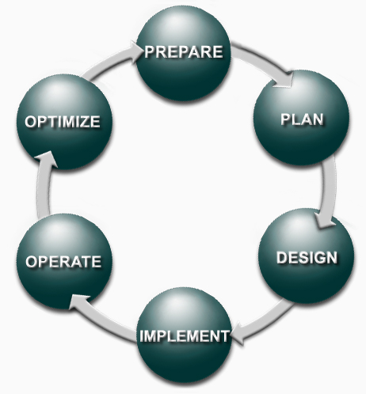
PPDIOO – System Lifecycle
Prepare
Plan
Design
Implement
Operate
Optimize
Notes:
Prepare: establish business requirements, develop strategy, proposing a high level conceptual architecture and identify technologies that can best support the architecture. Financial justification
Plan: identify system requirements, asses current sites and perform a gap analysis. Project plan helps manage tasks responsibilities critical milestones and resources required
Design: system design specialists take requirements from the planning phase and create a design specification document
Implement: implementation and verification begin after the design is signed off on. Attempt to integrate new system without interuptions to current systems and users
Operate: maintain system health through day to day operations. Fault detection and correction and performance monitoring that occur in daily operation are used in the optimize section of the lifecycle
Optimize: based on proactive management to identify and resolve issues before problems arise. Redeisgn if necessary

Slide 6
Lifecycle Approach Benefits
Lower Total Cost of Ownership (TCO)
Identify and validate requirements
Develop sound design aligned with technical requirements and business goals
Accelerate successful implementation
Increase availability
Stage tests of the proposed system before deployment
Improve staff skills
Proactively monitor systems for availability trends and alerts

Slide 7
Lifecycle Approach Benefits
Improve business agility
Establishing business requirements and technology strategies
Prepare sites to support the new system
Continually enhance performance
Accelerate access to applications
Improve service delivery by increasing availability, resource capacity and performance

Slide 8
Design Methodology
Identify Customer Requirements
Define Org. Goals
Identify Org. Constraints
Identify Technical Goals
Assess Technical Constraints
Characterize the existing system and sites
Gather documentation
Perform an onsite audit
Design system using Top Down approach

Slide 9
Plan an Implementation
Create implementation plan documents
More detail in the design means less knowledge necessary to implement
Create an implementation plan summary with dates
Reference sections of the detailed design document
Make sure to include a backout plan in case of failure

Slide 10
Plan an Implementation
Design Document:
Introduction
Design Requirements
Existing Infrastructure
Design
Proof of Concept
Implementation Plan
Appendixes
Notes:
Introduction: reasons for the system design or redesign
Design Requirements: defines organizational requirements and design goals
Existing Infrastructure: describes existing infrastructure and typically used in a redesign
Design: provide design details including configuration templates, addresses, and exact system configuration details
Proof of Concept: describe pilot or prototype verification and test results
Implementation Plan: provide implementation details for technical members to carry out tasks without requiring the presence of the deigner
Appendixes” lists and optional configuratons of existing systems

Slide 11
Prototype vs Pilot
Prototype: Test system that tries to simulate the full system or part of it for viability and usefulness, typically in an isolated environment
Pilot: Full production system that is used by a subset of the general audience to get a better understanding of how the product will be used in a real world environment. Data collected during a pilot typically used for final refinements to the production system before final roll out.

