Slide 1
CSCI 2930 Practical System Administration
Lecture 10: Storage and Security

Slide 2
Storage
OS stores data on disks using files
Specific way files are stored is called a file system
File systems provide meta data for files such as names and attributes and ACL’s
File systems also allows files to be stored in a hierarchy of directories or folders arranged in a directory tree
Used to only have one file system per disk
Virtual file systems allow different types to be used on the same disk

Slide 3
Storage
Newer file systems provide advanced capabilities such as encryption, software RAID, deduplication, etc…
File system limits exist for each example
Typical limits include
Max file size
Max number of files
Max filename length
Max volume size

Slide 4
Examples
Windows
Fat32
NTFS
Linux
Ext2/3/4
ReiserFS
Btrfs (B-tree file system)
BSD
UFS
ZFS (also Solaris)
Notes:
CDs must use ISO 9660 or UDF

Slide 5
RAID - Redundant Array of Independent Disks
Combine multiple disk drives into a single logical unit
Distribute data across the drives in different ways determined by the “RAID Level” used
RAID Level’s provide different characteristics for level of redundancy and performance required
RAID Parity – Error protection scheme typically using simple XOR parity

Slide 6
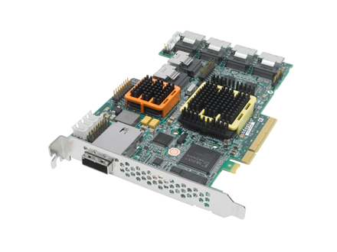
RAID Levels
RAID 0 – Striping w/o Parity
RAID 1 – Mirroring w/o Parity or Striping
RAID 5 – Block level striping w/ distributed parity
RAID 6 (RAID-DP) - Block level striping w/ double distributed parity
RAID 10 – Mirroring w/o parity but mirror block level stripe
Notes:
RAID 1+0 (mirroring and striping), data is written in stripes across primary disks that have been mirrored to the secondary disks
RAID 6 20% performance penalty for writes over RAID 5 typical

Slide 7
RAID Problems
Correlated Failures – Drives worn down over time and in same environment will fail together
Recovery Time for larger drives
RAID Write Hole – system crash without writing data from cache to disk
Notes:
RAID 1+0 (mirroring and striping), data is written in stripes across primary disks that have been mirrored to the secondary disks

Slide 8
Snap Shots
Point in Time read only state of the storage volume or drive
New data get written but special pointers remain to keep track of old data
Pointers only 4KB typically so very little storage overhead
Some file systems can create read-write versions used for virtualization, sandboxing or cloning
Not considered a proper backup unless stored remotely

Slide 9
Deduplication
Special type of data compression that looks at large sets of data to find duplicate files or blocks and only store single copies
Post-process dedupe: New data stored on SAN/NAS and a separate scheduled process will analyze the data at a later time and perform the deduplication
Con: Duplicate data stored for a short time
In-line dedupe: dedupe calculation performed as the data enters the SAN/NAS in real time.
Con: data ingestion can be slow due to the hash calculation overhead

Slide 10
Computer Security
Processes and mechanisms by which computer-based equipment, information and services are protected from unintended or unauthorized access, change or destruction
Principle of least privilege
Defense in Depth
Audit Trails
Code Review
Notes:
The principle of least privilege, where each part of the system has only the privileges that are needed for its function. That way even if an attacker gains access to that part, they have only limited access to the whole system
Defense in depth, where the design is such that more than one subsystem needs to be violated to compromise the integrity of the system and the information it holds
Audit trails tracking system activity, so that when a security breach occurs, the mechanism and extent of the breach can be determined. Storing audit trails remotely, where they can only be appended to, can keep intruders from covering their tracks.

Slide 11
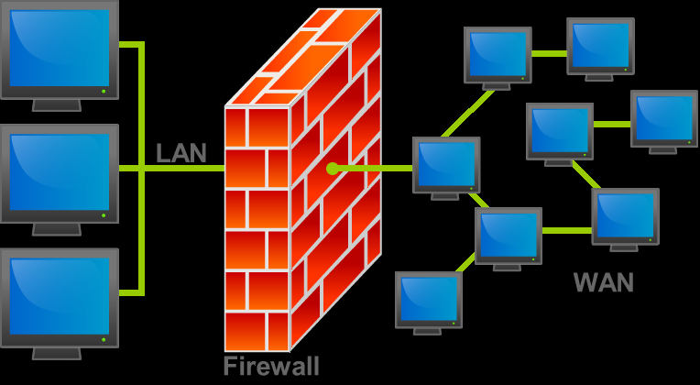
Firewalls
Software or hardware-based network security system that controls incoming and outgoing network traffic by analyzing data packets and determining whether they should be allowed through or not based on a rule set.
Creates a boundary between secure internal networks and “un-secure” public networks
First generation: packet filters
Second generation: "stateful" filters
Third generation: application layer

Slide 12
IPS/IDS
Intrusion prevention/detection systems
Network security appliances that monitor network and/or system activities for malicious activity.
Identify malicious activity, log information about this activity, attempt to block/stop it, and report it.
Signature-Based Detection
Statistical anomaly-based detection
Stateful Protocol Analysis Detection
Notes:
Signature-Based Detection: This method of detection utilizes signatures, which are attack patterns that are preconfigured and predetermined. A signature-based intrusion prevention system monitors the network traffic for matches to these signatures. Once a match is found the intrusion prevention system takes the appropriate action. Signatures can be exploit-based or vulnerability-based. Exploit-based signatures analyze patterns appearing in exploits being protected against, while vulnerability-based signatures analyze vulnerabilities in a program, its execution, and conditions needed to exploit said vulnerability.
Statistical anomaly-based detection: This method of detection baselines performance of average network traffic conditions. After a baseline is created, the system intermittently samples network traffic, using statistical analysis to compare the sample to the set baseline. If the activity is outside the baseline parameters, the intrusion prevention system takes the appropriate action. The particular intrusion in this case monitors users and network behaviors.
Stateful Protocol Analysis Detection: This method identifies deviations of protocol states by comparing observed events with “predetermined profiles of generally accepted definitions of benign activity.

Slide 13
ACL
List of permissions attached to an object.
An ACL specifies which users or system processes are granted access to objects, as well as what operations are allowed on given objects
Filesystem: privileges or permissions determine specific access rights, such as whether a user can read from, write to, or execute an object
Network ACL: rules that are applied to port numbers or IP Addresses that are available on a host or other layer 3 device, each with a list of hosts and/or networks permitted to use the service

Slide 14
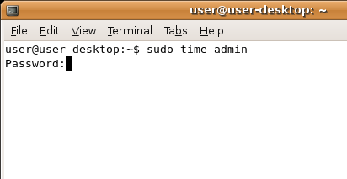
SUDO
Program for Unix-like computer operating systems that allows users to run programs with the security privileges of another user (normally the superuser, or root)
Unlike the su command, users typically supply their own password to sudo rather than the root password.
Example # sudo less /var/log/messages
Access granted via the sudoers file
Edited via the visudo command
Leaves an audit trail of who issued what commands

