Slide 1
CSCI 2930 Practical System Administration
Lecture 11: Disaster Recovery

Slide 2
Disaster Recovery
Also known as DR
The process, policies and procedures that are related to preparing for recovery or continuation of technology infrastructure which are vital to an organization after a natural or human-induced disaster
Subset of business continuity

Slide 3
Disaster Recovery
Classifications:
Natural Disasters
Floods, hurricanes, fire, gamma ray burst, tornadoes or earthquakes
Man made disasters
Hazardous material spills, infrastructure failure, or bio-terrorism

Slide 4
Disaster Recovery
Strategies:
Create business continuity plan with RTO’s and RPO’s
RTO – Recovery Time Objective
How fast you can recover a system or data
RPO – Recovery Point Objective
How much data can you lose
Cost benefit analysis typical

Slide 5
Disaster Recovery
High Availability
Prearranged level of operational performance will be met during a contractual measurement period
Documented in a Service Level Agreement (SLA)
Five 9’s = 5.5 min

Slide 6
Disaster Recovery
Availability % | Downtime per year | Downtime per month* | Downtime per week
90% ("one nine") | 36.5 days | 72 hours | 16.8 hours
95% | 18.25 days | 36 hours | 8.4 hours
97% | 10.96 days | 21.6 hours | 5.04 hours
98% | 7.30 days | 14.4 hours | 3.36 hours
99% ("two nines") | 3.65 days | 7.20 hours | 1.68 hours
99.5% | 1.83 days | 3.60 hours | 50.4 minutes
99.8% | 17.52 hours | 86.23 minutes | 20.16 minutes
99.9% ("three nines") | 8.76 hours | 43.8 minutes | 10.1 minutes
99.95% | 4.38 hours | 21.56 minutes | 5.04 minutes
99.99% ("four nines") | 52.56 minutes | 4.32 minutes | 1.01 minutes
99.999% ("five nines") | 5.26 minutes | 25.9 seconds | 6.05 seconds
99.9999% ("six nines") | 31.5 seconds | 2.59 seconds | 0.605 seconds
99.99999% ("seven nines") | 3.15 seconds | 0.259 seconds | 0.0605 seconds

Slide 7
Disaster Recovery
High Availability
Mean Time Between Failure (MTBF)
System Redundancy
Component Redundancy

Slide 8
Disaster Recovery
High Availability
Data Center Tiers
Tier Level | Requirements
1 | Single non-redundant distribution path serving the IT equipment Non-redundant capacity components Basic site infrastructure with expected availability of 99.671%
2 | Meets or exceeds all Tier 1 requirements Redundant site infrastructure capacity components with expected availability of 99.741%
3 | Meets or exceeds all Tier 1 and Tier 2 requirements Multiple independent distribution paths serving the IT equipment All IT equipment must be dual-powered and fully compatible with the topology of a site's architecture Concurrently maintainable site infrastructure with expected availability of 99.982%
4 | Meets or exceeds all Tier 1, Tier 2 and Tier 3 requirements All cooling equipment is independently dual-powered, including chillers and heating, ventilating and air-conditioning (HVAC) systems Fault-tolerant site infrastructure with electrical power storage and distribution facilities with expected availability of 99.995%

Slide 9
Disaster Recovery
Strategies:
Colocation facility
Back up to tape and send offsite
Backups to disk on site and automatically copied to offsite disk

Slide 10
Disaster Recovery
Strategies:
NAS or SAN replication to an off-site system
Sync
Async
Cloud infrastructure failover
Crash consistent vs Application consistent

Slide 11
Backup Levels
Full backup
All data
Incremental
An incremental backup is a backup of latest changes since the last backup (any level)
When a full recovery is needed the restoration process needs the last full backup plus all the incremental backups until the point-in-time of the restoration
Differential
Cumulative backup of all changes made since the last full or normal backup
Quicker recovery time but uses more space

Slide 12
Backup Levels
Dump
Level 0 - full backup - guarantees the entire file system is copied
A level number above 0 - incremental backup - tells dump to copy all files new or modified since the last dump of a lower level. The default level is 9.

Slide 13
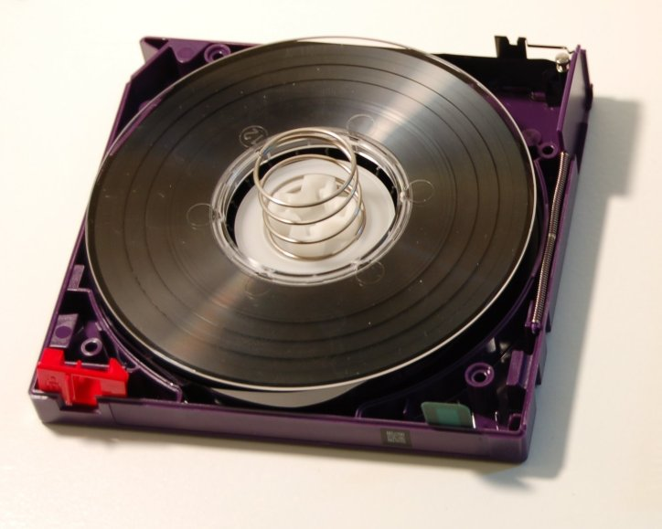
Backup Hardware
Tapes
Linear Tape-Open LTO
Magnetic tape data storage technology originally developed in the late 1990s as an open standards alternative to the proprietary magnetic tape formats
Rewind time of 80 sec
Average access time from beginning of tape = 50 sec
15 to 30 year archival
SDLT (Super Digital Linear Tape)
DAT (Digital Audio Tape)
Cleaning
Notes:
WORM for legal purposes (Write Once Read Many)

Slide 14
Backup Hardware
Generation
Attribute | LTO-1 | LTO-2 | LTO-3 | LTO-4 | LTO-5 | LTO-6 | LTO-7 | LTO-8
Release date | 2000 | 2003 | 2005 | 2007 | 2010 | Dec. 2012^{[6]} | TBA | TBA
Native data capacity | 100 GB | 200 GB | 400 GB | 800 GB | 1.5 TB^{[7]} | 2.5 TB^{[8]} | 6.4 TB^{[9]} | 12.8 TB^{[9]}
Max uncompressed speed (MB/s)^{[9]} | 20 | 40 | 80 | 120 | 140 | 160 | 315 | 472
Compression capable? | ALDC "2:1" |  |  |  |  | LTO-DC "2.5:1" | Planned "2.5:1"^{[10]}
WORM capable? | No |  | Yes |  |  |  | Planned
Encryption capable? | No |  |  | Yes |  |  | Planned
Partition capable? | No (1 allowed) |  |  |  | Yes (2 allowed) | Yes (4 allowed) | Planned
Tape thickness | 8.9 µm |  | 8 µm | 6.6 µm | 6.4 µm | 6.1 µm^{[11]}
Tape length | 609 m |  | 680 m | 820 m | 846 m^{[12]}
Tape tracks | 384 | 512 | 704 | 896 | 1280 | 2176^{[13]}
Write elements | 8 |  | 16^{[7][13]}
Wraps per band | 12 | 16 | 11 | 14 | 20^{[7]} | 34
Linear density (bits/mm) | 4880 | 7398 | 9638 | 13,250 | 15,142^{[14]} | 15,143^{[15]}
Encoding | RLL 1,7 | RLL 0,13/11; PRML |  |  | RLL 32/33; PRML | 32/33 RLL NPML^{[15]}
Cartridge memory | 4 KiB |  |  | 8 KiB |  | 16 KiB^{[13]:5}
Notes:
VTL presents a storage component (usually hard disk storage) as tape libraries or tape drives for use with existing backup software

Slide 15
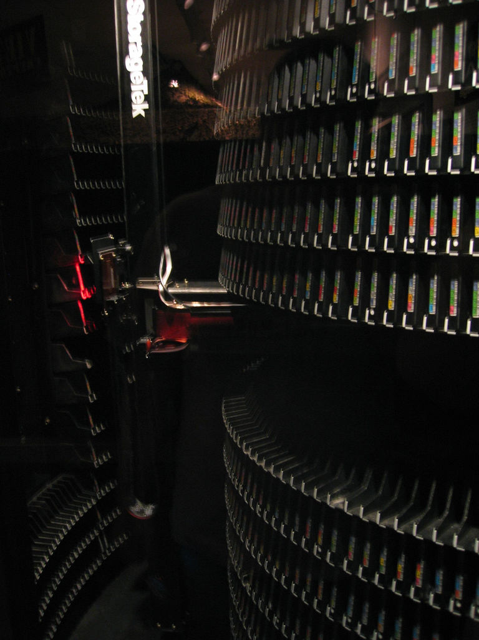
Backup Hardware
Tape drives
Reads and writes data on a magnetic tape
Tape Libraries
Contains one or more tape drives, a number of slots to hold tape cartridges, a barcode reader to identify tape cartridges and an automated method for loading tapes (a robot)
Virtual Tape Library – VTL
Presents a storage component (usually hard disk storage) as tape libraries or tape drives for use with existing backup software
Notes:
VTL

Slide 16
Backup Software
Tar (tape archive)
Developed to write data to sequential I/O devices for tape backup purposes
Used to collect many files into one larger file for distribution or archiving, while preserving file system information such as user and group permissions, dates, and directory structures
Dump – operates at the block level
Commvault
Symantec NetBackup/Backup Exec
Dell Netvault
Veritas
Notes:
It is often used across a network by piping its output through bzip2 then SSH.

