Slide 1
CSCI 2930 Practical System Administration
Lecture 12: Operations/Applications

Slide 2
Infrastructure Apps
DNS – Domain Name System
Nslookup – deprecated by the Internet Systems Consortium (ISC) in early 2011
Resurrected by the ISC in late 2011 ☺
Dig (domain information groper)
Host
whois
DHCP - Dynamic Host Configuration Protocol
System asks if there is a DHCP server available
Server Responds that it is available and offers an address
System requests the address that has been offered
Server acknowledges the request and sends extra info like lease time
Notes:
During deprecation: http://blog.smalleycreative.com/linux/nslookup-is-dead-long-live-dig-and-host/
Resurrection: https://kb.isc.org/article/AA-00496/0/BIND-9.9.0a3-Release-Notes.htm

Slide 3
Infrastructure Apps
Active Directory/Authentication
Database of user accounts, computers and groups
Includes information such as passwords, location, e-mail address, etc…
Policy Objects that can be applied to systems for management
E-Mail
VPN – Virtual Private Network
Used to connect to secured networks via an encrypted tunnel

Slide 4
Monitoring
Nagios – Services and Uptime
Cacti – Graphing of resources
Splunk – Log aggregation
Infrastructure - APC

Slide 5
Nagios Archiving to a Database
Nagios -> NDOMOD -> TCP socket -> NDO2DB -> MySQL Client –> MySQL Remote Server -> Database

Slide 6
Nagios and Cacti Together
Nagios Plugin For Cacti (NPC)
Easy to install as a plugin
Configuration requires some work…
http://trac.assembla.com/npc/wiki/QuickStartGuide
NDO2DB has to be working and you have to initialize the database with a NPC script

Slide 7
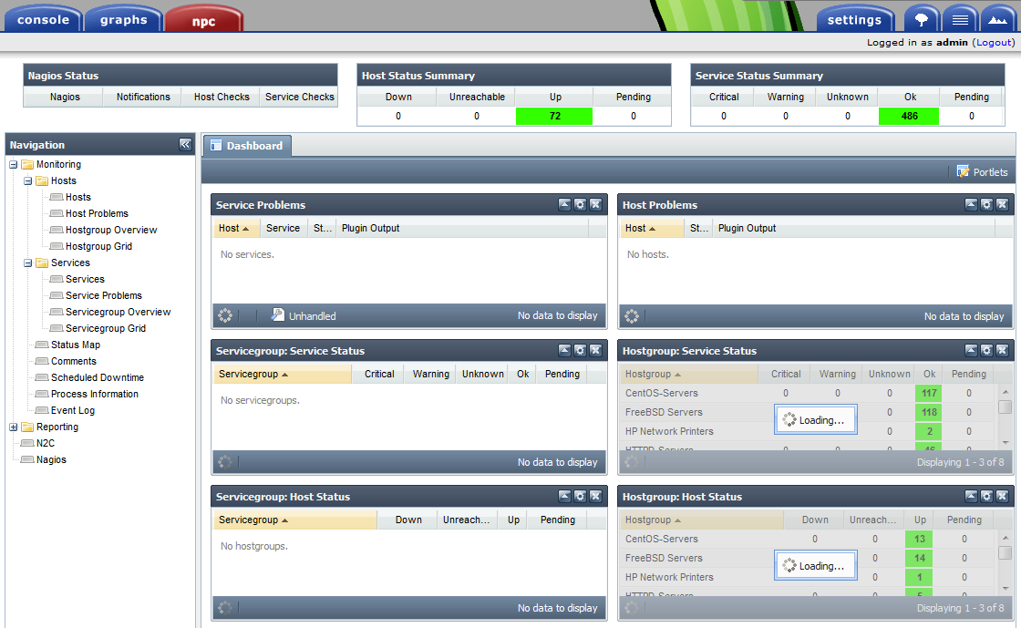

Slide 8
Splunk

