Slide 1
Problem Identification
-Big Mountain is a popular ski resort in the state of Montana
-The resort is currently installing a new lift, but it will have an annual maintenance cost in the ballpark of $1,540,000
-Big Mountain wants to figure out how to optimize their resort and ticket prices in order to cover these costs, as well as increase their overall income
-They are currently charging $81 for tickets, but are unsure if they should be charging more
-They are also willing to close some of their less popular facilities, provided it will be beneficial to do so.

Slide 2
Problem Identification (cont.)
-Big Mountain is currently the most expensive resort in Montana, although they do have more facilities than their competition
-the database provided has information on ski resorts throughout the US, but is missing some important data such as how many customers each resort usually has, or how much each spends on maintenance
-we do have a lot of data we can use though, so we can work with what we have
-after running several tests, we ended up using a random forest walk model

Slide 3
Recommendation & Key Findings
Our most accurate model tracks the 8 variables with the highest correlation to price. The most important variables for estimating ticket price by far are fastQuads, Runs, Snow making_ac, and vertical drop.
Our model’s ticket price estimate for Big Mountain based on these variables is $95.87, with a mean average error of $10.39. After Big Mountain adds their new lift, the value of said tickets goes up by 29 cents. Following this model and going with a low estimate, the resort could be charging about $85.77 to $96.16 for tickets. With an estimated 350,000 customers this year buying an average of 5 tickets each, this will more than cover the cost of the lift.

Slide 4
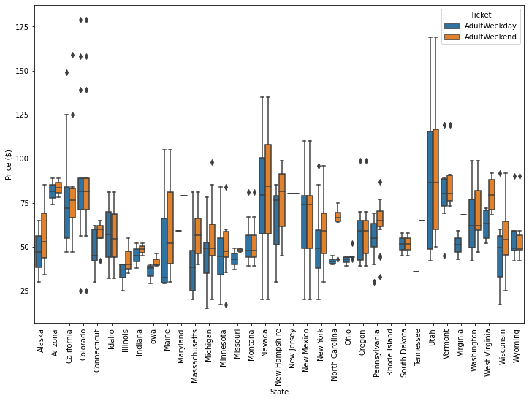
Modeling Results & Analysis
Histograms of ticket prices, both weekday and weekend, by state. Our target state Montana has fairly low-average prices, although Big Mountain is a visible outlier at $81 for both types of tickets.

Slide 5
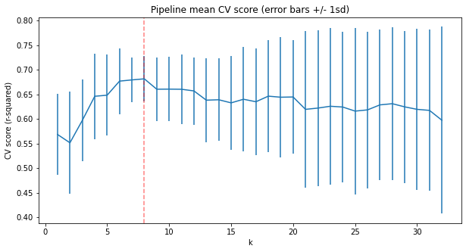
Modeling Results & Analysis
A graph to help indicate how many variables should be tracked for an optimal random forest model. The y-axis is the accuracy of the model for x number of variables, with the line length indicating the value within one standard deviation. 8 ended up being the optimal choice.

Slide 6
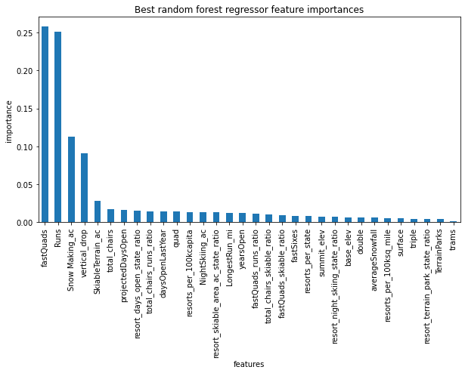
Modeling Results & Analysis
A bar graph indicating how important each feature is for predicting ticket price. The number of fastQuads and Runs alone make up about half of the influence.

Slide 7
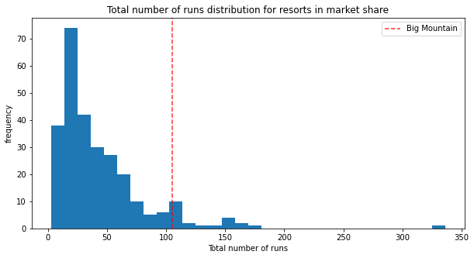
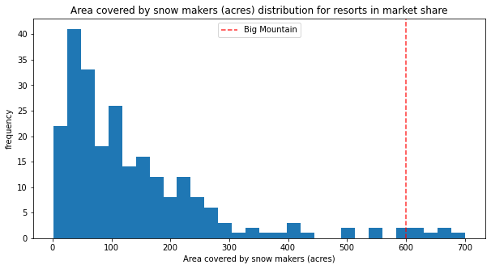
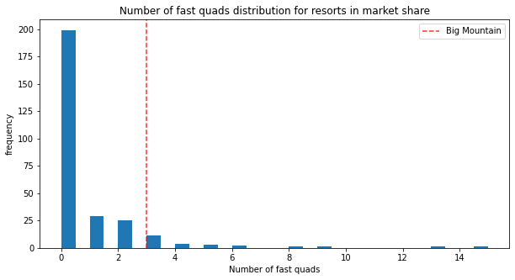
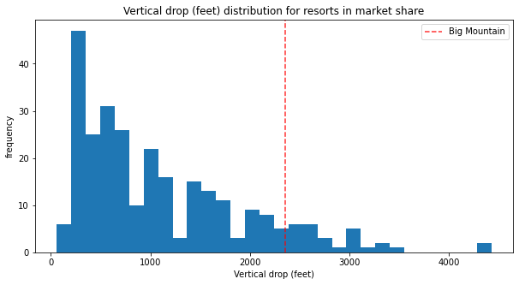
Modeling Results & Analysis
Montana’s stats for the most important features. The red line indicates where Big Mountain lies compared to other resorts.

Slide 8
Conclusion
-adjusting the price to be $85.77 to $96.16 after the new lift is installed will more than cover the cost of the lift, and bring additional profits of $6,807,500 to $24,990,000
-if Big Mountain wants to further increase profits in the future, some of the test scenarios we did recommended increasing the tallest vertical drop by 150ft, which would make tickets worth an additional $1.70
-Another option is to shut down the least popular run, which is estimated to not impact the ticket value but will reduce maintenance costs

