Slide 1
Citadel
A Note Taking Application
Ryan Mahoney

Slide 2
Inspiration
Problem
Last year I read the series A Song of Ice and Fire
A world packed with detail
Important details become hard to remember...
Who? What? When? Where?
Ryan Mahoney
Notes:
The name of this project is based off of a school in the GoT universe
Who is Jon Arryn, what was he poisoned with, when did he die, and where is the Vale?

Slide 3
Solution: Note Taking and Visualization
“Taking notes aids your comprehension and retention. Researchers found that if important information was contained in notes, it had a 34% chance of being remembered (Howe, 1970, in Longman and Atkinson, 1999). Information not found in notes had only a 5% chance of being remembered.”
Creating a graph, like a family tree, can help a person visualize how things are related
https://www.linkedin.com/pulse/20140907101944-51876784-the-biggest-benefits-of-effective-note-taking/
Notes:
https://www.linkedin.com/pulse/20140907101944-51876784-the-biggest-benefits-of-effective-note-taking/

Slide 4
Approach
Provide a convenient means of recording notes
Make it easy to relate notes
Produce common visualizations for different kinds of relationships
Ryan Mahoney
Notes:
Notes include characters, events, locations, and general notes

Slide 5
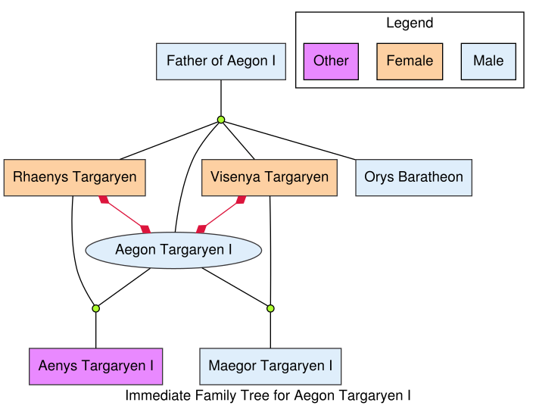
Characters to Characters → Family Trees

Slide 6
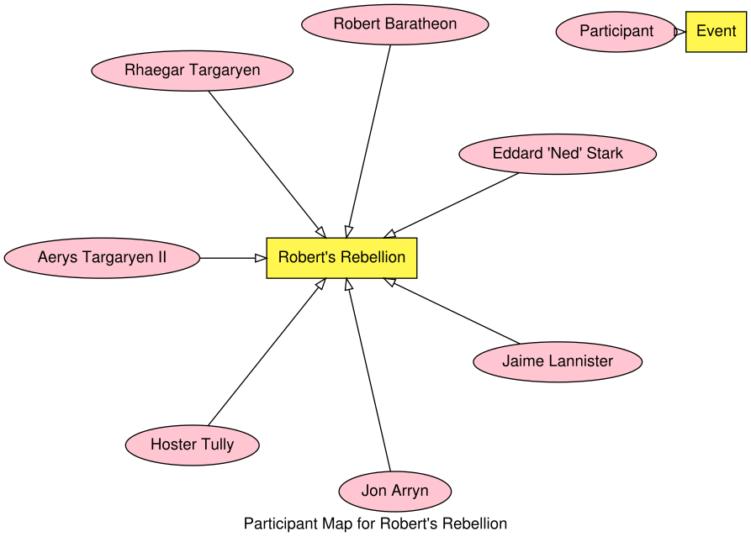
Characters to Events → Participant Graphs

Slide 7
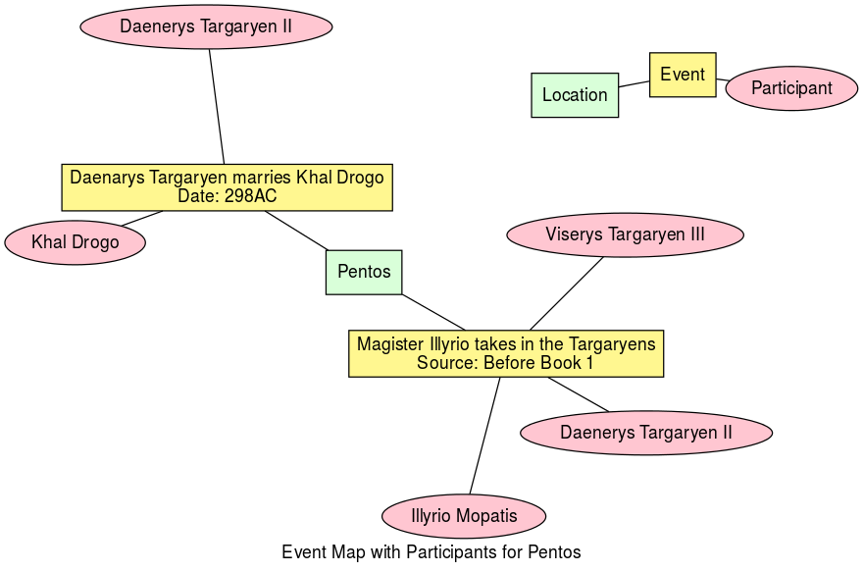
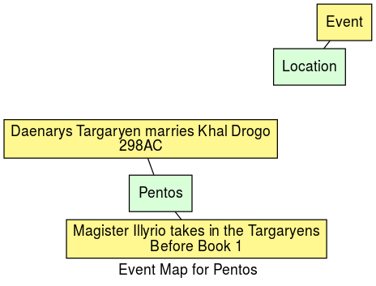
Events to Locations → Event Maps

Slide 8
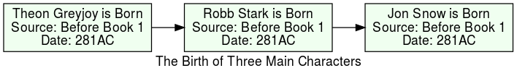
Events to Events → Timelines

Slide 9
Demonstration
Notes:
Go through a demonstration of adding jon snow information

Slide 10
Tools
GUI: Windows Presentation Foundation (WPF) format
XAML used to organize interface
Code Behind: C#
Used by WPF, offers wide functionality
Graphing: Graphviz
Software that uses the .dot language to draw graphs
Storage: XML
Low upkeep, flexible format for text storage
Ryan Mahoney

Slide 11
Methods
Recursion used to create Family Trees
Object Oriented Design
Subject/Observer Pattern Used on XML
LINQ Used to Parse Data
Ryan Mahoney

Slide 12
Discussion

Slide 13
Speed Bumps
DOT can be limiting:
twopi != clusters
dot has trouble with rank assignment
connecting subgraphs to nodes is tricky
Object Orientation led to Bloating
Overdone LINQueries
Overcomplicated XML Schema
One color being wrong and angrily recompiling to fix it

