Slide 1
Rasa with webview
Architectural summary
February, 2020

Slide 2
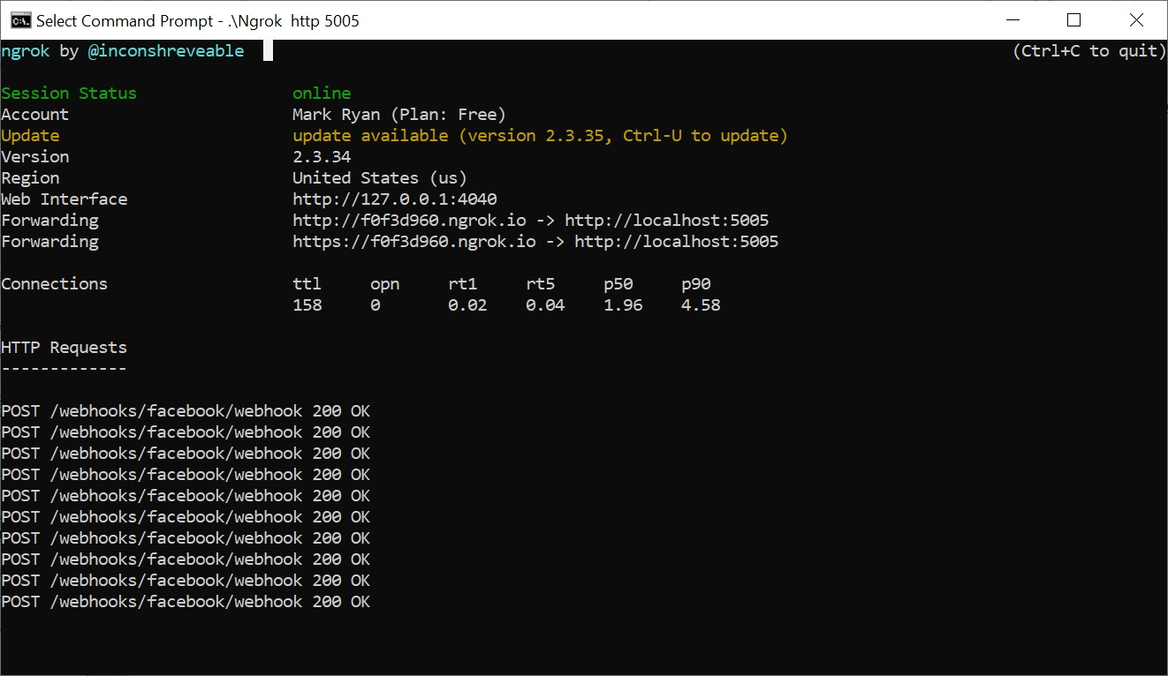


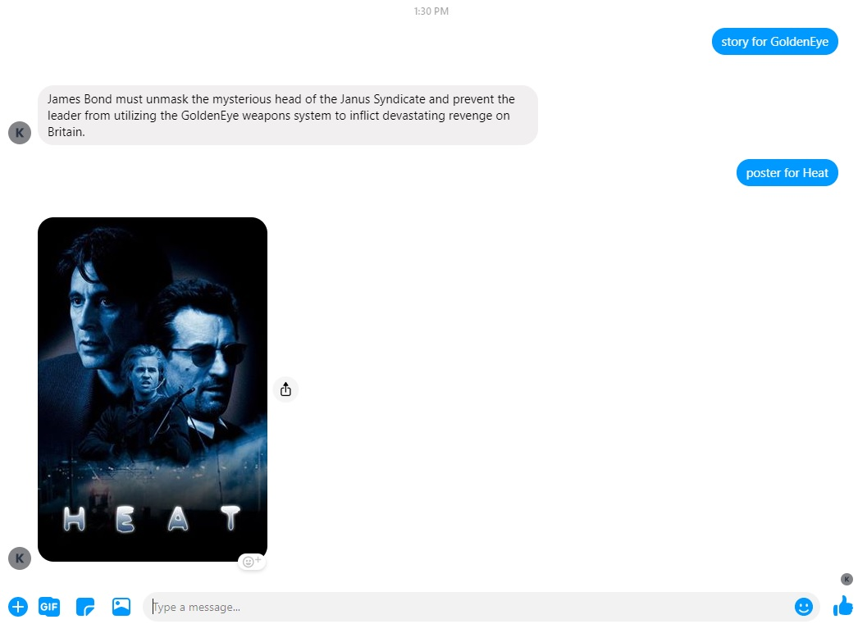

Services architecture Dec 2019
Weak link: broken if laptop goes offline
Public URL from ngrok
Webhook callback
Ngrok: serve localhost as public URL
Link between Rasa server and FM
Token from credentials.yml
Custom actions & slot values
Python custom actions
Models
Rasa server
Weak link: broken if Webhook to ngrok public URL lost
Facebook Messenger front end
Rasa models

Slide 3
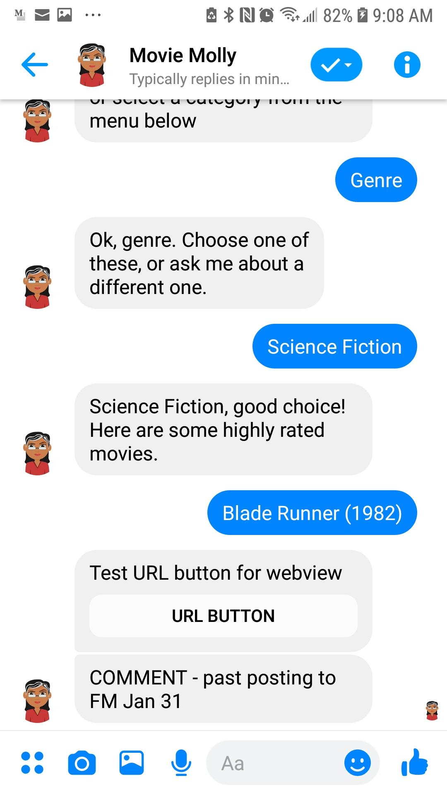
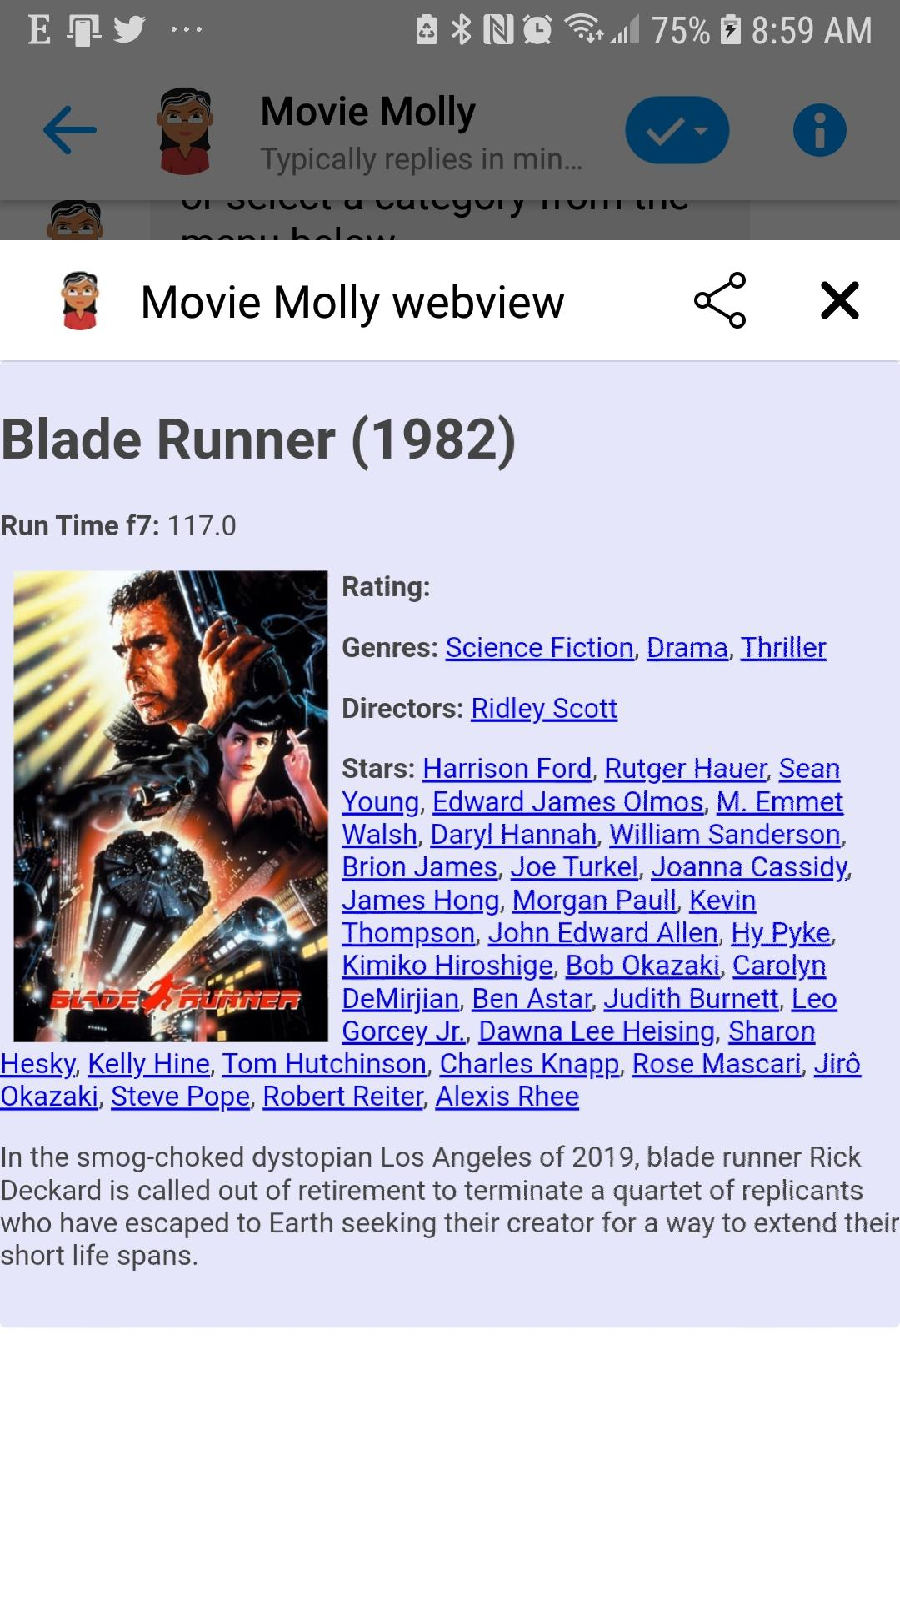





Architecture Feb 2020 blog version
1
2
Flask web server
Webhook callback
Actions & slot values
Python custom actions
Models
Rasa / FM link
Webview / FM link
Rasa server
Rasa models
Facebook Messenger front end
Web page displayed in Webview

