Slide 1
FIUS-MoveSense: Ultrasonic Movement Detection Using Smart Ultrasonic Sensors (FIUS) and Machine Learning Here
Machine Learning Project Presentation
Frankfurt University of Applied Sciences

Slide 2
Presented By Name: Md Maruf Hossain ID:1390272 maruf.hossain@stud.fra-uas.de
Name: Md Jamal Uddin
ID: 1387201
md.uddin2@stud.fra-uas.de
Name: Mousumi Parvin Tonny
ID:1393224
mousumi.tonny@stud.fra-uas.de
Name: Md. Shamsir Doha
ID: 1344011 mohammad.doha@stud.fra uas.de
Presented to
Prof. Dr. Andreas Pech
Information Technology Course Module
Machine Learning - WiSe 25/26

Slide 3
Abstract
FIUS‑MoveSense is an ultrasonic‑based movement detection system using machine learning.
Ultrasonic echo signals are captured using a FIUS sensor connected to a Red Pitaya board.
Each scan contains ~50,000 signal samples processed with signal filtering and feature extraction.
38 engineered features are used to train machine learning models.
Random Forest achieved the best performance with ~90.5% accuracy.

Slide 4
Introduction
Movement detection is important for robotics, smart homes, and industrial automation.
Camera‑based systems depend on lighting conditions and raise privacy concerns.
Ultrasonic sensing detects objects using reflected sound waves.
This project investigates movement detection using ultrasonic signals and machine learning.

Slide 5
Problem Statement
Movement detection is essential for robotics, automation, and smart sensing systems.
Camera‑based systems depend on lighting and privacy constraints.
Ultrasonic sensing provides robust detection independent of light conditions.
Goal: Detect movement using ultrasonic signals and machine learning.

Slide 6
Project Objectives
Design an ultrasonic sensing system for movement detection.
Develop a full signal processing and machine learning pipeline.
Extract discriminative features from ultrasonic echo signals.
Evaluate multiple ML classifiers.
Detect movement direction (approaching or moving away).

Slide 7
Hardware Architecture
Red Pitaya STEMlab Board
High‑speed ADC acquisition
1 MHz sampling rate
Interface for ultrasonic sensing
FIUS Ultrasonic Sensor
40 kHz ultrasonic pulse
Echo reflection measurement
Distance and movement detection

Slide 8
Dataset Overview
Total scans collected: 25,490
43 recording files collected from experiments
Not moving: 15,000 scans
Moving: 10,490 scans
Signals stored as high‑resolution time series (~50,000 samples)

Slide 9
Signal Processing Pipeline
Bessel Low‑Pass Filter removes noise while preserving waveform shape.
Hilbert Transform computes signal envelope.
Echo Peak Detection identifies object reflection.
FFT converts signal to frequency domain for spectral analysis.

Slide 10
Feature Engineering (38 Features)
Time‑domain features: mean, RMS, skewness, kurtosis, energy.
Zone‑based features: signal divided into distance regions.
Frequency features: spectral entropy, centroid, flatness.
Temporal features: scan‑to‑scan comparison (key innovation).

Slide 11
Machine Learning Models Evaluated
Random Forest
Support Vector Machine (SVM)
K‑Nearest Neighbors (KNN)
Logistic Regression
Hyperparameter tuning performed using GridSearchCV.

Slide 12
Model Performance Results
Random Forest achieved the best performance.
Accuracy: 90.53%
Precision: 85.56%
Recall: 92.63%
F1‑Score: 88.96%

Slide 13
Threshold Optimization
Default decision threshold (0.50) produced false positives.
Confidence threshold increased to 0.65.
Correct predictions improved to 9/10 real‑world tests.

Slide 14
Movement Direction Detection
Peak position of echo analyzed across scans.
Earlier peak → object approaching sensor.
Later peak → object moving away.
Enables contextual motion understanding.

Slide 15
Experimental Evaluation
10 real‑world test scenarios evaluated.
Stationary, approaching, departing and lateral motion tested.
System correctly detected movement in 9 out of 10 scenarios.

Slide 16
System Limitations
Multi‑person detection remains challenging.
Dataset collected in controlled environment.
Processing currently performed in batch mode.

Slide 17
Future Work
Real‑time streaming movement detection.
Multi‑target tracking capability.
Improved distance estimation from echo peaks.
Larger dataset collection.

Slide 18
Conclusion
FIUS‑MoveSense demonstrates reliable ultrasonic movement detection.
Machine learning significantly improves robustness.
Random Forest model achieved highest accuracy (~90%).
System can also estimate motion direction.

Slide 19
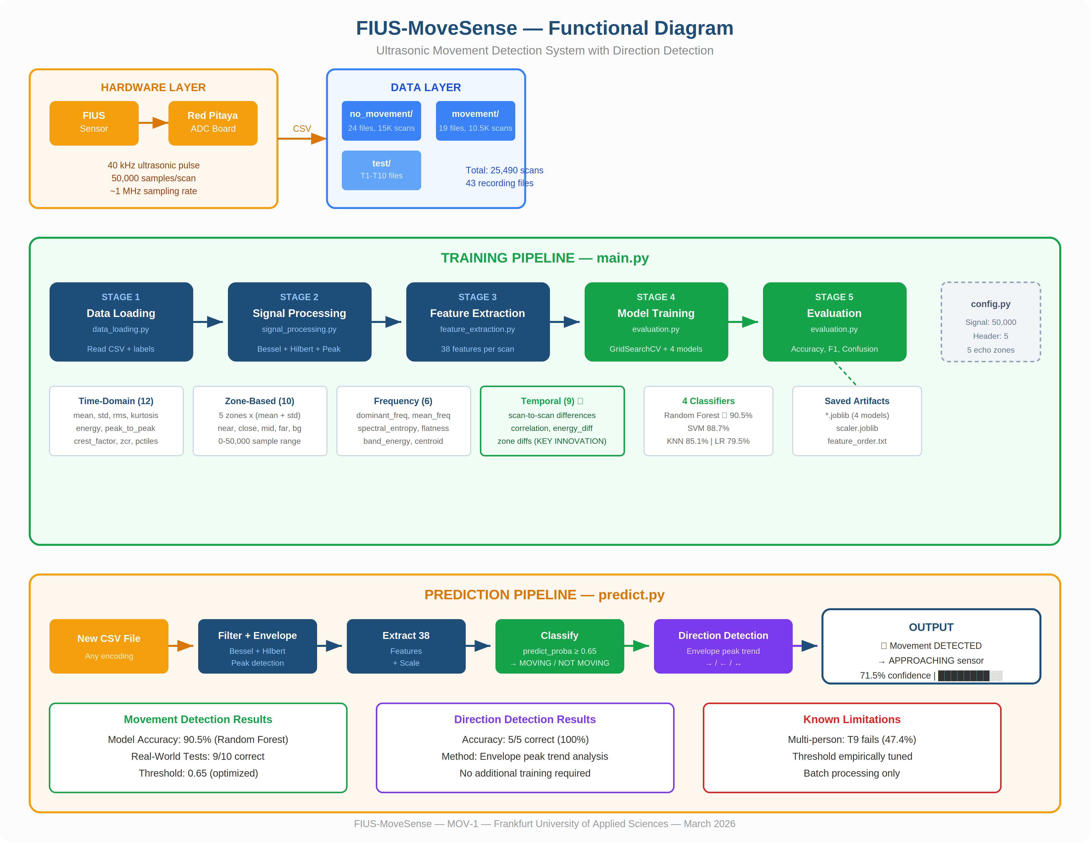
System Functional Diagram

Slide 20
References
[1] J. D. Wilson, Sensor Technology Handbook, Newnes, 2005.
[2] H. A. Aghajan and A. Cavallaro, Multi-Camera Networks: Principles and Applications, Academic Press, 2009.
[3] https://marceluda.github.io/rp_lock-in_pid/TheApp/RedPitaya_board/
[4] https://en.wikipedia.org/wiki/Bessel_filter.
[5] Evgeniou, T., Pontil, M. (2001). Support Vector Machines: Theory and Applications. In: Paliouras, G., Karkaletsis, V., Spyropoulos, C.D.(eds) Machine Learning and Its Applications. ACAI 1999. Lecture Notes in Computer Science(), vol 2049. Springer, Berlin, Heidelberg. https://doi.org/10.1007/3-540-44673-7_12.
[6] James, G., Witten, D., Hastie, T., & Tibshirani, R. (2013). An Introduction to Statistical Learning. Springer.
[7] Provost, F., & Fawcett, T. (2013). Data Science for Business. O'Reilly Media.
[8] K. Nakamura, Ultrasonic Transducers: Materials and Design, Woodhead Publishing, 2012.
[9] A. V. Oppenheim and R. Schafer, Discrete-Time Signal Processing, Pearson, 2010.
[10] Guyon and A. Elisseeff, "An Introduction to Variable and Feature Selection," Journal of Machine Learning Research, 2003.
[11] L. Breiman, "Random Forests," Machine Learning, vol. 45, no. 1, pp. 5–32, 2001.
[12] T. Fawcett, "An Introduction to ROC Analysis," Pattern Recognition Letters, 2006.
[13] S. Russell and P. Norvig, Artificial Intelligence: A Modern Approach, Pearson, 2021.

Slide 21
Thank You

