Slide 1

Housing Price Prediction Using Machine Learning
Ryan Maxam
DSC 630
August 23, 2026
DATA → MODEL → VALUE

Slide 2
02
Project Objective
Home price
3 models
Best fit
PREDICT
COMPARE
SELECT
Estimate residential prices from observable property characteristics.
Linear Regression, Decision Tree, and Random Forest.
Balance predictive performance with interpretability.
Which modeling approach most accurately predicts housing prices while remaining practical and interpretable?
Business value: faster, data-driven valuation support for buyers, sellers, investors, and real estate professionals.

Slide 3
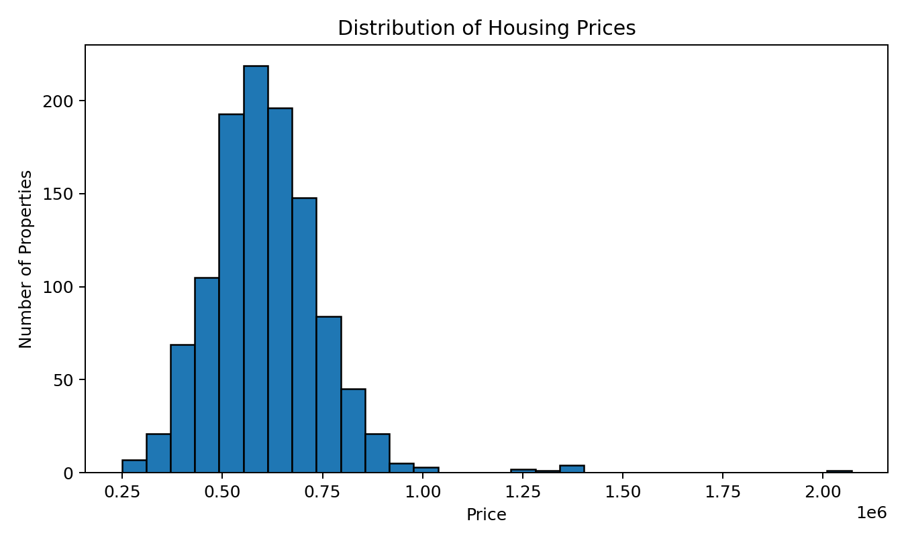
03
Dataset Overview
1,124
8
Price
RECORDS
PREDICTORS
TARGET
Predictor mix
• Numerical: Area_SqFt, Rooms, Build_Year
• Categorical: Location, Street_Type, Furnishing, Property_Type, Has_Pool
Price distribution is right-skewed (skewness = 1.75).

Slide 4
04
Data Quality & Preparation
01
02
03
04
Missing values
Imputation
Train / test split
Transformation
33 each in Area_SqFt, Rooms, and Furnishing (2.9%).
Median for numerical values; most-frequent for Furnishing.
80 / 20 split with random_state = 42.
Standardization + one-hot encoding inside the pipeline.
→
→
→
Pipeline design keeps preprocessing learned from training data only, reducing data leakage risk.

Slide 5
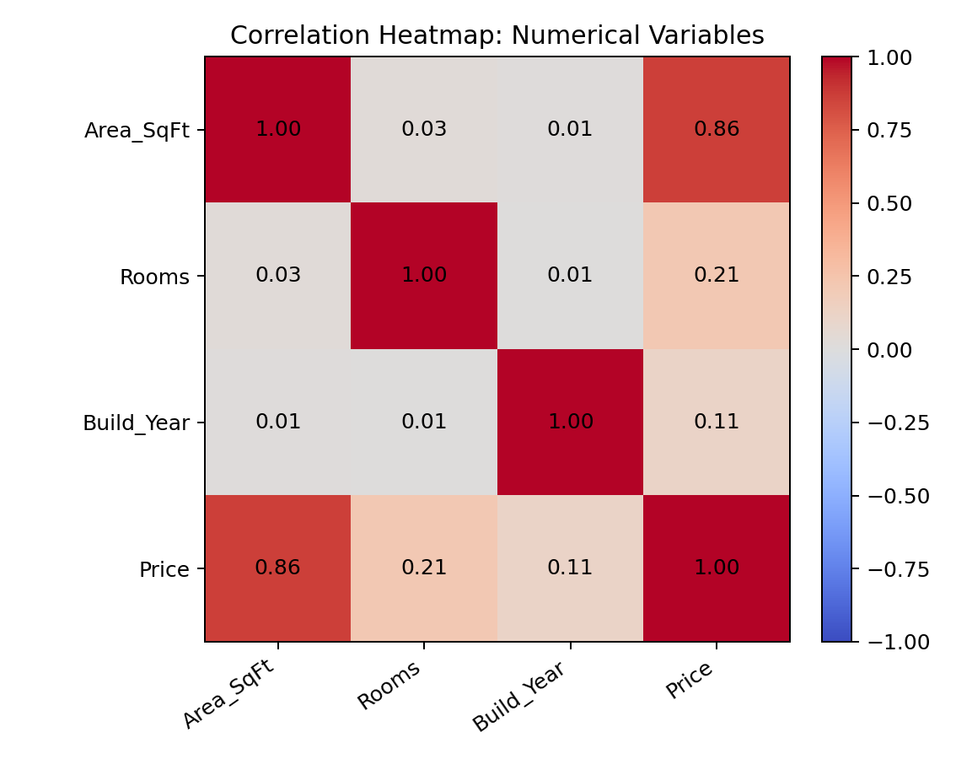
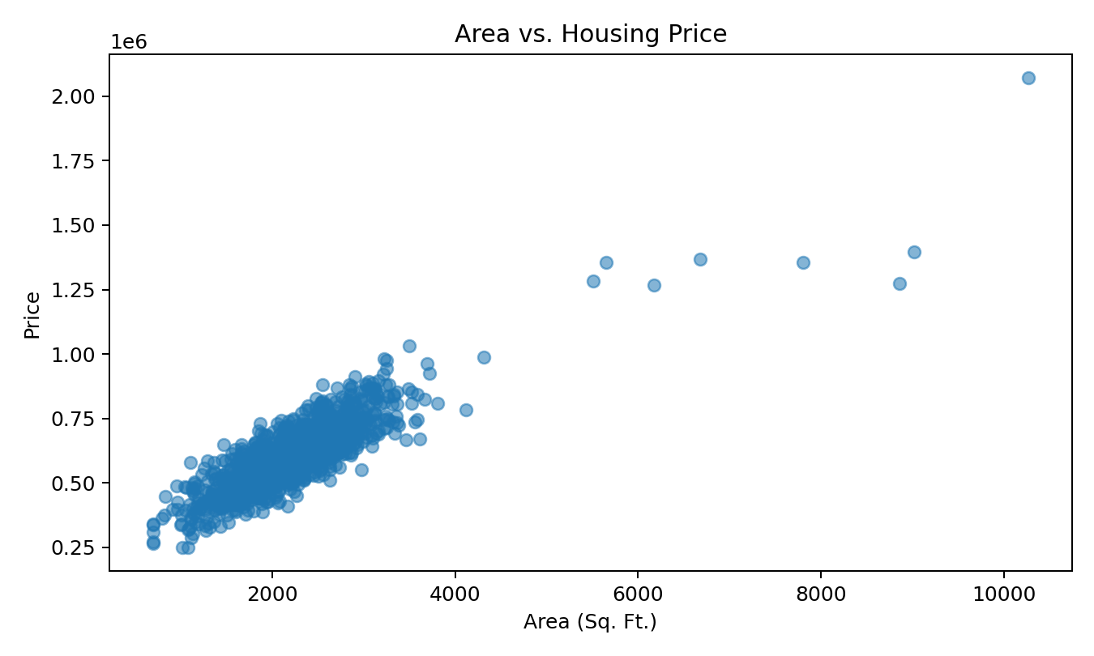
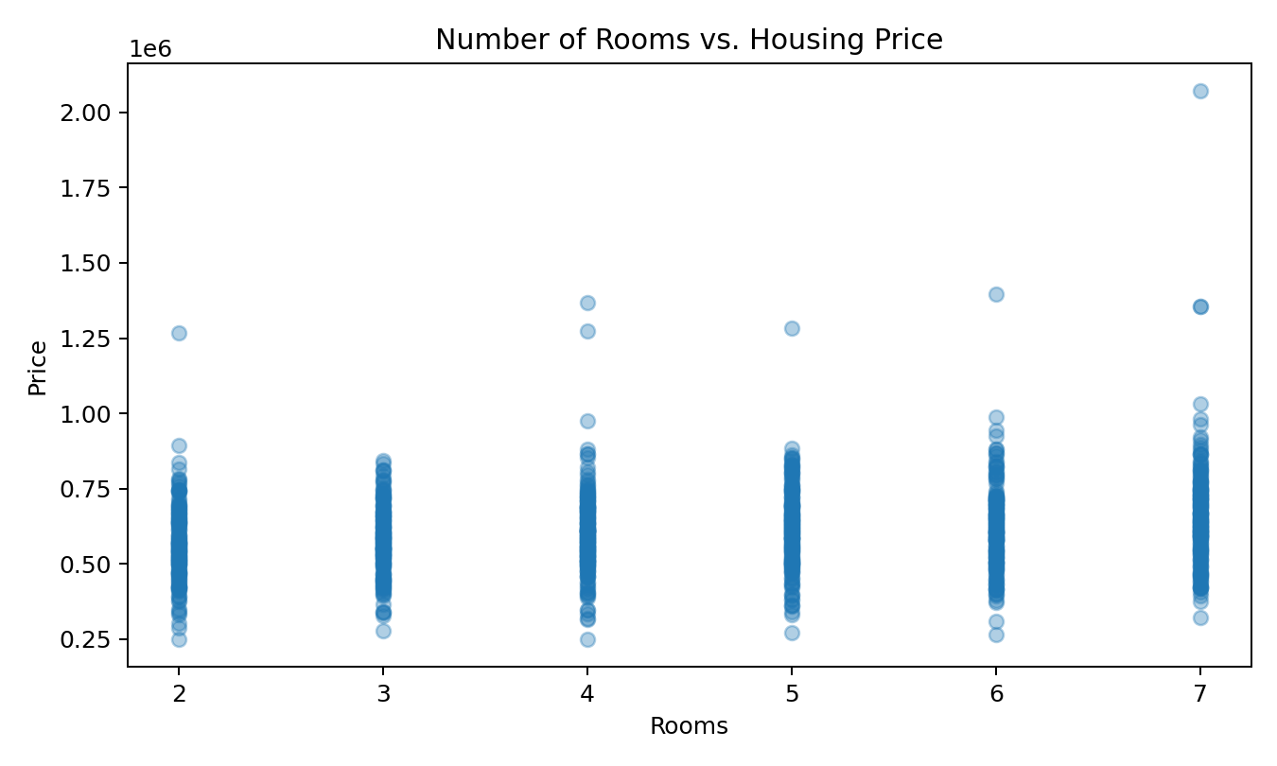
05
Exploratory Findings
2,237 sq. ft.
$608,202
r = 0.862
4.57
AVG. SIZE
AVG. PRICE
TOP CORRELATION
AVG. ROOMS
Correlation heatmap
Area vs. price
Rooms vs. price

Slide 6
06
Models Evaluated
BASELINE
TREE
ENSEMBLE
Linear Regression
Decision Tree
Random Forest
Interpretable baseline
Nonlinear model
Ensemble model
Captures the strong linear relationship between size and price.
Max depth 8; minimum 5 observations.
300 trees; minimum 2 observations per leaf.
Same preprocessing and train-test framework used for all three models.

Slide 7
07
Evaluation Metrics
RMSE
Penalizes larger errors
MAE
Typical absolute error
Lower is better
Lower is better
R²
Variation explained
5-fold CV RMSE
Stability across splits
Higher is better
Lower is better
Using multiple metrics prevents model selection from depending on a single measure.

Slide 8
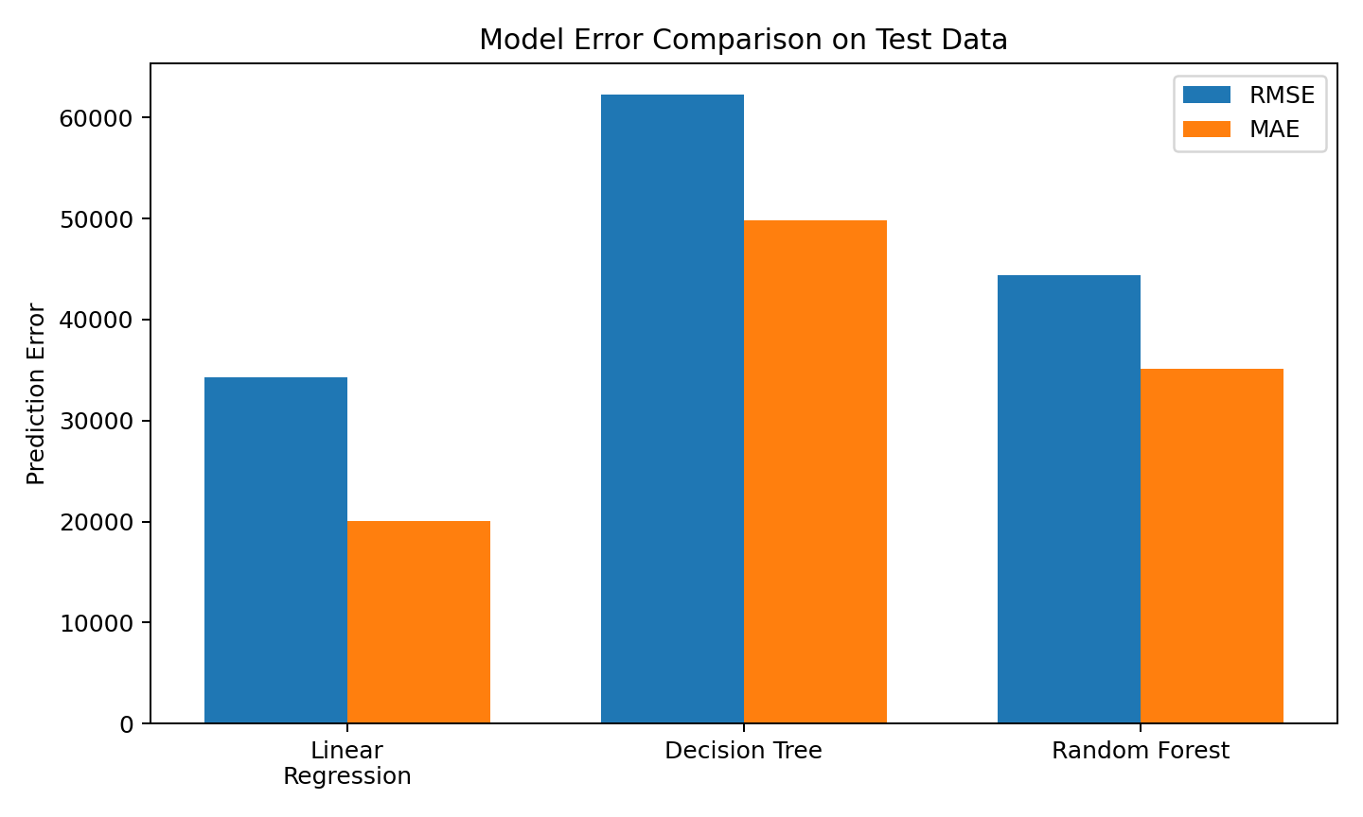
08
Model Performance
$34,259 RMSE
LINEAR REGRESSION — BEST
MAE $20,084 | R² 0.944
$44,439 RMSE
RANDOM FOREST
MAE $35,089 | R² 0.907
$62,236 RMSE
DECISION TREE
MAE $49,804 | R² 0.817
Linear Regression also had the lowest 5-fold CV RMSE: $34,526.

Slide 9
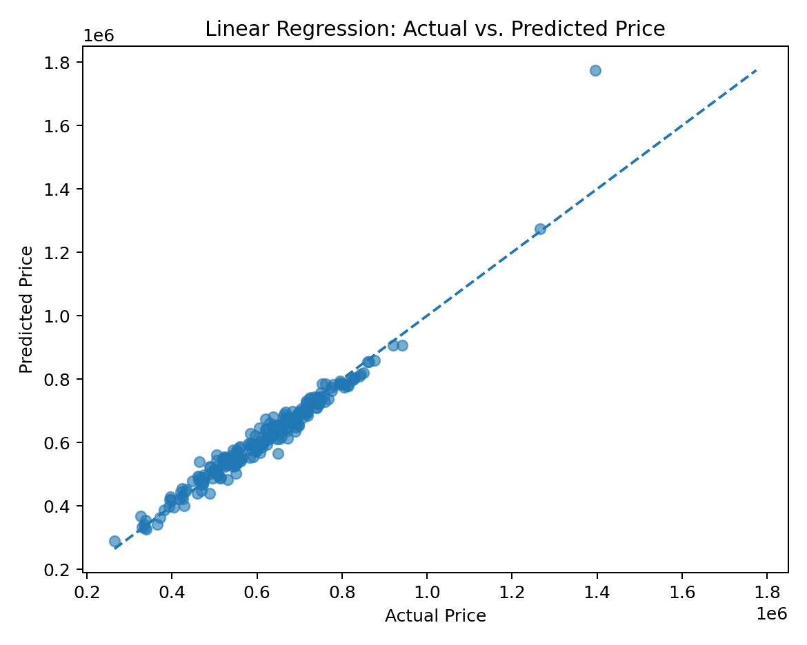
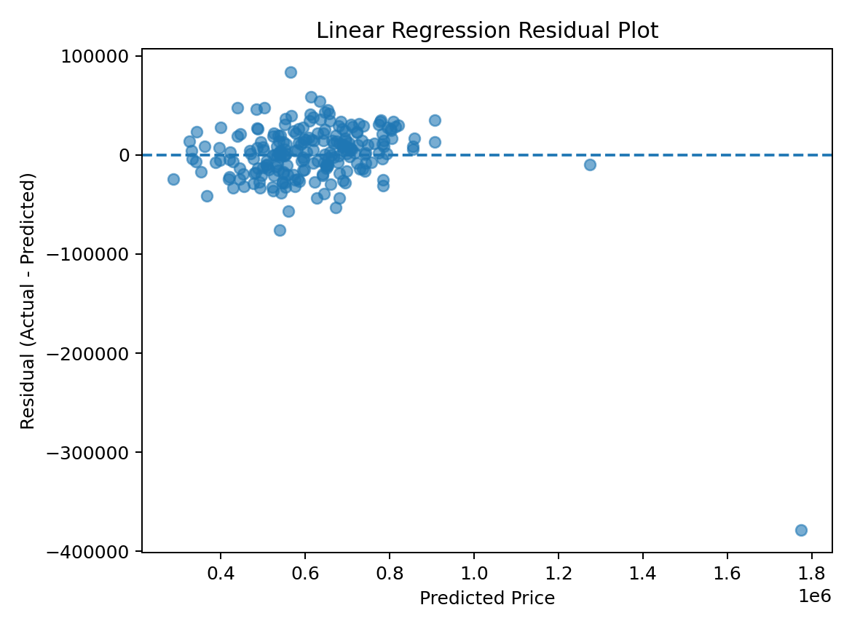
09
Best Model: Linear Regression
Actual vs. predicted
Residual pattern
R² = 0.944 • strongest test + CV performance

Slide 10
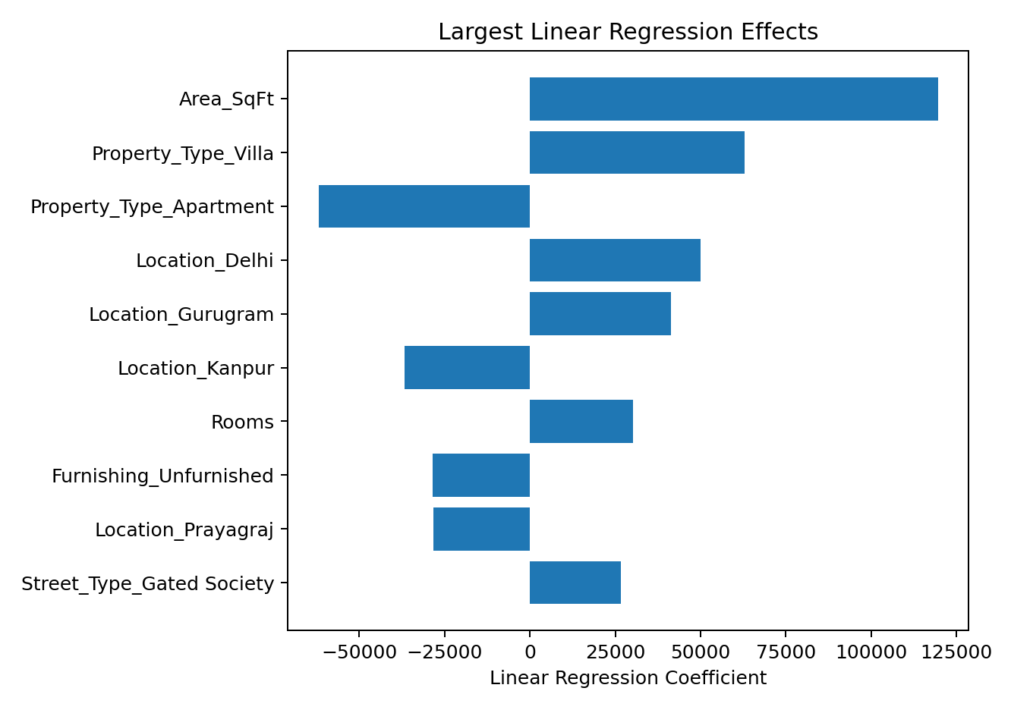
10
Interpretation of Predictors
STRONGEST DRIVER
Property size remained the dominant numerical predictor.
CATEGORICAL EFFECTS
Location, property type, furnishing, street type, and pool status also contribute.
INTERPRET CAREFULLY
Coefficients show associations in this dataset—not proof of causation.

Slide 11
11
Business Recommendation
Use Linear Regression for decision support.
The model should support but not replace professional appraisal or local market analysis.
• Fast initial housing price estimate
• Strong predictive accuracy and interpretability
• Keep Random Forest as a secondary benchmark
Unusually expensive properties may produce larger errors.

Slide 12
12
Limitations & Future Work
01
Geography
02
Property condition
Add more detailed local geographic information.
Capture renovations, condition, and upgrades.
03
Market context
04
Generalizability
Include current indicators and recent local sales.
Validate on additional markets and datasets.

Slide 13
13
Conclusion
Linear Regression delivered the strongest overall performance.
0.944
$34,259
$20,084
R²
Test RMSE
Test MAE
Careful preprocessing and transparent model comparison produced a practical, interpretable solution for residential price prediction.

Slide 14
14
References
Yadav, R. (2026). House price prediction [Dataset]. Kaggle.
Pedregosa et al. (2011). Scikit-learn: Machine learning in Python. Journal of Machine Learning Research, 12, 2825–2830.
Ryan Maxam • DSC 630 • August 23, 2026

