Slide 1
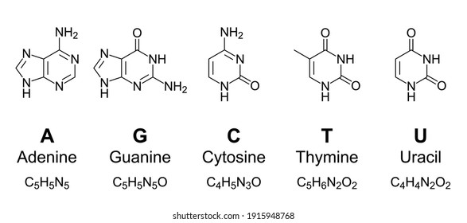
Introduction to Sequencing Experiments: Approaches, Assessment, and Analysis
Ryan Boileau
aged DSCB graduate student, Blelloch Lab
(Built on previous work together with Bryan Marsh)

Slide 2
Outline and Learning Goals
Approaches: What kinds of experiments leverage sequencing?
Assessment: What’s a standard processing workflow and what are general quality control metrics?
Analysis: How do you extract biology from your experiments?
R exercise for differential analysis of RNA-seq

Slide 3
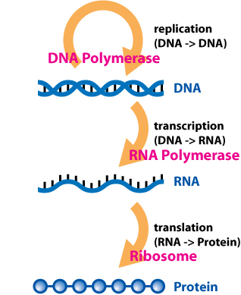
Approaches: The basic flavors of sequencing
Whole genome sequencing
Examples: Human Genome Project, T2T consortium, bisulfite sequencing (detecting DNA methylation)
Transcriptomics
Examples: full length RNA, mRNA, miRNA, nascent RNA
Epigenomics
Examples: ATAC-seq, ChIP-seq, CUT&RUN, CUT&TAG, Hi-C
*Image from Socratic.org

Slide 4
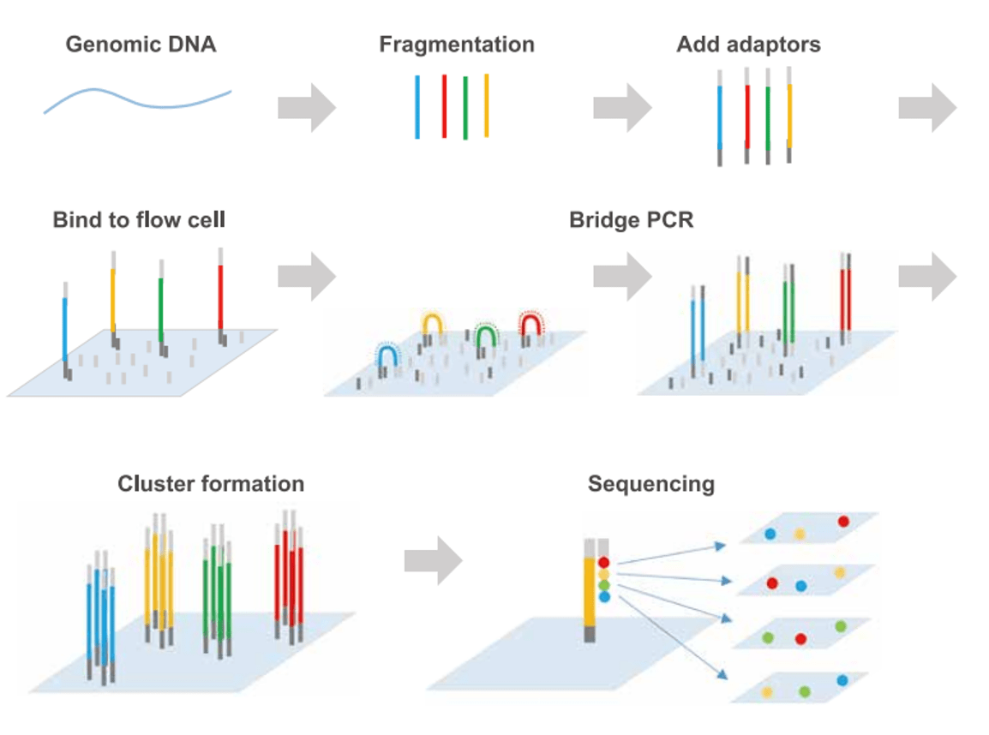
The actual sequencing process
Illumina
(sequencing by synthesis)
*Images from Illumina and Indiana U

Slide 5
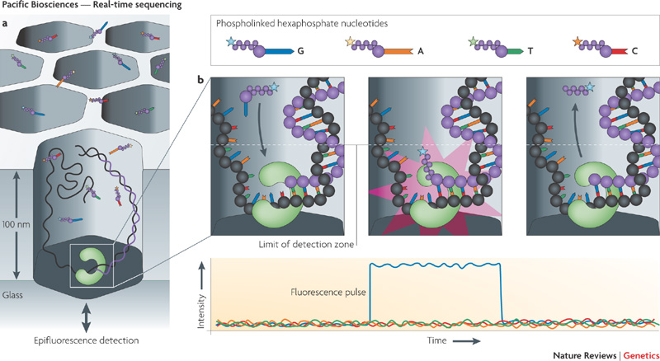
The actual sequencing process
PacBio SMRT-seq
(Single molecule real time)

Slide 6
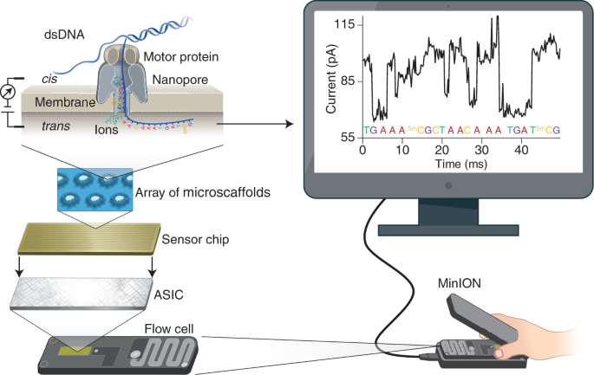
The actual sequencing process
Oxford Nanopore
(Single molecule real time)
*Image from Nature

Slide 7




Preparing your sequencing samples
Kits
Less understanding required, More expensive, highly optimized
”DIY” protocols
More understanding required, Less expensive, probably needs some optimizing
i.e. RNA-seq, ATAC-seq, ChIP-seq/CUT&TAG, combinatorial indexing scRNA-seq

Slide 8
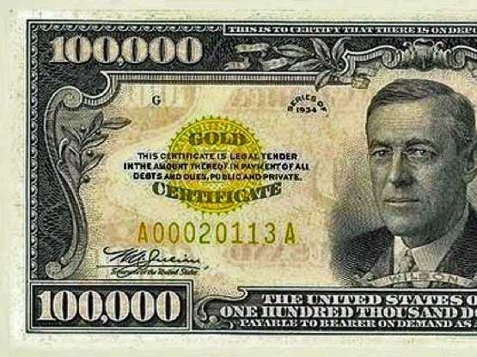
Make your PI happy, stretch your funding (C.R.E.A.M. – Wu Tang Clan)
Many sequencing reaction kits can be used in a “half” or “third” reaction format
Most sequencing kits use SPRI beads for selecting certain sizes of DNA. Make your own!
Sequencing Services:
On campus: CAT core, IHG core (500e6/$1600)
Off campus: UCSD IGM core (500e6 reads/$900)
Commercial: BGI/MGI ($660/400e6), Novogene
Note: variable sequencing types, cost, turn around

Slide 9
Overview of RNA-Seq
Enrichment or depletion protocols
i.e. PolyA selection or rRNA digestion
Illumina, sequencing by synthesis
Notes:
Sequecing works through the hybridization of adapters to the flow cell, amplification, incorporation of fluorescent nucleotides, imaging the emission or each cluster which corresponds to a base, wash rinse repeat for N times (this is the read length)

Slide 10
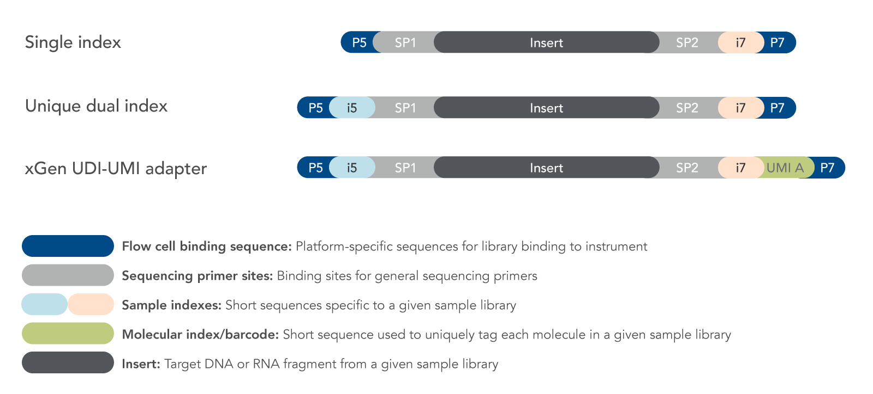
”Barcoding” for multiplexing samples in the same lane
*Image from IDT

Slide 11
”Barcoding” for multiplexing samples in the same lane
Choosing barcode sequences is critical:
Are the barcodes for all samples diverse enough?
Are they 6nt or 8nt long?
Do you have combinatorial barcodes in the same sample e.g. single cell approaches?
Because you thought ahead, demultiplexing of your pooled library into the individual samples worked

Slide 12
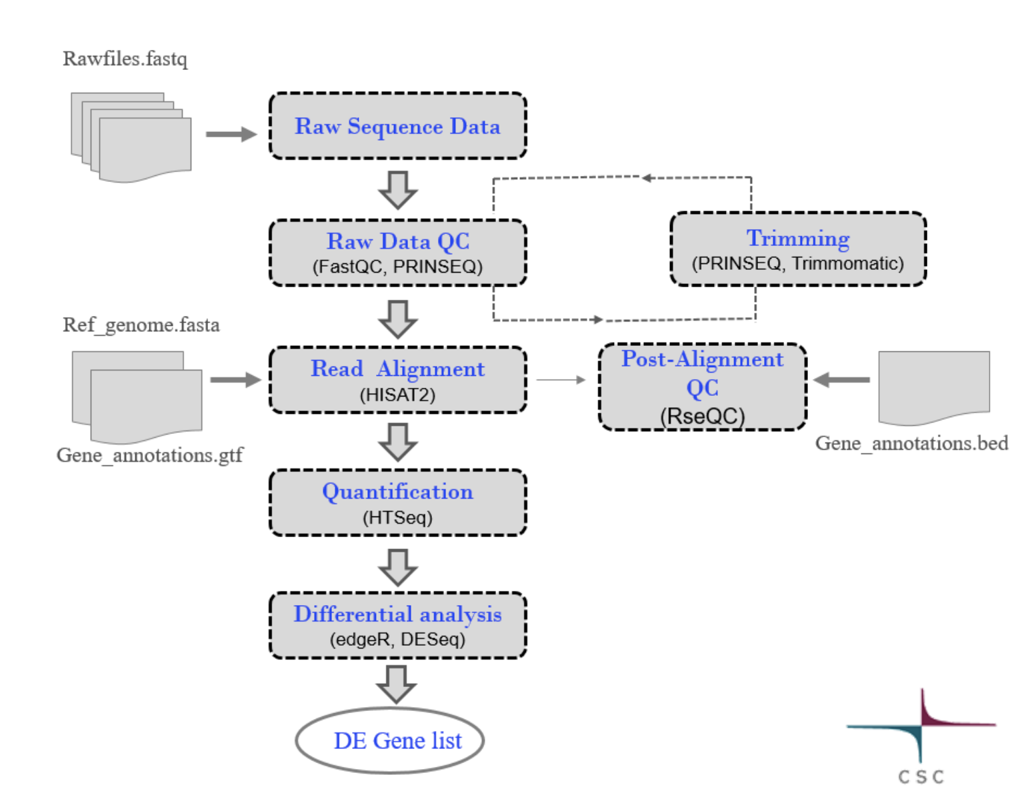
General RNA-Seq analysis pipeline
Sequencer
Server Cluster
Desktop
(R, python)
https://research.csc.fi/rnaseq-tutorial

Slide 13
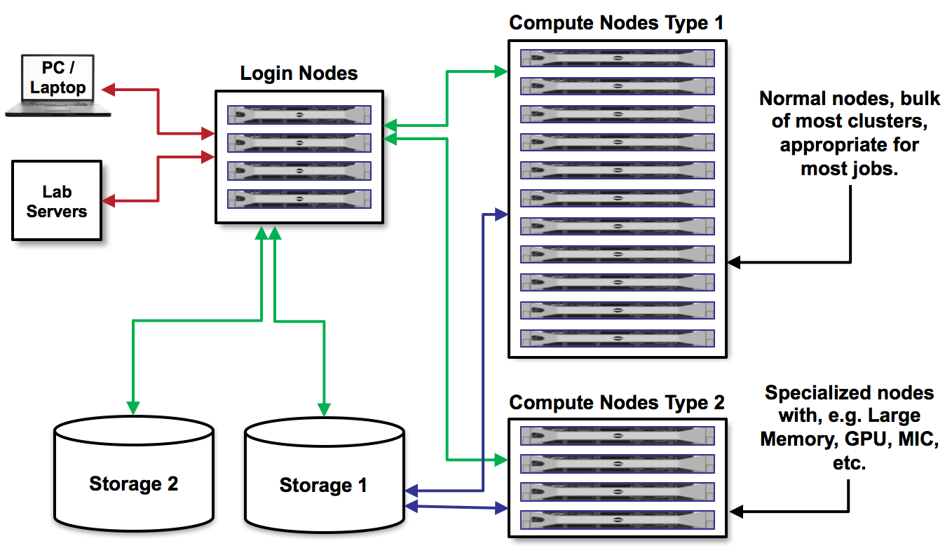
High Performance Computing
@UCSF?
Wynton cluster
C4 cluster
https://tacc-reproducible-intro-hpc.readthedocs.io/

Slide 14
File management software for the desktop
Cyberduck or FileZilla
GUI software to access cluster and visualize your file tree, rearrange files, delete, rename, etc...
(Note to self: Show them the organized part of your cluster files on cyberduck)

Slide 15
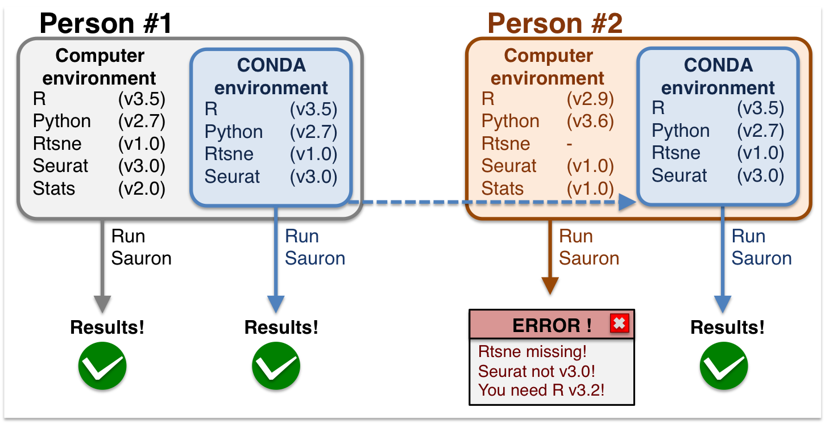
Building and reproducing computational environments
Conda environments
Containerization by Singularity (preferred) and Docker
https://nbisweden.github.io/workshop-scRNAseq/conda_instructions.html

Slide 16


Don’t build your own pipelines if you don’t have to!
Nextflow pipelines
Workflow management software
Community curated pipelines
Singularity/Docker containers
Version control
Active and supportive community
Alternative: Snakemake
Python based workflow manager

Slide 17
General RNA-Seq analysis pipeline
Sequencer
Server Cluster
Desktop
(R, python)
https://research.csc.fi/rnaseq-tutorial

Slide 18
Assessment: quality control of your sequenced samples
FastQC is the most common software
It will calculate for you:
Adapter contamination
Sequence quality
GC content of reads
Duplicated sequences (PCR ”jackpotting”)
Notes:
Looking for: do we have a bunch of adapter dimers? Seq quality (probablility of correct call)? Bias towards certain bases and against others? Many duplicated sequences (PCR artifact jackpotting others)

Slide 19
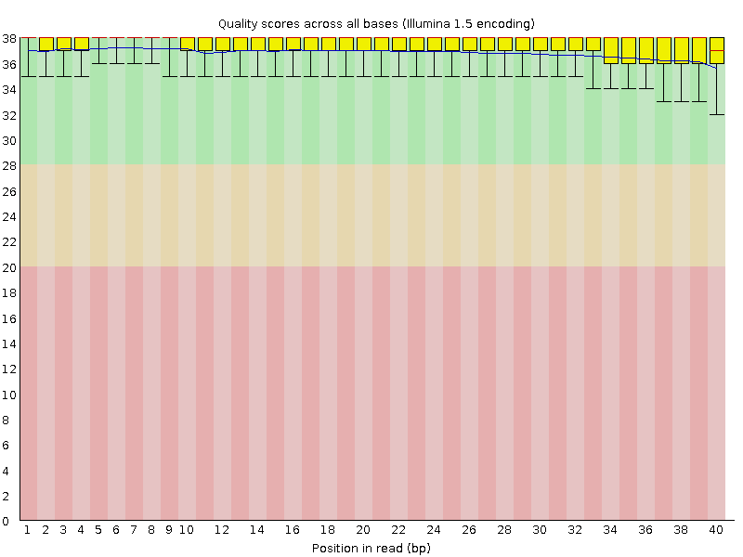
Check for major sequencing errors with FastQC
Good quality report
Bad quality report
https://www.bioinformatics.babraham.ac.uk/projects/fastqc/
Notes:
Phred score – log 10 of the probablility a base score is correct (10 ->90%, 20 ->99%, 30 ->99.9%, 40 ->99.99%)

Slide 20
Mapping short reads for RNA-Seq
Most common mappers for RNA-Seq
HISAT2
STAR
Pseudoaligners - Kallisto

Slide 21
MultiQC to check quality of mapped data
E3.5, E4.5, E5.5 samples from paper
Mapping statistics
% Aligned reads
Unique
Multimapping
RSeQC
Where do reads map?
Strandedness?
Coverage over a gene?
featureCounts
How many mapped reads overlap a feature (gene, lncRNA, etc)?
What type of features do reads map to (protein coding, rRNA)?
Notes:
Exit and show the multiQC
Go through general stats, biotype, read distribution, gene body coverage

Slide 22
Gene counts from mapped data are generated by featureCounts
Mapped reads (bam file that contains read and genomic coordinates where it maps)
Gene annotation (gtf file with genomic coordinates of all annotated exons)
Gene 1
Gene 2
Gene 3
Count:
7
2
1

Slide 23
Normalizing counts by library size
Raw counts
 | A | B
Gene 1 | 5 | 10
Gene 2 | 5 | 15

Slide 24
Normalizing counts by library size
Raw counts
 | A | B
Gene 1 | 5 | 10
Gene 2 | 5 | 15
Sequencing depth:
A: 1 million reads
B: 2 million reads
Counts per million (CPM)
 | A | B
Gene 1 | 5 | 5
Gene 2 | 5 | 7.5

Slide 25
Normalizing counts by fragment size
Raw counts
 | A
Gene 1 | 5
Gene 2 | 10

Slide 26
Normalizing counts by fragment size
Raw counts
 | A
Gene 1 | 5
Gene 2 | 10
Gene length:
Gene 1: 1 kb
Gene 2: 3 kb
 | A
Gene 1 | 5
Gene 2 | 3.33
RPKM (Reads Per Kilobase per Million mapped reads)

Slide 27
Analysis: Deriving biology from your experiment
Transcriptomics
Clustering analysis (heatmaps, PCA)
Differential gene expression (DESeq2, Limma)
Gene Ontology (clusterProfiler, enrichR)

Slide 28
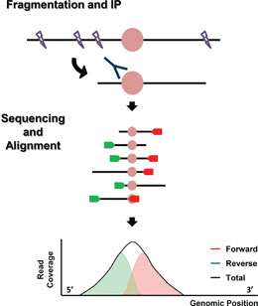
Epigenomics! Same but not same same
Epigenomics
ChIP-seq example
Clustering analysis (heatmaps, PCA)
Differential peak analysis (DESeq2, Diffbind)
Peak Motif Analysis (Homer, Gimmemotifs)
Image from ASM journals

Slide 29
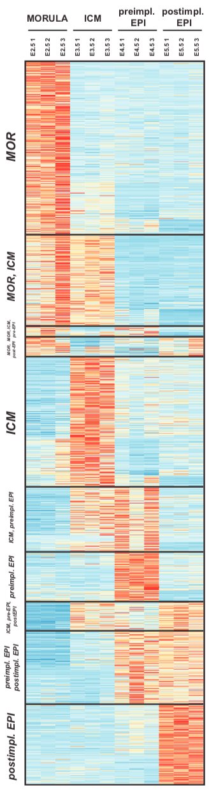
We Need to Simplify - Dimensionality Reduction
How do we plot something like this (thousands of points) more simply?
Curse of Dimensionality
Needs:
Visualize/Analyze
Simplicity (fewer values)
Fidelity to complete dataset
“Retain Variation” in the dataset
Genes
Knox et al. 2008

Slide 30
PCA separates samples “a” and “b”
a: 3 samples with 1000 random points from a normal distribution w/ mean 100
b: 3 samples with 1000 random points from a normal distribution w/ mean + add values to first 200 rows
Notes:
Can help interperate differences in data by known external factors. Components have no inherent meaning!

Slide 31
Important to normalize data for PCA
a2, a3, and b1 were sequenced twice as deep as a1, b2, b3
Notes:
To anchor this to our handling of RNAseq data – normalization can have a huge impact
However, many things can affect PCA. Components have no inherent meaning!

Slide 32
Outliers can have a big impact on PCA
Important to scale data
a1-3 1000 measurements with mean ~ 100, b1-3 mean ~ 100. Adding 300 to just 1 value in a1 and b1 drives PCA
Notes:
Normalization and scaling (log normalize functions in many packages, including Seurat) help to reduce outliers
In this raw data adding 1 value of +300 can drive the pca

Slide 33
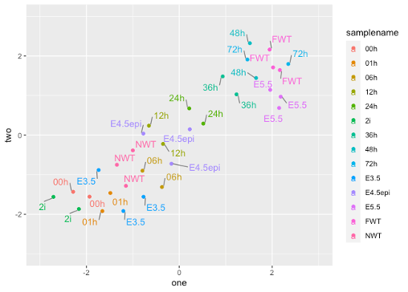
Example: Biological insight from a UMAP

Slide 34
R exercise: Differential Gene Expression of RNA-seq
Find .zip folder or individual files at
https://github.com/ryanmboileau/UCSF_DSCB_introtosequencing

Slide 35
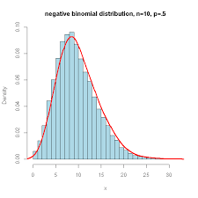
Know your software packages!
Statistical assumptions
i.e. DESEq2 assumes a negative binomial distribution of gene expression
Edge case handling
E.g. mapping sequencing reads based on base quality scores
https://www.biostars.org/p/6028/

Slide 36
Addition fun with Rstudio
Dplyr, ggplot, Complexheatmap
Use ggplot to make good enough figures then export as layered graphics and edit in Adobe Illustrator or Affinity Design
Rstudio can create interactive analyses (3D objects, figures with metadata when highlighting)
Using Rstudio on an HPC from your desktop

Slide 37
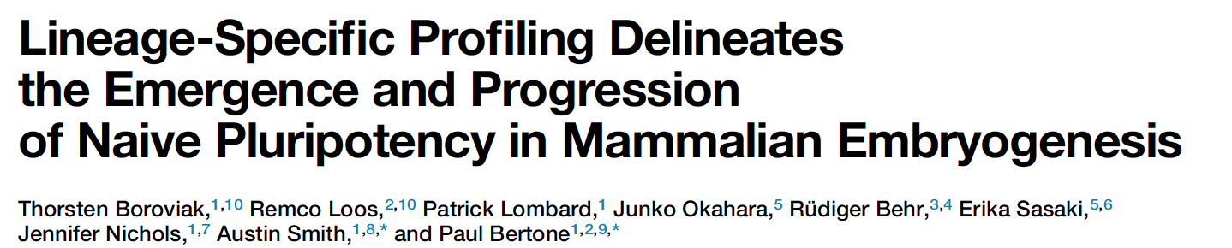
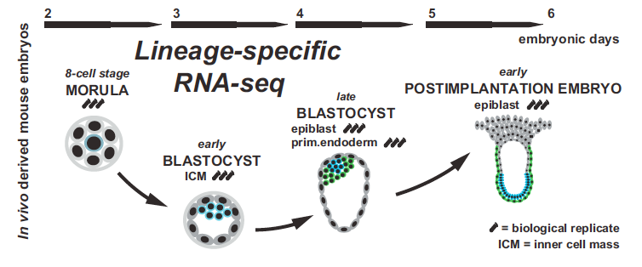
Notes:
Introduce Paper – Go over main claims and take questions

