Slide 1
Multispectral Heart Rate Sensor
MHRS
Motion-robust wearable PPG sensing
Aoke Huang • Ryan Hall
Boston University | EC601
MHRS / EC601 / SPRINT 1
01
Notes:
Hi everyone, we’re Aoke and Ryan, and our project is the Multispectral Heart Rate Sensor, or MHRS. We're investigating ways to improve the reliability of optical heart-rate measurements during movement. Today we'll share our Sprint 1 progress, including our initial signal-processing results.

Slide 2
Mission Statement
For runners who rely on heart-rate data to guide exercise intensity, MHRS is a wearable sensing platform that investigates optical sensing and signal-processing techniques to improve heart-rate measurement reliability during movement.
FOR
HOW
Runners using heart rate to guide exercise intensity
Test wearable sensing and processing approaches that reduce motion-related corruption
The mission may evolve after experimental testing.
MHRS / EC601 / SPRINT 1
02
Notes:
Our target user is a runner who relies on heart rate to guide their workout intensity. The problem is that wrist PPG measurements can become unreliable when the runner moves. Our mission is to test sensing and processing strategies that make heart-rate estimates more robust, rather than assume one technique already solves motion artifacts, thus we get our mission statement of For runners who rely on heart-rate data to guide exercise intensity, MHRS is a wearable sensing platform that investigates optical sensing and signal-processing techniques to improve heart-rate measurement reliability during movement.

Slide 3
What we are building toward
01 Cardio zones
Compare exercise HR with a reference
02 Motion robustness
Identify artifacts and compare to baseline
03 Training history
Save timestamped HR measurements
04 Wearable fit
Record data without being uncomfortable
05 Battery life
Estimate runtime from measured power
Sprint 1 focus: dataset-based heart-rate processing and system feasibility.
MHRS / EC601 / SPRINT 1
03
Notes:
We translated that mission into five user stories. A runner should be able to stay in a target cardio zone, obtain useful measurements while moving, save timestamped heart-rate data for later review, wear the sensor without holding it in place, and use it for reasonable periods without frequent charging. Each story has measurable acceptance criteria, such as comparing readings with a reference or estimating battery runtime. During Sprint 1, we focused especially on data processing and proving our analysis workflow works.

Slide 4
Tools and Reasoning
Python + NumPy / SciPy
Pandas + Matplotlib
Load PPG-DaLiA and filter/estimate HR
Smooth estimates and visualize errors
GitHub + Projects
PPG + MCU + IMU
Track work, review changes, document results
Planned hardware for synchronized optical/motion acquisition
MHRS / EC601 / SPRINT 1
04
Notes:
For analysis, we used Python, NumPy and SciPy to load PPG-DaLiA wrist PPG data, filter the signal, and estimate heart rate. Pandas helps with the outlier rejection and smoothing, and Matplotlib visualizes the comparison with ECG-based reference values. GitHub is where we track our work and document the implementation. Separately, our intended hardware path uses a PPG sensor, microcontroller and motion sensor; that hardware acquisition pipeline is a next step, not a completed result on this slide.

Slide 5
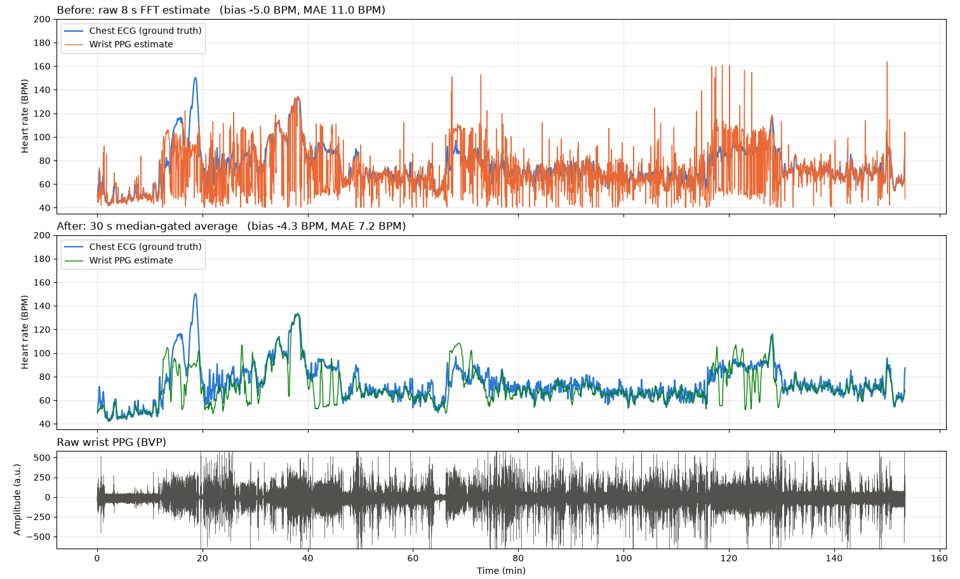
Progress
BEFORE
11.0 BPM MAE
AFTER
7.2 BPM MAE
~35% lower MAE
S1 only • offline smoothing
PPG-DaLiA subject S1 | wrist PPG vs chest ECG | output committed in repository
MHRS / EC601 / SPRINT 1
05
Notes:
This is our main demonstrated result so far. We used subject S1 from the PPG-DaLiA dataset, with wrist blood-volume-pulse recordings and chest-ECG heart-rate labels. We filtered the PPG, divided it into eight-second windows stepping every two seconds, and found the strongest frequency peak in each window to estimate heart rate. The first comparison had a mean absolute error of 11.0 beats per minute. We then applied a median-based outlier gate and moving average to the PPG-derived estimates, without using the reference labels to clean them. That reduced mean absolute error to 7.2 BPM—about a 35 percent decrease for this subject. The important limitation is that this is offline, centered smoothing on just one subject. It demonstrates a working analysis pipeline, not yet real-time accuracy or improved hardware performance.
1. Load recorded wrist PPG and ECG labels
PPG-DaLiA subject S1, wrist PPG sampled at 64 Hz
2. Bandpass-filter the PPG
Keep approximately 0.5–4 Hz components
3. Estimate heart rate using FFT
Analyze 8-second windows, advancing 2 seconds each time
4. Apply outlier rejection and smoothing
15-window (~30-second) median-guided cleaning
5. Compare against ECG reference
Calculate the mean absolute error before and after

Slide 6
What we learned
DATA LESSON
DESIGN LESSON
ECG labels arrive every 2 seconds, but each represents an 8-second window. Correct alignment matters.
Offline smoothing removes isolated spikes, but sustained motion can still mislead the estimator.
Scope decision: prioritize wearable geometry + IMU-based filtering; defer custom optics.
MHRS / EC601 / SPRINT 1
06
Notes:
Two findings changed our approach. First, timing alignment is essential: the ECG-derived labels are provided every two seconds, where if you incorrectly align labels to PPG measurements, you can create artificial differences between the signals and miscalculate error. Second, smoothing can remove isolated bad estimates, but it cannot reliably distinguish a sustained movement frequency from the actual pulse such as if there was repetitive arm movement which could be misidentified as the pulse. It also smooths away some rapid heart-rate changes, and our centered implementation uses future data. So instead of jumping directly into custom optics, we’re prioritizing a reproducible baseline, synchronized motion sensing, and a clearer experimental design.

Slide 7
Sprint 2 and Next Steps
DEMO GOAL
PRIORITIES
Show a reproducible heart-rate processing baseline and an initial sensor acquisition path, with the hardware status demonstrated rather than assumed.
1. Lock components and architecture
2. Test PPG + IMU acquisition
3. Define ECG-reference protocol
4. Plan 2×2 geometry × filtering study
Main risk: hardware integration and synchronized sensor streams.
Help needed: feedback on reference setup and feasible test protocol.
MHRS / EC601 / SPRINT 1
07
Notes:
In Sprint 2, our goal is to demonstrate both a reproducible heart-rate processing baseline and an initial path for acquiring sensor measurements. We’ll lock down the hardware architecture, test PPG and IMU acquisition, define a reference measurement protocol, and plan a small study comparing sensor geometry and filtering. Our biggest risk is reliably synchronizing streams from the sensors. We’d especially appreciate feedback on a feasible reference setup and a controlled protocol we can complete within the semester. Thank you!

