Slide 1

Mid-Project Update
AML 3103
Neural Networks and Deep Learning
Presented by :
Ryan - c0946432
Eduardo - c0943861
Hetvi - c0954042
Sandhya - c0956298

Slide 2
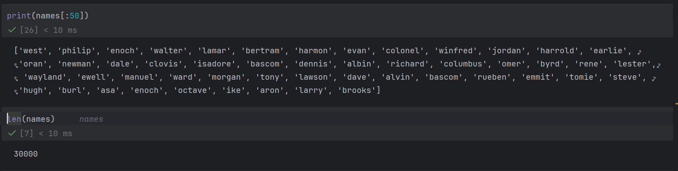
Dataset Overview
Names Count
We initially worked with ~6,779 names and later expanded the dataset to ~30,000 names.
The larger corpus helps the model see more spelling patterns and improves generalization when generating new names.
Data Preprocessing
Names are treated as lowercase character sequences.
We focus on the letters a–z and map everything into a clean character-level representation for modeling.
Character Set
Our vocabulary has 27 symbols: the 26 lowercase letters a–z plus a special "." token that marks the start/end of a name.
2

Slide 3
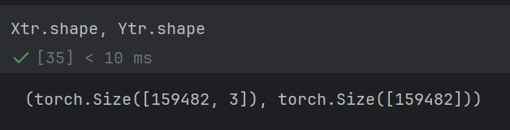
Context Encoding (Input–Target Pairs)
Context Windowing
We use a context window of 3 characters.
For each position in a name, the previous 3 characters form the input, and the next character is the target label.
Encoded Dataset Size
After encoding the ~30,000 names, we obtain around 199k (input, target) pairs.
Each input has shape (3,) (three character indices), and each target is a single index.
Train / Dev / Test Split
We shuffle the names and split them 80% / 10% / 10%.
For each split, we build (X, Y) tensors, giving Xtr, Ytr, Xdev, Ydev, and Xte, Yte.
Why Context Helps
This context-based encoding lets the model learn short-range dependencies between characters instead of predicting each letter independently.
3

Slide 4
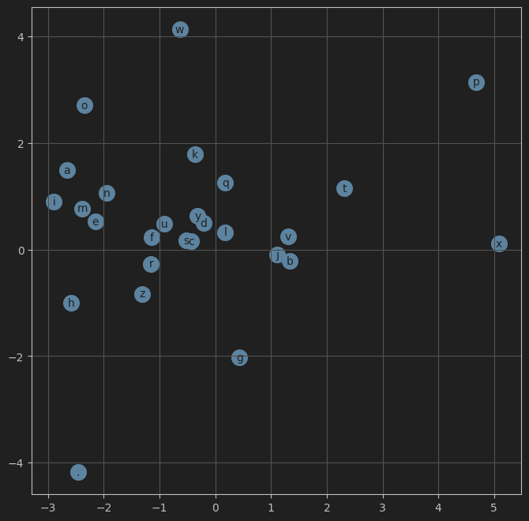
Neural Network Model
Embeddings
Context Size
Each character is mapped to a 10-dimensional embedding vector, allowing the model to learn relationships between characters.
We use a context window of 3 characters, so the network sees the last 3 characters when predicting the next one.
MLP Structure
Tanh Activation
Our model is a 2-layer MLP with:
• Input: 3 × 10 = 30-dim vector
• Hidden layer: 200 neurons with Tanh activation
• Output: 27 logits (one per character in the vocabulary)
The Tanh activation introduces non-linearity, allowing the network to learn richer patterns over character sequences.
Output Logits
The model predicts logits, which are converted to probabilities using softmax during loss computation.
4

Slide 5
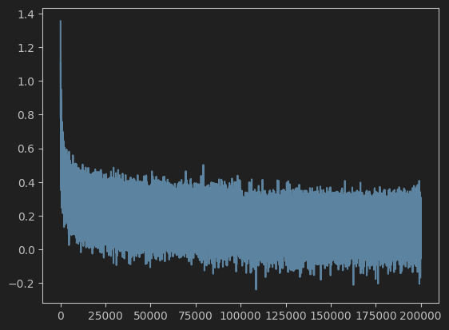
Training the MLP Model
Cross-entropy Loss
We use cross-entropy loss to compare the predicted logits against the true next-character label.
Mini-batch SGD
We train using mini-batches (size 32 in our code), which makes training faster and more stable than full-batch updates.
Learning Rate
We started with a learning rate of 0.1 for rapid early learning,
then reduced it to 0.01 once the loss began to plateau.
With the larger ~30k-name dataset, the smaller learning rate helped stabilize training and avoid overshooting while still converging.
Loss Decreases
The training loss decreases steadily over ~200k steps, and the dev loss stays close to the train loss, confirming that the model is learning meaningful name patterns without severe overfitting.
Activation Diagnostics
We visualized the histograms of the Tanh activations. Initially, we observed "saturation" (peaks at -1 and 1), which causes the vanishing gradient problem. This required fixing our weight initialization.
5

Slide 6
Part 3: Optimization & Network Dynamics
Fixing Initialization ("The Hockey Stick" Loss)
Problem: With random weights, the initial loss was ~18.6, far higher than the expected uniform loss of ~3.3. This resulted in a "hockey stick" loss curve where the model wasted early epochs just squashing weights down.
Solution: We scaled the output layer weights (W2) to be near-zero and biases (b2) to zero. This ensured the model started with a uniform prediction distribution.
Kaiming Initialization (He Init)
Problem: Standard Gaussian initialization caused the variance of activations to shrink or explode deeper in the network.
Solution: We implemented Kaiming Initialization (scaling weights by gain / sqrt(fan_in)).
Result: This keeps the variance of activations stable throughout the network, preventing the Tanh neurons from becoming "dead" (saturated).
Batch Normalization
Implementation: We inserted a BatchNorm1d step before the non-linearity.
Mechanism: This standardizes the hidden layer inputs to have a mean of 0 and variance of 1, then scales/shifts them using learned parameters (bngain, bnbias).
Benefit: This stabilized training significantly and removed the strong dependency on perfect weight initialization.
6

Slide 7
Project Summary
Dataset
Context-Based Encoding
Neural Model
We expanded the dataset from ~6,000 to ~30,000 names, providing a stronger foundation for training.
We encode each name into many training examples of
(3-character context → next character),
giving us ~159k training pairs plus separate dev and test splits.
The character-level MLP now includes Batch Normalization and Kaiming Initialization. It processes 3-character contexts using embeddings and a 200-neuron hidden layer to generate names with improved training stability.
Next Steps
Challenges
With the network dynamics stabilized via Batch Norm, the next phase (Part 4) will focus on Manual Backpropagation. We will manually calculate gradients to gain a mathematical understanding of the backward pass, verifying our work against PyTorch's autograd.
Managing variable name lengths during context windowing
Ensuring correct tensor shapes for embeddings, logits and loss
Handling out-of-range characters and cleaning the dataset
Maintaining training stability while tuning learning rate and other hyperparameters
7

