Slide 1
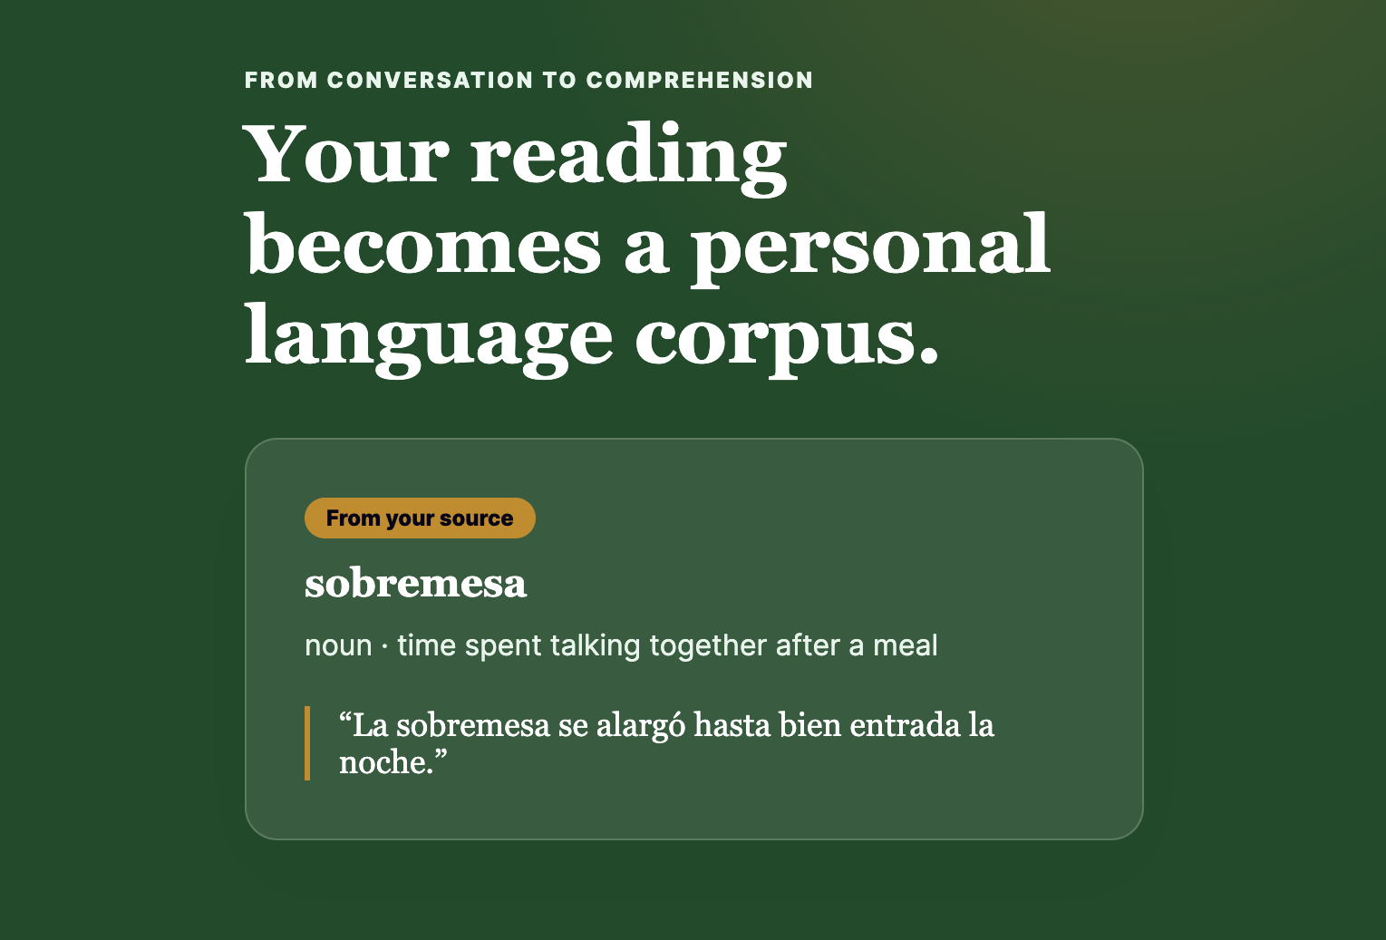
LOQUELA / FIELD GUIDE
A current-state
walkthrough.
From everyday content to structured practice.
Source → lookup → card → deck → practice
PORTFOLIO CASE STUDY · 2026
Notes:
[Sources]
No web sources used. Sample UI screens are generated from the current Loquela frontend and portfolio context. User-provided product screenshots are cited in the slide notes where used.
The cover visual is a user-provided Loquela contextual-learning graphic.

Slide 2
LQ
LOQUELA / FIELD GUIDE 02 / 10
THE IDEA
The loop is simple: capture, understand, keep, revisit.
Loquela turns a moment from real content into something you can return to later.
01
02
03
04
Capture
→
Understand
→
Keep
→
Revisit
Bring in a video, document, or pasted passage.
Look up the word in the context where it appeared.
Save the definition, example, and source provenance.
Practice the cards now or export them to Anki.
02
A single word can move from real content into lasting practice.
Notes:
[Sources]
No web sources used. Sample UI screens are generated from the current Loquela frontend and portfolio context. User-provided product screenshots are cited in the slide notes where used.
This slide is intentionally screenshot-free: it gives the audience the mental model before the product tour begins.

Slide 3
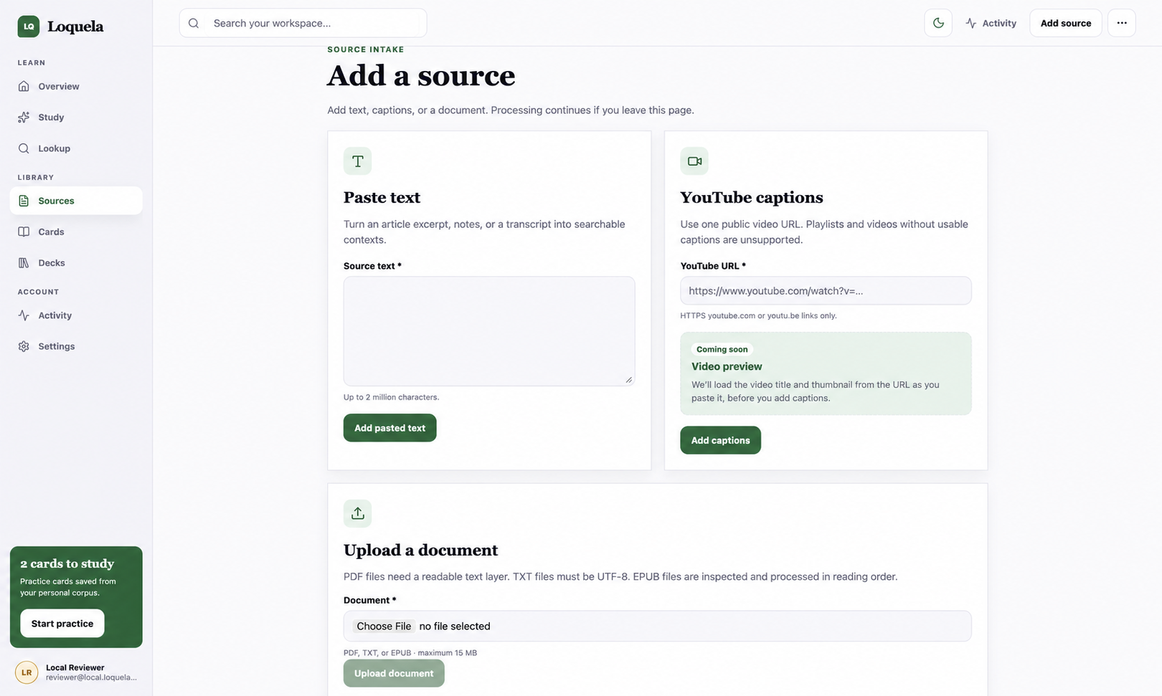
LQ
LOQUELA / FIELD GUIDE 03 / 10
SOURCES
Start with the content you already have.
Ingest a source once, then use it as searchable context later.
REAL SCREENSHOT / ADD A SOURCE
03
Current intake paths: pasted text, YouTube captions, and PDF / TXT / EPUB upload.
Notes:
[Sources]
No web sources used. Sample UI screens are generated from the current Loquela frontend and portfolio context. User-provided product screenshots are cited in the slide notes where used.
This slide uses the user-provided Add a source screenshot at full width so the three intake paths remain legible.

Slide 4
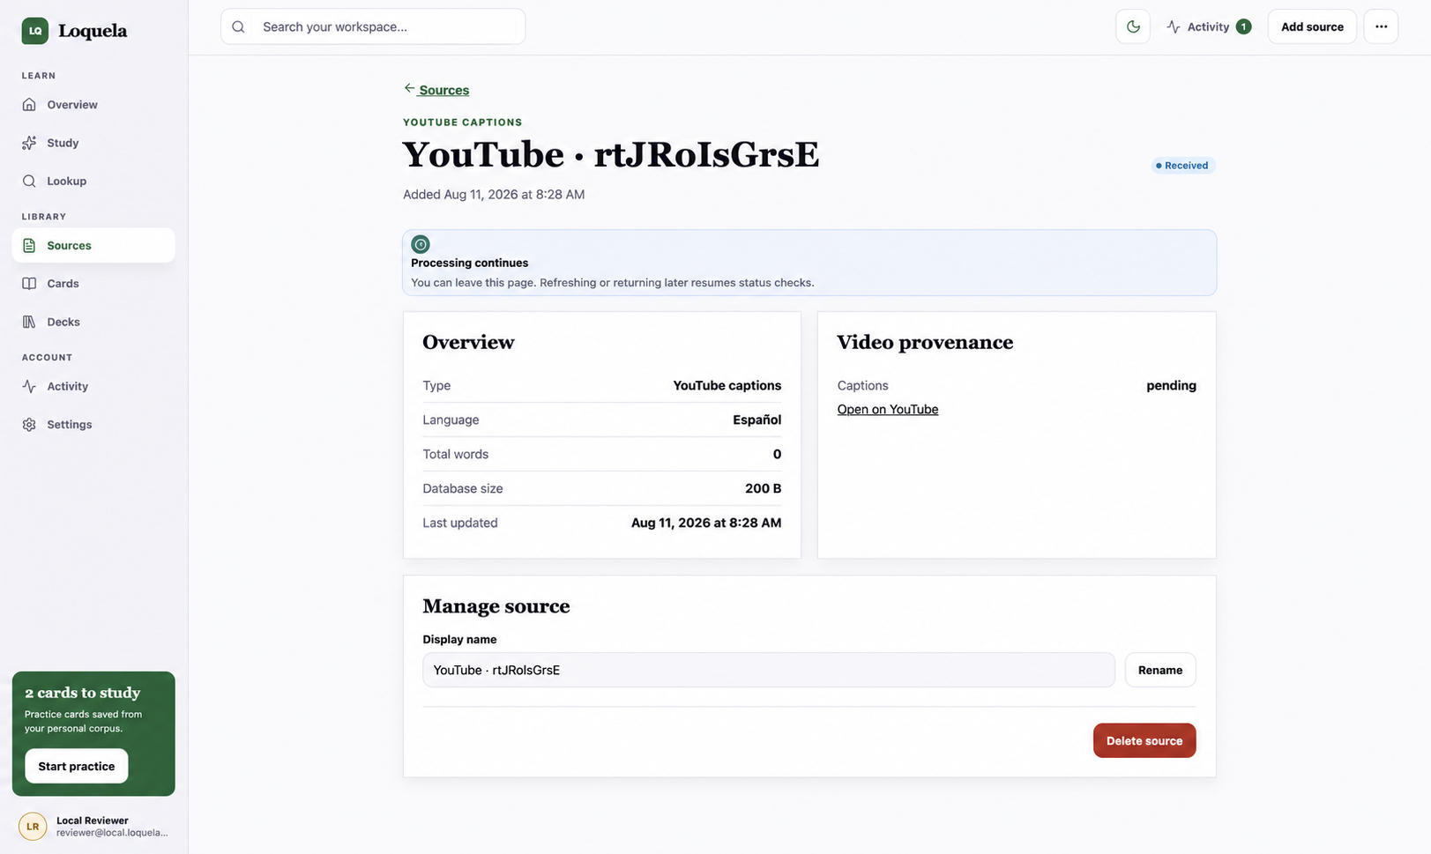
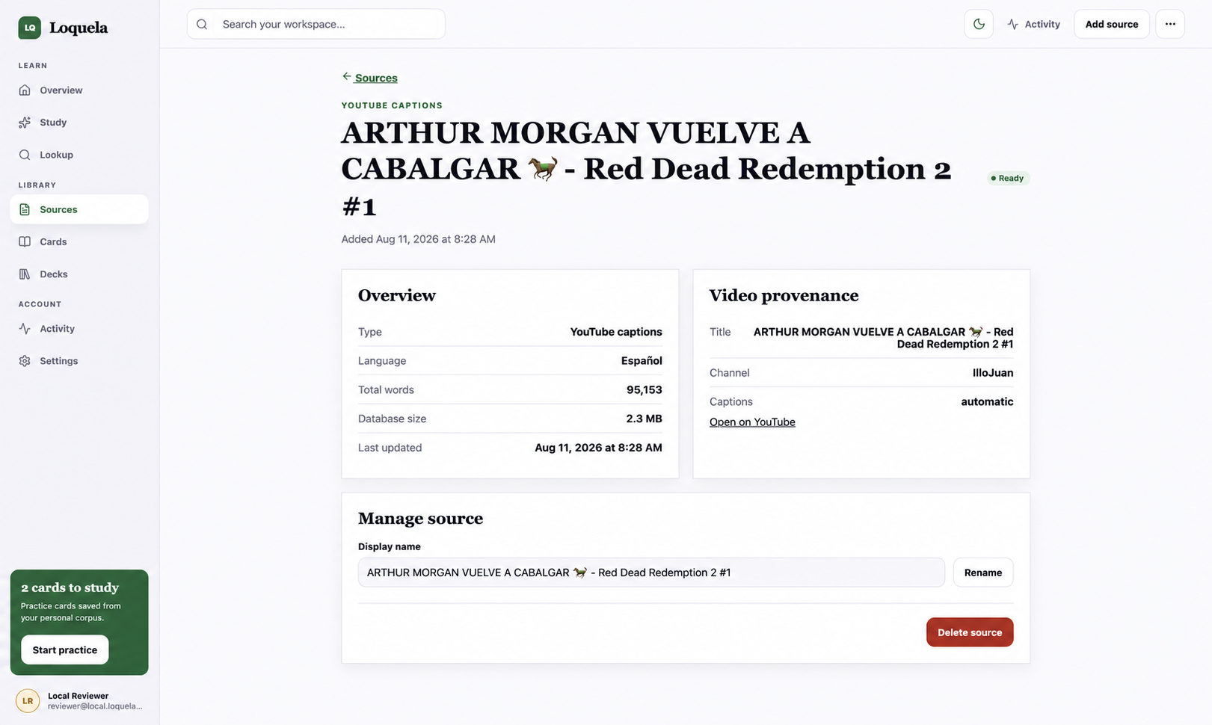
LQ
LOQUELA / FIELD GUIDE 04 / 10
SOURCES
Follow the source to ready.
Leave the page while ingestion continues, then return when the source is searchable.
REAL SCREENSHOT / PROCESSING CONTINUES
REAL SCREENSHOT / READY TO SEARCH
Processing continues in the background. Leave the page and return when the source is ready.
Once ready, the source exposes its language, word count, provenance, and searchable content.
04
The source lifecycle is now readable as a sequence: add → process → search.
Notes:
[Sources]
No web sources used. Sample UI screens are generated from the current Loquela frontend and portfolio context. User-provided product screenshots are cited in the slide notes where used.
This slide uses the user-provided processing and ready source screenshots side-by-side as the second half of the ingestion story.

Slide 5
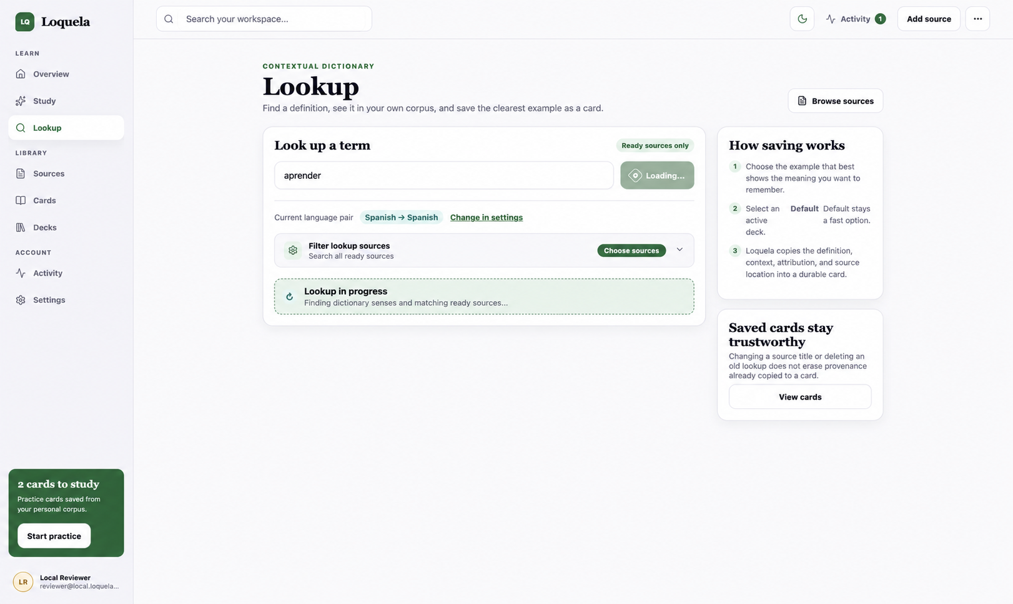
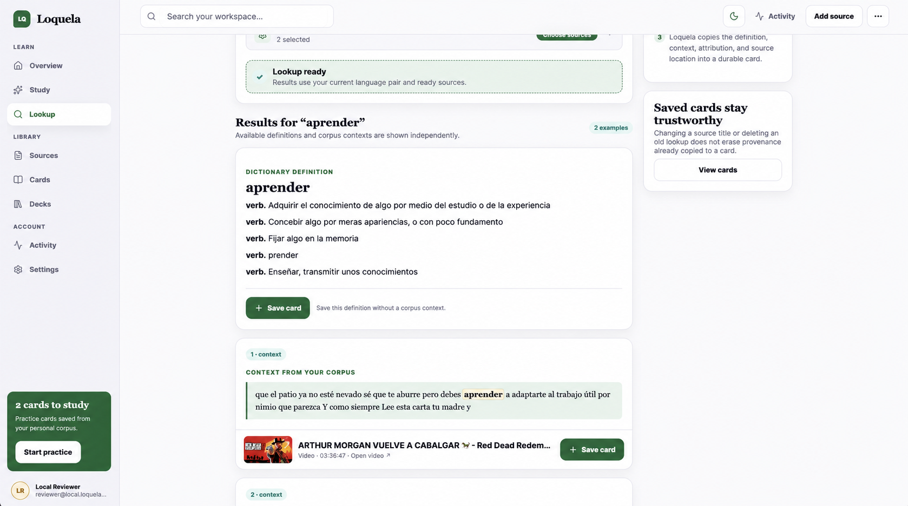
LQ
LOQUELA / FIELD GUIDE 05 / 10
LOOKUP
Look up a word where you found it.
Search, inspect the definition, and compare it with context from your sources.
REAL SCREENSHOT / LOOKUP IN PROGRESS
REAL SCREENSHOT / LOOKUP RESULTS
The request starts with a language pair and ready-source filter.
The result combines dictionary senses, corpus context, provenance, and Save card actions.
05
Here, Loquela looks up aprender inside the source corpus.
Notes:
[Sources]
No web sources used. Sample UI screens are generated from the current Loquela frontend and portfolio context. User-provided product screenshots are cited in the slide notes where used.
The previous three-panel placeholder layout was replaced with two readable, user-provided lookup captures: loading and results.

Slide 6
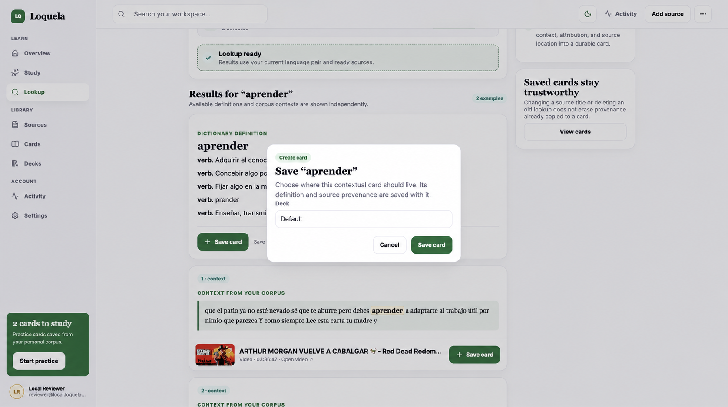
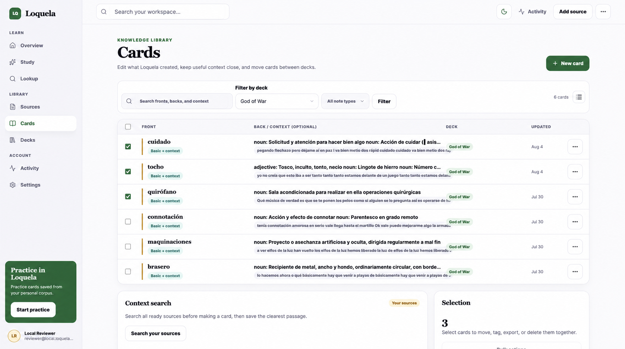
LQ
LOQUELA / FIELD GUIDE 06 / 10
CARDS
Save the useful insight as a card.
A card keeps the word, meaning, context, and destination deck together.
REAL SCREENSHOT / SAVE CARD
REAL SCREENSHOT / CARD LIBRARY
Choose a destination deck before saving the definition and context.
Saved cards retain the front, back/context, deck, and provenance for later editing.
06
The lookup becomes durable study material instead of a one-off definition.
Notes:
[Sources]
No web sources used. Sample UI screens are generated from the current Loquela frontend and portfolio context. User-provided product screenshots are cited in the slide notes where used.
The user-provided Save card modal and Cards library captures replace the two sample placeholders.

Slide 7
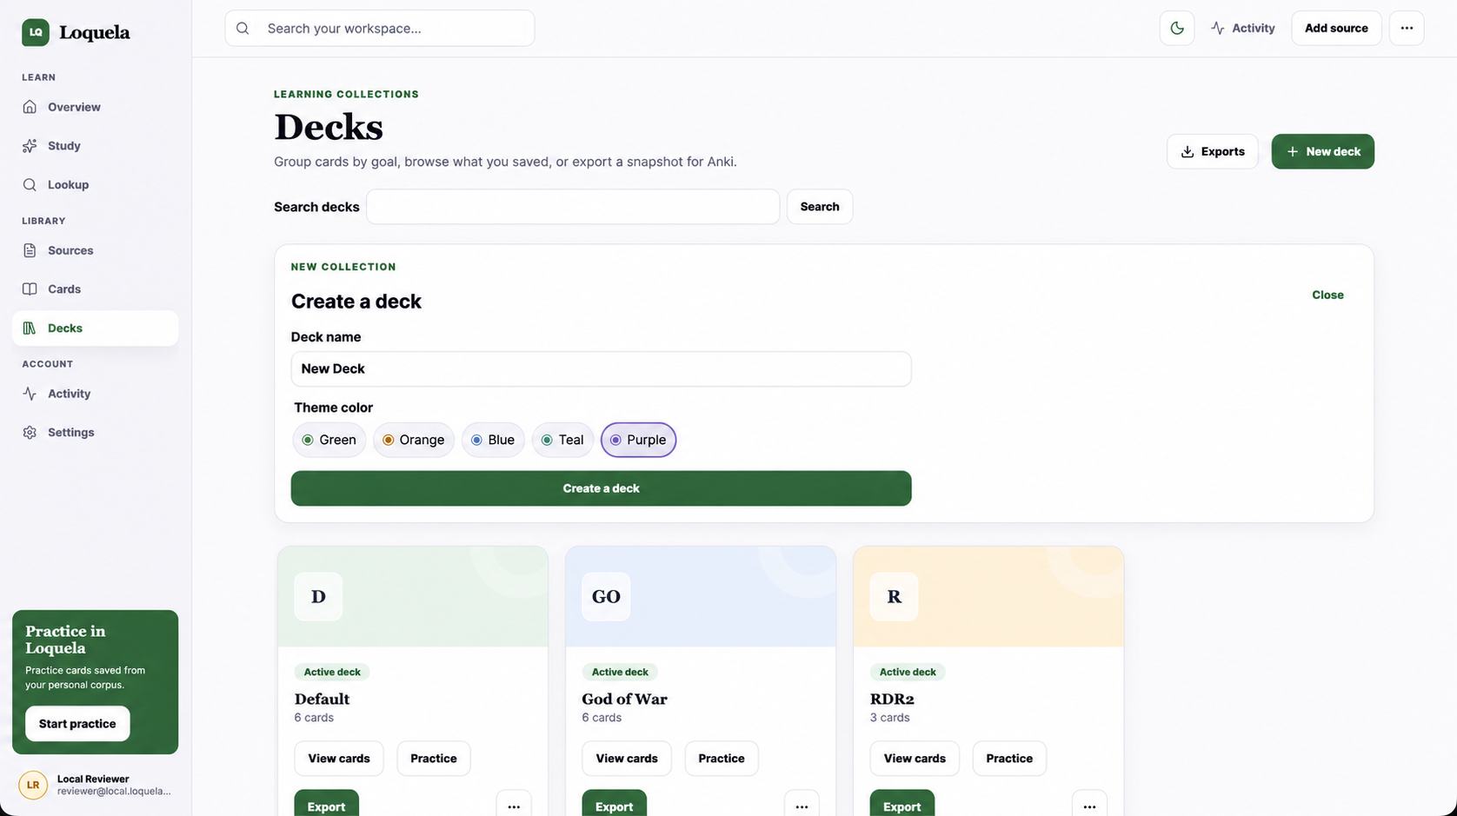
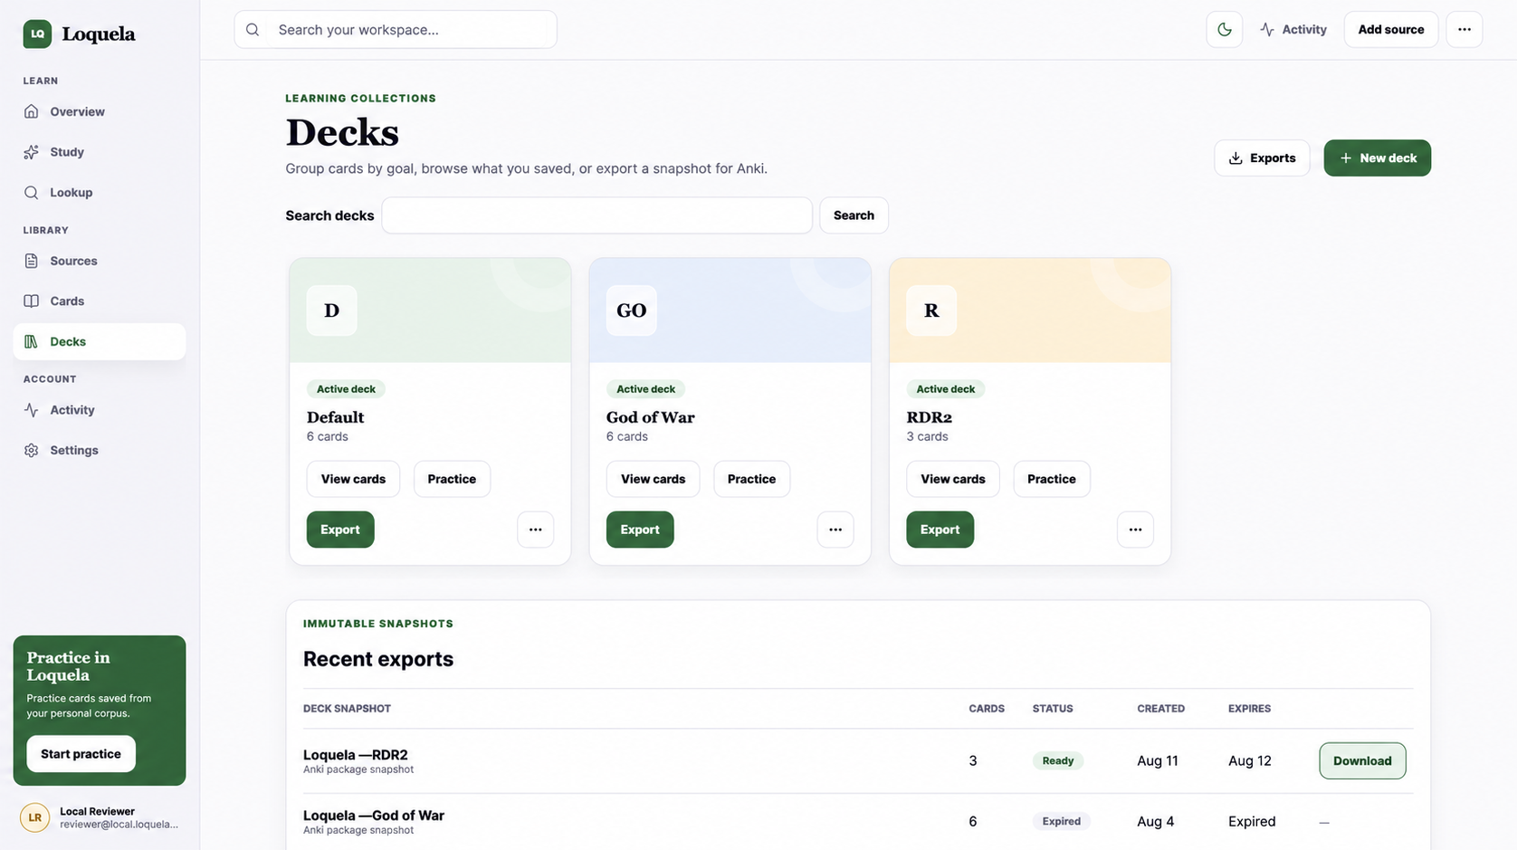
LQ
LOQUELA / FIELD GUIDE 07 / 10
DECKS
Give cards a home, then export it.
Decks organize the material by goal and create the handoff point to Anki.
REAL SCREENSHOT / CREATE AND ORGANIZE DECKS
REAL SCREENSHOT / EXPORT AND DOWNLOAD
Create a deck, choose a theme, and see its cards in the library.
Export a deck snapshot as an Anki package and download it from Recent exports.
07
Two larger captures keep creation, organization, and the export handoff legible.
Notes:
[Sources]
No web sources used. Sample UI screens are generated from the current Loquela frontend and portfolio context. User-provided product screenshots are cited in the slide notes where used.
The three narrow placeholders were consolidated into two larger user-provided captures: deck creation/library and exports/download.

Slide 8
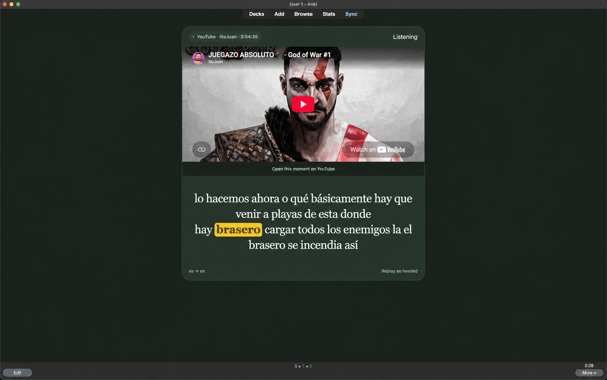
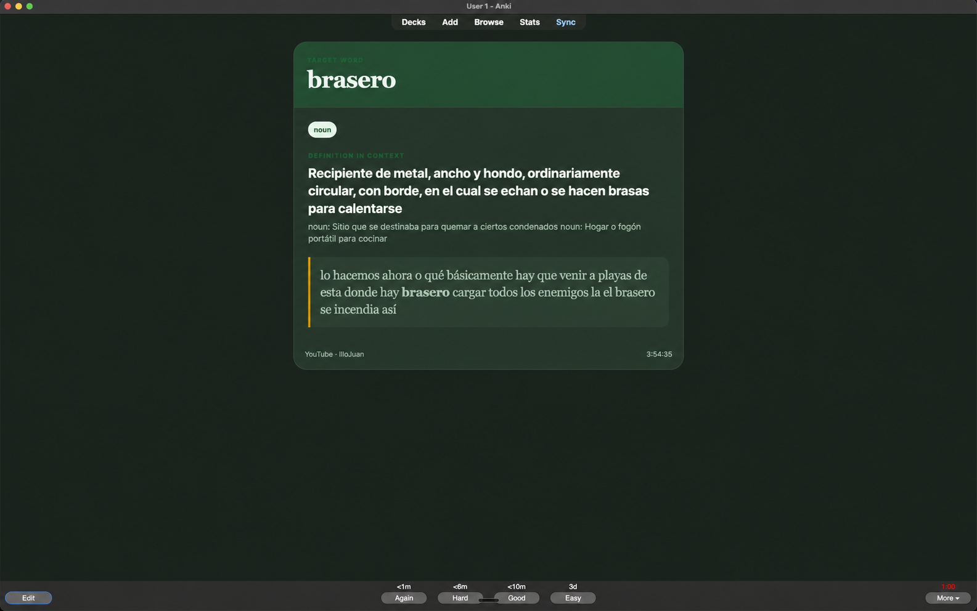
LQ
LOQUELA / FIELD GUIDE 08 / 10
ANKI
See the card exactly as Anki will receive it.
The exported deck makes the workflow portable beyond Loquela.
REAL SCREENSHOT / ANKI FRONT
REAL SCREENSHOT / ANKI BACK
Front: recall the target word from the source context.
Back: reveal the definition, context, source, and timestamp.
08
Anki receives a portable front/back card with source context preserved.
Notes:
[Sources]
No web sources used. Sample UI screens are generated from the current Loquela frontend and portfolio context. User-provided product screenshots are cited in the slide notes where used.
The user-provided Anki front and back screenshots replace the sample placeholders on the export payoff slide.

Slide 9
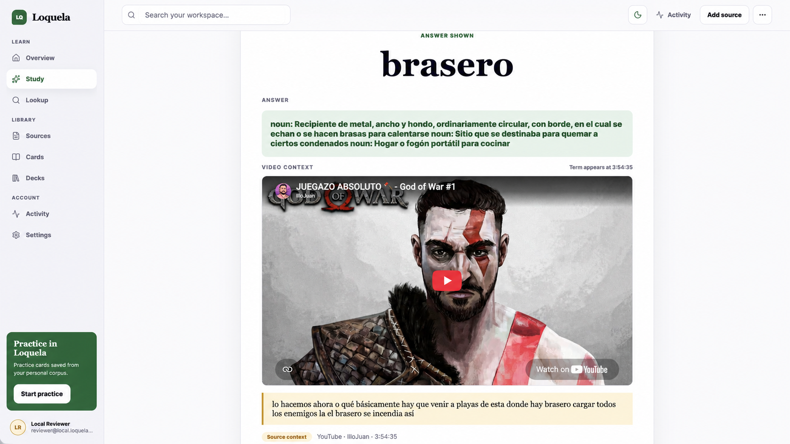
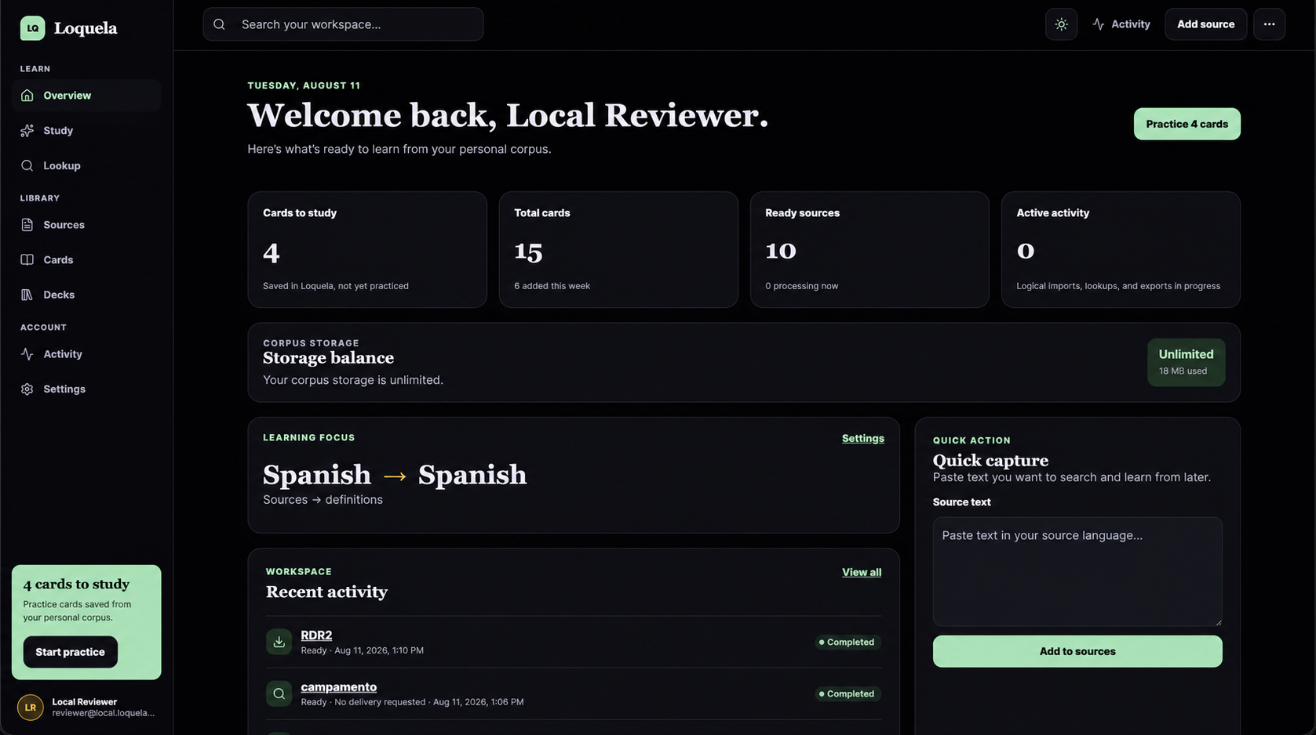
LQ
LOQUELA / FIELD GUIDE 09 / 10
PRACTICE
Practice brings the loop back to memory.
Keep the final slide focused on the simple practice experience, with dark mode as a small aside.
REAL SCREENSHOT / LOQUELA CARD / ANSWER SHOWN
REAL SCREENSHOT / DARK MODE
CURRENT STATE
Simple practice only — ratings do not change Anki scheduling.
09
Loquela turns the content you already care about into practice you can return to.
Notes:
[Sources]
No web sources used. Sample UI screens are generated from the current Loquela frontend and portfolio context. User-provided product screenshots are cited in the slide notes where used.
The user-provided Loquela answer-state screenshot is the primary practice visual. The dark-mode dashboard is intentionally secondary, as requested.

Slide 10
LQ
LOQUELA / FIELD GUIDE 10 / 10
ACCESS
A note on access
CURRENT ACCESS
Loquela is still being tested.
Invite only
Access is currently whitelisted and invite-only for certain email addresses while the product is in testing.
Whitelisted email addresses
while testing continues
This deck documents the current experience — not yet a public release.
10
10
For portfolio viewers: invite access can be shared selectively during the testing phase.
Notes:
[Sources]
No web sources used. Sample UI screens are generated from the current Loquela frontend and portfolio context. User-provided product screenshots are cited in the slide notes where used.
This closing slide is based on the portfolio project note that Loquela is currently invite-only while it is being tested.

