Slide 1
Classifying Musical Genre from Lyrics.com
Springboard Capstone Project
By Ryan Swan

Slide 2

Genre Classification
As of May 2019, 40,000 music tracks uploaded daily to Spotify
Classification and characterization of these tracks is necessary for presenting them to listeners
Genre is the most commonly used classification by both listeners and industry professionals

Slide 3

Lyrics.com
Online database of user-submitted lyric data across many genres and languages
Scraped dataset comprises 1.5 million songs
150,000 songs with annotated genre
20,000 songs with annotated tag information
Data is structured but poorly curated
Contains duplicates (ie “Covers”, “Reissues”)
Data is subject to misspelling or misattribution

Slide 4
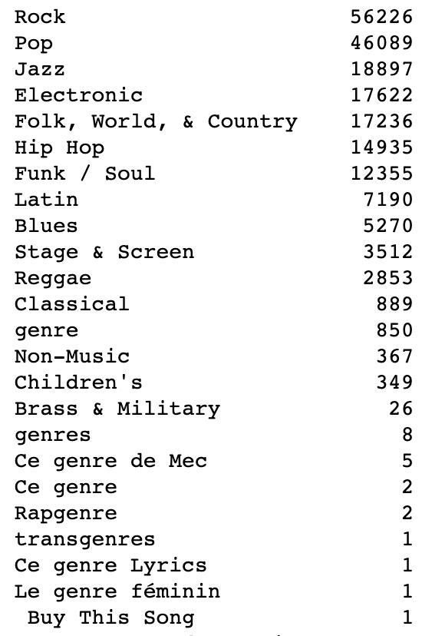
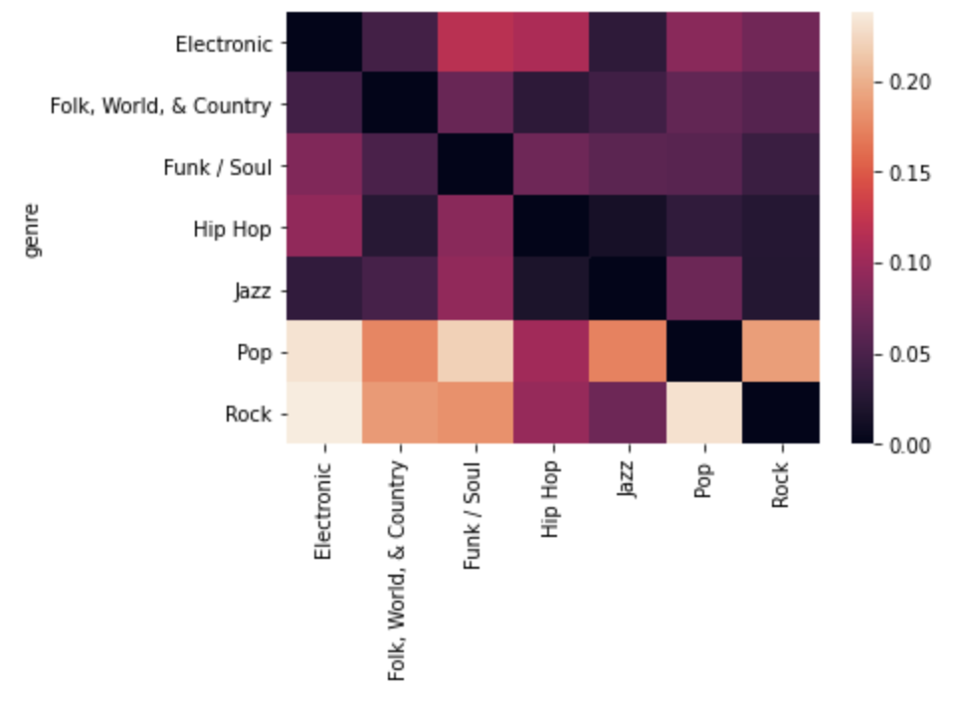
Exploratory Analysis
Singly-tagged genres
Overlap in multiple-tagged genres
Many genres are represented, but only seven have more than 10,000 examples.
Rock and Pop are the most highly represented genres and also the most highly intermixed

Slide 5
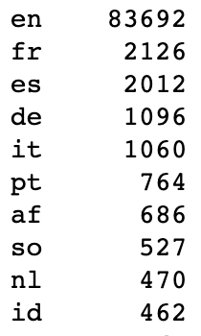
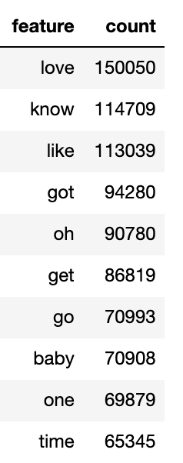
Linguistic Features
Most Common Languages
Most Common English Words
English is by far the most highly represented language in the data set
The most common words in the dataset after elimination of stopwords reflect fairly common phrases and verbs

Slide 6
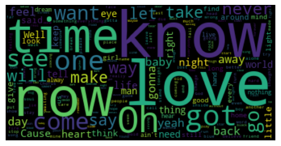
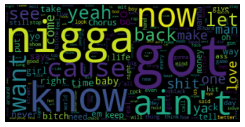
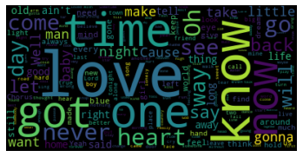
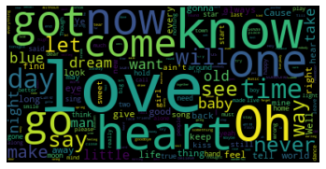
Word Clouds
Rock
Hip Hop
Word clouds capture the most common words and phrases within each musical genre
Even from a cursory view, Hip Hop appears the most distinct
Folk
Jazz

Slide 7
Data Cleaning
Focus on:
150,000 tracks with genre data
Hip Hop, Folk, and Electronic genres
English-language tracks
Duplicates detected via heuristic
Lyric data sorted by track title
Blocks of 20,000 tracks selected
Cosine similarity computed (80% threshold)
Oldest match retained (original entry)
Resulting data represents 40,000 tracks
97% reduction over full 1.5 million tracks!

Slide 8
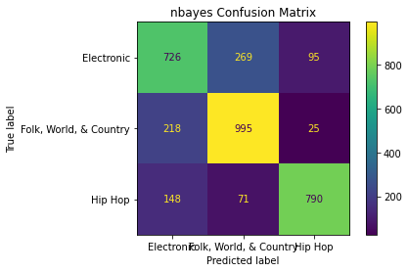
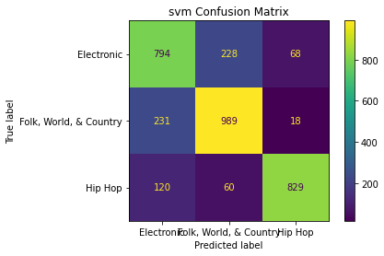


Classification
XGBoost performance was the most effective
Separation of Folk and Electronic was more difficult than Hip Hop

Slide 9
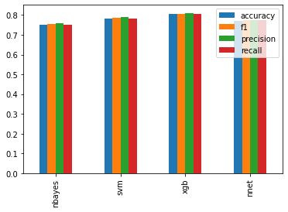
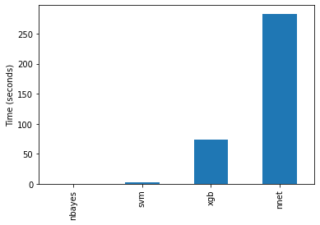
Resource Usage
While most models performed similarly, there are large differences in training time
SVM may make up for its slightly lower accuracy with better efficiency

Slide 10
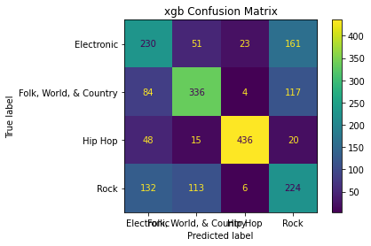
Addition of Rock Genre
Despite being the most highly represented genre, Rock is the most difficult to classify
Introduction of Rock decreases classification accuracy of other genres
Rock may represent an uninformative label or a grouping of several distinct subgenres

Slide 11

Questions?
Thank you!

