Slide 1
Genre Classification in the Free Music Archive
Springboard Capstone Project
By Ryan Swan

Slide 2

Genre Classification
As of May 2019, 40,000 music tracks uploaded daily to Spotify
Classification and characterization of these tracks is necessary for presenting them to listeners
Genre is the most commonly used classification by both listeners and industry professionals

Slide 3
Free Music Archive
Freely available library including
Artist metadata
Audio features (Librosa, Echonest)
Audio files
Geocoordinate data
100,000 tracks with data

Slide 4
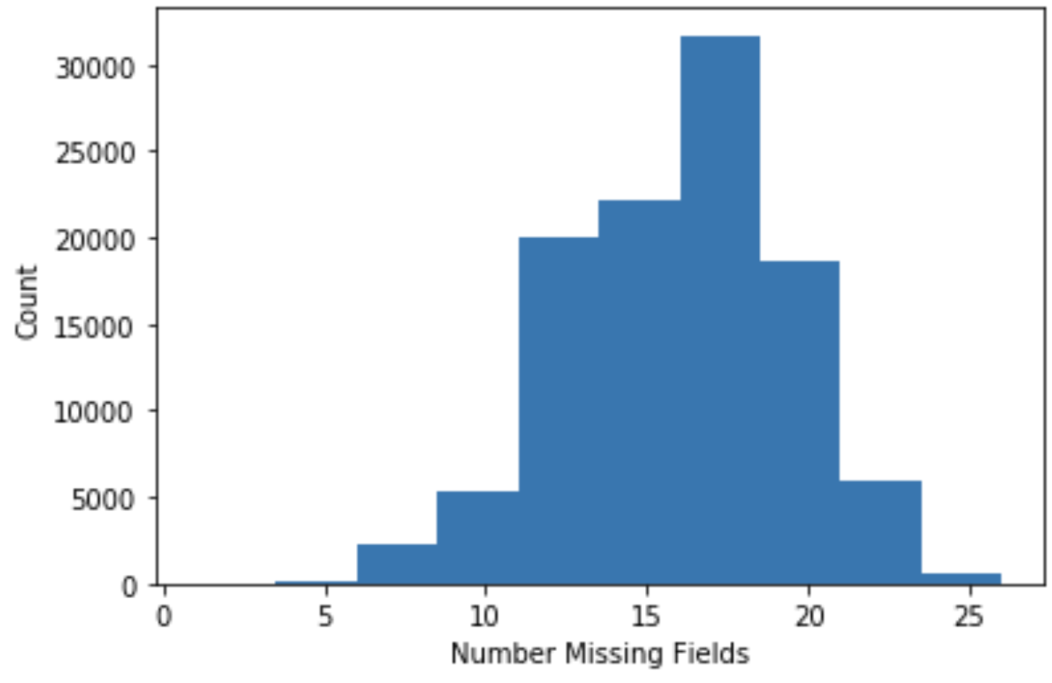
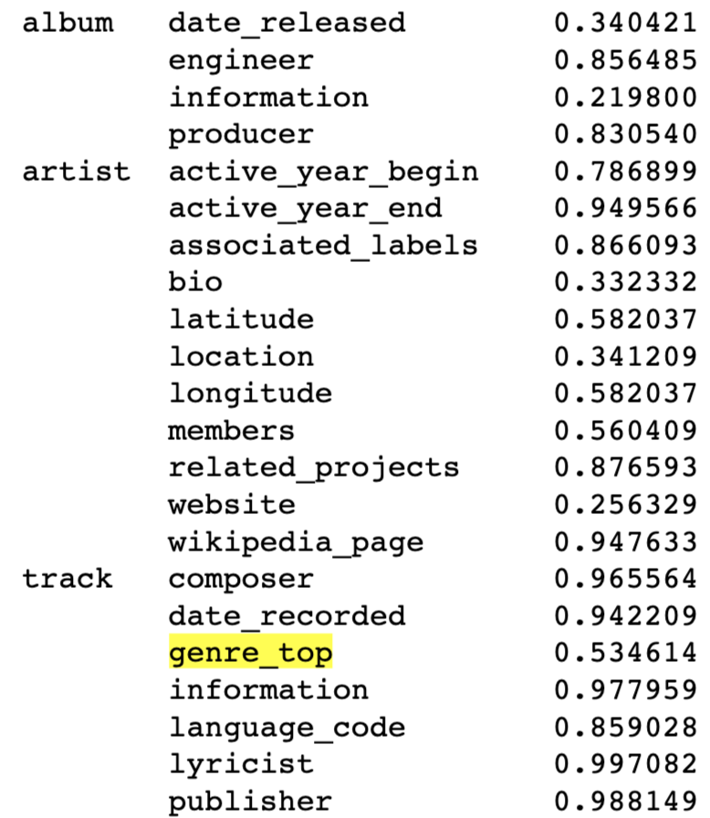
Data Consistency
Notes:
Despite the large size of the FMA, there is a large amount of missing information.
Decided to exclude instead of impute.
Per-row missing fields seemed normally distributed, giving some credence to assume that these missing fields are randomly distributed.

Slide 5
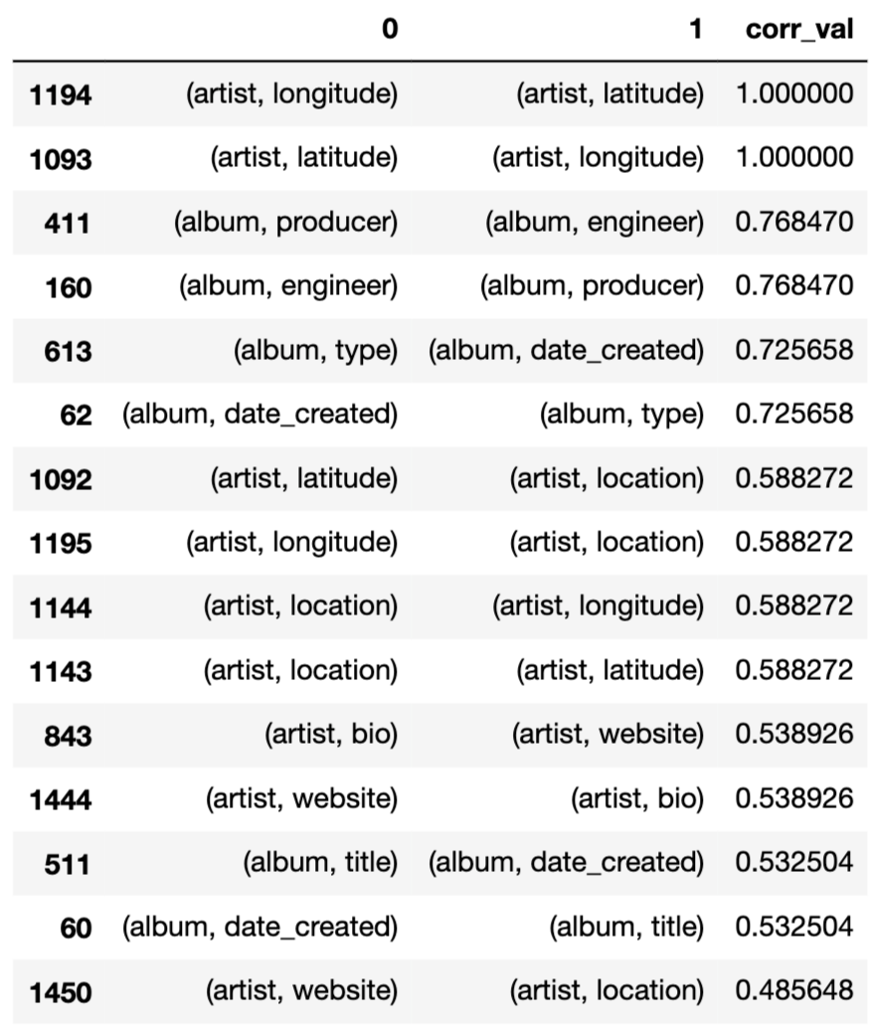
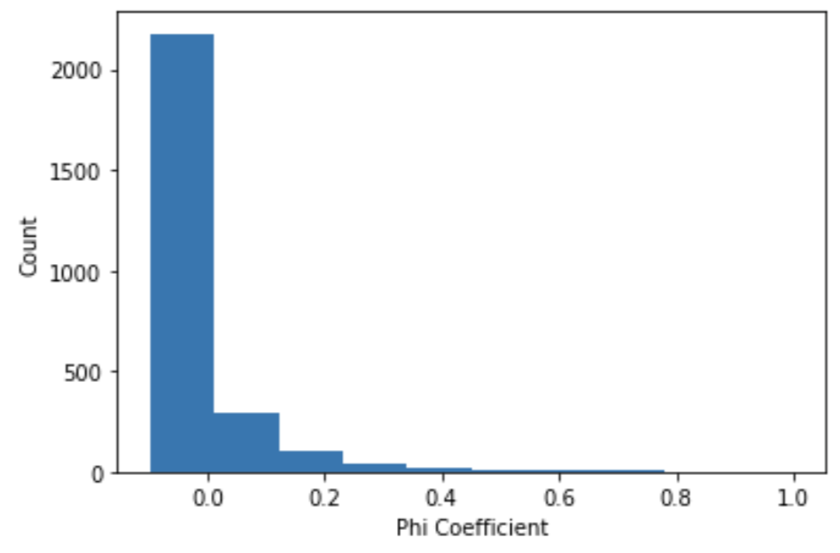
Data Consistency
Notes:
The most highly correlated missing features were expected – long/lat for example.
Most combinations of features were not correlated for missingness

Slide 6
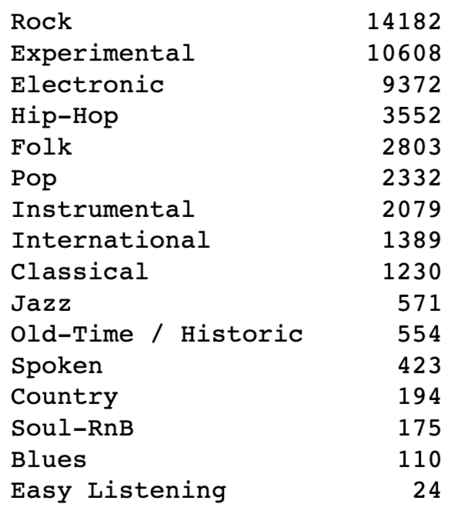
Genre Breakdown
Considered tracks with only one genre tag (approx. 45,000 tracks)
Narrowed focus for analysis to top three genres
Rock
Experimental
Electronic

Slide 7
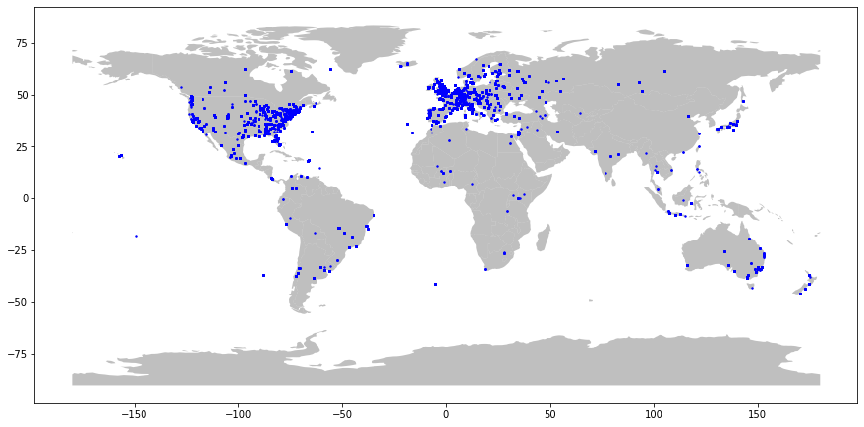
Geographic Analysis
Notes:
Geocoordinates allow EDA of physical distribution of artists
International data skewed to North America and Europe
Other continents underrepresented (call out Japan, Mexico)

Slide 8
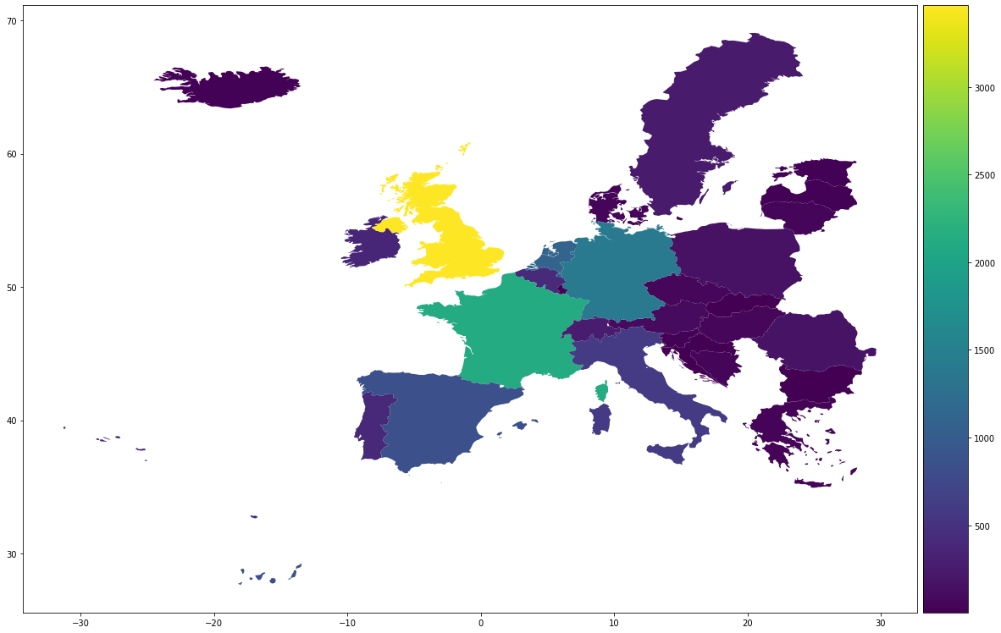
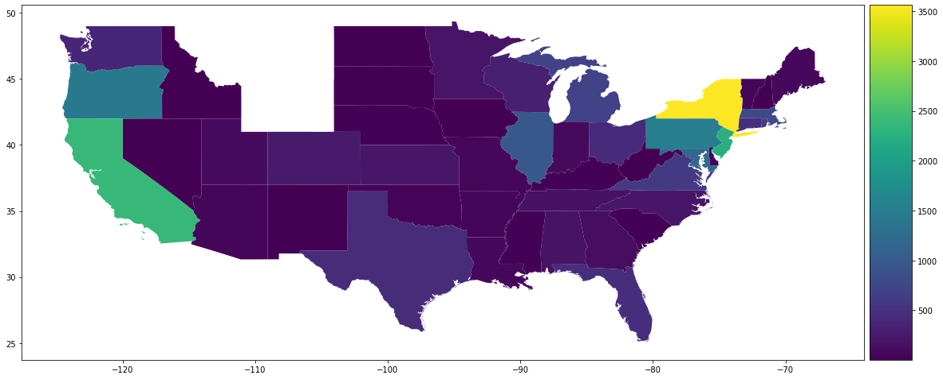
Geographic Analysis
Notes:
Point out population centers
Oregon Netherlands overrepresented

Slide 9
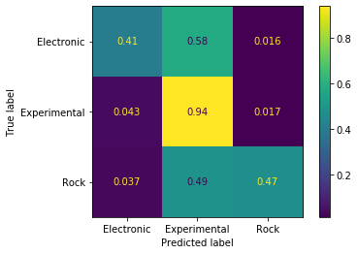
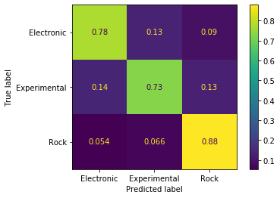
ML: Genre Classification
SVM
Neural Net

Slide 10
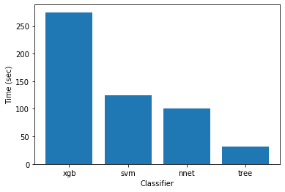
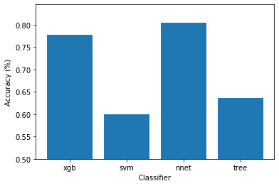
Training Time vs. Accuracy

Slide 11
Hyperparameter Tuning
GridCV with 5-fold cross validation to evaluate:
Hidden layer size
Alpha
Activation function
Solver
Learning rate
Max iterations to converge
Max Accuracy: 80%

Slide 12


Questions
Thanks!

