Slide 1
Ryan’s Super Fun Report That He Definitely Put A Lot of Time and Effort Into

Slide 2
Demonstration Report for Malvankar IW 2018
If you wish, you may copy this demonstration and insert your own content.

Slide 3
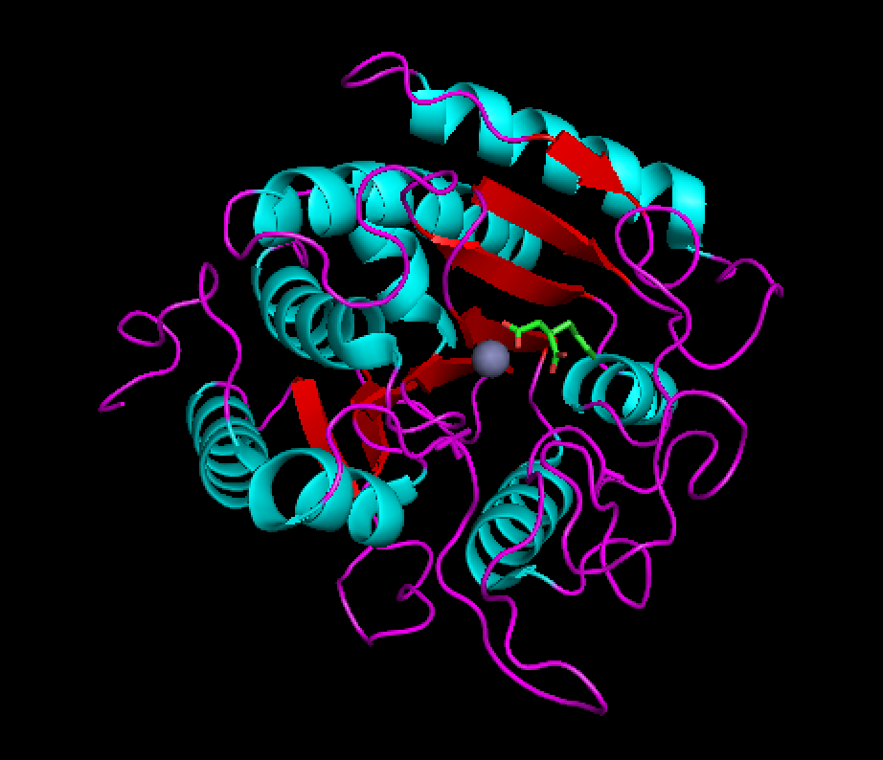
Section 1: Identity. Report for Malvankar IW 2018
Ryan Nguyen
Major: BQBS, first year
1CBX
Human carboxypeptidase complexed with benzylsuccinate and a Zinc ion.
Involved in peptide hydrolysis, secreted by pancreas; mutations implicated in chronic pancreatitis .
X-ray crystallography, resolution 2.0 Ångstroms.

Slide 4
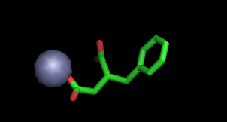
Section 2: Composition
Protein chains: 1
DNA chains: 0
RNA chains: 0
Ligands
BZS: Benzylsuccinate and Zinc Ion
Non-Standard Residues
(None)
Zn^{2+,} O, C

Slide 5
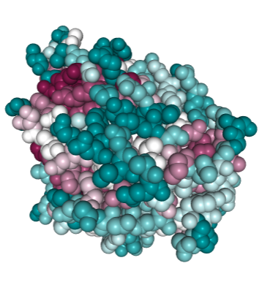
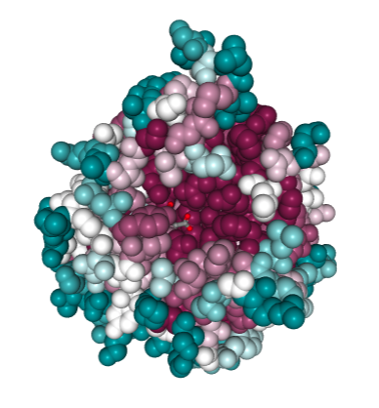

Section 3A: Evolutionary Conservation
http://consurf.tau.ac.il/results/1539920870/output.php
The ligand-binding side is much more conserved than the opposite side. In addition, residues in the core of the protein are more conserved.
Side not binding ligand.
Side binding ligand.

Slide 6
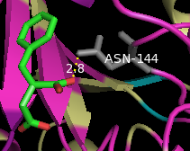
Section 3B: Evolutionary Conservation.
Conservation of N144 and contact with BZS.
Asparagine 144 is identified as the grey residue. Consurf indicates that this residue is highly conserved. Its carboxamide is 2.8 angstroms away from the Oxygen of the BZS, which implicates hydrogen bonding as an evolutionary pressure of maintaining this conservation.

Slide 7
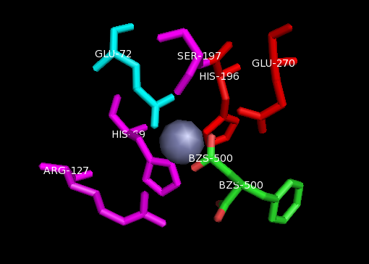
Section 3C: Evolutionary Conservation.
Much cooler cation amino acid stabilization.
The Zinc cation is implicated in a number of stabilizing interactions with neighboring amino acids including ionic bonding and cation-pi interactions. It is probably this particular interaction that drives the presence of positively charged and aromatic amino acids.

Slide 8
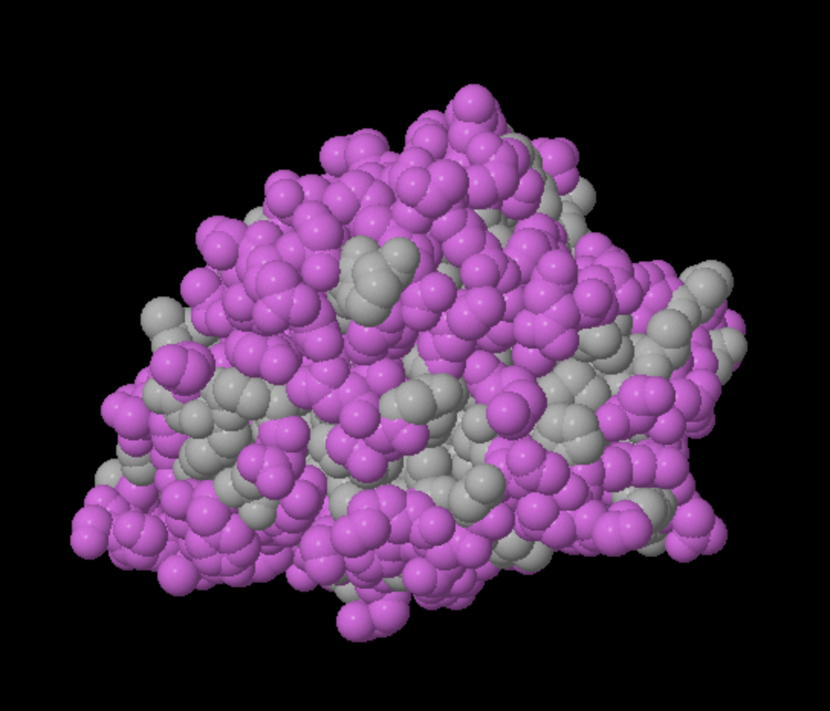
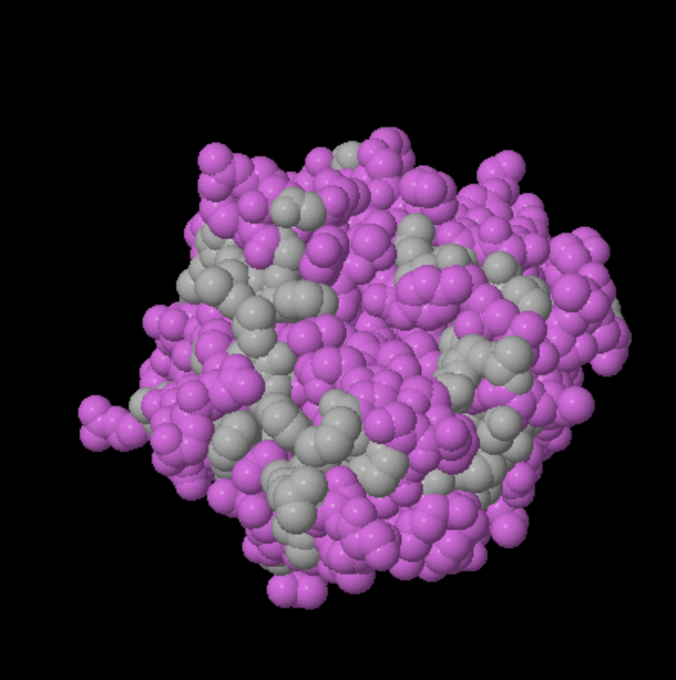
Section 4: Hydrophobic/Polar
This protein has a mostly polar surface, consistent with it being water soluble. Small hydrophobic patches are interspersed throughout the protein.
Hydrophobic
Polar/Charged
Side not binding ligand.
Side binding ligand.

Slide 9

Section 5: Polar Core
The core binding to the ligand mainly consists of polar molecules.

Slide 10
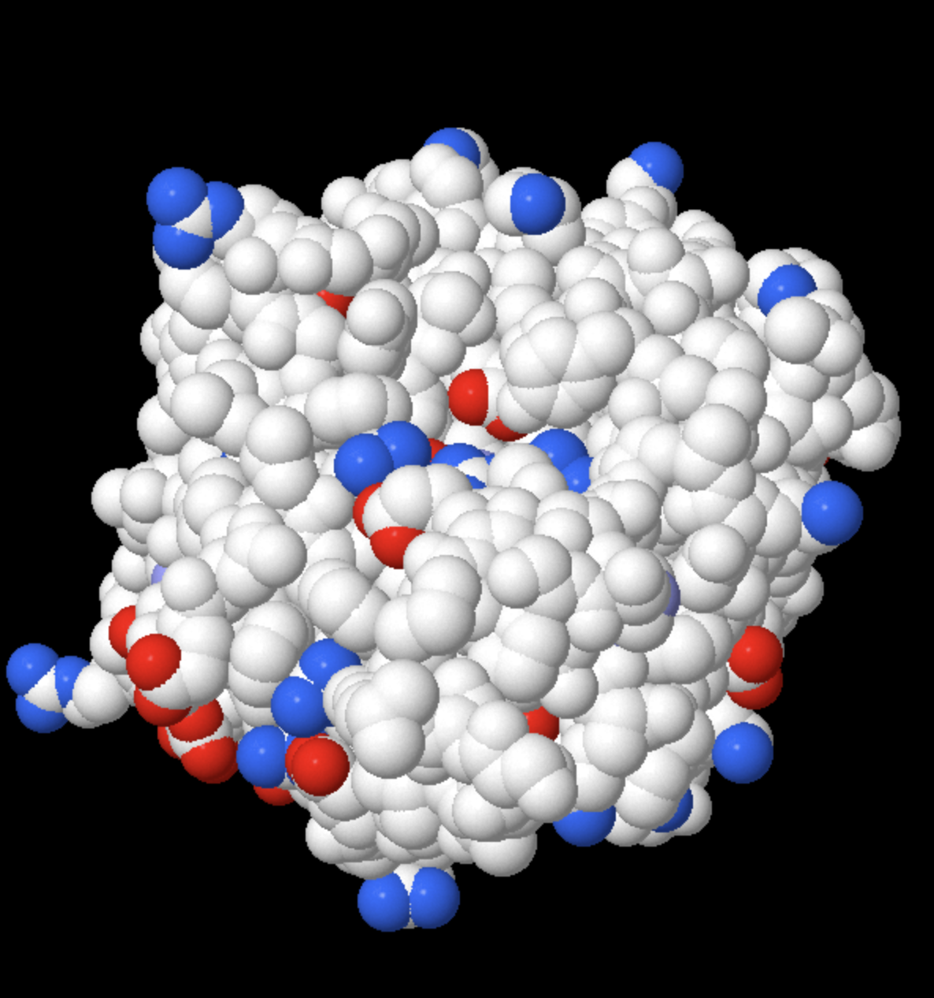
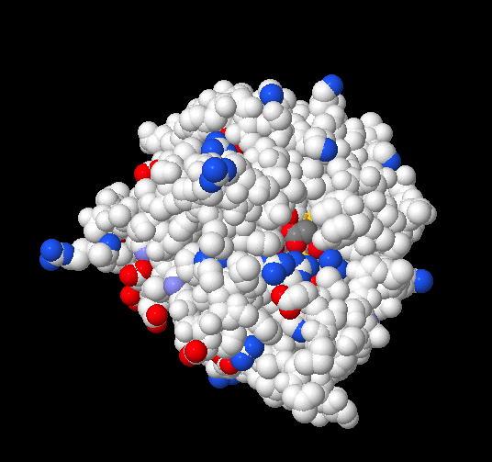
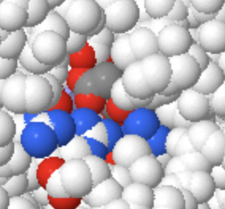
Section 6: Charge
Cationic +
Anionic -
The outer part of the carboxypeptidase is largely devoid of charge. However, the ligand is negatively charged and is generally surrounded by positively charged amino acids.
Showing ligand bound (ligand in gray)
Side binding ligands. BZS is marked with yellow halos, but it’s pretty hard to see
Side not binding ligand.

Slide 11

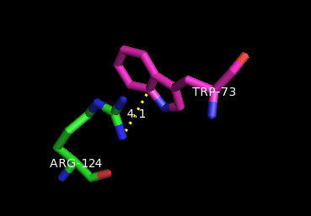
Section 7: Cation-Pi Interaction

Slide 12
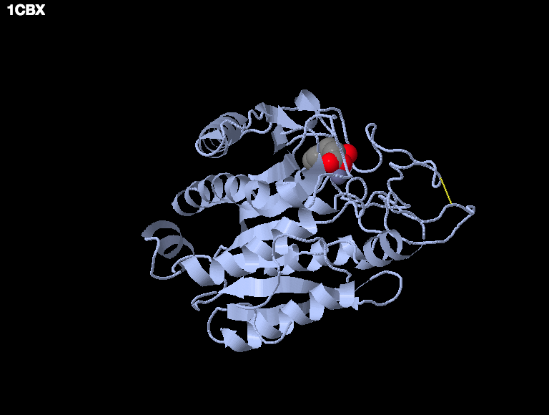
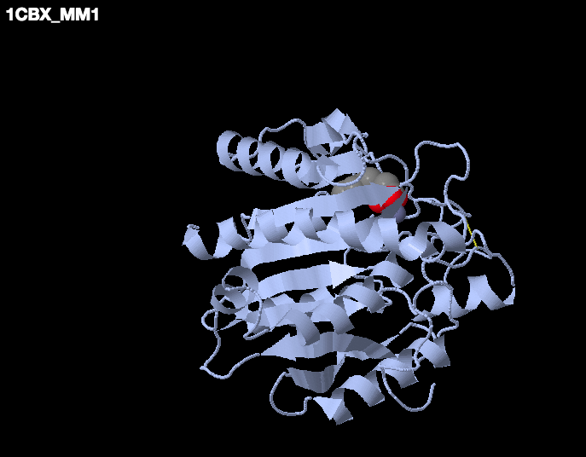
Section 8: Biological Unit
The published PDB file (asymmetric unit) has 1 chain.
MakeMultimer: 1 chain. It’s a monomer
Asymmetric Unit: 1 chain
Biological Unit: 1 chain

Slide 13
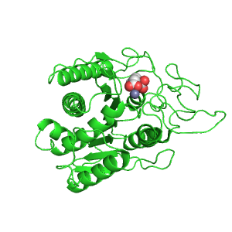
Animation from Polyview-3D
The oxygens on BZS (denoted in red) are forming a salt bridge with the Zn2+ (denoted in gray). Not really sure what this adds to the analysis but here we are.
This 400 pixel animation spins through 360 degrees in 2 degree steps, with a 5/100 second delay.

Slide 14
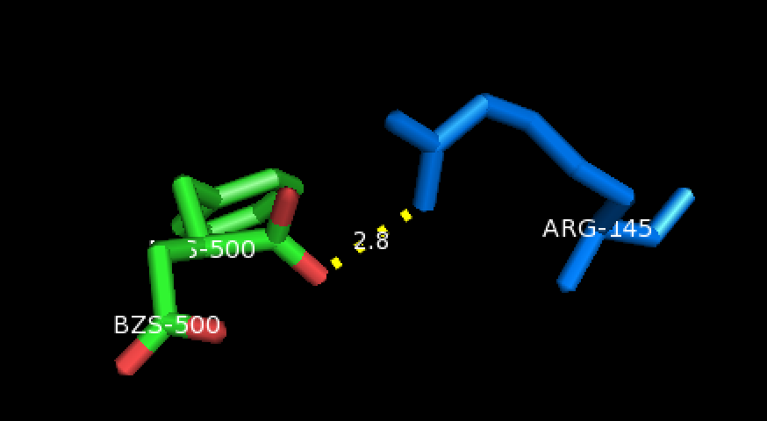
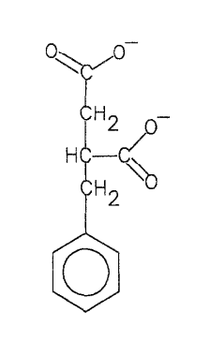
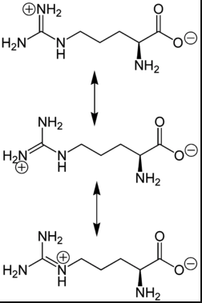
Section 9: Noncovalent Bonds
Nitrogen of Arginine 145 is hydrogen-bonded to an oxygen on the ligand Bezylsuccinate. Because arginine only has nitrogens with hydrogens, it can be assumed that arginine is the hydrogen bond donor and the carboxylic acid carbonyl oxygen is the hydrogen bond acceptor. However, if the nitrogen that BZS interacts with is positively charged, it may also be an ionic salt bridge interaction with the anionic oxygen group of BZS and the cationic amine group of R145
BZS
Arginine
(Chemical structures from Mangani et al. and Wikipedia, respectively )

Slide 15
Section 10A: How Structure Supports Function
1CBX is a model of human pancreatic carboxypeptidase 1 (CPA1), an enzyme which is able to hydrolyze peptide bonds at the C- end of peptide chains, complexed with the small molecule benzylsuccinate (BZS) and the divalent cation form of Zinc¹. BZS is a competitive inhibitor of carboxypeptidase activity for a number of biochemical reasons.

Slide 16
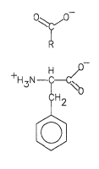
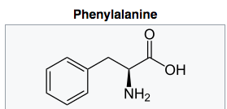
Section 10B: How Structure Supports Function.
Background for BZS ligand
BZS is a small molecule that is a competitive inhibitor of carboxypeptidase activity. It is structurally similar to the amino acid phenylalanine (aromatic ring moiety). It is also structurally similar to the products of peptide hydrolysis. Due to these profound similarities in peptide chain reactants and peptide hydrolysis products, it is able to act competitively against other peptide chains².
However, BZS is not alone sufficient for carboxypeptidase inhibition and is, in fact, driving a more potent inhibitory complex.
Peptide hydrolysis products
BZS
Chemical structures from Mangani et al., Wikipedia, and Mangani et al., respectively

Slide 17
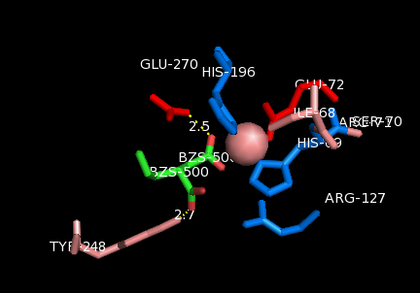
Section 10C: How Structure Supports Function.
Ligand binding sites.
The carboxylate group on BZS is able to form a salt bridge with a Zinc ion. This Zinc ion then coordinates interactions with six of the amino acids in the active site. This particular set of interactions causes conformational changes that allow for Q270 and Y248 to hydrogen bond with BZS. The combination of these interactions causes the binding pocket to be fully occupied by these inhibitors.

Slide 18
Section 10D: How Structure Supports Function.
Induced Fit
The function of BZS in inhibiting carboxypeptidase activity is an example of an “induced- fit” model³. While BZS alone cannot drive competition, the addition of a divalent cation such as Zn2+ allows for conformational changes that drive this process.
The Zn2+ is able take advantage of the polar core (5) to interact in a variety of ways such as cation- pi interactions and salt bridge interactions (3C) which drive the initial complex to form. This allows for BZS to make hydrogen bonds with other amino acids (10C).

Slide 19
Section 10E: Sources
https://en.wikipedia.org/wiki/Carboxypeptidase_A
https://www.sciencedirect.com/science/article/pii/0022283692906716?via%3Dihub
https://www.ncbi.nlm.nih.gov/pmc/articles/PMC3018770/

