Slide 1
Capstone Project ‘26
Ryann Lacks, Project Manager Intern

Slide 2


Project Overview
Senior design capstone project Fall ‘25 - Spring '26.
Notes:
Senior design capstone project for all computer science majors.
Inherited an existing project from a previous team.
Application built for Milestone Decisions located in Moscow, ID.

Slide 3



Stakeholders
Milestone Decisions Capstone Instructor WSU Voiland College
Notes:
Our most important stakeholder was our client, Milestone Decisions. It was our mission to create an application that is both usable and reliable. It was helpful to have a client that was clear on their needs, there was little to no margin for the “What if’s”, our client was very clear about what was in and out of scope. Other stakeholders included WSU affiliates like our capstone instructor and the College of Engineering. It is important to the Students, instructors, and department of WSU to create a great project and uphold our university’s reputation.

Slide 4






Creating the Scope
Determine Requirements
Budget Restrictions
Formulate Ideas
Delegate Sprint Work
Consider Priorities
How do we stay on track?
Notes:
Milestone Decisions came to WSU with the problem: They had no way of tracking and managing the items they bought for their organization. Since they are a state funded organization, they need the ability to track all expense costs for their equipment and belongings. *Add in any upfront risks that we had going into the project. What issues pitfalls did you know about up front that you tried to dodge? How did that change your plan?*

Slide 5
In Scope
Not In Scope
Cost tracking
Fixing UI bugs
Assignment capabilities
User-Friendly interface
Building a new application
Mobile device compatibility
Advanced data tools
Notes:
The scope of this project was focused on fixing bugs in the existing code as well as implementing new features the client requested. We considered our tasks and prioritized which items needed a higher priority with variables like core functionality and usage frequency. From our early discussions, we came up with a short list of high priority features that the client needs. ​ ​ Build upon the existing application so that Milestone Decisions can:​
Track different types of items​
Assign these items to residents and households​
Track the cost of items​
Dynamically create and remove objects as their business changes

Slide 6
Financial Considerations
Budget: < $100
Open Source Tools
Minimal Maintenance Overhead
Notes:
Our client made it very clear at the beginning of the project that they are under strict budgeting restrictions. As a state funded organization, they did not have much room in their budget to support and maintain this application, they want it to be as cost friendly as possible. Our solution to this was to continue what the previous team had used, mongoDB (non-relational database) to store data and vercel (cloud based application) to deploy. Using these platforms allowed us to satisfy our clients budgetary needs and provides a clean handoff to other developers who may need to do maintenance work. However, it also restricts the amount of data that can be stored in the database, limiting their tracking abilities

Slide 7
Schedule
Research/ Planning
September, 2025
Backend Dev.
October, 2025
GUI Dev.
November, 2025
Integration & Test
January, 2026
Deploy & Doc.
February, 2026
Presentation
April 21, 2026
Notes:
Our instructor scheduled sprint deadlines throughout the two semesters of our project - the project followed an agile methodology where each sprint of the 6 lasted about 4 weeks.

Slide 8
Concept & Early Discussions
Sprint Goal: Define the project vision and initial requirements
Notes:
During the first sprint, we focused on defining the project vision and aligning the team on the overall scope and objectives. This included brainstorming features the client wanted to add, identifying problems the system could provide a solution to, and defining high-level system features. From this sprint, we would have a clear project concept, a list of initial features, and preliminary architecture agreements.
*Talk about how this is when we learned there was an existing project and we would be building off a previous project
This shortened our scope by alot. We would spend more time understanding the existing project and its architecture than spending time designing one.

Slide 9
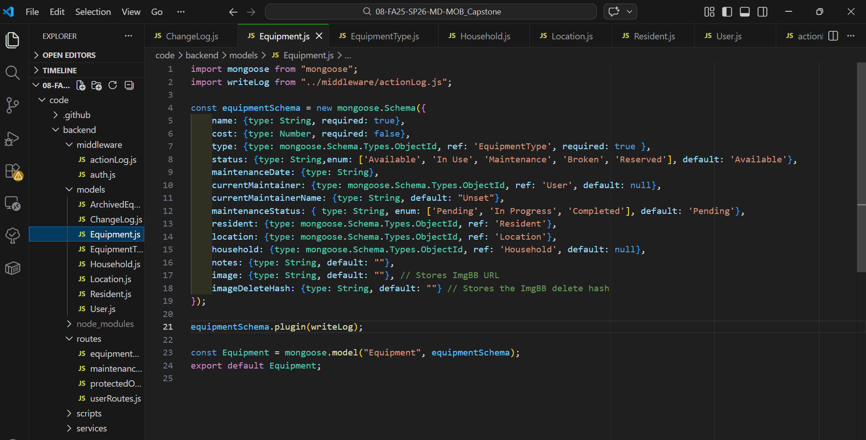
2. Core Backend Functionality
Sprint Goal: Develop the core logic that powers the system
Notes:
This sprint focused on building the foundation of the system so that future interface and integration work could rely on a stable backend. This included designing the system architecture, creating backend classes and data structures, and setting up data storage. From this sprint, we would have a functional backend system, data models, and core logic.

Slide 10
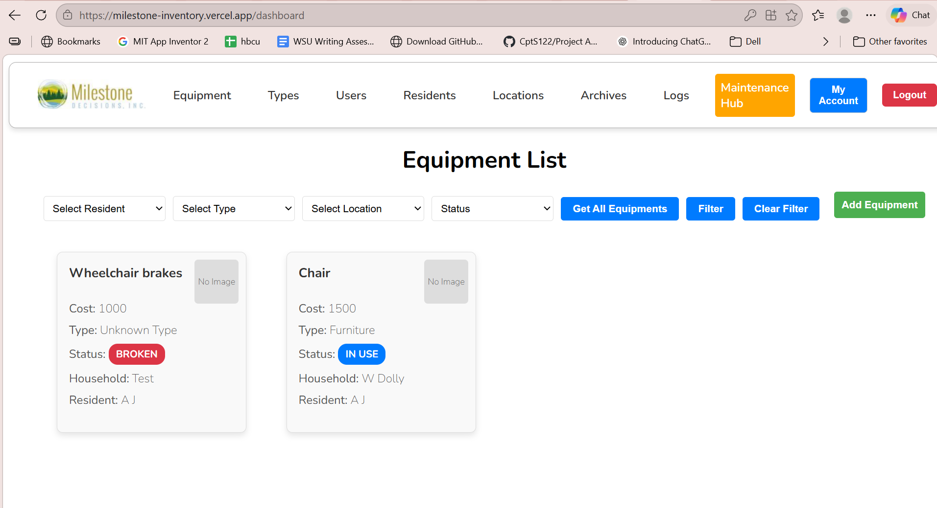
3. GUI Development
Sprint Goal: Create the user interface for interacting with the system
Notes:
This sprint focused on translating the backend functionality into a usable interface for end users. This included designing UI layouts, implementing forms and controls, routing GUI elements to backend logic, and improving the usability and workflow of the product. Our deliverables included a working graphical interface, functional user interactions, and an improved user experience.

Slide 11
4. Integration & Testing
Sprint Goal: Ensure all components work together correctly
Notes:
The focus during this sprint was ensuring that all system components worked together seamlessly by integrating backend systems with GUI components, testing user workflows, and debugging functionality issues. Success in this sprint meant a fully integrated application, resolved integration bugs, and verified system functionality.

Slide 12
5. Deployment & Tutorials
Sprint Goal: Prepare the system for demonstration and user understanding
Notes:
During this sprint, we focused on making the application accessible to users and preparing materials to help others understand how to use it. In this sprint, we deployed the application,tested the system from a user perspective, updated installation step documentation, and developed tutorials for our users.

Slide 13
6. Documentation & Presentation
Sprint Goal: Finalize project documentation and prepare for project delivery
Notes:
This final sprint will focus on consolidating out work into clear documentation and communicating the result of the project. This sprint will last from mid March to late April, and our deliverables will include out capstone presentation, documentation, and our completed submission.

Slide 14
Challenges & Mitigations
How did we tackle challenges?
Conflicting Priorities
Deadline Strains
Roadblocks
Communication
Organization
Contingency
Updating Stakeholders Regularly
GitHub
School Breaks
Weekly Team Meetings
Meeting Minutes
Workloads
Discord Chats
Notes:
As this project is wrapping up, a few approaches proved especially effective during our project. We established weekly meetings early on to keep the students, client, and mentor aligned on expectations and deliverables. With busy student schedules, open communication was essential. Our team regularly shared conflicts, flagged issues in the code, and alerted each other when deadlines were becoming tight. When we encountered backend dependencies and roadblocks, we created a timeline for each component and updated our group chat as tasks were completed. Consistently documenting code changes in GitHub and scope adjustments in OneDrive was also extremely helpful, especially since the project spanned several months and included holidays, other coursework, and extracurricular commitments.

Slide 15





Retrospective
What would I do differently?
Time Tracking Long Term Goals
What can we do next?
Cost Dashboard Mobile Integration AI Capabilities
Notes:
Looking retrospectively on our project, I feel confident in our adherence to our original timeline, budget, and scope. Things ran very smooth and there were very few strains in our schedule. However, if I were to run this project again I would like to keep tabs on things like time tracking ( How much time is spent on issues) and set some long term reach goals if the work in our scope is done early. This would help us improve our estimates and planning as well as align our project features with future expansion. While the current system meets the core project objectives, there are several opportunities for long term improvement.
One potential enhancement is the addition of cost dashboards. These would allow administrators to monitor spending in a bigger picture.
Another improvement would be mobile integration. Expanding the platform to mobile devices would make the system more accessible and convenient for users.
Finally, creatively incorporating AI capabilities could add modern and intelligent features such as personalized recommendations or predictive insights.

