Slide 1
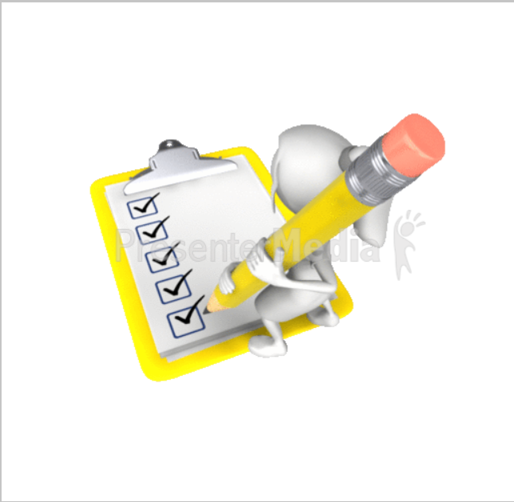
“checkIt”
Grocery List App
Frictionless Shopping
checkIt

Slide 2
Grocery List App
checkIt
Introduction Project 2:
Group 8 decided to develop a Grocery List App
The audience: technically savvy shopper
App Name: checkIt

Slide 3
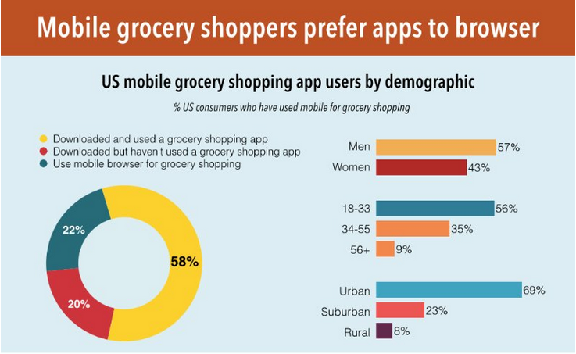
Mobile grocery shoppers prefer apps to browser
checkIt
US mobile grocery shopping app users by demographic

Slide 4
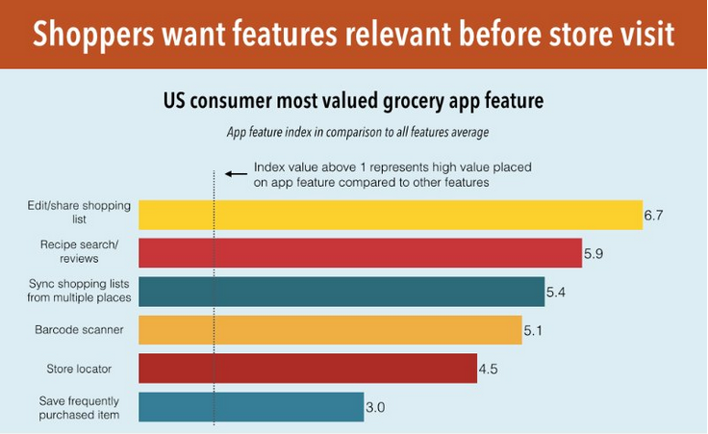
Most valued grocery app features
checkIt
*Consumers want app features that improve pre-purchase experience
*Consumers most requested feature is the editable and sharable shopping list
*Consumers also want to use grocery apps to search and review recipes, scan barcodes and locate nearby stores

Slide 5
What is the “checkIt” shopping list app?
checkIt
Replaces traditional pen and paper grocery lists
Built-in database that digitally adds available products
Manage list in quick, convenient, hassle free methods:
Alphabetically
By Category
By Aisle
In order of priority
Recipe

Slide 6
checkIt – How it works
checkIt
Shopping made easy with powerful features for search, add, copy and re-use
Search for products by entering product name or a few letters from the name to select an item for your list or favorites
Add products manually to your list or favorites
Copy items from your favorites list and add them to your shopping list
Re-use previous shopping list to create a new shopping list
Move shopping list items to shopping cart when you are ready to checkout

Slide 7
checkIt - Interface (home)
checkIt
Search for Products
To add to lists
Create new lists
Convert (create) list to shopping cart
Create new orders
Create and Edit
favorites or staples lists

Slide 8

checkIt - Interface (favorites)
checkIt
Display Products
Added to favorites
List products, units, category (aisles)
See what Lists favorites are associated with
Name your lists

Slide 9
checkIt - Interface (merchants)
checkIt
List products
by merchants

Slide 10
checkIt - Interface (orders)
checkIt
Name Orders for quick reference and reuse

Slide 11
checkIt – Benefits
checkIt
Saves time
Convenience with no pens and papers or memorizing
Less time spent compiling lists
Decisions about what products to purchase are predetermined by the time you arrive at store
Less time spent in store wandering around looking for items
Saves money
Guards against impulse purchases because you shop from a list
Users can accurately prepare/work from a budget
Supports healthy life style
Fewer impulse purchases lead to healthier product planning and choices

Slide 12
checkIt - Strengths
checkIt
Simple design and interface
Pre-loaded products with upc codes
Powerful search to find products of interest
Ability to organize by categories
Ability to create favorites list
Ability to save previous shopping list
Ability to move from lists to shopping cart
Track visitor usage with Google Universal Analytics

Slide 13
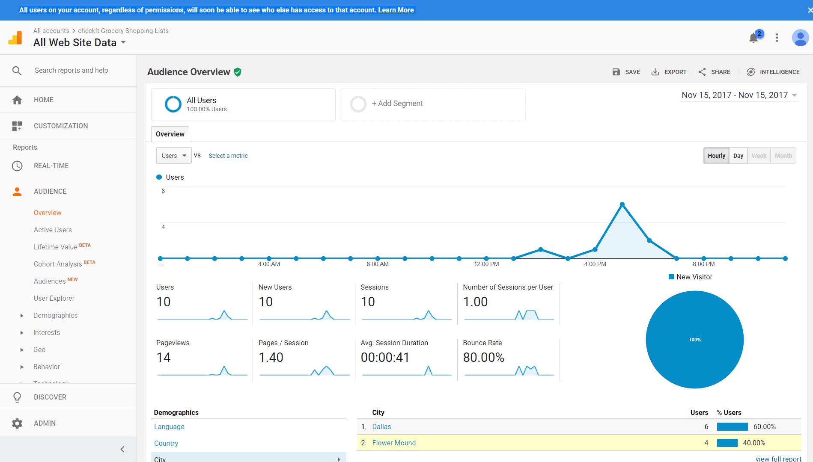
checkIt – Site Performance Insights
checkIt
Account level
(domain)
Visitor Tracking
Specify dates
of interest
Select desired
metrics to monitor
Dashboard displays
popular performance metrics

Slide 14
checkIt - Weaknesses
checkIt
Real-time updating of product lists may not be available
No scanner capability currently
No way to determine if product inventory is available in store at time of purchase

Slide 15
checkIt - Opportunities
checkIt
Future enhancements might include:
Barcode Scanner capability
Budget customization
Coupon compatible
Price comparison across stores
Store inventory/availability
Event based tracking (performance analytics)
On site location based ads
Push notifications for product specials that might be of interest based on previous purchases

Slide 16
checkIt - Technology
checkIt
checkIt app technology includes:
Node.js
NPM packages:
Express
Handlebars
MySQL
Universal-analytics
Bootstrap
New package: NPM Universal-analytics (Google)

