Slide 1
AZ-400.00 Module 2: Getting Started with Source Control

Slide 2
Lesson 01: Module overview

Slide 3
Module overview
Lesson 1: Module overview
Lesson 6: Introduction to GitHub
Lesson 2: What is Source Control
Lesson 7: Migrating from Team Foundation Version Control (TFVC) to Git in Azure Repos
Lesson 3: Benefits of Source Control
Lesson 8: Authenticating to Git in Azure Repos
Lesson 4: Types of Source Control systems
Lesson 9: Lab
Lesson 5: Introduction to Azure Repos
Lesson 10: Module review and takeaways

Slide 4
Learning objectives
After completing this module, students will be able to:
Describe the benefits of using Source Control
Describe Azure Repos and GitHub
Migrate from TFVC to Git

Slide 5

Lesson 02: What is Source Control?

Slide 6
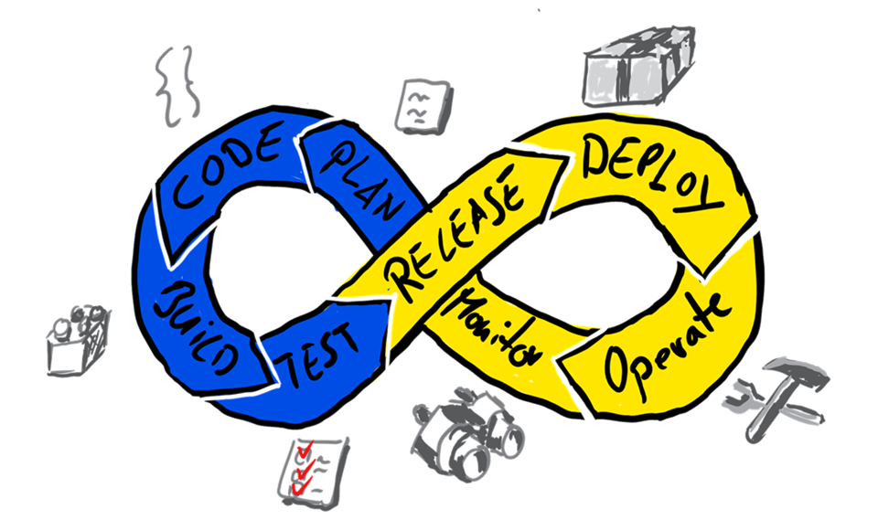
Introduction to Source Control
DevOps is a revolutionary way to release software quickly and efficiently while maintaining a high level of security
Source Control (version control) is a critical part of DevOps

Slide 7
Foundational practices of DevOps
Foundational practices and the 5 stages of DevOps evolution
 | Defining practices and associated practices | Practices that contribute to success
Stage 0 | Monitoring and alerting are configurable by the team operating the service Deployment patterns for building applications or services are reused Testing patterns for building applications or services are reused Teams contribute improvements to tooling provided by other teams Configurations are managed by a configuration management tool
Stage 1 | Application development teams use version control Teams deploy on a standard set of operating systems | Build on a standard set of technology Put application configurations in version control Test infrastructure changes before deploying to production Source code is available to other teams
Stage 2 | Build on a standard set of technology Teams deploy on a single standard operating system | Deployment patterns for building applications and services are reused Rearchitect applications based on business needs Put system configurations in version control
Stage 3 | Individuals can do work without manual approval from outside the team Deployment patterns for building applications and services are reused Infrastructure changes are tested before deploying to production | Individuals can make changes without significant wait times Service changes can be made during business hours Post-incident reviews occur and results are shared Teams build on a standard set of technologies Teams use continuous integration Infrastructure teams use version control
Stage 4 | System configurations are automated Provisioning is automated Application configurations are in version control Infrastructure teams use version control | Security policy configurations are automated Resources made available via self-service
Stage 5 | Incident responses are automated Resources available via self-service Rearchitect applications based on business needs Security teams are involved in technology design and deployment | Security policy configurations are automated Application developers deploy testing environments on their own Success metrics for projects are visible Provisioning is automated
* The practices that define each stage are highlighted in bold font
Notes:
2019 State of DevOps report - https://puppet.com/resources/report/state-of-devops-report

Slide 8
What is Source Control?
Source Control is the practice of tracking and managing changes to code
Source Control Management (SCM) systems provide a running history of code development and help to resolve conflicts when merging contributions from multiple sources
Source Control protects source code from both catastrophe and the casual degradation of human error and unintended consequences
Benefits include: Reusability, traceability, manageability, efficiency, collaboration, and learning

Slide 9
Lesson 03: Benefits of Source Control

Slide 10
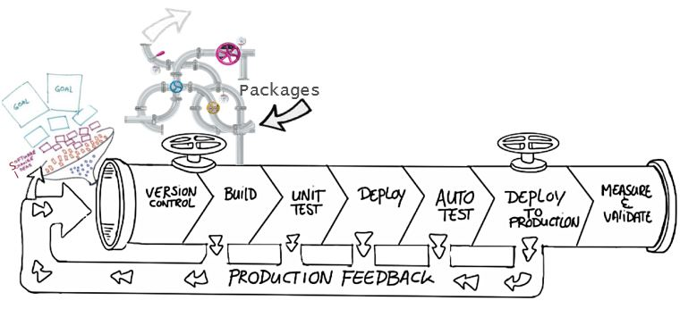
Benefits of Source Control
Create workflows
Work with versions
Collaboration
Maintains history of changes
Automate tasks

Slide 11
Best practices for Source Control
Make small changes
Don’t commit personal files
Update often and right before pushing to avoid merge conflicts
Verify your code change before pushing it to a repository; ensure it compiles and tests are passing
Pay close attention to commit messages as these will tell you why a change was made
Link code changes to work items
No matter your background or preferences, be a team player and follow agreed conventions and workflows

Slide 12
Lesson 04: Types of Source Control Systems

Slide 13
Centralized version control
Strengths | Best Used for
Easily scales for very large codebases Granular permission control Permits monitoring of usage Allows exclusive file locking | Large integrated codebases Audit and access control down to the file level Hard to merge file types
Centralized
There is a single central copy of your project and programmers commit their changes to this central copy
Common centralized version control systems are TFVC, CVS, Subversion (or SVN) and Perforce

Slide 14
Distributed version control
Strengths | Best Used for
Cross platform support An open source friendly code review model via pull requests Complete offline support Portable history An enthusiastic growing user based | Smaller size (in bytes) and modular codebases Evolving through open source Highly distributed teams Teams working across platforms Greenfield codebases
Distributed
Every developer clones a copy of a repository and has the full history of the project
Common distributed source control systems are Mercurial, Git and Bazaar
Notes:
A greenfield project is one that lacks constraints imposed by prior work.

Slide 15
Git and TFVC
Git:
Distributed Source Control system
Each developer has a copy of the source repository on their dev machine
TFVC:
Centralized Source Control system
Team members have only one version of each file on their dev machines
In the Server workspaces model, before making changes, team members publicly check out files
In the Local workspaces model, each team member takes a copy of the latest version of the codebase with them and works offline as needed

Slide 16
Why Git?
Feature Branches
Distributed Development
Pull Requests
Community
Release Cycles

Slide 17
Common objections to using Git
Overwriting History – TFVC does not allow this, but with both you still overwrite the code
Large Files – Git works best with repos that are small and that do not contain large files (or binaries); consider using Git LFS
Large Repos – This is no longer a blocker
Git? GitHub? – There is confusion about the difference
Learning Curve – Some training and instruction will be needed
Discussion – What objections do you have?

Slide 18
Working with Git locally
DEMO
Notes:
Take a moment to complete the demonstration, as defined in the student manual.

Slide 19
Lesson 05: Introduction to Azure Repos

Slide 20
What is Azure Repos
Set of version control tools to manage your code:
Git: Distributed version control
Team Foundation Version Control (TFVC): Centralized version control

Slide 21
Lesson 06: Introduction to GitHub

Slide 22
What is GitHub
Largest open source community
Owned by Microsoft
Features of GitHub:
Automate from code to cloud
Securing software, together
Seamless code review
Code and documentation in one place
Coordinate
Manage teams

Slide 23
Lesson 07: Migrating from TFVC to Git

Slide 24
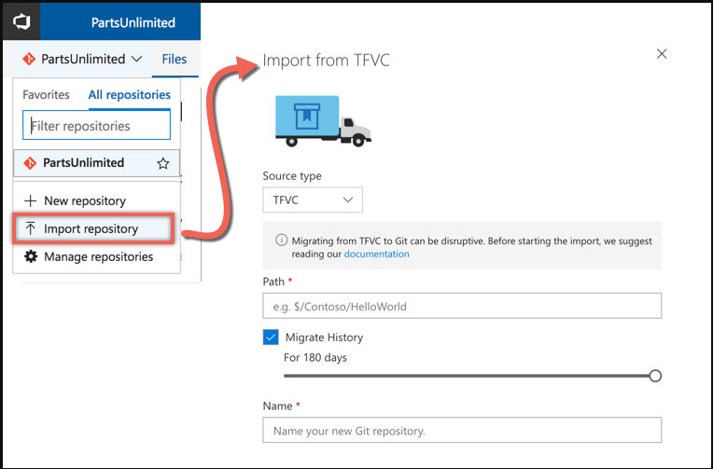
Migrating from TFVC to Git
Single branch import
Full synchronization (Git-tfs)

Slide 25
Migrating from TFVC to Git
Migrating the tip:
Only the latest version of the code
History remains on the old server
Migrating with history:
Tries to mimic the history in git
Recommend to migrate the tip, because:
History is stored differently – TFVC stores change sets, Git stores snapshots of the repository
Branches are stored differently – TFVC branches folders, Git branches the entire repository
Notes:
Video: https://www.youtube.com/watch?v=QsJdFkMKLN0

Slide 26
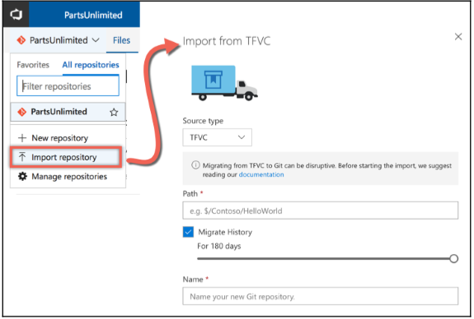
Import repository
Azure DevOps server now provides an out-of-the-box migration workflow called import repository

Slide 27
Lesson 08: Authenticating to your Git Repos

Slide 28
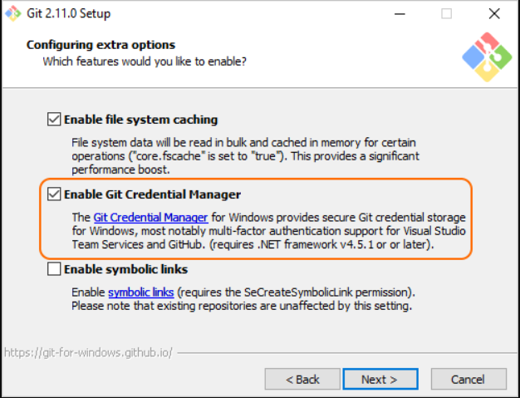
Authenticating to your Git Repos
Git Credential Manager simplifies authentication with your Azure DevOps Services/TFS Git repos
Supports MFA and two-factor authentication with GitHub repositories
You can also configure your IDE with a Personal Access Token or SSH to connect with your repos

Slide 29
Demonstration: Git credential manager
When you first connect to a Git repo the credential manager prompts for your Microsoft Account or Azure Active Directory credentials
Once authenticated, the credential manager creates and caches a personal access token for future connections to the repo

Slide 30
Lesson 09: Lab

Slide 31

Lab: Version controlling with Git in Azure Repos
In this lab, Version Controlling with Git in Azure Repos, you will establish and work with a local Git repository
You will learn how to
Exercise 1:
Configuring the lab environment
Exercise 2:
Cloning an existing repository
Exercise 3:
Saving work with commits
Exercise 4:
Reviewing history
Exercise 5:
Working with branches
Note that you must have already completed the prerequisite labs in the Welcome section
Notes:
Exercise 6 and 7 will be completed in Module 2.
Version Controlling with Git in Azure Repos - https://www.azuredevopslabs.com/labs/azuredevops/git/
✔️ Note that you must have already completed the prerequisite labs in the Welcome section.

Slide 32
Lesson 10: Module review and takeaways

Slide 33
What did you learn?
Describe the benefits of using Source Control
Describe Azure Repos and GitHub
Migrate from TFVC to Git

Slide 34
Module 2 review questions
What are some of the benefits of Source Control?
1
2
What are the benefits of using Distributed Version Control?
3
What are the benefits of using Centralized Version Control?
4
What is Source Control?
Notes:
Q1 Answer: Benefits include: reusability, traceability, manageability, efficiency, collaboration, learning, create workflows, work with versions, collaboration, maintains history of changes, and automate tasks.
Q2 Answer: complete offline support and cross platform support
Q3 Answer: easily scales for very large codebases, granular permission control
Q4 Answer: Source control is the practice of tracking and managing changes to code.

