Slide 1
AZ-400.00 Module 3: Scaling Git for Enterprise DevOps

Slide 2
Lesson 01: Module overview

Slide 3
Module overview
Lesson 5: Why care about GitHooks
Lesson 1: Module overview
Lesson 2: How to structure your Git Repo
Lesson 6: Fostering inner source
Lesson 3: Git branching workflows
Lesson 7: Lab
Lesson 4: Collaborating with pull requests in Azure Repos
Lesson 8: Module review and takeaways

Slide 4
Learning objectives
After completing this module, students will be able to:
Explain how to structure Git repos
Describe Git branching workflows
Leverage pull requests for collaboration and code reviews
Leverage Git hooks for automation
Use Git to foster inner source across the organization

Slide 5
Lesson 02: How to structure your Git Repo

Slide 6
Mono vs Multi Repos
A repository is a place where the history of your work is stored
Advantages
Mono-repo – source code is kept in a single repository
Clear ownership
Better scale
Narrow clones
Multiple-repo – each project has its own repository
Better developer testing
Reduced code complexity
Effective code reviews
Sharing of common components
Easy refactoring

Slide 7
Lesson 03: Git branching workflows

Slide 8
Branching workflow types
Feature branching – All feature development should take place in a dedicated branch instead of the master branch
Gitflow branching – A strict branching model designed around the project release
Forking Workflow – Every developer uses a server-side repository
Evaluate the workflow:
Does this workflow scale with team size?
Is it easy to undo mistakes and errors with this workflow?
Does this workflow impose any new unnecessary cognitive overhead to the team?

Slide 9
Feature branch workflow
Create a branch
Add commits
Open a pull request
Discuss and review your code
Deploy
Merge
All feature development should take place in a dedicated branch instead of the master branch
Encapsulating feature development leverages pull requests, which are a way to initiate discussions around a branch
Share a feature with others without touching any official code

Slide 10
Git branching model for continuous delivery
DEMO
Notes:
Take a moment to complete the demonstration, as defined in the student manual.

Slide 11
GitFlow branch workflow
Create a Release branch
Merge back
Complete
Master
Create a Develop branch
Issue with the Master?
Hotfix branch
Merge back to Develop and Master
Create a Feature branch
Merge back
Complete
GitFlow is great for a release-based software workflow
GitFlow offers a dedicated channel for hotfixes to production

Slide 12

Forking branch workflow
Forking Branch workflow gives every developer their own server-side repository
Each contributor has not one, but two Git repositories: a private local one and a public server-side one
Most often seen in public open source projects
Contributions can be integrated without the need for everybody to push to a single central repository
Typically follows a branching model based on the GitFlow Workflow
Forked repositories use the standard git clone command

Slide 13
Lesson 04: Collaborating with pull requests

Slide 14
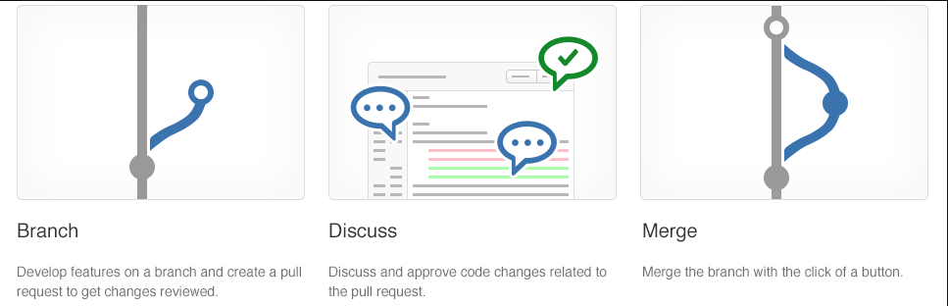
Collaborating with pull requests
Pull requests let you tell others about changes
Collaboration using the Shared Repository Model
Review and merge your code in a single collaborative process
Be sure to provide good feedback and protect branches with policies

Slide 15
Azure Repos collaborating with pull requests
DEMO

Slide 16
Lesson 05: Why care about GitHooks

Slide 17
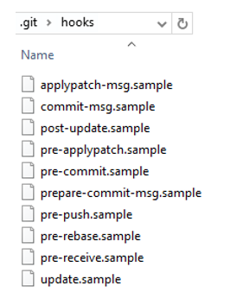
Why care about GitHooks?
A mechanism that allows arbitrary code to be run before, or after, certain Git lifecycle events occur
Use GitHooks to enforce policies, ensure consistency, and control your environment
Can be either client-side or server-side
Using GitHooks is like having little robot minions to carry out your every wish

Slide 18
GitHooks in action
Will my code:
Break other code?
Introduce code quality issues?
Drop the code coverage?
Take on a new dependency?
Will the incoming code:
Break my code?
Introduce code quality issues?
Drop the code coverage?
Take on a new dependency?

Slide 19
Lesson 06: Fostering inner source

Slide 20
Fostering inner source
Fork-based pull request workflows allows anybody to contribute
Inner Source brings all the benefits of open source software development inside your firewall
We recommend the forking workflow for large numbers of casual or occasional committers

Slide 21
Implementing the fork workflow
What’s in a fork?
Sharing code between forks
Choosing between branches and forks
The forking workflow:
Create a fork
Clone it locally
Make your changes locally and push them to a branch
Create and complete a PR to upstream
Sync your fork to the latest from upstream

Slide 22
Inner source with forks
DEMO
Notes:
Take a moment to complete the demonstration, as defined in the student manual.

Slide 23
Lesson 07: Lab

Slide 24
Lab: Code review with pull requests
In this lab, Version Controlling with Git in Azure Repos, you will work branching and merging
You will learn how to:
Exercise 6: Managing branches from Azure DevOps
Exercise 7: Managing repositories
Note that you must have already completed the prerequisite labs in the Welcome section
Notes:
The first five exercises were completed previously.
Version Controlling with Git in Azure Repos - https://www.azuredevopslabs.com/labs/azuredevops/git/

Slide 25
Lesson 08: Module review and takeaways

Slide 26
What did you learn?
Explain how to structure Git repos
Describe Git branching workflows
Leverage pull requests for collaboration and code reviews
Leverage Git hooks for automation
Use Git to foster inner source across the organization

Slide 27
Module 3 review questions
1
What repository type offers the benefits of reduced code complexity, effective code reviews, and sharing of common components?
2
What are the three types of branching?
3
What are GitHooks?
4
What are some best practices when working with files in Git? What do you suggest for working with large files?
Notes:
Q1 Answer: Multiple-repo - Multiple repo advantages - Better developer testing, reduced code complexity, effective code reviews, sharing of common components, and easy refactoring.
Q2 Answer: Trunk-based development, Gitflow branching, and Forking workflow
Q3 Answer: A mechanism that allows arbitrary code to be run before, or after, certain Git lifecycle events occur. Use GitHooks to enforce policies, ensure consistency, and control your environment. Can be either client-side or server-side.
Q4 Answer: Best practices: use a package management system for DLLs, library files, and other dependent files, don't commit the binaries, logs, tracing output or diagnostic data from your builds, don't commit large, frequently updated binary assets, and use diffable plain text formats, such as JSON, for configuration information. For large files, use Git LFS.

