Slide 1
AZ-400.00 Module 4: Consolidating Artifacts and Designing a Dependency Management Strategy

Slide 2
Lesson 01: Module overview

Slide 3
Module overview
Lesson 1: Module overview
Lesson 4: Migrating and consolidating artifacts
Lesson 2: Packaging dependencies
Lesson 5: Lab
Lesson 6: Module review and takeaways
Lesson 3: Package management

Slide 4
Learning objectives
After completing this module, students will be able to:
Recommend artifact management tools and practices
Abstract common packages to enable sharing and reuse
Migrate and consolidate artifacts
Migrate and integrate source control measures

Slide 5
Lesson 02: Packaging dependencies

Slide 6
What is dependency management
Dependencies in software:
Modern software is complex
Component based development is common
Not all software is written by a single team
Dependencies on components created by other teams or persons

Slide 7
Elements of a dependency management strategy
Standardization
Package formats and sources
Versioning

Slide 8
Identifying dependencies
Find components and source code that can have independent:
Deployment
Release
Versioning
Things to consider:
Change frequency
Changes should be unrelated to other parts of system
Can package exist by itself
Package should add value for others

Slide 9
Source and package componentization
Source componentization:
Split out components
Related projects in different solutions
Package componentization:
Composing your solution to use packages

Slide 10
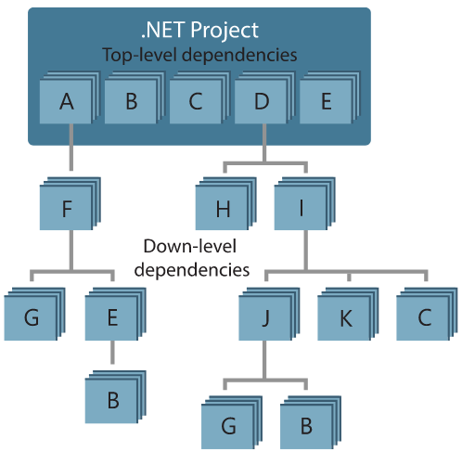
Decompose your system
Approach:
Draw dependency graph
Group components in sets of related components
Few spanning check-ins across sets
Ideally a single team is responsible
Shared release cadence for single set

Slide 11
Scanning your Codebase for dependencies
Duplicate code
High cohesion and low coupling
Individual lifecycle
Stable parts
Independent code and components

Slide 12
Lesson 03: Package management

Slide 13
Packages
Mechanism to create, share and consume code and components
Contains (compiled) code with metadata content for consuming packages

Slide 14




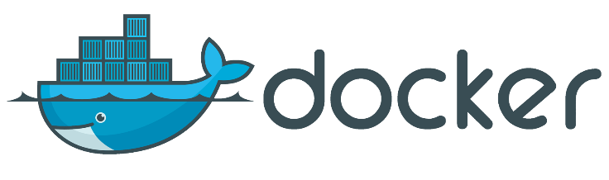
Types of packages
Microsoft platform and .NET artifacts
Node.js modules
Python scripts
Universal packages
Java packages
Docker images
NuGet Microsoft development platform and .NET artifacts
Npm node.js modules
Maven Java packages
Python Python script
Universal Set of related files
Docker Container images
Symbols Symbol files

Slide 15
Package feeds
Centralized storage of package artifacts:
Public or privately available
Offer secure access for private feeds
Versioned storage of packages
Managed by tooling
Also known as:
Package repositories
Package registry

Slide 16
Private and public feeds
Public:
NuGet.org
Npmjs.org
PyPi.org
Docker Hub
Private feeds:
MyGet
Azure Container Registry
Azure Artifacts
Self-hosted solution

Slide 17
Package feed managers
Manages feed
Maintain local installation cache
Search and list packages from feed
Publish packages
Consume packages
Choose tooling:
Command-line tooling
Integrated in build and release pipelines

Slide 18
Package sources
Public sources
NuGet Gallery
https://nuget.org
NPMjs
https://npmjs.org
Maven
https://search.maven.org
Docker Hub
https://hub.docker.com
Python Package Index
https://pypi.org

Slide 19
Package sources
Self-hosted and SaaS based private package feeds
Package type | Self-hosted private feed | SaaS private feed
NuGet | NuGet server | Azure Artifacts, MyGet
NPM | Sinopia, cnpmjs.org, Verdaccio | NPMjs.org, MyGet, Azure Artifacts
Maven | Nexus, Artifactory, Archiva | Azure Artifacts, Bintray, JitPack
Docker | Portus, Quay, Harbor | Docker Hub, Azure Container Registry, Amazon Elastic Container Registry
Python | PyPI Server | Gemfury

Slide 20
Consuming packages
1
Identify a required dependency in your codebase
2
Find a component that satisfies the requirements for the project
3
Search the package sources for a package offering a correct version of the component
4
Install the package into the codebase and development machine
5
Create the software implementation that uses the new components from the package

Slide 21

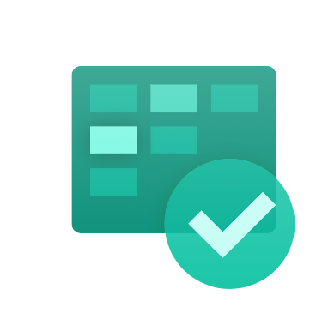

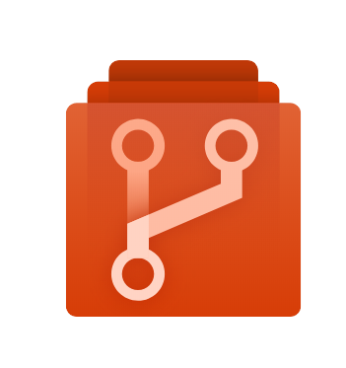

Azure DevOps
Azure Pipelines
Azure Boards
Azure Test Plans
Azure Repos
Azure Artifacts

Slide 22
Azure Artifacts
Part of Azure DevOps:
Create private and public package feeds
Types of packages supported:
NuGet
NPM
Maven
Universal
Python

Slide 23
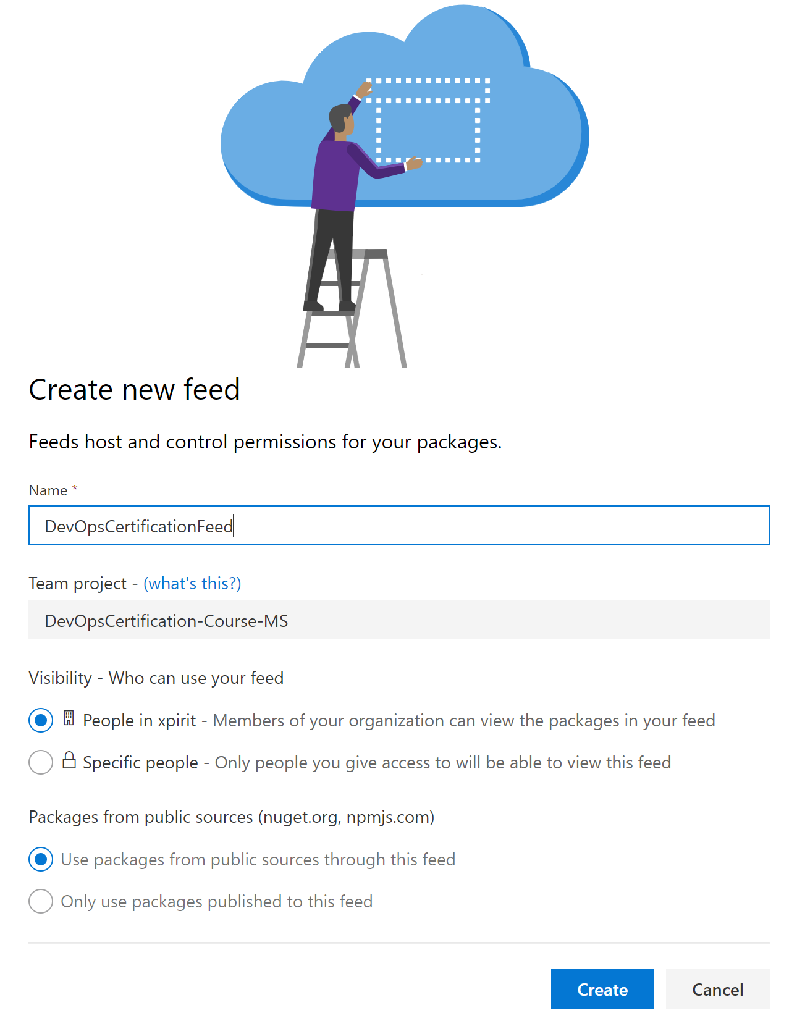
Publishing packages creating a feed
From Azure DevOps portal
Feeds are centralized
Specify:
Name
Visibility
Public sources as upstreams

Slide 24
Creating a package feed
DEMO
Notes:
Take a moment to complete the demonstration, as defined in the student manual.

Slide 25
Pushing a package
DEMO
Notes:
Take a moment to complete the demonstration, as defined in the student manual.

Slide 26
Promoting a package
DEMO
Notes:
Take a moment to complete the demonstration, as defined in the student manual.

Slide 27

Package management
Create a package feed
Connect to the feed
Create a NuGet package and publish it to the feed
HANDS ON
Import the new NuGet package into an existing project
Update a NuGet package in the feed

Slide 28
Lesson 04: Migrating and consolidating artifacts

Slide 29
Identifying existing artifact repositories
An artifact is a deployable component of your application
Azure Pipelines can work with a wide variety of artifact sources and repositories
Each release can specify which version of the artifacts are required
Azure Artifacts can eliminate the need to manage file shares or to host private package servers
Azure Artifacts provides universal artifact management for Maven, npm and NuGet

Slide 30
Migrating and integrating artifact repositories
Get started with NuGet packages in Azure DevOps Services and TFS
Use npm to store JavaScript packages in Azure DevOps Services or TFS
Get started with Maven packages in Azure DevOps Services and TFS
Get started with Python packages in Azure Artifacts
Publish and then download a Universal Package

Slide 31
Lesson 05: Lab

Slide 32

Lab: Package management with Azure Artifacts
In this lab, Package Management with Azure Artifacts, you will:
Create a package feed
Connect to the feed
Create a NuGet package and publish it to the feed
Import the new NuGet package into an existing project
Update a NuGet package in the feed
Note that you must have already completed the prerequisite labs in the Welcome section
Notes:
Package Management with Azure Artifacts - https://www.azuredevopslabs.com/labs/azuredevops/packagemanagement

Slide 33
Lesson 06: Module review and takeaways

Slide 34
What did you learn?
Recommend artifact management tools and practices
Abstract common packages to enable sharing and reuse
Migrate and consolidate artifacts
Migrate and integrate source control measures

Slide 35
Module 4 review questions
1
If you are creating a feed that will allow yourself and those that you invite to publish, what visibility should you choose?
2
Can you create a package feed for Maven in Azure Artifacts?
3
What type of package should you use for Machine learning training data & models?
4
If an existing package is found to be broken or buggy, how should it be fixed?
5
What is meant by saying that a package should be immutable?
Notes:
Q1 Answer: Private
Q2 Answer: Yes
Q3 Answer: Universal
Q4 Answer: Publish a new version
Q5 Answer: A published version should never be changed, only replaced by a later version.

