Slide 1
AZ-400.00 Module 6: Managing application config & secrets

Slide 2
Lesson 01: Module overview

Slide 3
Module overview
Lesson 5: Manage secrets, tokens, and certificates
Lesson 1: Module overview
Lesson 6: Implement tools for managing security
Lesson 2: Introduction to security
Lesson 3: Implement secure and compliant development process
Lesson 7: Lab
Lesson 4: Rethinking application config data
Lesson 8: Module review and takeaways

Slide 4
Learning objectives
After completing this module, students will be able to:
Manage application config and secrets
Implement Tools for Managing security and compliance in pipeline

Slide 5
Lesson 02: Introduction to security

Slide 6
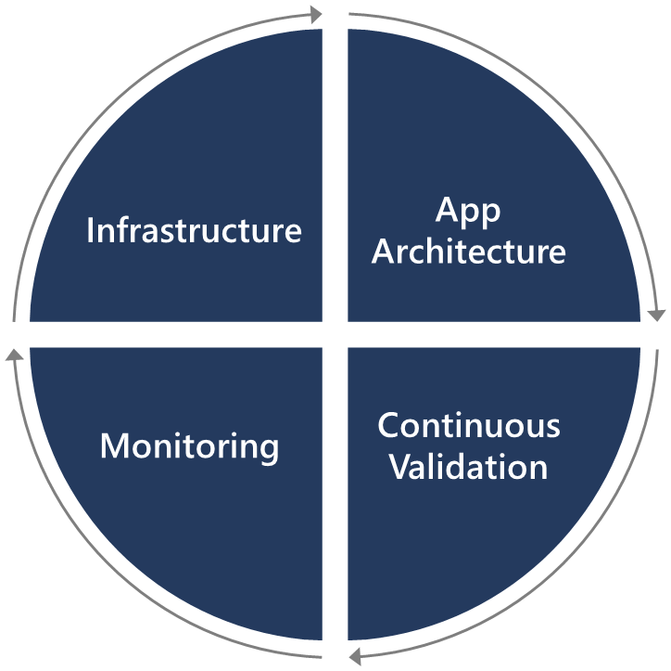
Introduction to security
Securing applications is a continuous process that encompasses secure infrastructure, designing an architecture with layered security, continuous security validation, and monitoring for attacks
Security is everyone’s responsibility

Slide 7
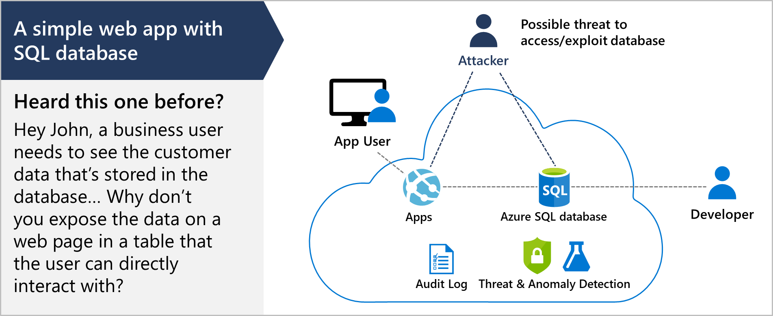
SQL injection attack

Slide 8

Lesson 03: Implement secure & compliant development processes

Slide 9
Threat modeling
Define security requirements
2. Diagram
Create an application diagram
1. Define
3. Identify
Identify threats
Threat
Modeling
Mitigate threats
5. Validate
4. Mitigate
Validate that threats have been mitigated

Slide 10
Threat modeling
DEMO

Slide 11
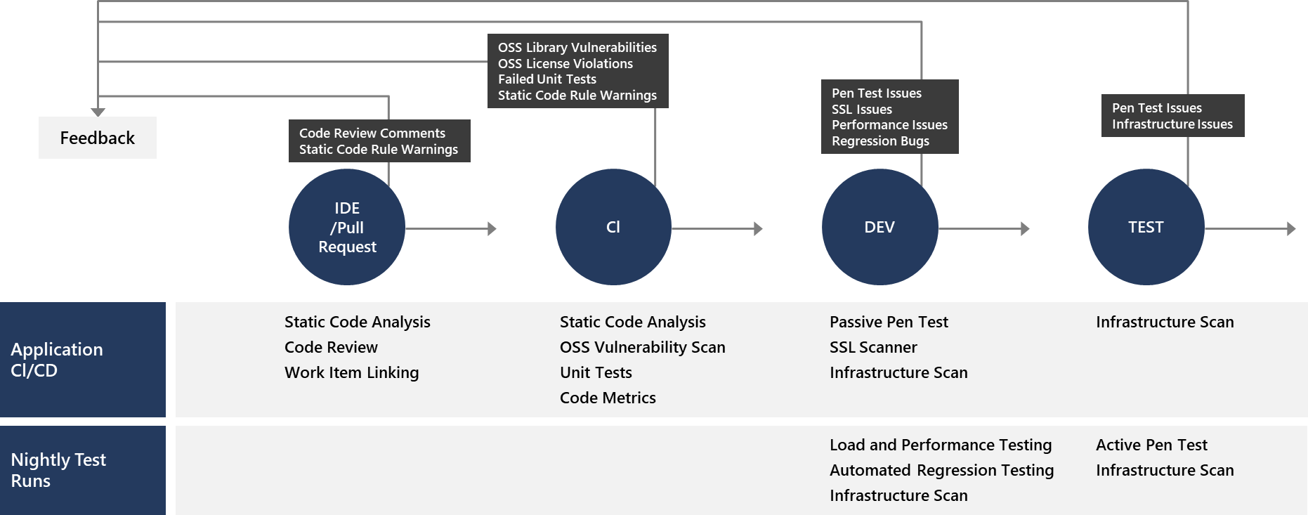
Key validation points
Continuous security validation should be added at each step from development through production

Slide 12
Continuous integration
The CI build should be executed as part of the pull request (PR-CI) process and once the merge is complete
Several tools are available:
SonarQube
Visual Studio Code Analysis and the Roslyn Security Analyzers
Checkmarx – A Static Application Security Testing (SAST) tool
BinSkim – A binary static analysis tool that provides security and correctness results for Windows portable executables
And many more
Be sure to scan third party packages for vulnerabilities and check OSS license usage

Slide 13
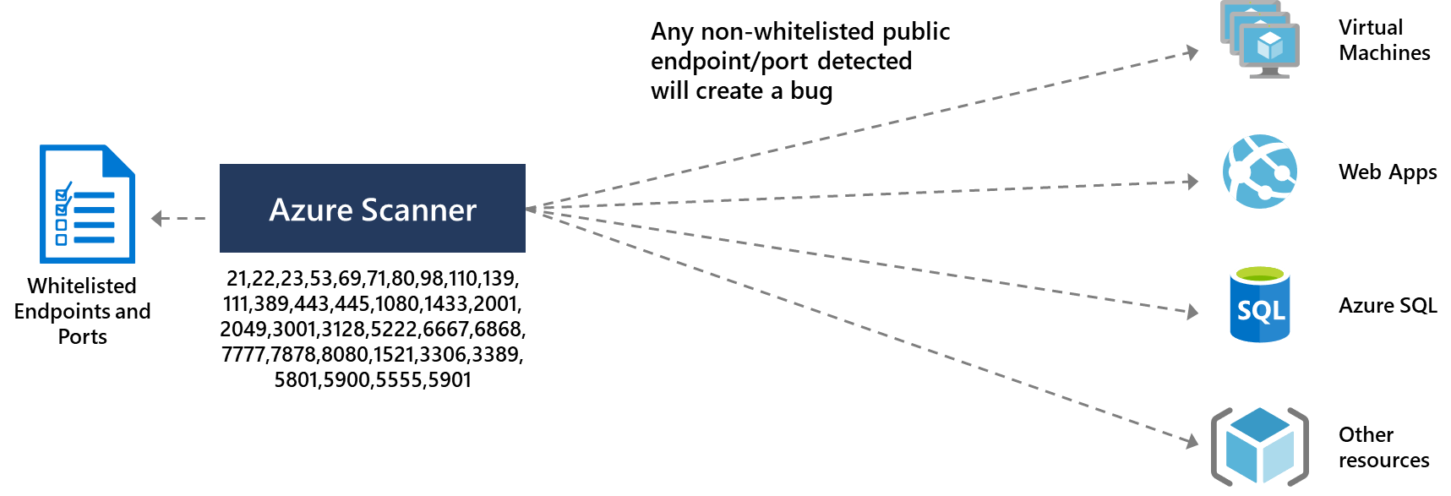
Infrastructure vulnerabilities
Be sure to validate the infrastructure
Use the Azure Security Center and Azure Policies

Slide 14
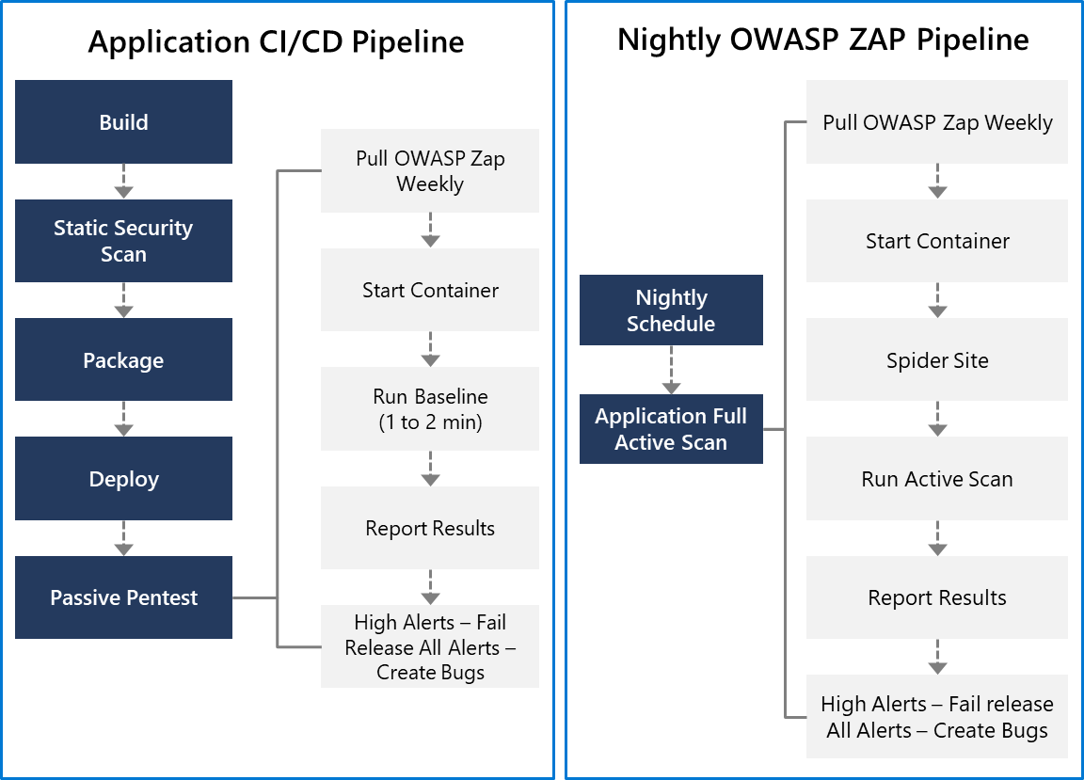
Application deployment to DEV and TEST
OWASP ZAP can be used for penetration testing
Testing can be active or passive
Conduct a quick baseline scan to identify vulnerabilities
Conduct nightly more intensive scans

Slide 15
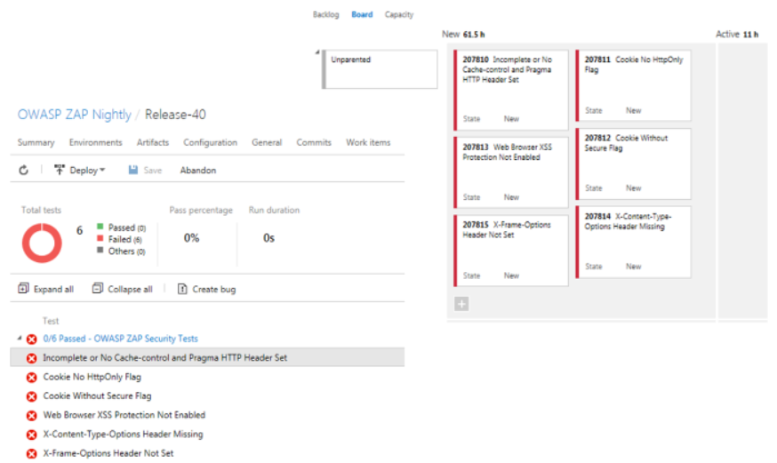
Results and bugs
OWASP ZAP provides a report with results
and bugs
Use a holistic and layered approach to security

Slide 16
Lesson 04: Rethinking application config data

Slide 17
Rethinking application config data
Configuration information is stored in files
Changes can require downtime and administrative overhead
Challenging to manage changes to local configurations across multiple running instances of the application
Discussion: How will secure this information?

Slide 18
Separation of concerns
Configuration Custodian: Responsible for generating and maintaining the life cycle of configuration values
Configuration Consumer: Responsible for defining the schema (loose term) for the configuration and then consuming the configuration values in the application or library code
Configuration Store: The underlying store that is leveraged to store the configuration
Secret Store: A separate store for persisting secrets

Slide 19
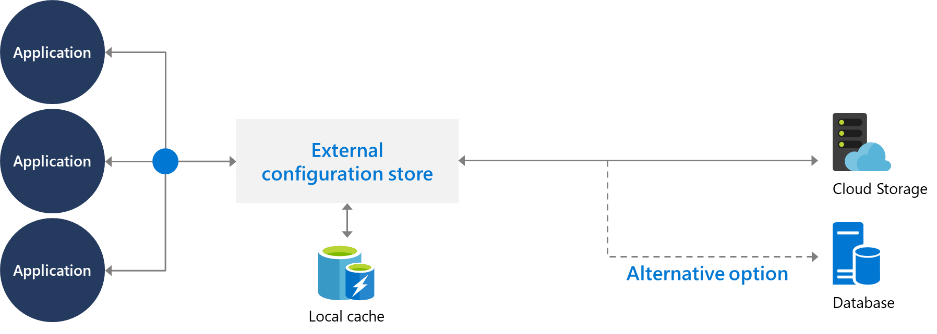
External configuration store patterns
Store the configuration information in external storage
Provide an interface to quickly and efficiently read and update

Slide 20
Integrating Azure key vault with Azure pipeline
Azure Key Vault allows you to manage your organization’s secrets and certificates in a centralized repository

Slide 21
Lesson 05: Manage secrets, tokens, and certificates

Slide 22
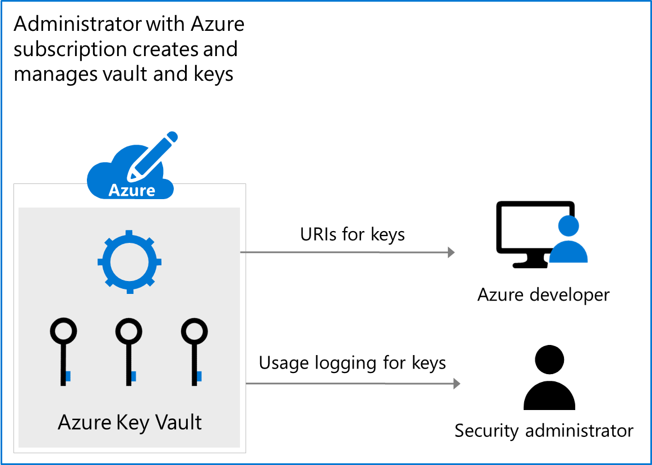
Manage secrets, tokens & certificates
Centralize application secrets
Securely store secrets and keys
Monitor access and use
Simplified administration of application secret
Integrate with other Azure services

Slide 23
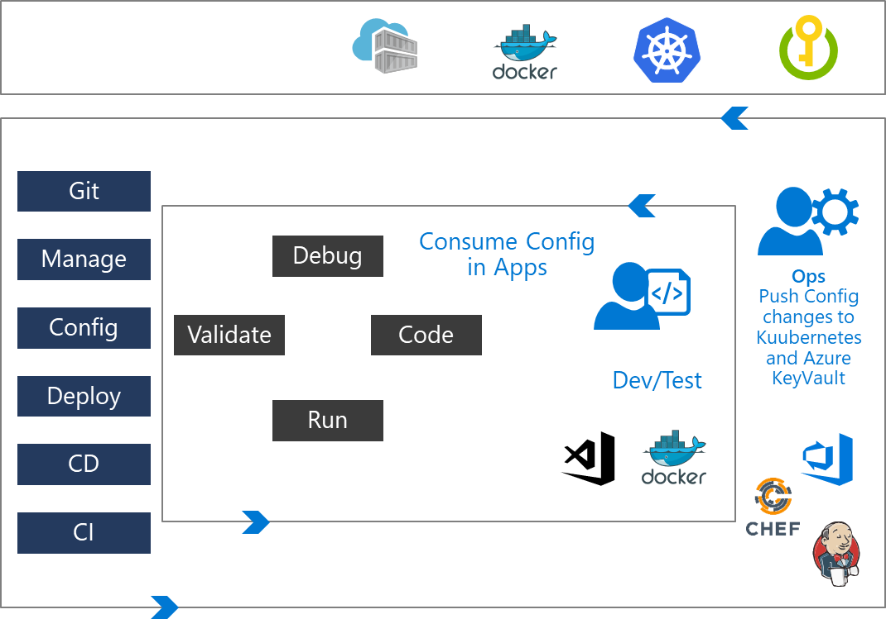
DevOps inner and outer loop
The Inner loop is focused on the developer teams iterating over their solution development
Developer teams consume the configuration published by the outer loop
The Ops Engineer governs the configuration management and pushes the changes

Slide 24
Kubernetes and Azure key vault
Use Kubernetes and Azure Key Vault together to get the best security benefits:
Azure Key Vault Secret store
Kubernetes ConfigMaps
Kubernetes Secrets

Slide 25
Lesson 06: Implement tools for managing security and compliance

Slide 26
SonarCloud
Technical debt – measure between the codebase’s current state and an optimal state
SonarQube

Slide 27
Implement continuous security validation
Coding
Build
QA & security
Production
$80/defect
$240/defect
$960/defect
$7,600/defect
Source: Ponemon Institute Research
Reduce cost by moving DevSecOps to the left
Use automated tooling and processes to identify problems

Slide 28
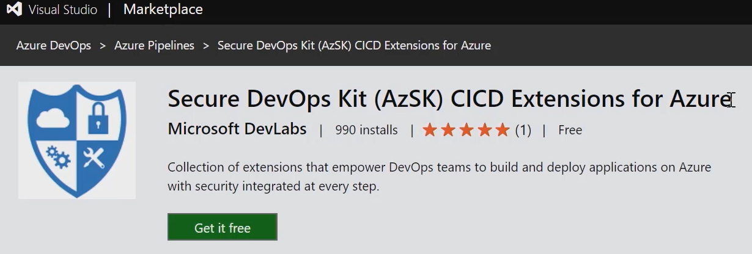
Securing infrastructure with AzSK

Slide 29
Azure policy and governance
DEMO

Slide 30
Lesson 07: Lab

Slide 31
Lab: Integrating Azure key vault with Azure DevOps
Complete the Integrating Azure KeyVault with Azure DevOps. You will learn how to:
Create a key vault, from the Azure portal, to store a MySQL server password
Configure permissions to let a service principal to read the value
Retrieve the password in an Azure pipeline and passed on to subsequent tasks
Notes:
Integrating Azure KeyVault with Azure DevOps - https://www.azuredevopslabs.com/labs/vstsextend/azurekeyvault/

Slide 32
Lesson 08: Module review questions

Slide 33
What did you learn?
Manage application config and secrets
Implement Tools for Managing security and compliance in pipeline

Slide 34
Module review questions
1
What is OWASP ZAP and how can it be used?
2
What are the five stages of threat modeling?
3
Why would you use WhiteSource Bolt?
4
What is the Azure Key Vault and why would use it?
Notes:
Q1 Answer: OWASP ZAP can be used for penetration testing. Testing can be active or passive. Conduct a quick baseline scan to identify vulnerabilities. Conduct nightly more intensive scans.
Q2 Answer: Define security requirements. Create an application diagram. Identify threats. Mitigate threats. Validate that threats have been mitigated.
Q3 Answer: Use WhiteSource Bolt to automatically detect alerts on vulnerable open source components, outdated libraries, and license compliance issues in your code.
Q4 Answer: Azure Key Vault is a cloud key management service which allows you to create, import, store & maintain keys and secrets used by your cloud applications. The applications have no direct access to the keys, which helps improving the security & control over the stored keys & secrets. Use the Key Vault to centralize application and configuration secrets, securely store secrets and keys, and monitor access and use.

