Slide 1
AZ-400.00 Module 07: Managing code quality and security policies

Slide 2
Lesson 01: Module overview

Slide 3
Module overview
Lesson 1: Module overview
Lesson 2: Managing code quality
Lesson 3: Managing security policies
Lesson 4: Lab
Lesson 5: Module review and takeaways

Slide 4
Learning objectives
After completing this module, students will be able to:
Manage code quality including: Technical debt SonarCloud, and other tooling solutions
Manage security policies with open source and OWASP

Slide 5
Lesson 02: Managing code quality

Slide 6
Code quality defined
Short deadlines, a lack of coding standards, and poor technical skills can lead to code that is NOT:
Clear and readable
Maintainable
Documented
Extensible
Efficient
Secure

Slide 7
Quality metrics
A few of the most important quality metrics:
Defect
Complexity:
Program vocabulary
Program length
Calculated program length
Volume
Difficulty
Effort

Slide 8


Measuring and managing quality metrics
Failed Builds Percentage
Failed Deployments Percentage
Ticket Volume
Bug Bounce Percentage
Unplanned Work Percentage

Slide 9
Technical debt defined
Technical Debt describes the future penalty that you incur today by making easy or quick choices in software development practices

Slide 10
Sources and impacts of technical debt
Common sources of technical debt are:
Lack of coding style and standards
Over-engineering code
Lack of or poor design of unit test cases
Insufficient comments and documentation
Ignoring or not understanding object orient design principles
Not writing self-documenting code
Monolithic classes and code libraries
Taking shortcuts to meet deadlines
Poorly envisioned use of technology, architecture and approach
Leaving dead code in place

Slide 11



Using automated testing to measure technical debt
Technical debt:
Adds problems during development that makes it more difficult to add customer value
Saps productivity and frustrates development teams
Makes code both hard to understand and fragile
Increases the time to make changes, and to validate those changes
Starts small and grows over time
One way to minimize the accumulation of technical debt, is to use automated testing and assessment
Notes:
For more information, you can see:
SonarCloud - https://sonarcloud.io/about

Slide 12
Discussion: Code quality tooling
Azure DevOps can be integrated with a wide range of existing tooling that is used for checking code quality during builds
Which code quality tools do you currently use (if any)?
What do you like or don’t like about the tools?

Slide 13
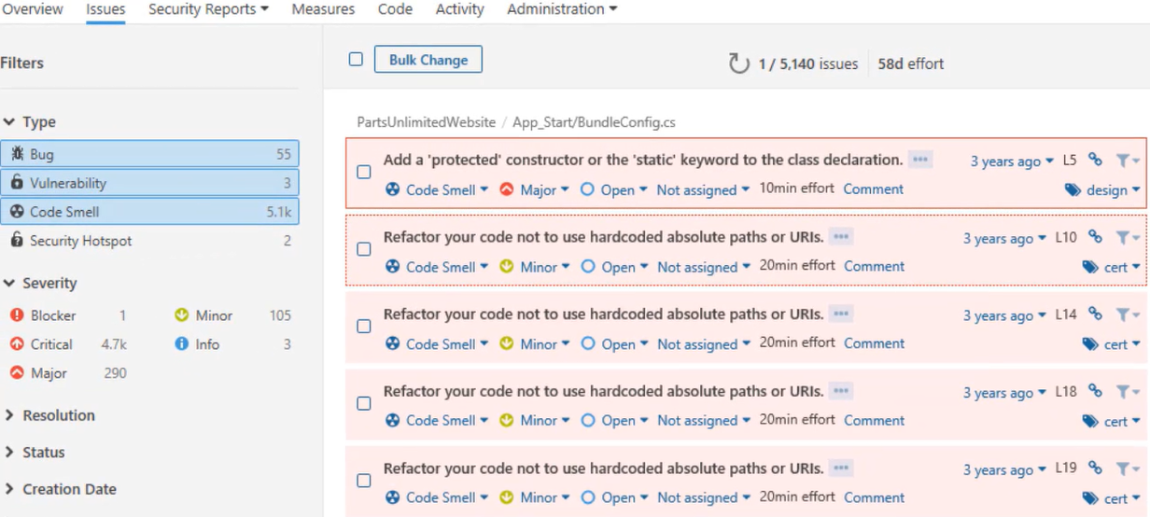
Measuring and managing technical debt

Slide 14
Integrating other code quality tools
NDepend is a Visual Studio extension that assesses the amount of technical debt that a developer has added during a recent development period, typically in the last hour
Resharper Code Quality Analysis is a command line tool and can be set to automatically fail builds when code quality issues are found
Notes:
For more information, you can see:
NDepend - https://www.ndepend.com
Visual Studio marketplace - https://marketplace.visualstudio.com/items?itemName=ndepend.ndependextension&targetId=2ec491f3-0a97-4e53-bfef-20bf80c7e1ea
Resharper Code Quality Analysis - https://marketplace.visualstudio.com/items?itemName=alanwales.resharper-code-analysis

Slide 15
Planning effective code reviews
Everyone is trying to achieve better code quality
Knowledge Sharing

Slide 16
Lesson 03: Managing security policies

Slide 17
Inspecting and validating code bases for compliance
There are many aspects to building and deploying secure applications
General knowledge problem
Code is created correctly and securely implements the required features, and we need to make sure that the features were designed with security in mind in the first place
Complies with the rules and regulations that it is required to meet

Slide 18
Planning to implement OWASP secure coding practices
Start with secure coding practices
Open Web Application Security Project (OWASP) – A global charitable organization focused on improving the security of software
OWASP regularly publish a set of Secure Coding Practices
Notes:
See http://owasp.org

Slide 19
Inspecting and validating code bases for compliance
Micro Focus Fortify searches for violations of security-specific coding rules and guidelines
Checkmarx CxSAST is designed for identifying, tracking and fixing technical and logical security flaws
BinSkim is a static analysis tool that scans binary files
OWASP Zed Attack Proxy Scan is an open-source web application for professional penetration testers
Notes:
For more information, you can see:
Fortify - https://marketplace.visualstudio.com/items?itemName=fortifyvsts.hpe-security-fortify-vsts
Checkmarx CxSAST - https://marketplace.visualstudio.com/items?itemName=checkmarx.cxsast
OWASP Zed Attack Proxy Scan - https://marketplace.visualstudio.com/items?itemName=kasunkodagoda.owasp-zap-scan
BinSkim - https://blogs.msdn.microsoft.com/secdevblog/2016/08/17/introducing-binskim/

Slide 20
Open source licensing challenges
Open source software is code that everyone can read, modify, enhance, and share
Incorporating open source code is convenient but can cause issues:
Security
Quality
Old versions
Licensing
Minimize risk by implementing automated systems to manage the code
Notes:
For more information, you can see:
Common Vulnerabilities and Exposures - https://cve.mitre.org/about/

Slide 21
Discussion: Security policy tooling
Azure DevOps can be integrated with a wide range of existing tooling that is used for checking security policy during builds
Which security policy tools do you currently use?
What do you like or don’t like about the tools?

Slide 22
Lesson 04: Lab

Slide 23
Lab: Managing technical debt with azure DevOps and SonarCloud
In this hands-on lab, Managing Technical Debt with Azure DevOps and SonarCloud, you will learn how to manage and report on technical debt using SonarCloud integration with Azure DevOps
You will perform the following tasks:
Integrate SonarCloud with Azure DevOps and run an analysis
Analyze the results
Configure a quality profile to control the rule set used for analyzing your project
Note that you must have already completed the prerequisite labs in the Welcome section
Notes:
Managing Technical Debt with Azure DevOps and SonarCloud -https://www.azuredevopslabs.com/labs/azuredevops/sonarcloud/

Slide 24
Lesson 05: Module review and takeaways

Slide 25
What did you learn?
Manage code quality including: Technical debt SonarCloud, and other tooling solutions
Manage security policies with open source and OWASP

Slide 26
Module review questions
1
You want to run a penetration test against your application. Which tool could you use?
2
What is code smells? Give an example of a code smell
3
You are using Azure Repos for your application source code repository. You want to create an audit of open source libraries that you have used. Which tool could you use?
4
Name three attributes of high-quality code
5
You are using Azure Repos for your application source code repository. You want to perform code quality checks. Which tool could you use?
Notes:
Q1 Answer: OWASP ZAP. OWASP ZAP is designed to run penetration testing against applications. Bolt is used to analyze open source library usage. The two Sonar products are for code quality and code coverage analysis.
Q2 Answer: Code smells are characteristics in your code that could possibly be a problem. Code smells hint at deeper problems in the design or implementation of the code. For example, code that works but contains many literal values or duplicated code.
Q3 Answer: WhiteSource Bolt is used to analyze open source library usage. OWASP ZAP is designed to run penetration testing against applications. The two Sonar products are for code quality and code coverage analysis.
Q4 Answer: High quality code should have well-defined interfaces. It should be clear and easy to read so self-documenting is desirable, as is short (not long) method bodies.
Q5 Answer: SonarCloud is the cloud-based version of the original SonarQube, and would be best for working with code in Azure Repos.

