Slide 1
AZ-400.00 Module 08: Implementing a container build strategy

Slide 2
Lesson 01: Module overview

Slide 3
Module overview
Lesson 1: Module overview
Lesson 2: Implementing a container build strategy
Lesson 3: Lab
Lesson 4: Module review and takeaways

Slide 4
Learning objectives
After completing this module, students will be able to:
Implement a container strategy including how containers are different from virtual machines and how microservices use containers
Implement containers using Docker

Slide 5
Lesson 02: Implementing a container build strategy

Slide 6
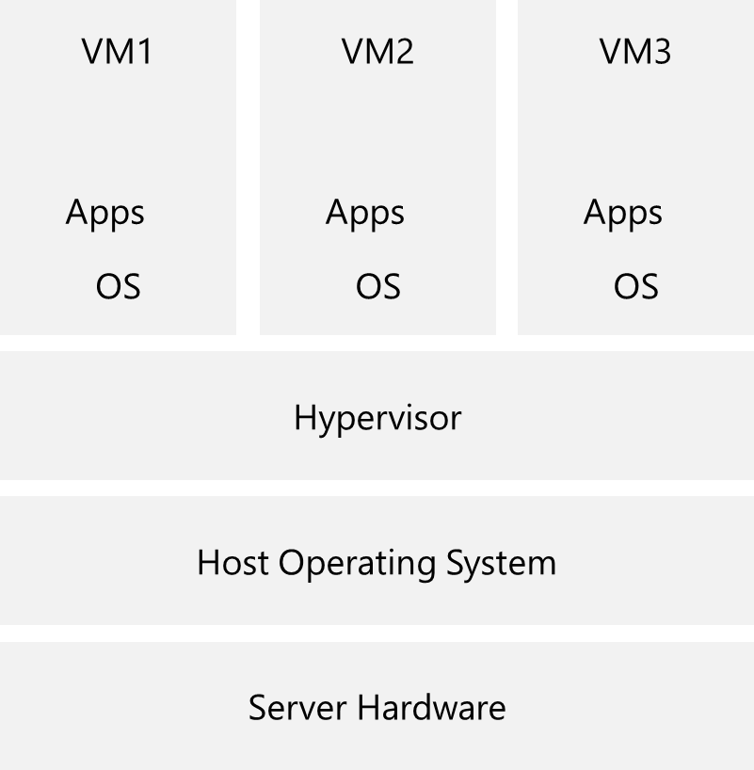
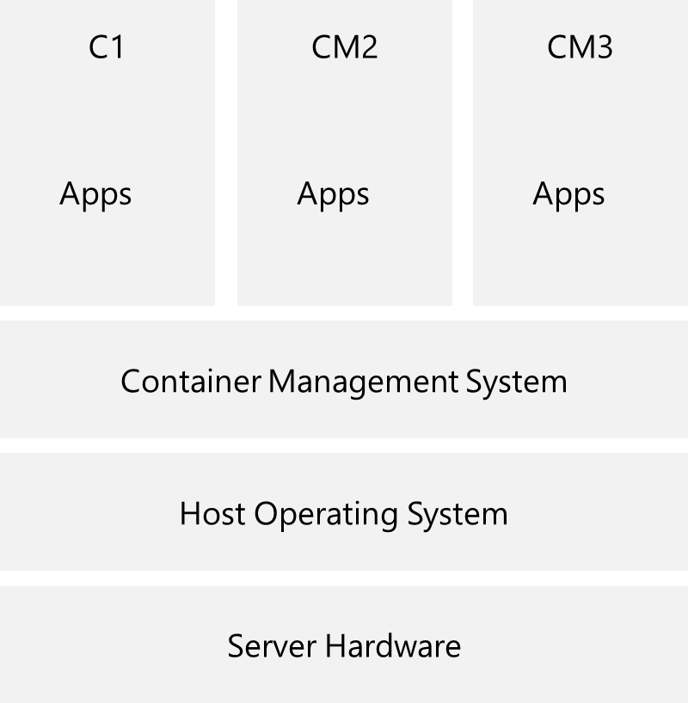
Overview of containers

Slide 7
Discussion: Containers vs virtual machines
In your development environment:
Do you currently use virtualization of any type?
Do you prefer to deploy containers or virtual machines?

Slide 8
Docker containers and development
Docker is a software containerization platform with a common toolset, packaging model, and deployment mechanism
Docker greatly simplifies containerization and distribution of applications that can be run anywhere
A Docker image can be created that will deploy identically across any environment in seconds
DockerHub has more than 180,000 applications in the public community repository
Docker organized the Open Container Initiative (OCI)
Notes:
For more information, you can see:
Docker Ebook, Docker for the Virtualization Admin - https://goto.docker.com/docker-for-the-virtualization-admin.html
Mark Russinovich blog post on Containers: Docker, Windows, and Trends- https://azure.microsoft.com/en-us/blog/containers-docker-windows-and-trends/

Slide 9
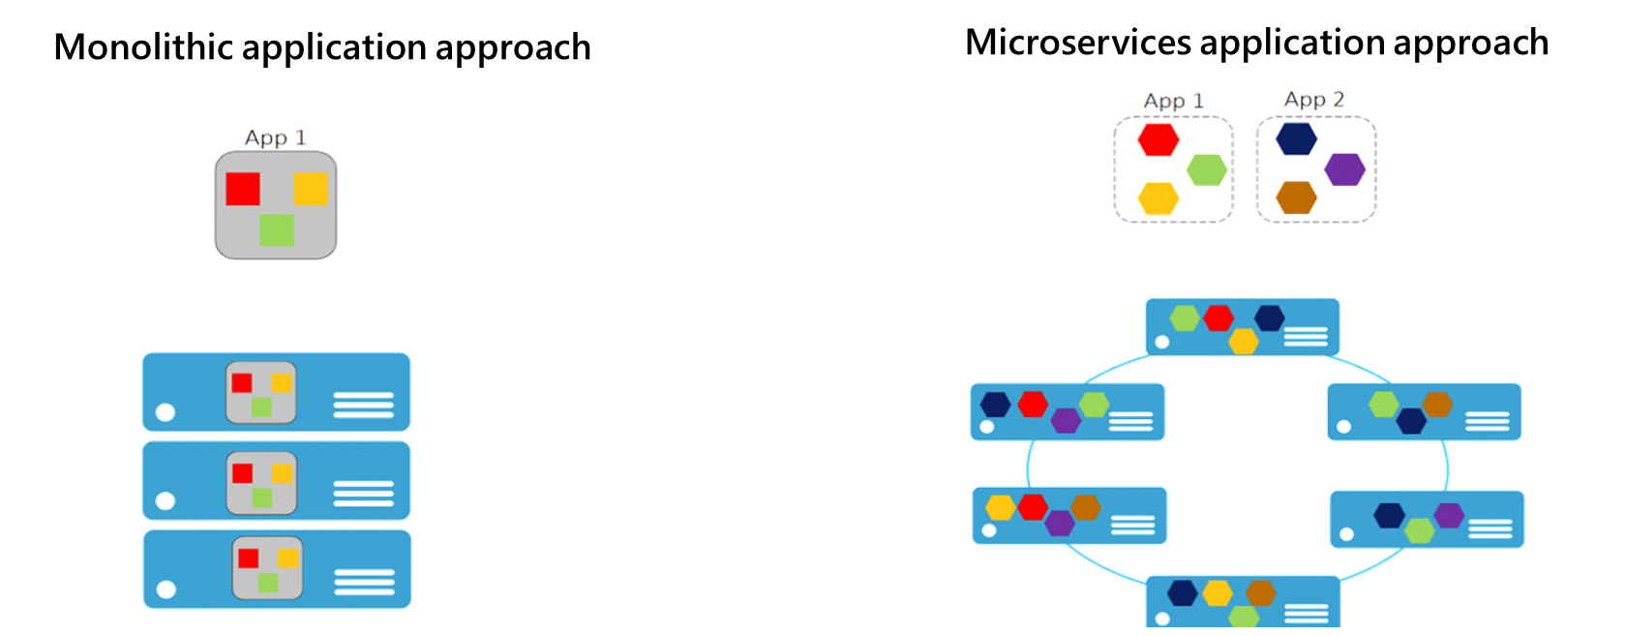

Microservices and containers
With Microservices every part of the application is deployed as a fully self-contained component

Slide 10
Azure container related services
Azure Container Instances let you focus on creating your applications rather than provisioning and management of the infrastructure
Azure Kubernetes Service is the de facto standard for container orchestration
Azure Container Registry lets you store and manage container images in a central registry
Azure Service Fabric to build and operate always-on, scalable, distributed apps
Azure App Service provides a managed service for both Windows and Linux based web applications
Notes:
For more information, you can see:
Azure Container Instances - https://azure.microsoft.com/en-us/services/container-instances/
Azure Kubernetes Service - https://azure.microsoft.com/en-us/services/kubernetes-service/
Azure Container Registry - https://azure.microsoft.com/en-us/services/container-registry/
Azure Service Fabric - https://azure.microsoft.com/en-us/services/service-fabric/
Azure App Service - https://azure.microsoft.com/en-us/services/app-service/

Slide 11
Dockerfile core concepts
FROM ubuntu
LABEL maintainer="greglow@contoso.com"
ADD appsetup /
RUN /bin/bash -c 'source $HOME/.bashrc; \
echo $HOME'
CMD ["echo", "Hello World from within the container"]
Dockerfiles are text files that contain the commands needed by docker build to assemble an image
Notes:
For more information, you can see: Dockerfile reference - https://docs.docker.com/engine/reference/builder/

Slide 12
Multiple stage builds
Keep the image size as small as possible
Each FROM instruction starts a new stage
Layers are additional instructions added to the Dockerfile
The stages are numbered in order, starting with stage 0
Multi-stage builds helps optimize the files, improves their readability, and makes them easier to maintain
Stages are named using an AS clause
Naming stages lets you build them separately
Notes:
The Demonstration: Adding Docker Support to an Existing App explains the code sample in the student guide.

Slide 13
Considerations for multiple stage builds
Adopt Container Modularity
Avoid Unnecessary Packages
Choose an Appropriate Base
Avoid Including Application Data
Notes:
For more information, you can see: Use multiple stage builds - https://docs.docker.com/develop/develop-images/multistage-build/

Slide 14
Demonstration: Create an Azure container registry
Container Registry
Microsoft
Azure Container Registry is a private registry for hosting container images. Using the Azure Container Registry, you can store Docker-formatted images for all types of container deployments. Azure Container Registry integrates well with orchestrators hosted in Azure Container Service, including Docker Swarm, DC/OS, and Kubernetes. Users can benefit from using familiar tooling capable of working with the open source Docker Registry v2.
Use Azure Container Registry to:
Store and manage container images across all types of Azure deployments
Use familiar, open-source Docker command line interface (CLI) tools
Keep container images near deployments to reduce latency and costs
Simplify registry access management with Azure Active Directory
Maintain Windows and Linux container images in a single Docker registry
Notes:
Create an Azure Container Registry - https://www.youtube.com/watch?v=IWbDG9cXa6s

Slide 15
Demonstration: Add docker support to an existing application
FROM microsoft/dotnet:2.1-aspnetcore-runtime AS base
WORKDIR /app
EXPOSE 6636
EXPOSE 44320
FROM microsoft/dotnet:2.1-sdk AS build
WORKDIR /src
COPY ["WebApplication1/WebApplication1.csproj", "WebApplication1/"]
…
RUN dotnet build "WebApplication1.csproj" -c Release -o /app
FROM build AS publish
RUN dotnet publish "WebApplication1.csproj" -c Release -o /app
FROM base AS final
WORKDIR /app
COPY --from=publish /app .
ENTRYPOINT ["dotnet", "WebApplication1.dll"]
Notes:
Add Docker Support to an Existing Application - https://www.youtube.com/watch?v=pYkQjmUsA-8

Slide 16
Lesson 03: Lab

Slide 17
Lab: Modernizing your existing ASP.NET apps with Azure
In this hands-on lab, Modernizing your existing ASP.NET Apps with Azure, you will learn how to modernize an existing ASP.NET application with migration to Docker images managed by the Azure Container Registry
You will perform the following tasks:
Migrate the LocalDB to SQL Server in Azure
Using the Docker tools in Visual Studio 2017, add Docker support for the application
Publish Docker Images to Azure Container Registry (ACR)
Push the new Docker images from ACR to Azure Container Instances (ACI)
Notes:
Follow the instructions at this location:
Modernizing your existing ASP.NET Apps with Azure -https://www.azuredevopslabs.com/labs/vstsextend/aspnetmodernize/

Slide 18
Lesson 04: Module review and takeaways

Slide 19
What did you learn?
Implement a container strategy including how containers are different from virtual machines and how microservices use containers
Implement containers using Docker

Slide 20
Module review questions
1
You are reviewing an existing Dockerfile. How would you know if it's a multi-stage Dockerfile?
2
You are designing a multi-stage Dockerfile. How can one stage refer to another stage within the Dockerfile?
3
What is the line continuation character in Dockerfiles?
4
You are using Azure to manage your containers. Which container orchestration styles are supported?
5
When the Open Container Initiative defined a standard container image file format, which format did they choose as a starting point?
Notes:
Q1 Answer: Multi-stage Docker files are characterized by containing more than one starting point provided as FROM instructions.
Q2 Answer: The FROM clause in a multi-stage Dockerfile can contain an alias via an AS clause. The stages can refer to each other by number or by the alias names.
Q3 Answer: Lines can be broken and continued on the next line of a Dockerfile by using the backslash character.
Q4 Answer: Swarm, DC/OS, and AKS are supported.
Q5 Answer: The OCI used the Docker format as a starting point.

