Slide 1
AZ-400.00 Module 9: Manage artifact versioning, security and compliance

Slide 2
Lesson 01: Module overview

Slide 3
Module overview
Lesson 5: Implement a versioning strategy
Lesson 1: Module overview
Lesson 2: Package security
Lesson 6: Lab
Lesson 7: Module review and takeaways
Lesson 3: Open source software
Lesson 4: Integrating license and vulnerability scans

Slide 4
Learning objectives
After completing this module, students will be able to:
Inspect open source software packages for security and license compliance to align with corporate standards
Configure build pipeline to access package security and license rating
Configure secure access to package feeds
Inspect codebase to identify code dependencies that can be converted to packages
Identify and recommend standardized package types and versions across the solution
Refactor existing build pipelines to implement version strategy that publishes packages
Manage security and compliance

Slide 5
Lesson 02: Package security

Slide 6
Package feeds
Package feeds are trusted sources of packages
Feeds have to be secured:
Private feeds
Not allow access by unauthorized users for publishing

Slide 7
Package compliance
Companies must be compliant to rules and regulations:
Governmental
Certification
Standards
Open-source software have licenses that might violate compliancy rules
Compliancy should be guaranteed and provable

Slide 8
Securing access to package feeds
Restricted access for consumption:
Whenever a package feed and its packages should only be consumed by a certain audience, it is required to restrict access to it. Only those allowed access will be able to consume the packages from the feed
Restricted access for publishing:
Secure access is required to restrict who can publish so feeds and their packages cannot be modified by unauthorized or untrusted persons and accounts

Slide 9
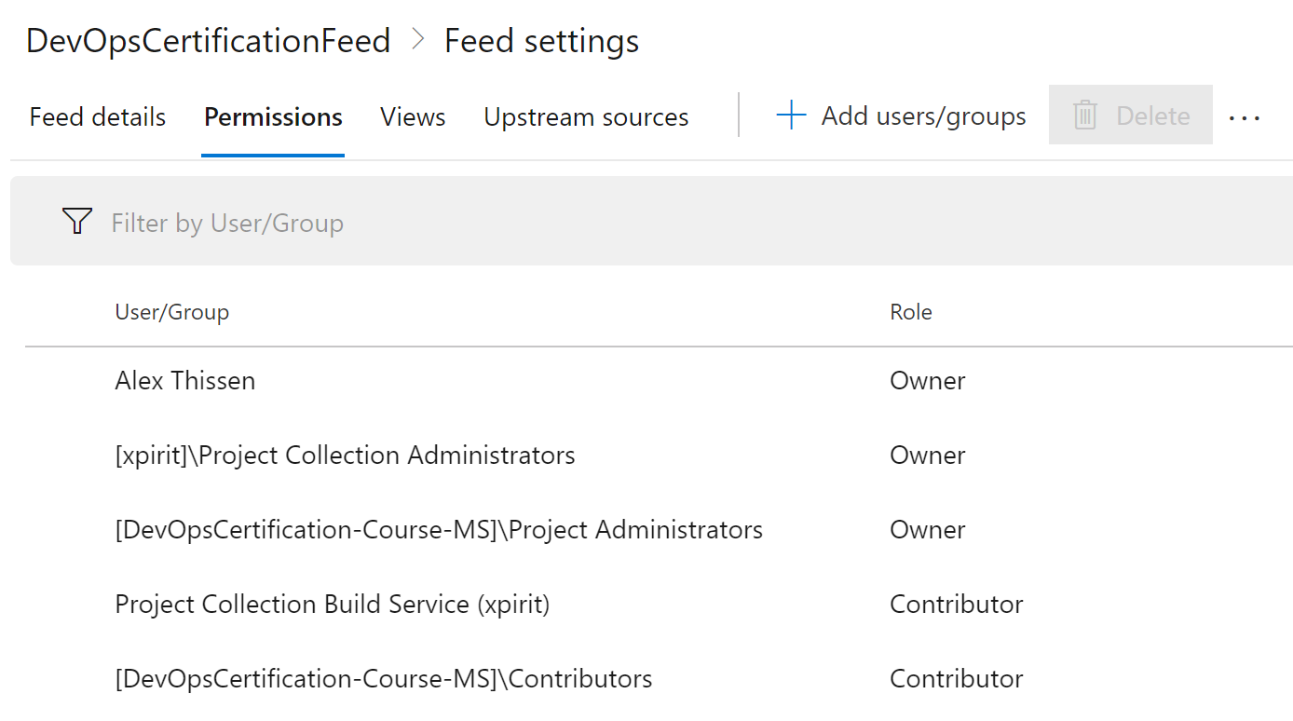
Roles
Available roles in Azure Artifacts:
Reader: Can list and restore (or install) packages from the feed
Collaborator: Is able to save packages from upstream sources
Contributor: Can push and unlist packages in the feed
Owner: Has all available permissions for a package feed
Project Collection Build Service is contributor by default

Slide 10
Permissions
Roles have certain permissions
Permission | Reader | Collaborator | Contributor | Owner
List and restore/install packages | ✓ | ✓ | ✓ | ✓
Save packages from upstream sources |  | ✓ | ✓ | ✓
Push packages |  |  | ✓ | ✓
Unlist/deprecate packages |  |  | ✓ | ✓
Delete/unpublish package |  |  |  | ✓
Edit feed permission |  |  |  | ✓
Rename and delete feed |  |  |  | ✓

Slide 11
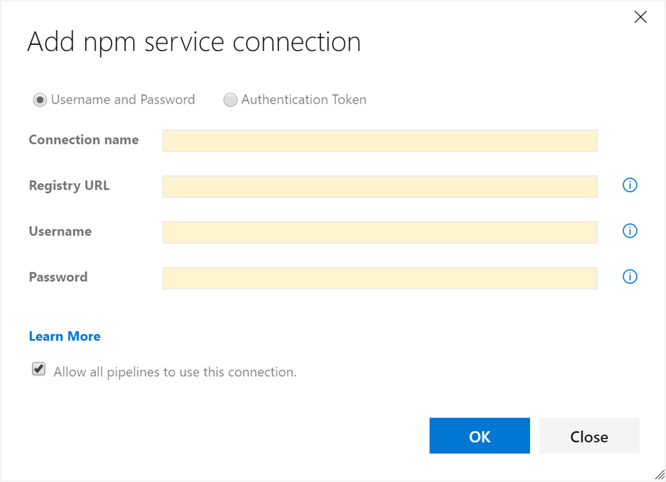
Credentials
Authentication is required for Azure Artifacts
Transparently taken care of when logged into portal or in build tasks
External package sources may require credentials:
Create a service connection

Slide 12
Lesson 03: Open source software

Slide 13
How software is built
Software based for 80% on components:
Internal teams
Commercial 3rd party
Open-source community
Almost all software nowadays uses open-source software is some way, shape or form

Slide 14
What is open-source software?
Open-source software (OSS) is a type of computer software in which source code is released under a license in which the copyright holder grants users the rights to study, change, and distribute the software to anyone and for any purpose
https://en.wikipedia.org/wiki/Open-source_software

Slide 15
Challenge to corporates
Be of low quality:
This would impact maintainability, reliability and performance of the overall solution
Have no active maintenance:
The code would not evolve over time or be alterable without making a copy of the source code, effectively forking away from the origin
Contain malicious code:
The entire system that includes and uses the code will be compromised. Potentially the entire company’s IT and infrastructure is affected
Have security vulnerabilities:
The security of a software system is as good as its weakest part. Using source code with vulnerabilities makes the entire system susceptible to attack by hackers and misuse
Have unfavorable licensing restrictions:
The effect of a license can affect the entire solution that uses the open-source software

Slide 16
Licenses and vulnerabilities
According to the open source definition of OpenSource.org a license should not:
Discriminate against persons or groups
Discriminate against fields of endeavor
Be specific to a product
Restrict other software

Slide 17
Open-source package license
Restrictive
ATTRIBUTION
BSD
MIT
Apache
DOWNSTREAM
MPL
EPL
MS-RL
COPYLEFT
GPL
LGPL
AGPL
Permissive

Slide 18
License implications and rating
Using a package implies following license requirements:
Depending on license type this may have a high, medium or low impact on distributed software using it
License rating indicates impact of use of packages:
Compliancy
Intellectual property
Exclusive rights

Slide 19
Lesson 04: Integrating license and vulnerability scans

Slide 20
Artifact repositories
Artifact repositories are centralized package storages within a company:
Similar to package feeds facilitates in:
Proxying external package sources
Creating a single (internal) repository for packages
Providing overview of packages in use
Scanning packages

Slide 21
Tools for assessing package security and license rating
Approach 1: Scan centralized artifact repository
Approach 2: Tooling during build in pipeline
Tool | Type
Artifactory | Artifact repository
SonarQube | Static code analysis tool
White Source(Bolt) | Build scanning

Slide 22
White source bolt
DEMO

Slide 23
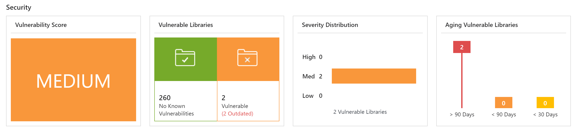
Interpret alerts from assessment
Report Contains
Security vulnerabilities
License risks and compliancy
Outdated libraries
Aspects to keep in mind:
False positives
Security bug bar

Slide 24
Lesson 05: Implement a versioning strategy

Slide 25
Introduction to versioning
Software changes: Your code and dependencies alike:
Packages need to be versioned
Identification
Maintainability
Each package has its own lifecycle and rate of change

Slide 26
Immutable packages
Packages are immutable
Packages are immutable
Once published a package cannot be changed
Replacing or updating a package is not allowed
Any change requires a new version

Slide 27
Versioning of artifacts
Way to express version technically varies per package type
Versioning requires a scheme
Typical Scheme:
2.1.15
Major
Minor
Patch

Slide 28
Semantic versioning
Express nature and risk of change
1.2.3
-beta2
Nature of change
Quality of change
See also: https://semver.org

Slide 29
Release views
Views help in defining quality without changing version numbers
Three default views:
Local
Release
Prerelease
1
2
3
https://pkgs.dev.azure.com/{yourteamproject}/_packaging/{feedname} @{Viewname}/nuget/v3/index.json

Slide 30
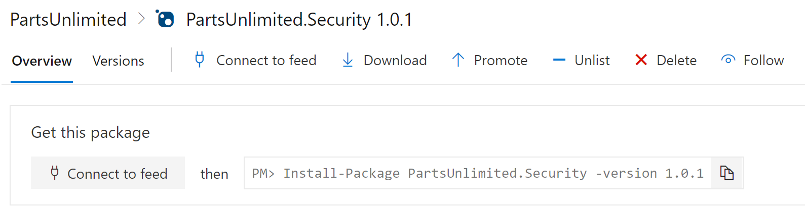
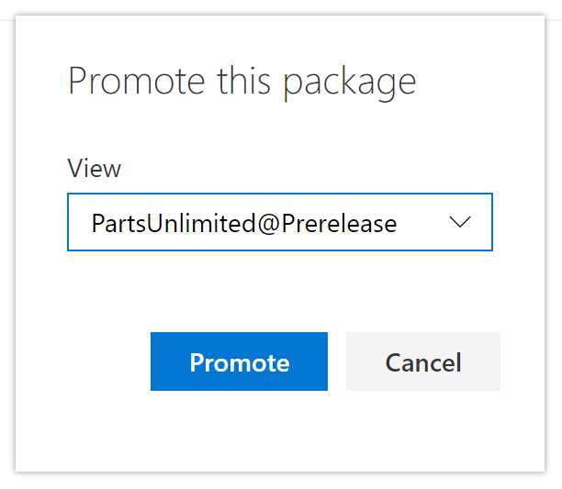
Promoting packages
Promote packages from @local view to other release views
Upstream sources will only be evaluated from @local view:
Only visible in other release views after being promoted

Slide 31
Promoting a package
DEMO

Slide 32
Best practices for versioning
Have a documented versioning strategy
Adopt SemVer 2.0 for your versioning scheme
Each repository should have a unique feed
When creating a package, also publish it to the unique feed

Slide 33
Pushing from the pipeline
DEMO

Slide 34
Lesson 06: Lab

Slide 35

Lab: Manage open source security and license with white source
In this lab, Managing Open-Source Security and License with Whitesource, you will use White Source Bolt with Azure DevOps to automatically detect alerts on vulnerable open source components, outdated libraries, and license compliance issues in your code. You will be using Web Goat, a deliberately insecure web application, maintained by OWASP designed to teach web application security lessons. You will learn how to:
Detect and remedy vulnerable open source components
Generate comprehensive open source inventory reports per project or build
Enforce open source license compliance, including dependencies’ licenses
Identify outdated open source libraries with recommendation to update
Note that you must have already completed the prerequisite labs in the Welcome section
Notes:
Managing Open-Source Security and License with Whitesource - https://www.azuredevopslabs.com/labs/vstsextend/WhiteSource

Slide 36
Lesson 07: Module review and takeaways

Slide 37
What did you learn?
Inspect open source software packages for security and license compliance to align with corporate standards
Configure build pipeline to access package security and license rating
Configure secure access to package feeds
Inspect codebase to identify code dependencies that can be converted to packages
Identify and recommend standardized package types and versions across the solution
Refactor existing build pipelines to implement version strategy that publishes packages
Manage security and compliance

Slide 38
Module review questions:
1
What issues are often associated with the use of open source libraries?
2
How can an open source library cause licensing issues if it is free to download?
3
What is the minimum feed permission that will allow you to list available packages and to install them?
4
What is open source software?
5
How can you restrict which files are uploaded in a universal package feed?
Notes:
Q1 Answer: Bugs, security vulnerabilities, and licensing issues
Q2 Answer: Each library has usage restrictions as part of the licensing. These restrictions might not be compatible with your intended application use.
Q3 Answer: Reader
Q4 Answer: A type of software where users of code are permitted to study, change, and distribute the software. The open source license type can limit the actions (such as sale provisions) that can be taken.
Q5 Answer: By using an .artifactignore file

