Slide 1
AZ-400.00 Module 12: Implement an appropriate deployment pattern

Slide 2
Lesson 01: Module overview

Slide 3
Module overview
Lesson 1: Module overview
Lesson 6: Dark launching
Lesson 2: Introduction to deployment patterns
Lesson 7: A/B testing
Lesson 3: Implement blue green deployment
Lesson 8: Progressive exposure deployment
Lesson 4: Feature toggles
Lesson 9: Lab
Lesson 5: Canary releases
Lesson 10: Module review and takeaways

Slide 4
Learning objectives
After completing this module, students will be able to:
Describe deployment patterns
Implement blue-green deployment
Implement canary release
Implement progressive exposure deployment

Slide 5
Lesson 02: Introduction into deployment patterns

Slide 6
Introduction
Continuous delivery is more than release management
Deployment is only a step:
Testing
Safe coding
Architecture
Monoliths are hard to deliver because of all the dependencies:
Break up in smaller pieces
Microservices

Slide 7

Definitions of microservices
Small and focused on doing one thing well autonomous
“Loosely coupled service oriented architecture with bounded contexts”
‒ Adrian Cockcroft (Netflix)
“SOA done right”
‒ Anonymous
“… services are independently deployable and scalable, each service also provides a firm module boundary, even allowing for different services to be written in different programming languages”
‒ Martin Fowler (Thoughtworks)

Slide 8
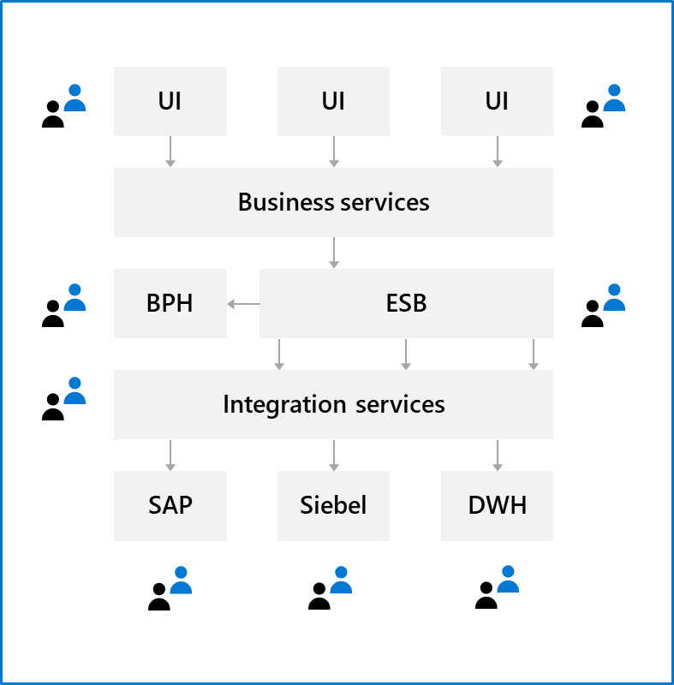
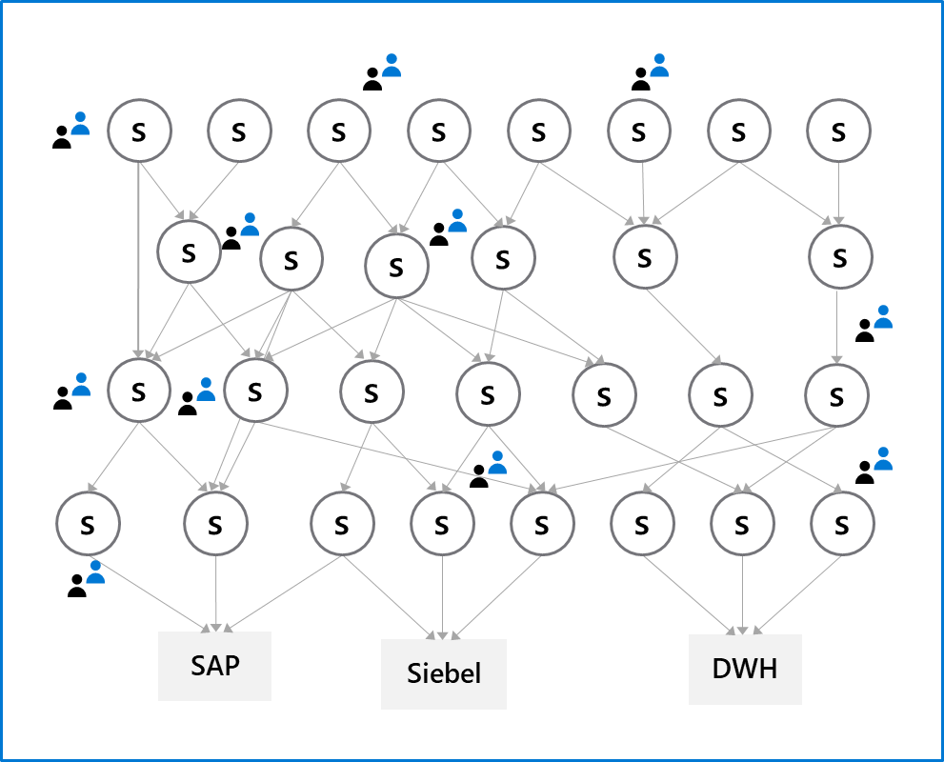
Micro services architecture

Slide 9
Deployment patterns
“Classical” deployment patterns
Dev
Test
Staging
Production

Slide 10

“THERE IS NO PLACE LIKE PRODUCTION”
Source: Brian Harry, Microsoft Technical Fellow

Slide 11
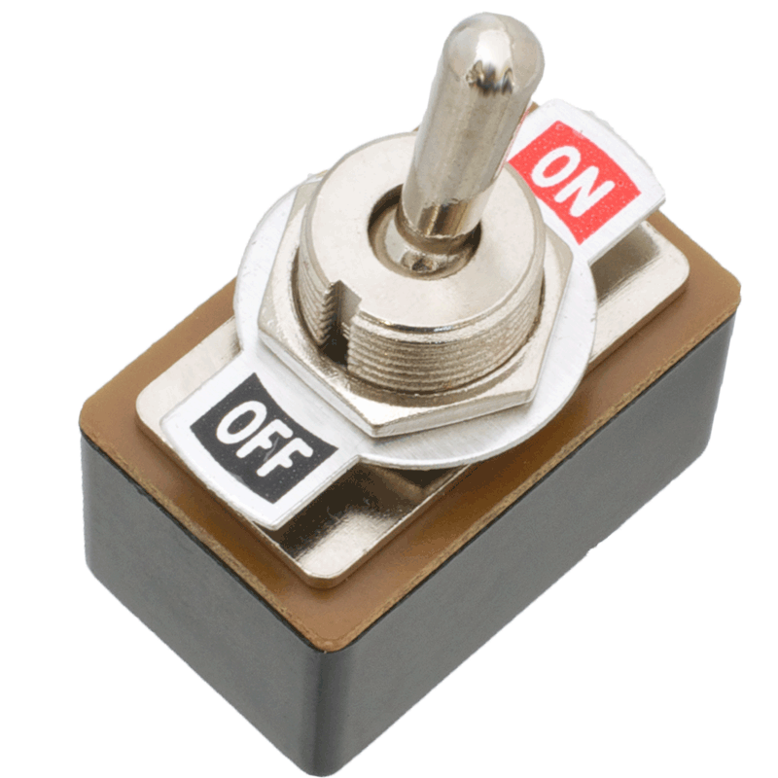
Modern practices
Blue green deployments
Canary releases
Dark launching
A/B testing
Progressive exposure deployment/ring based deployments
Enabled by feature toggles

Slide 12
Discussion – A critical look at your architecture
Are your architecture and the current state of your software ready for continuous delivery?
Topics you might want to consider are:
Is your software built as one big monolith or is it divided into multiple components?
Can you deliver parts of your application separately?
Can you guarantee the quality of your software when deploying multiple times a week?
How do you test your software?
Do you run 1 or multiple versions of your software?
Can you run multiple versions of your software side-by-side?
What do need to improve to implement continuous delivery?

Slide 13
Lesson 03: Implement blue green deployment

Slide 14
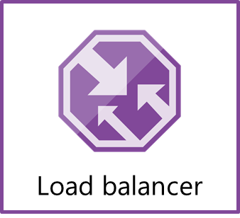
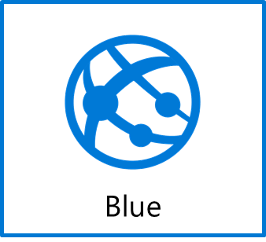

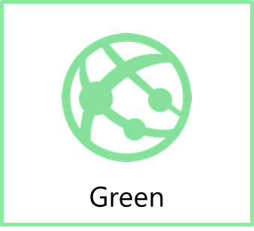
Blue green deployment
www.production.com
Swap
www.temp.production.com

Slide 15
Deployment slots
What is it?
A way to set up multiple environments and swap between environments
Why do you need it?
When you want to deploy with zero downtime
When you need to test in production
When you want easy rollback

Slide 16
Set up a blue – green deployment
DEMO
Notes:
Take a moment to complete the demonstration, as defined in the student manual.

Slide 17
Lesson 04: Feature toggles

Slide 18
Feature toggle
What is it?
Mechanism to separate feature deployment from feature exposure
A.k.a. feature flippers, feature flags, feature switch, conditional feature, etc.
Why do you need it?
It enables you to give control back to the business on when to release the feature
Enables A/B testing, canary releases and dark launching
It provides an alternative to keeping multiple branches in version control
Enables change without redeployment

Slide 19
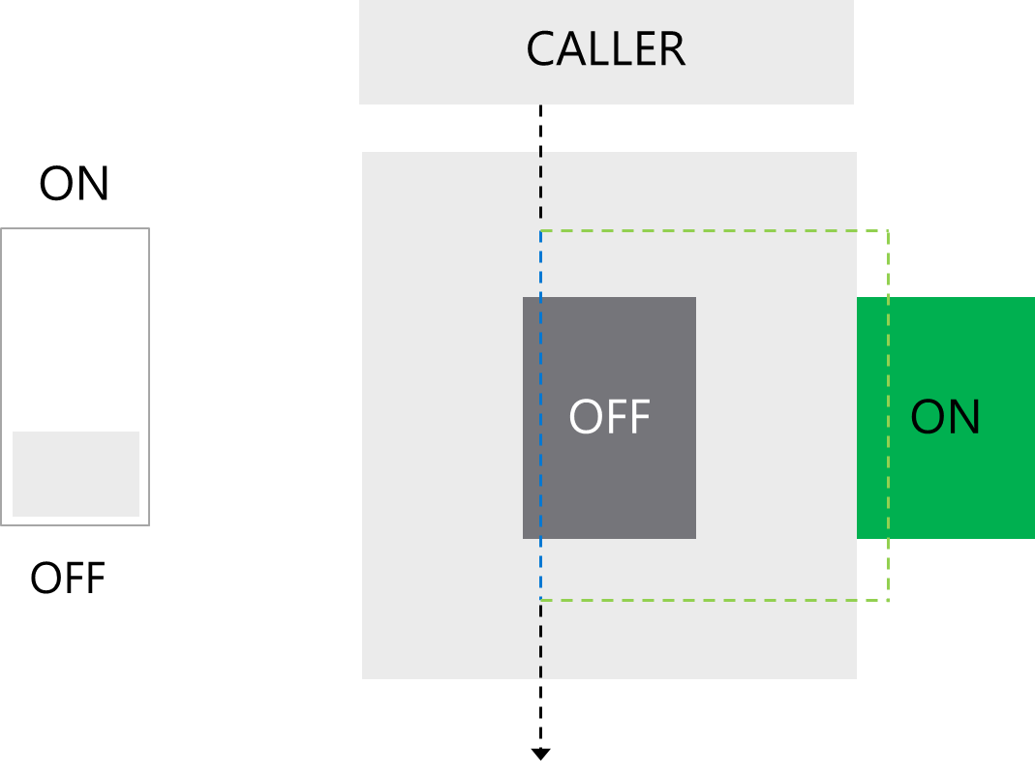
Feature toggle

Slide 20
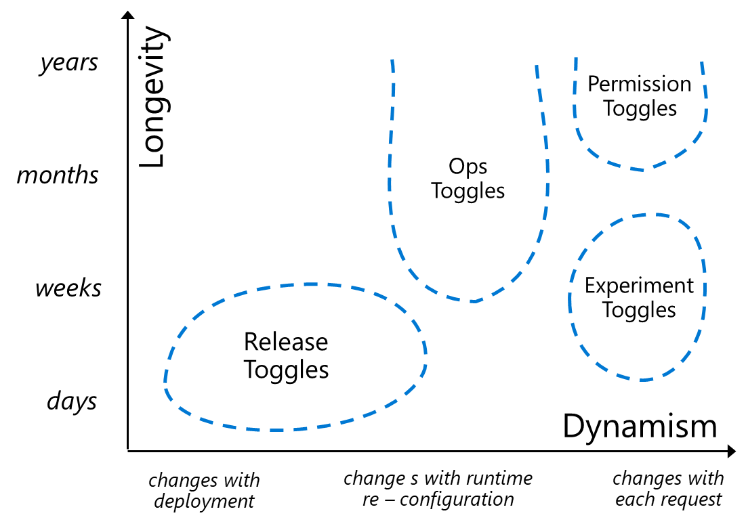
Feature toggle maintenance
Feature toggles need to be maintained!
Remove them when you can
It is technical debt if you keep them around
Source:http://martinfowler.com/articles/feature-toggles.html

Slide 21

Lesson 05: Canary releases

Slide 22

Canary release
What is it?
Releasing a feature to a limited subset of end users
Why do you need it?
Validates there is no break
When you want to gradually roll out a feature to ensure enough capacity

Slide 23

Canary release
How do you do it?
Use a combination of feature toggles, traffic routing and deployment slots
Random selection of users:
Setup deployment slots with feature enable
Route %traffic to the instance with the new feature enabled
Target specific user segment
Use feature toggle to enable feature for specific user segment

Slide 24



Canary release
Load Balancer
v1
v1
v1
v1

Slide 25
Traffic manager
What is it?
Traffic manager provides the ability to route traffic between Azure app services
Within an app service, routes traffic between deployment slots
Why do you need it?
It enables failover and load distribution capabilities
It enables you to deploy to a slot and then slowly move traffic over to the other slot

Slide 26
Traffic manager options
Traffic manager provides four options:
1
Route traffic based on availability
2
Route traffic round robin
3
Route traffic based on weight
4
Route traffic based on latency
In the context of continuous delivery, we are most interested in option 1 and 3

Slide 27
Ring-based deployment
DEMO
Notes:
Take a moment to complete the demonstration, as defined in the student manual.

Slide 28
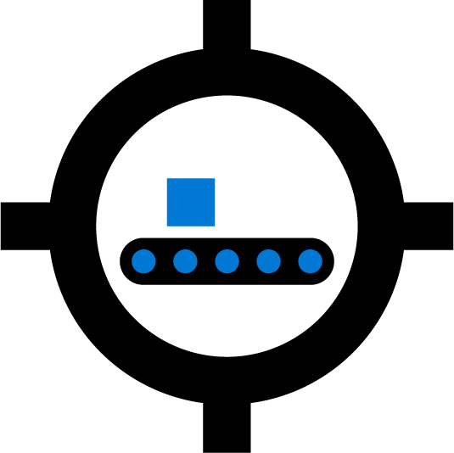
Lesson 06: Dark launching

Slide 29
Dark launching
Dark Launching is in many ways similar to Canary Testing. However, the difference here is that you are looking to assess the response of users to new features in your frontend, rather than testing the performance of the backend. The idea is that rather than launch a new feature for all users, you instead release it to a small set of users. Usually, these users aren’t aware they are being used as guinea pigs for the new feature and often you don’t even highlight the new feature to them, hence the term “Dark” launching

Slide 30
Lesson 07: A/B testing

Slide 31
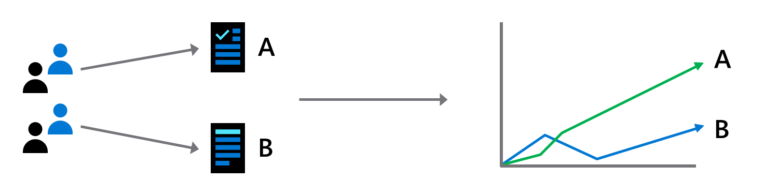
A/B testing
A/B testing is mostly an experiment where two or more variants of a page are shown to users at random, and statistical analysis is used to determine which variation performs better for a given conversion goal

Slide 32
Why A/B testing
Experiment on features and usage
Improve conversion rate
Continuous experiments
Measure impact of change

Slide 33

Lesson 08: Progressive exposure deployment

Slide 34
What is progressive exposure deployment
A.k.a. Ring Based Deployment
Deploy changes to risk tolerant customers first, progressively roll out to larger and larger sets of customers
Automated health checks
Possibility to stop or roll back

Slide 35
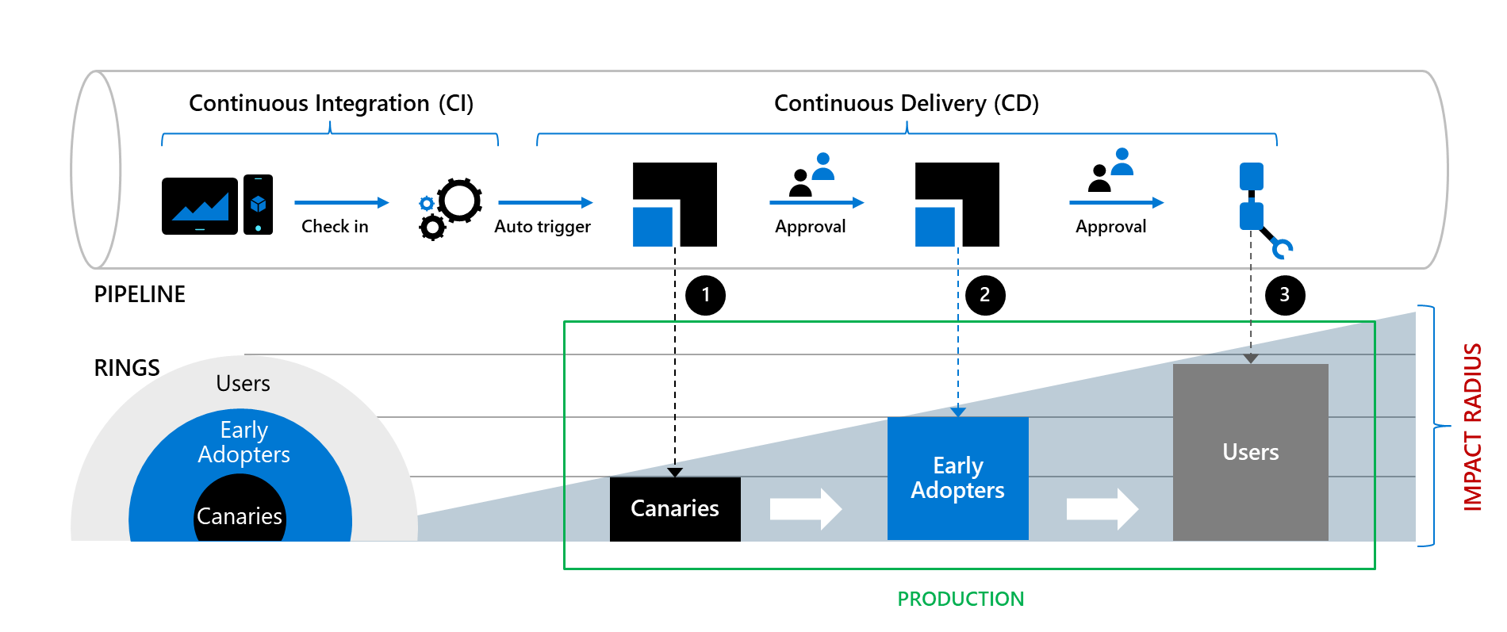
CI/CD with deployment rings

Slide 36
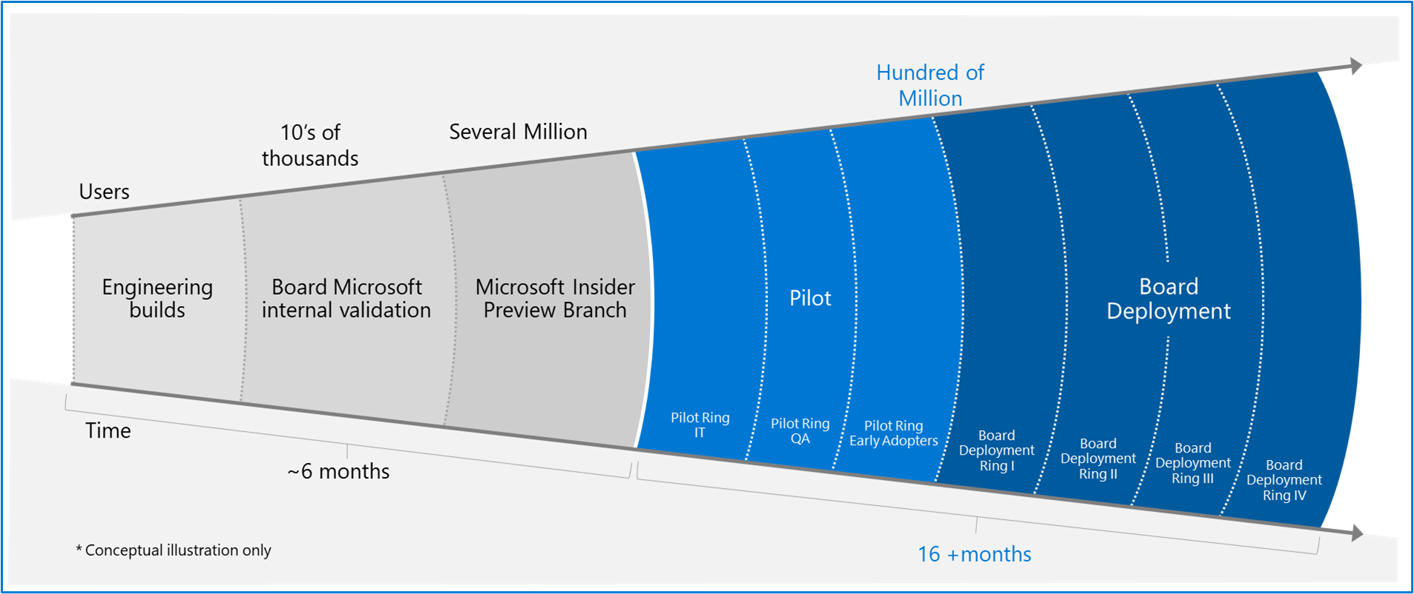
Example: Windows team

Slide 37
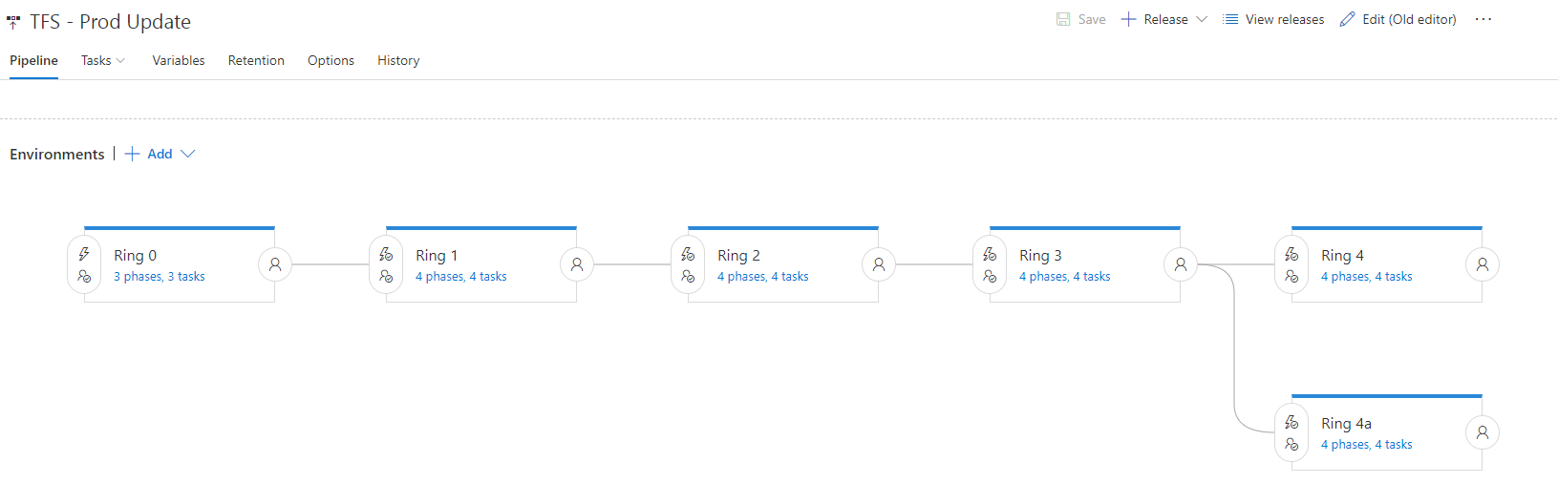
Deployment definition
In Azure DevOps, rings are modeled as Stages

Slide 38
Lesson 09: Lab

Slide 39

Lab: Feature flag management with LaunchDarkly and Azure DEVOPS
In this lab, Feature Flag Management with LaunchDarkly and AzureDevOps, you will investigate the use of feature flags and learn how to:
Implement a very simple feature flag for an ASP.NET MVC application
Integrate LaunchDarkly with Azure DevOps
Roll out LaunchDarkly feature flags in Azure DevOps release pipelines
Note that you must have already completed the prerequisite labs in the Welcome section
Notes:
Feature Flag Management with LaunchDarkly and AzureDevOps - https://www.azuredevopslabs.com/labs/vstsextend/launchdarkly/

Slide 40
Lesson 10: Module review and takeaways

Slide 41
What did you learn?
Describe deployment patterns
Implement blue-green deployment
Implement canary release
Implement progressive exposure deployment

Slide 42
Module review questions
1
What is the easiest way to create a staging environment for an Azure WebApp?
2
What Azure-based tool can you use to divert a percentage of your web traffic to a newer version of an Azure website?
3
What characteristics make users suitable for working with Canary deployments?
4
What is a potential disadvantage of using Canary deployments?
5
Apart from the traffic routing method, what else does Azure Traffic Manager consider when making routing decisions?
Notes:
Q1 Answer: Create a webslot (deployment slot)
Q2 Answer: Azure Traffic Manager
Q3 Answer: High tolerance for issues; Like working with bleeding-edge code.
Q4 Answer: Needing to look after multiple versions of code at the same time. Or, the users might not be the right ones to test changes in the particular deployment.
Q5 Answer: Health of the end point. (It includes built-in endpoint monitoring and automatic endpoint failover)

