Slide 1
AZ-400.0 Module 13: Implement process for routing system feedback to development teams

Slide 2
Lesson 01: Module overview

Slide 3
Module overview
Lesson 1: Module overview
Lesson 5: Migrating to Azure DevOps
Lesson 2: Implement tools to track system usage, feature usage, and flow
Lesson 6: Lab
Lesson 3: Implement routing for mobile application
Lesson 7: Module review and takeaways
Lesson 4: Develop monitoring and status dashboards

Slide 4
Learning objectives
After completing this module, students will be able to:
Configure crash report integration for client applications
Develop monitoring and status dashboards
Implement routing for client application crash report data
Implement tools to track system usage, feature usage, and flow
Integrate and configure ticketing systems with development team’s work management

Slide 5
Lesson 02: Implement tools to track system usage, feature usage, and flow

Slide 6
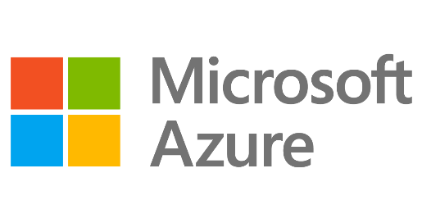
Microsoft Azure management overview
Introduction
MIGRATE
GOVERN
Policy management
Cost management
SECURE
Security management
Threat protection
CONFIGURE
Configuration
Update management
Automation
Scripting
PROJECT
Backup
Disaster recovery
MONITOR
App, infra & network monitoring Log Analytics & Diagnostics

Slide 7
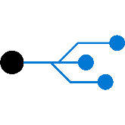
Azure application insights
Azure Log Analytics
Web pages
Client apps
Alerts
AI
PowerBI
Https request
Application Insights
Your Web Services
Visual
Studio
AI
Rest API
Dependency Calls
SQL
External Services
Background Services
Continuous
Export
AI
Azure

Slide 8
How do I use application insights
Monitor
Detect, Diagnose
Build, Measure, Learn

Slide 9
How do I use application insights
DEMO
Notes:
Take a moment to complete the demonstration, as defined in the student manual.

Slide 10
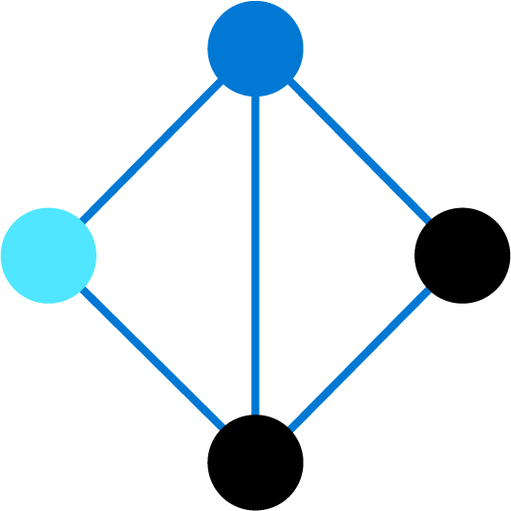
Lesson 03: Implement routing for mobile application crash report data

Slide 11
App center diagnostics
App Center Diagnostics is a cloud service that helps developers monitor the health of an application, delivering the data needed to understand what happens when an app fails during testing or in the wild
In the App Center Diagnostics UI, you can attach, view and download one binary and one test attachment to your crash reports
Track events leading up to a crash to capture useful information about the state of your app

Slide 12
Configure alerts
1
Log into App Center and select your app
2
In the left menu, navigate to Settings
3
Click on Email notifications
4
Select the box next to crashes

Slide 13
Create a bug tracker

Slide 14
Lesson 04: Develop monitoring and status dashboards

Slide 15
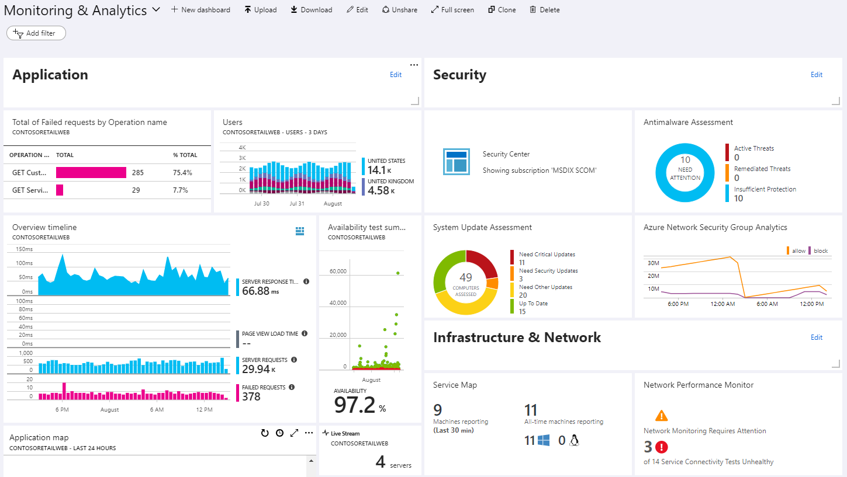
Azure dashboards

Slide 16
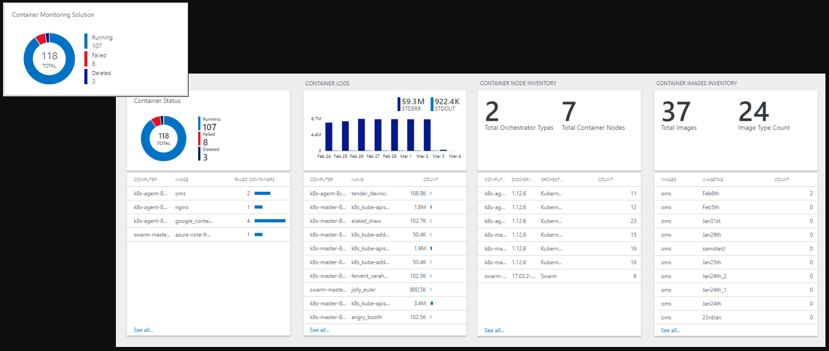
View designer in Azure monitor

Slide 17
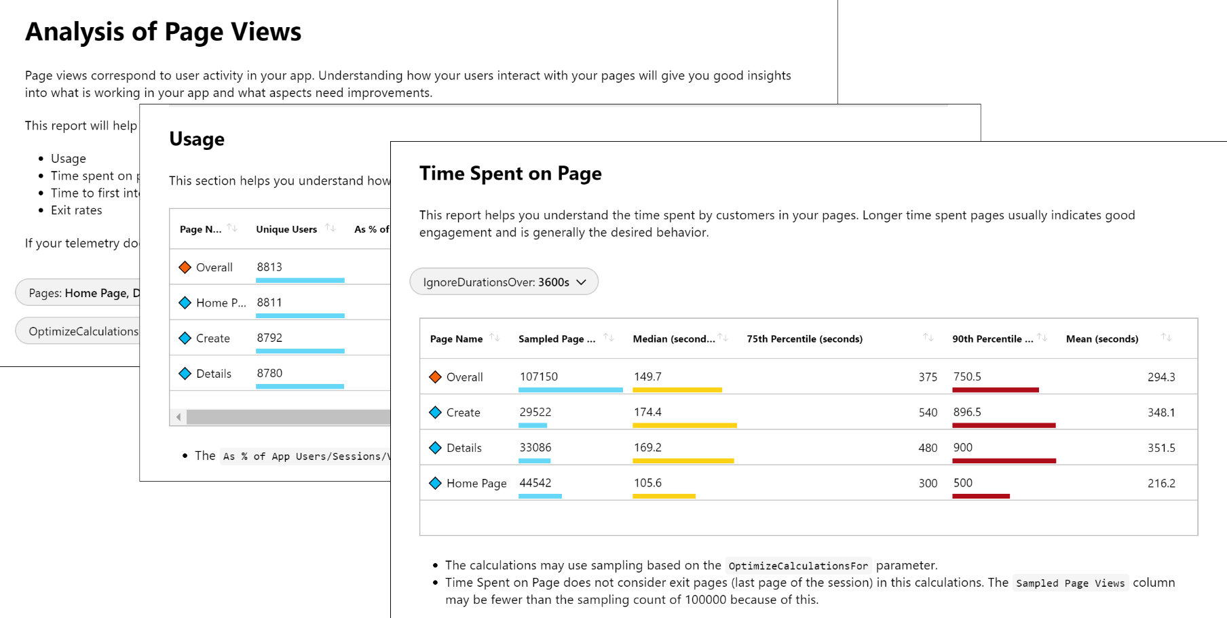
Azure monitor workbooks

Slide 18
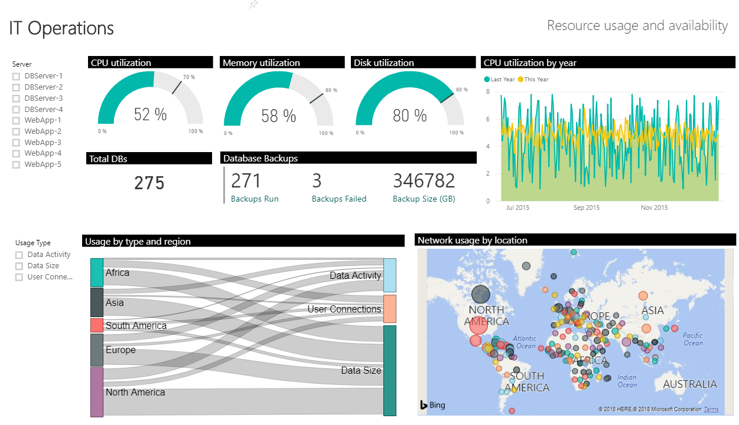
Power BI

Slide 19
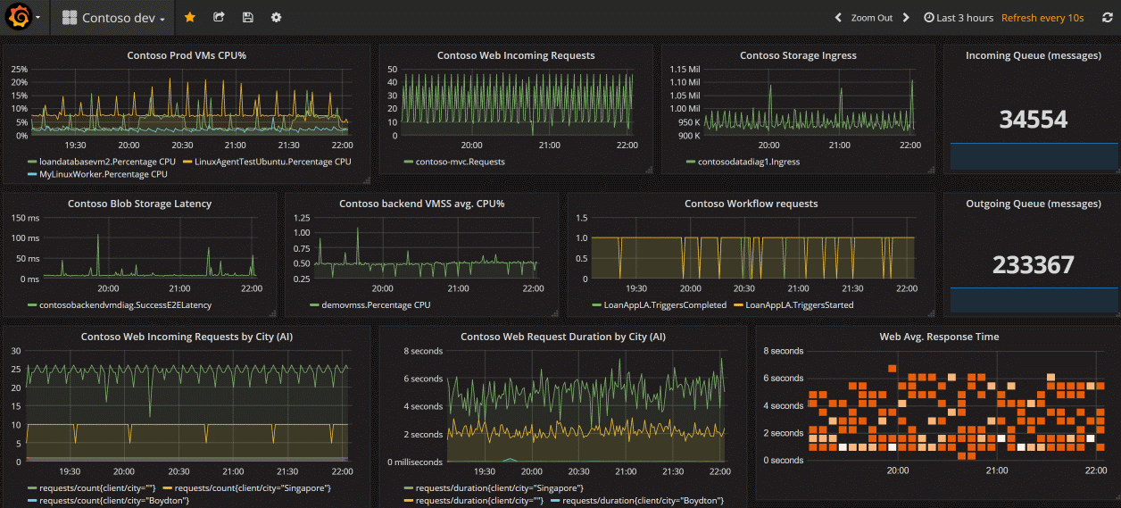
Grafana

Slide 20
Build your own custom application
Advantages:
Complete flexibility
Combine metrics and log data
Disadvantages:
Significant engineering required

Slide 21

Lesson 05: Integrate and configure ticketing systems

Slide 22
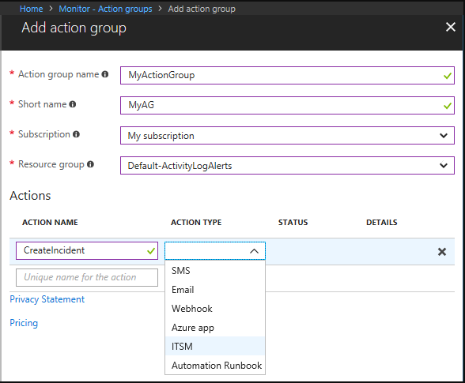
IT Service Management connector

Slide 23
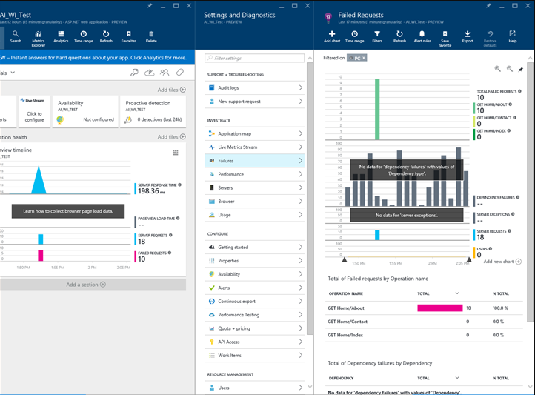
Integrate with Azure boards

Slide 24
Lesson 06: Lab

Slide 25

Lab: Monitoring application performance with application insights
In this lab, Monitoring Application Performance with Application Insights, you will learn how to:
Implement application insights
Track application usage
Create application alerts
Note that you must have already completed the prerequisite labs in the Welcome section
Notes:
Monitoring Application Performance with Application Insights - https://azuredevopslabs.com/labs/azuredevops/appinsights/

Slide 26
Lesson 07: Module review and takeaways

Slide 27
What did you learn?
Configure crash report integration for client applications
Develop monitoring and status dashboards
Implement routing for client application crash report data
Implement tools to track system usage, feature usage, and flow
Integrate and configure ticketing systems with development team's work management

Slide 28
Module review questions
Does Azure Monitor allow you to create alerts from log query?
1
What features are provided by Azure Monitor?
2
3
What query language can you use to query Azure Log Analytics?
4
What platform integration does Azure Monitor provide to visualize your logs in real time?
Notes:
Q1 Answer: yes
Q2 Answer: 1. Detect and diagnose issues across applications and dependencies with Application Insights.
2. Correlate infrastructure issues with Azure Monitor for VMs and Azure Monitor for Containers.
3. Create visualizations with Azure dashboards and workbooks.
4. Support operations at scale with smart alerts and automated actions.
Q3 Answer: Kusto
Q4 Answer: Power BI and/or Grafana

