Slide 1
AZ-400.00 Module 15: Azure Deployment Models and Services

Slide 2
Lesson 01: Module overview

Slide 3
Module overview
Lesson 1: Module overview
Lesson 5: Serverless and HPC Computer Services
Lesson 2: Deployment models and options
Lesson 6: Azure Service Fabric
Lesson 3: Azure Infrastructure-as-a-Service (IaaS) services
Lesson 7: Lab
Lesson 4: Azure Platform-as-a-Service (PaaS) services
Lesson 8: Module review and takeaways

Slide 4
Learning objectives
After completing this module, students will be able to:
Describe deployment models and services that are available with Azure

Slide 5
Lesson 02: Deployment models and options

Slide 6
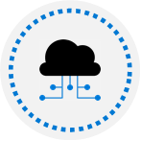
Comparing IaaS, PaaS, and FaaS
IaaS:
You must provision the individual VMs with their associated network and storage components. Microsoft manages the physical infrastructure.
PaaS:
Azure provides a managed hosting environment for deploying applications
Doesn’t require management of VMs or networking resources
FaaS:
Makes use of serverless architecture
FaaS goes furthest in removing the need to worry about the hosting environment
Simplicity, elastic scale, and paying only for time code is running
Notes:
This is a general description of the three models without going into real detail. Describe how each model generally differs and emphasize that the needs of the application and the application’s consumers will determine which implementation offers the best approach in each case.
When comparing the three environments, remember that:
IaaS gives the most control, flexibility, and portability.
FaaS provides simplicity, elastic scale, and potential cost savings because you pay only for the time your code is running.
PaaS falls somewhere between the two.
In general, the more flexibility a service provides, the more responsible you are for configuring and managing the resources.
FaaS services automatically manage nearly all aspects of running an application, while IaaS solutions require you to provision,
configure, and manage the VMs and network components you create.

Slide 7
Azure compute options
IaaS:
Azure virtual machines
PaaS:
Azure App Service
Azure Container Instances
Azure Cloud Services
FaaS:
Azure Functions
Azure Batch
Modern native cloud apps, providing massive scale and distribution:
Azure Service Fabric
Azure Kubernetes Service
Notes:
This slide lists out the various compute services that are available bucketed according to the service model

Slide 8
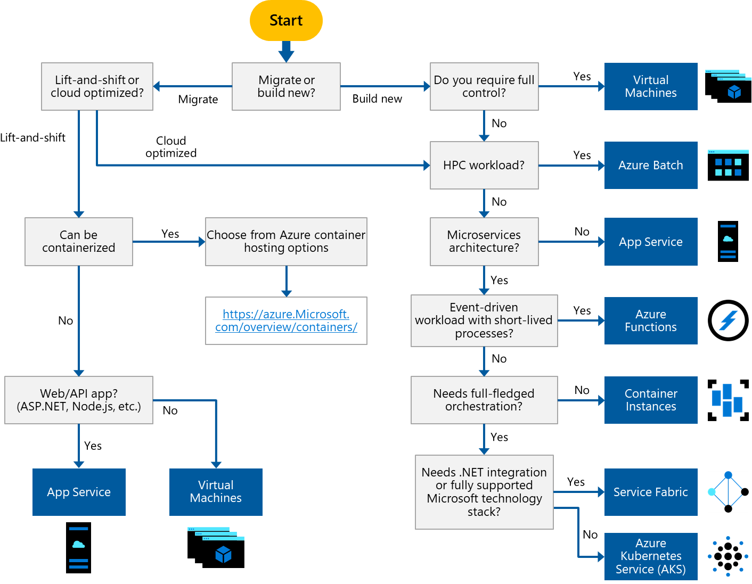
Choosing a compute service
Hosting model for your compute resources.
Evaluate each application for its unique requirements:
Feature sets
Service limits
Cost
SLA
Regional availability
Developer ecosystem and team skills
Compute comparison tables
Notes:
Azure offers several options to host your application code. As you determine the compute resources for your application, use the flowchart as a starting point to help evaluate the key decision criteria to reach an optimal solution for your application(s).
Stress that every application will have unique requirements and there are additional considerations to evaluate beyond what is explicitly called out in the flowchart.
Also point out that you will in many cases need to evaluate separate workloads within and application depending on the complexity of the solution. A complete solution might incorporate two or more compute services.

Slide 9
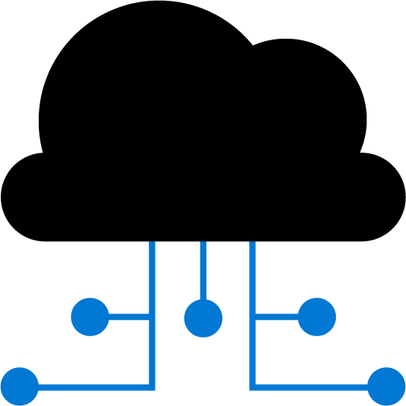
Lesson 03: Azure Infrastructure-as-a-Service (IaaS) services

Slide 10
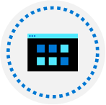
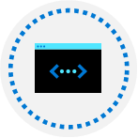
Azure virtual machines
Azure VMs provide the benefits of virtualization, but must still be deployed, configured, and maintained
Operating system support for Windows and Linux OS deployments
Windows
Windows Server and Windows client images available in Azure Marketplace for development test and production
Images identified by publisher, offer, SKU, and version
Only 64-bit operating systems supported
Linux
Endorsed distributions available in Azure Marketplace
Additional Linux partner-products, such as Docker, Jenkins
Notes:
Mention how to find what Windows Server SKUs are available in different locations, using the Azure CLI example in the content, in this case West Europe. A similar query is shown for Linus RedHat SKUs in the West US region.
Call out the list of Linux endorsed distribution, and though not an extensive list you can point them to https://docs.microsoft.com/en-us/azure/virtual-machines/linux/endorsed-distros for a complete list of endorsed distributions with links to specific products.

Slide 11
Azure virtual machines (cont.)
Azure VMs usage scenarios:
Convenient way to create and test specific computer configurations
Run applications in the cloud to meet changing demand
Extend an existing datacenter
Deployment, configuration management, and extensions:
ARM templates and Windows PowerShell DSC
Third party examples, such as Chef, Puppet, Ansible, and Terraform
Azure VMs service limits – Azure Resource Manager:
Each service has its own service limits, quotas, and constraints.
Example: VM scale sets include a default of 200 VMs per availability set
Notes:
The usage scenarios are just some of the most common. Ask students if they have specific examples in addition to what is listed on the slide.
Point out the obvious fact that any metrics and defaults change fairly frequently, and to periodically monitor the documentation for updates.
You have already covered VM extensions in an earlier module but remind students of some of the uses for VM extensions, such as running custom scripts on VMs post deployment.

Slide 12

Scaling Azure VMs
Use virtual machine scale sets (VMs) for managing a group of identical, load balanced VMs
Benefits of scale sets
Create and manage multiple VMs at large scale
Provide high availability and application resiliency
Automatically scale as resource demand fluctuates
Options to configure VMs deployed in a scale set
Use extensions to configure a VM post deployment
Deploy a managed disk with a custom disk image
Differences between VMs and scale sets
Scale sets provide automated versus manual creation, configuration, and integration for different scenarios
Notes:
Discuss some of the benefits of virtual machine scale sets for each of the scenarios in the table. When you have multiple VMs that must be deployed across Availability Zones or Availability Sets, or you need to control traffic where load balancer and gateway configuration is required, creating scale sets will be a significant benefit. In these scenarios, would you rather manually create and manage individual VMs, or automatically do this from a central configuration? Especially when you need to add more instances and ensure high availability.
Also, with scale sets, you can automatically scale out based on host metrics or things like Application Insights.
As with all quoted numbers related to service limits, quotas, and constraints, these can change over time.

Slide 13
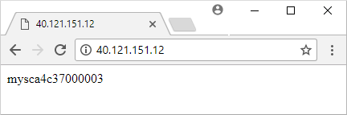
Demonstration create virtual machine scale set
1
Create a resource group and a virtual machine scale set
2
Deploy a sample web application using a Custom Script Extension
3
Create a load balancer rule to allow traffic to reach the sample application
4
Access the sample web application and obtain the load balancer’s IP address:
Load balancer distributes traffic to one of your VM instances
Notes:
✔ You could have students do this walkthrough, but it may be easier to just demonstrate the procedure. That way if some students don’t already have a subscription, you avoid the issues associated with ensuring all students can meet the prerequisites to do the task.
The slide lists the individual steps only for the walkthrough, so you will need to cover the sample script in the content.
Mention the “good hygiene” of removing resources when no longer needed, using az group delete.

Slide 14
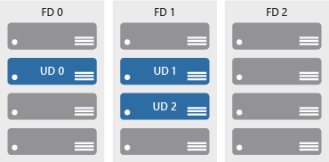
Availability
Availability sets ensure VM distribution across multiple, isolated hardware clusters
Update domains:
Sequenced update of a maintenance event
logical section of the datacenter
Fault domains:
Provide for physical separation of workloads across the datacenter
Leverage Update management service for VM updates and patches
Notes:
Explain how the physical structural components work with logical components to ensure overall availability during maintenance windows or unplanned outages.
Use the diagram to briefly explain availability sets, with the first fault domain with one domain, the second with two, and the third with no update domain.
Mention that Update management lets you quickly assess the status of available updates, schedule required updates installation, and review deployment results to verify updates were applied successfully. You may want to just show this quickly in the portal.

Slide 15
Additional IaaS considerations
Monitoring and analytics:
Boot diagnostics – screen captures for troubleshooting
View VM metrics through the dedicated Azure host
View performance metrics using diagnostic extensions
Alerts:
Example: available free disk space drops below a certain amount
Load balancing:
Azure Load Balancer provides high availability by distributing incoming traffic between healthy VMs
Define rules for specific ports and protocols mapping to the VMs
Migrate AWS and on-premises workloads to Azure and utilize Managed Disks
Notes:
The points covered in this topic are by no means exhaustive but are definitively relevant to IaaS VMs in DevOps scenarios.
If students aren’t already familiar with alerts, you could show the Alerts blade in the portal and add a simple alert for a VM.
Load balancing: Describe the Azure Load Balancer and how to define a front-end IP configuration. Explain that the back-end address pool contains the relevant IP addresses of the VMs virtual NICs, and outline how the process works between the front-end IP configuration and the back-end address pool.
Traffic flow is then controlled through custom load balancing rules that you create.
Mention that in addition to migrating workloads like AWS and on-premises solutions to Azure, you can also migrate classic deployment Azure solutions to an Azure Resource Manager deployment.

Slide 16
VMs versus containers
Containers are less resource intensive due to shared OS
Memory, disk, and CPU shared, so less overhead on startup and better isolation
Faster startup, roughly equivalent to the time required to start a process
OS implements process isolation at kernel level, and occurs quickly
Containers promote improved server density
Extends the concept of virtualization through even more efficient utilization hardware resources (memory, CPU, and so on)
Higher server density = More efficiency
Density and isolation comparison – refer to the graphic in the content
Tools available to enable Windows and Linux containers side by side
Notes:
While comparing containers with VMs, this topic really focuses on the benefits of containers and why companies are increasingly adopting their use as a more lightweight alternative. Containers are not an automatic solution, and it does depend on an organization’s needs and existing environment.
Discuss improved server density that you get as a result of containers. Use the graphic in the content to highlight the differences in density, scalability, and agility between different environments, and that with containers and processes sharing the kernel how that causes the efficiency to improve as a result.
Mention the note on the graphic that Windows Hyper-V containers don’t share the kernel, in case there’s any confusion.
Also call out the tools in Windows 10 and Windows Server 2019 for running side by side Linux and Windows containers.

Slide 17

Windows Server and Hyper-V containers
Windows Server containers:
Additional services in the OS for managing containers – The Docker engine and compute services
Each container uses same set of system processes, with a set of application process to distinguish each container
Hyper-V containers:
Specifically optimized to run containers
More secure alternative to Windows Server containers in the event of a vulnerability in the OS from sharing kernel and memory
Nano Server:
Headless deployment option for running cloud applications
Runs as a container in a container host such as Server Core
Notes:
Use the diagrams to highlight the differences in architecture between Windows Server and Hyper-V containers. While there are similarities, focus on Hyper-V’s containers’ more optimized, virtualized environment that allows a more secure container implementation.
Note that Hyper-V containers are supported now on both Windows Server 2016 and newer versions, and on the Windows 10 Anniversary edition.
Note the different scenario examples listed for Nano Server.

Slide 18

Azure VMs and Containers
There are benefits to running containers under an IaaS model in Azure using Azure VMs. You can run the following containers:
Windows Server, Hyper-V, Docker containers on Windows Server
Docker containers on Linux deployments
Typical scenarios for using containers in an Azure VM:
Dev/test: VMs in the cloud are ideal when you need to quickly create or stop the environment
Scalability: Where you only need a small number of VMs in production until you move to a more advanced PaaS environment
Production environments with existing deployment tools and processes. Move to the cloud with minimal environment deployment changes
Notes:
Docker containers on Windows Server are on Windows Server 2019 or Windows Server 2019 Nano servers.
Point out the choices of tool for installing the Docker version you want – cloud-init or a Custom Script Extension.
Also mention the complexity of installing Docker in a scenario when you need to deploy multiple VMs in a load balanced infrastructure – including VM OS updates and scalability. It’s generally not a best practice to do so when dealing with large scale or complex applications.

Slide 19

Automating IaaS infrastructure
Azure VMs supports wide range of deployment, configuration, and management toolsets:
ARM templates and scripting with bash, Azure CLI and PowerShell
Windows PowerShell DSC, or Azure Automation DSC
Third party tool integration (Ansible, Chef, Puppet, and Terraform)
VM extensions provide additional capabilities through post deployment configuration and automation:
Run custom scripts
PowerShell DSC: Set up DSC on a VM to manage configurations and environments
Collect diagnostics data for application health monitoring
Notes:
Don’t spend much time on this topic as you’ll cover these tools in more depth later in the course. This is just a summary list of automation toolsets for deployment and configuration operations.

Slide 20

Azure DevTest labs
Creates environments consisting of pre-configured bases or Azure Resource Manager templates
Enables developers on teams to efficiently self-manage virtual machines (VMs) and PaaS resources without waiting for approvals
Quickly provision Windows and Linux environments by using reusable templates and artifacts
Usage Scenarios:
Dev or Test environments
Integrate with CI/CD pipeline for automated tests and deleting images afterwards
Scale up your load testing by provisioning multiple test agents and create pre-provisioned environments for training and demos

Slide 21
Lesson 04: Azure Platform-as-a-Service (PaaS) services

Slide 22
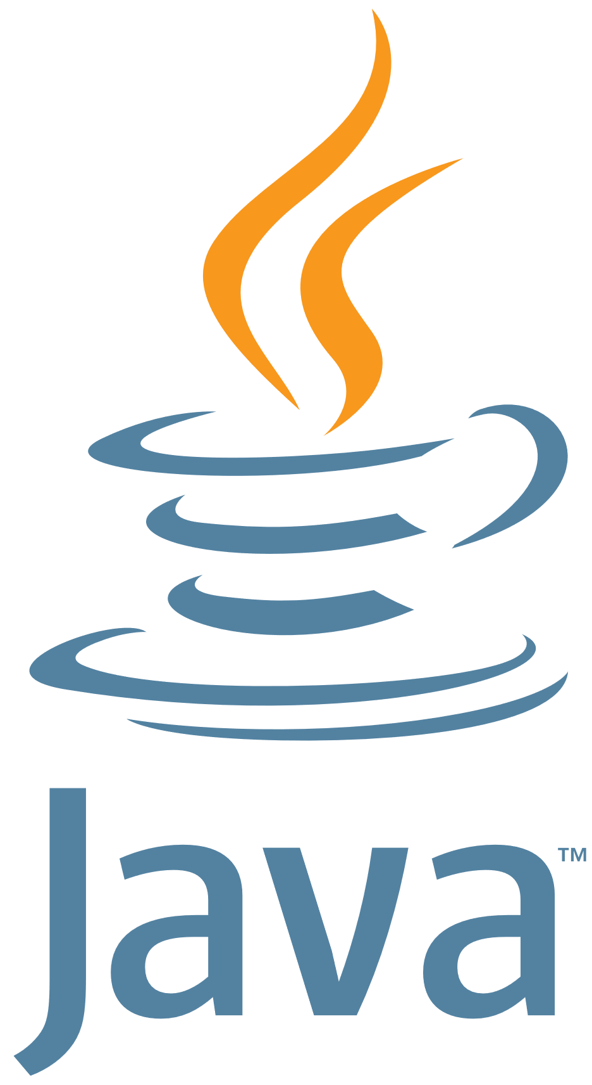

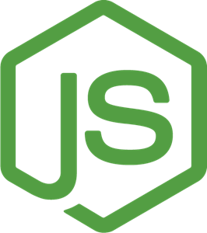
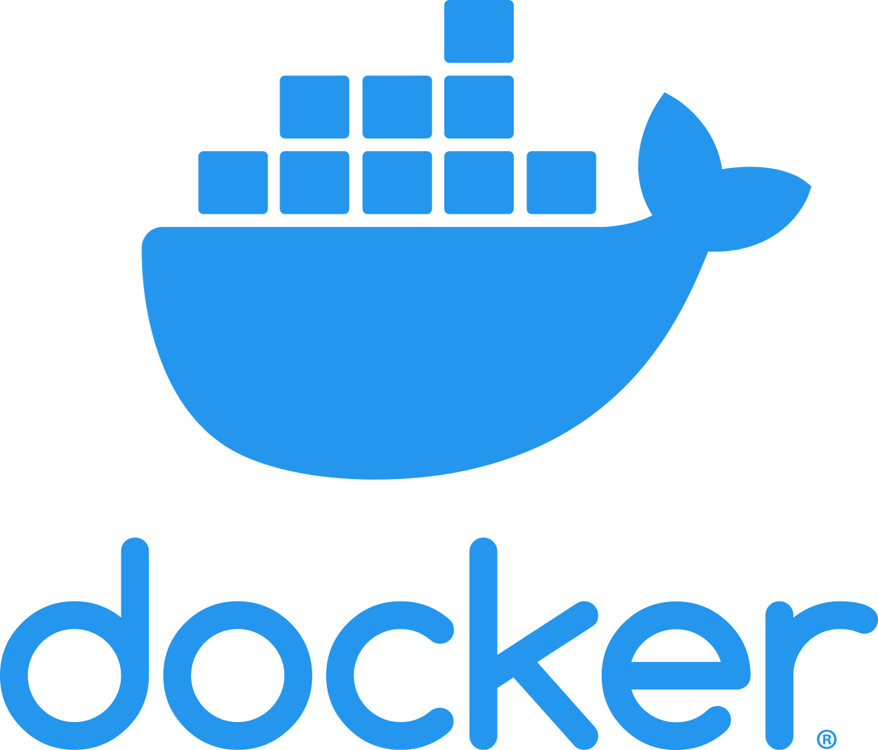
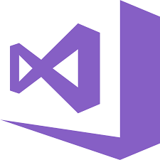



Azure app service
Fully managed environment enabling high productivity development:
Platform-as-a-service (PaaS) offering for building and deploying highly available and scalable cloud apps for web and mobile
Developer productivity using .NET, .NET Core, Java, Python and a host of others
Pay only for the compute resources used
Azure platform handles infrastructure so that developers focus on core web apps and services
Azure provides enterprise-grade security and compliance. Azure Active Directory
Notes:
✔ With App Service, you pay for the Azure compute resources you use. The compute resources you use is determined by the App Service plan that you run your Web Apps on.
For more information, you can see:
App Service - https://azure.microsoft.com/en-us/services/app-service/
While the slide provides a high-level look at App Service, focus on some of the DevOps capabilities, such as continuous deployment from Azure DevOps, GitHub, Docker Hub, and other sources.
Additionally, security and compliance is built-in with App Service being ISO, SOC, and PCI compliant. Authentication occurs through Azure AD, or through the appropriate API for the various social media services.

Slide 23
App service plans
Define a set of compute resources for a web app to run
App Service plans define:
Region where compute resources will be created (West US, East US, etc.)
Number of virtual machine instances (scale count.)
Instance size (Small, Medium, Large)
Pricing tier (next slide)
One or more apps can be configured to run in the same App Service plan
Notes:
Don’t spend too much time on this and the next slide (which goes into a little more detail on the different pricing tiers). Just introduce the concepts of an app service plan.
For more information, you can see:
Azure App Service plan overview - https://docs.microsoft.com/en-us/azure/app-service/azure-web-sites-web-hosting-plans-in-depth-overview

Slide 24

App service plans – Pricing tiers
Shared
Compute
Dedicated
Compute
Isolated
Consumption
Shared compute. Free and Shared. Runs an app on the same Azure VM as other App Service apps, and the resources cannot scale out
Dedicated compute. The Basic, Standard, Premium, and PremiumV2 tiers run apps in the same plan in dedicated Azure VMs
Isolated. Dedicated Azure VMs on dedicated Azure Virtual Networks
Consumption. Only available to function apps
Notes:
This slide is a continuation of the previous one. Pricing tiers is part of the App Service Plans topic.
For more information, you can see:
App Service plan comparison - https://azure.microsoft.com/en-us/pricing/details/app-service/plans/
App Service limits - https://docs.microsoft.com/en-us/azure/azure-subscription-service-limits#app-service-limits
App Service pricing - https://azure.microsoft.com/en-us/pricing/details/app-service/linux/
An Introduction to Azure Functions – https://docs.microsoft.com/en-us/azure/azure-functions/functions-overview

Slide 25

Demonstration create a Java App In app service on Linux
1
Open Azure Cloud Shell and choose the Bash environment
2
Create a Java app by executing the Maven command in the Cloud Shell prompt
3
Open the code editor in the Bash environment:
From the hello world directory, open pom.xml.
4
Add the plugin definition to the xml file
5
Deploy the app:
mvn package azure-webapp:deploy
6
Verify app deployment in your browser
Notes:
✔ You could have students do this walkthrough, but it may be easier to just demonstrate the procedure. That way if some students don’t already have a subscription, you avoid the issues associated with ensuring all students can meet the prerequisites to do the task.
The slide lists the just the high-level steps for the walkthrough, you can use the code provided in the content.

Slide 26
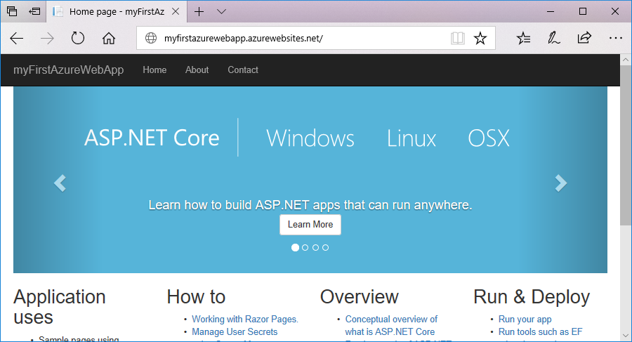
Demonstration deploy a .NET core-based app
Use Visual Studio to create an ASP.NET Core web app
1
Run the app locally and then deploy to Azure App Service
2
Notes:
In this walkthrough, you will create an ASP.NET Core web app, and then deploy it to Azure App Services.
Ensure you have met the prerequisites, including the Visual Studio 2017 installation, before performing the walkthrough.
The slide outlines the high-level outline of the walkthrough.

Slide 27
Scale app services
Scaling ensures the right amount of resources to manage an application’s needs:
Scale up: Add additional resources (CPU, memory, etc.)
Scale out: Increase the number of VM instances
Configure Auto scale to manage fluctuating load of an application:
Metric: E.g. scale in or out based on a percentage CPU value
Schedule: E.g. scale down on weekends or scale up for increased holiday demand
Configure Auto scale profiles: Regular, fixed date, and recurrence
Notes:
Point out that with scale up, you can also add extra features as well as additional resources.
Discuss Autoscale settings used to trigger actions based on metrics related to load, performance or schedule.
Talk through the JSON example of scaling in the content. Point out the Autoscale setting with the one profile and two metric rules (one for scale-in and one for scale-out).
For information on best practices with Autoscale, see:
https://docs.microsoft.com/en-us/azure/azure-monitor/platform/autoscale-best-practices

Slide 28


Web app for containers
Web App for Containers is Azure’s service container hosting service
Enables developers to deploy update and scale their container apps much faster
Platform automatically takes care of OS patching, capacity provisioning, and load balancing
Integrated continuous integration/continuous delivery capabilities
Rich configuration features including: Add custom domains, Azure AD integration, add SSL certificates, and more
Ideal environment to run web apps that don't' require extensive infrastructure control
Supports Linux and Windows
Notes:
Web App for Container provides the following features:
Deploy containers using Docker Hub, Azure Container Registry, or private registries
Implement A/B deployments using deployment and swap slots
Scale out automatically with auto-scale
Enable application logs, and see logging information in real-time with Log Stream
Connect remotely into your containers using PowerShell and WinRM

Slide 29
Demonstration deploy a custom docker image to a web app for containers
1
Open Azure Cloud Shell and choose the Bash environment
2
Configure a deployment user with a new username and password
3
Create a resource group
4
Create an Azure App Service plan
5
Create a web app in the App Service plan
Notes:
✔ You could have students do this walkthrough, but it may be easier to just demonstrate the procedure. That way if some students don’t already have a subscription, you avoid the issues associated with ensuring all students can meet the prerequisites to do the task.
The slide lists the just the high-level steps for the walkthrough, you can use the code provided in the content.

Slide 30
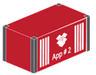
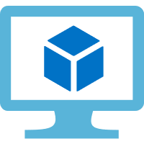
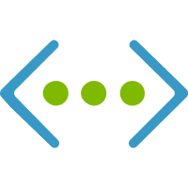
Azure container instances
PaaS service for running both Linux and Windows containers
Port 80 (Public IP Address)
Run as single containers, providing isolation for individual containers
Port 80
Isolation achieved by using Hyper-V containers
Container
Web Server
Fast way to run a container in Azure without the need to own or provision a VM
Container Host
Virtual network
Notes:
First of 2 slides. Use the graphic to help describe the concept of an Azure Container Instance.
Mention that by using Azure Container Instances, there’s no need to create, manage, or scale a VM and that hypervisor-level security provides isolation between individual containers.

Slide 31
Azure container instances (cont.)
Public IP connectivity and DNS name:
Expose your containers directly to the internet with an IP address and a fully qualified domain name (FQDN)
Custom sizes and resources:
Specify exact specifications of CPU cores and memory
Fine tune cost based on what’s used
Virtual network deployment (preview):
Deploy container instance into a subnet in the Azure Virtual Network (VNET) for secure communications with other resources in the VNet
Persistent Storage:
Retrieve and persist state with Azure Container Instances by using Azure Files shares
Notes:
Assign a public IP address to a container in order to make it accessible from the internet. In the previous slide, the container exposes port 80, and so the port is connected to a public IP address that accepts traffic on port 80 of the virtual host.
Point out that port mappings are not available in Azure Container Instances, so container and host will need to use the same port number.
Virtual network deployment lets you deploy container instances into a subnet within your VNet and so those instances can communicate with other resources in the VNet, including on-prem resources via VPN Gateway or ExpressRoute.
Discuss the scenario where interaction between containers is needed. Use the graphic in the content to describe container groups. Point out that containers are always part of a container group, even if only deploying a single container.
Point out that usage scenarios such as task automation or build jobs that can be accomplished using isolated containers, then use Azure Container Instances. If you need full container orchestration, then you should consider the recommendation to use Azure Kubernetes Service (AKS) instead.
Mention the restriction that applies to using Windows container and container groups due to the unavailability of network namespaces on the Windows OS.

Slide 32
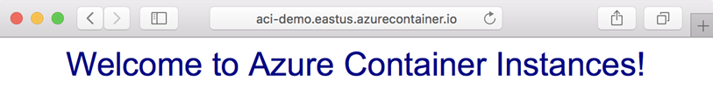
Demonstration create a container on ACI
1
Open Azure Cloud Shell and choose the Bash environment
2
Create a resource group
3
Create a container with a unique FQDN and apply it to port 80
4
Verify the container’s ProvisioningState is Succeeded
5
Open a browser to view the deployed app is running in Azure:
Notes:
✔ You could have students do this walkthrough, but it may be easier to just demonstrate the procedure. That way if some students don’t already have a subscription, you avoid the issues associated with ensuring all students can meet the prerequisites to do the task.
The slide lists the just the high-level steps for the walkthrough, you can use the code provided in the content.

Slide 33
Lesson 05: Serverless and HPC Compute Services

Slide 34
Serverless computing
Definition of serverless computing
Cloud-hosted execution environment with abstraction of the underlying hosting environment
Consumption based service, on demand provisioning and pay only for what you use. Low management overhead
Event-driven scalability, application components react to events and triggers in near real-time
Benefits of serverless computing include efficiency, flexibility, and focus on solving business problems
Examples of serverless Azure services: Event Grid, Azure Functions, Automation, and Logic Apps
Notes:
A key point is that serverless apps runs only in response to events. Types of events that trigger events can include a timer, a message from another service, or a REST endpoint.
Because the underlying hosting environment is abstracted from the running code, no configuration or maintenance is needed.
Serverless computing allows developers to focus on writing their application code, and when scaling is managed automatically, with billing only for the exact resources used. A very efficient model.
Mention the different types of Azure serverless services, but in this lesson, you’ll focus specifically on Azure Functions.

Slide 35
Functions as a Service (FaaS)
Programming model that uses Functions to achieve serverless compute
Functions used this way have the following characteristics:
Single purpose, reusable pieces of code, processing input and returning a result
Short-lived, freeing up resources when finished execution
Stateless, and so independent on the state of other processes
Event driven and scalable
Notes:
Briefly introduce the FaaS programming model. The rest of the lesson will be on Azure Functions.

Slide 36
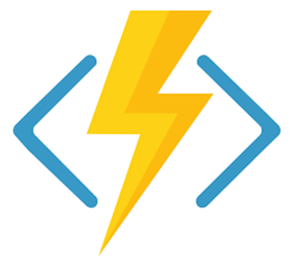







Azure functions
Key features of Azure Functions
Choice of language
Pay-per-use pricing model
Support for NuGet and Node Package Manager
Integrated security with OAuth providers, such as Azure AD, Facebook, Microsoft Account, and others
Simplified integration with other Azure services and SaaS offerings
Options for code development and deployment (portal, continuous integration, GitHub, Azure DevOps Services, and more)
Functions runtime is open-source and available on GitHub
Notes:
Briefly cover the key Azure Function features as you’ve already covered the key attributes when discussing serverless computing… things like focus on code only and not underlying infrastructure, event driven, automatic scaling, charges billed only as used, and statelessness. Mention that Azure Functions are ideal when messages are being received for example, from an IoT solution, and can rapidly respond to the message/trigger.
The list of key features is not exhaustive, and you can see more information at https://docs.microsoft.com/en-us/azure/azure-functions/.
Mention that language support is dependent on the different versions of Azure Functions runtime, so be sure to check the documentation for the latest information – https://docs.microsoft.com/en-us/azure/azure-functions/supported-languages#languages-in-runtime-1x-and-2x
You can also point students to the Azure Serverless Computing Cookbook at https://azure.microsoft.com/en-us/resources/azure-serverless-computing-cookbook/, which is a downloadable guide to building serverless apps that is provided by Microsoft.

Slide 37
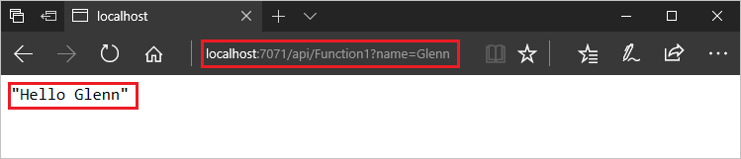
Demonstration create Azure Functions using Azure CLI
Part 1: Create a function to run locally using the Azure CLI
1
Open Azure Cloud Shell and choose the Bash environment
2
Create a local function app project
3
Create an HTTP-triggered function and update to allow anonymous access
4
Run the function locally and confirm the runtime output
5
Function returns the response “Hello Glenn” to the HTTP GET request:
Notes:
✔ You could have students do this walkthrough, but it may be easier to just demonstrate the procedure. That way if some students don’t already have a subscription, you avoid the issues associated with ensuring all students can meet the prerequisites to do the task.
The slide lists the just the high-level steps for the walkthrough, you can use the code provided in the content.

Slide 38
Demonstration create Azure Functions using Azure CLI (cont.)
Part 2: Deploy the function app to Azure
6
Using az group create, create a resource group to store the function app and related resources
7
Create a general-purpose storage account in the newly created resource group
8
Use az functionapp create to create a function app, which provides the environment for serverless execution
9
Use func azure functionapp publish to deploy the function app project to Azure
10
Test the function (cURL on Linux or Mac, Bash on Windows).
Notes:
The slide lists the just the high-level steps for part 2 of the walkthrough. Here is where you’ll take the local function app project you just created and deploy it to Azure.
The Azure documentation also provides the code that is presented in the student content.
For more information, see:
Create your first function from the command line – https://docs.microsoft.com/en-us/azure/azure-functions/functions-create-first-azure-function-azure-cli
As mentioned in the topic, deleting resources when no longer needed is always a good idea, and a good reminder to students.

Slide 39
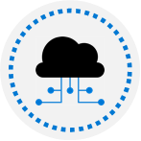
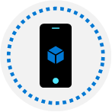
Batch services
Azure Batch – Fully managed cloud service for job scheduling and compute resource management:
Creates, manages, and scales a pool of compute nodes (VMs) to run largest, resource-intensive workloads
Provides a job scheduler to submit jobs into the VM pool (or set of VM pools)
Requirements to run applications:
Application (doesn’t need to be cloud aware)
Pool of VMs (Batch service creates, manages, and monitors the pool)
Job scheduler to define the tasks that make up the job
Location to store output, typically Blob storage
Notes:
Azure Batch is ideal for running batch processing automated tasks that are composed of large-scale jobs. This can be done on demand so is an excellent option when you need to run large scale batch processing in the cloud, without having to worry about predefining a schedule.
Essentially, it enables the breaking down of computationally intensive workloads into individual tasks and you get the benefits of efficiently running those tasks in parallel at scale.

Slide 40
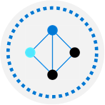
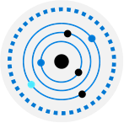

Batch services (cont.)
Usage scenarios and application types:
Independent/parallel:
Applications or tasks operate independently
Adding VMs will speed up task completion
Tightly coupled:
High performance computing (HPC) applications (e.g. scientific/engineering)
Examples: Car crash simulations, of Artificial Intelligence (AI) training frameworks
Multiple tightly coupled in parallel:
Example: Instead of four nodes to carry out a job, use 40 nodes and run the job 10 times, to scale the job task, running those jobs in parallel
Notes:
Use the graphics in the student content to help talk through the different usage scenarios

Slide 41
Lesson 06: Azure Service Fabric

Slide 42
Azure Service Fabric overview
Azure Service Fabric:
Distributed systems platform for deploying and managing scalable, containerized microservices applications
Microservices run at high density on a shared pool of machines, or cluster
Designed for modern cloud native applications
Where does Service Fabric run?
Create clusters for SF in the cloud, on-premises, and on both Windows and Linux operating systems
Development environment (SDK) identical to the production environment, so what runs locally deploys to the clusters in other environments
Notes:
Provide a brief overview of Service Fabric as there are a number of topics to cover in this lesson.
You can refer to the list of key capabilities in the student content as time and interest allows, but you may want to spend more time on the subsequent topics in this lesson.
Note: Service Fabric is currently undergoing a transition to open development. The goal is to move the entire build, test, and development process to GitHub. You can view, investigate and contribute on the https://github.com/Microsoft/service-fabric/ page. There are also many sample files and scenarios to help in deployment and configuration.

Slide 43
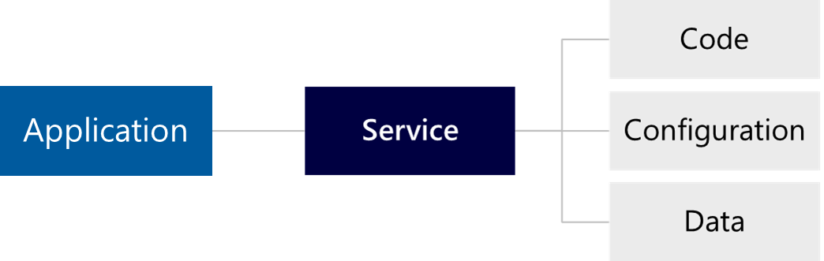
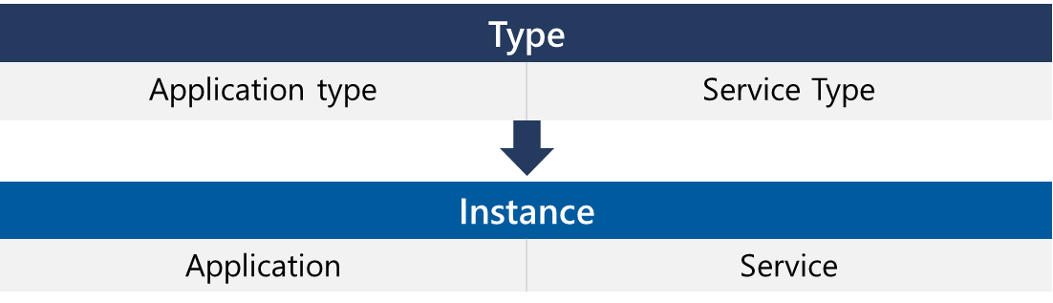
Application model
Service Fabric applications
One or more services that work together to automate business processes
Code, configuration, and data are separately version able and deployable
Application and service types – similar concept to OOP
Types comparable to class definition
Application and Service comparable to instances
Notes:
Point out that application types and service types are described through XML files.
The concept of using a class definition to create multiple instances of an object is readily applicable to the Application model.
Service Fabric monitors applications for health to ensure they are running well and that resources are used optimally. Services may be moved across nodes to load balance overall resource consumption, with the goal to try and get each node running with the appropriate number of services. Service Fabric does this automatically (as shown in the diagram in the student content).

Slide 44

Programming models
Reliable Services:
Stateless – e.g. services hosting ASP.NET Web APIs
Stateful – Keep internal state, stored redundantly across multiple nodes for availability and error recovery
Reliable Actors:
Framework built on Reliable Services, uses Virtual Actors’ design pattern
Guest Executable:
Package and run existing executables as SF (stateless) services, ensuring high availability
Containers:
Like guest executables, but the difference is that SF can restrict consumption (e.g. CPU and memory) to achieve greater density on clusters
Notes:
Briefly describe the four different programming models for creating a Service Fabric application.
When developing application for use on Service Fabric, you can take advantage of the following environments and languages:
Windows – comes with an SDK and tool support. Program clusters in C# using Visual Studio.
Linux – develop Java-based services for Linux clusters using Eclipse Neon. You can also program in C# using .NET Core and Visual Studio Code if you prefer.
For more information, see:
https://www.eclipse.org/neon/

Slide 45
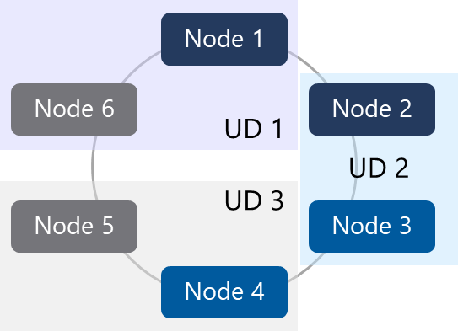
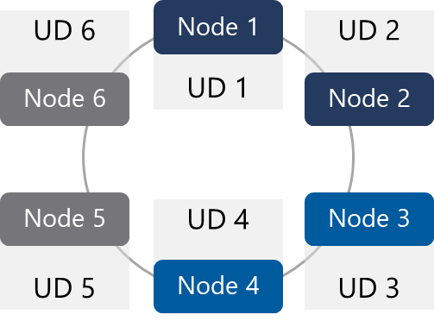
Scaling Azure clusters
Example 1
Upgrade domain (UD) – Policy describing groups of nodes to be upgraded at same time
Includes changes to cluster software and running software
By upgrading two nodes at the same time, they complete quickly
Example 2
Adding more UDs, upgrades become more granular, with lower impact
Nodes in different UDs are not upgraded at the same time
Try to have one UD for one fault domain
Notes:
Cover the concepts behind scaling clusters: adding and removing nodes; node types – the scale sets that make up a cluster; how upgrade domains can be used to stagger rolling software upgrades for lower impact;
Emphasize that two nodes that share a fault domain also share a single point of failure and what you have to account for when creating a system that needs to be highly available.
Use the diagram to help explain the concepts. Discuss boundaries that apply to scaling Azure clusters, including any restrictions or requirements.
There is a lot of material in this topic, so you may want to just focus on the key architectural concepts and have students read the material in their own time.

Slide 46
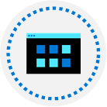
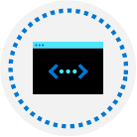
Create clusters anywhere
Windows operating system:
Service Fabric standalone cluster – Deploy cluster manually using PowerShell tools, then running Windows Server
Create in Azure (in the portal or using an ARM template)
Local development cluster – Runs on one machine simulating multiple servers. Allows developers to debug apps before deploying to a production cluster
Linux operating system:
Create Linux clusters in Azure and a local development cluster on Linux Ubuntu 16.04 and Red Hat Enterprise Linux 7.4 (preview support)
All programming models are in preview (currently)
Notes:
In earlier topics, we have covered the fact that you can create Service Fabric clusters in many types of different environments, including those listed (Windows and Linux operating systems, on premises and in the cloud, and on one or multiple machines).
Note: Standalone clusters currently aren't supported for Linux. Linux is supported on one-box for development and Linux virtual machine clusters.
For more information, see:
Differences between Service Fabric on Linux and Windows – https://docs.microsoft.com/en-us/azure/service-fabric/service-fabric-linux-windows-differences

Slide 47
Demonstration create a standalone service fabric cluster on Windows Server
Part 1: Create a standalone server and validate the environment
1
Provision the required machines up front
2
Run PowerShell scripts to create the Service Fabric cluster
3
Validate the environment before creating the cluster
PowerShell
Virtual machine
Service Fabric Cluster
The required scripts and binaries are downloaded in a single package, the Service Fabric standalone package
Notes:
✔ You could have students do this walkthrough, but it may be easier to just demonstrate the procedure. That way if some students don’t already have a subscription, you avoid the issues associated with ensuring all students can meet the prerequisites to do the task.
This slide lists the high-level preparation and validation tasks prior to creating the Service Fabric cluster. The next slide lists just the high-level steps for creation (and removal) of the cluster (or any nodes in the cluster). You can use the code and steps provided in the content, which are more fully referenced in the Azure documentation (see link below).
As a prerequisite, ensure that you download setup files and PowerShell scripts for the Service Fabric standalone package, which you run to setup a service fabric cluster. You can download these from the Download Link provided in the student content.
Note: Because standalone clusters aren’t currently supported for Linux (at the time of writing), you will perform these steps in the context of a standalone deployment on Windows Server.
If you perform this walkthrough, there is some preparation and planning involved that is detailed in the student content, including:
Planning for server resources
Defining fault domains and upgrade domains
Installing the software prerequisites
Familiarizing yourself with downloaded files
The sample cluster configuration files include ClusterConfig.Unsecure.DevCluster.json, which is the simplest cluster configuration, an unsecure, three-node cluster running on a single computer. Detailed steps on how to set up a Service Fabric cluster are available in the Azure documentation.
For more information, see:
Create a standalone cluster running on Windows Server – https://docs.microsoft.com/en-us/azure/service-fabric/service-fabric-cluster-creation-for-windows-server

Slide 48
Demonstration create a standalone service fabric cluster on Windows Server (cont.)
Part 2: Deploy a Docker Compose file
1
Run the CreateServiceFabricCluster.ps1 script to create the cluster for all designated machines
2
Connect to the cluster and verify it is running and available
3
Access Service Fabric Explorer through a browser
Connect-ServiceFabricCluster -ConnectionEndpoint <*IPAddressofaMachine*>:<Client connection end point port>
4
Run the Start-ServiceFabricClusterUpgrade script to upgrade the cluster software to a specific version
5
Remove the Service Fabric cluster and perform any cleanup
Notes:
This slide lists just the high-level steps for creation (and removal) of the cluster (or any nodes in the cluster). You can use the code and steps provided in the content, which are more fully referenced in the Azure documentation (see link below).
For more information, see:
Create a standalone cluster running on Windows Server – https://docs.microsoft.com/en-us/azure/service-fabric/service-fabric-cluster-creation-for-windows-server

Slide 49
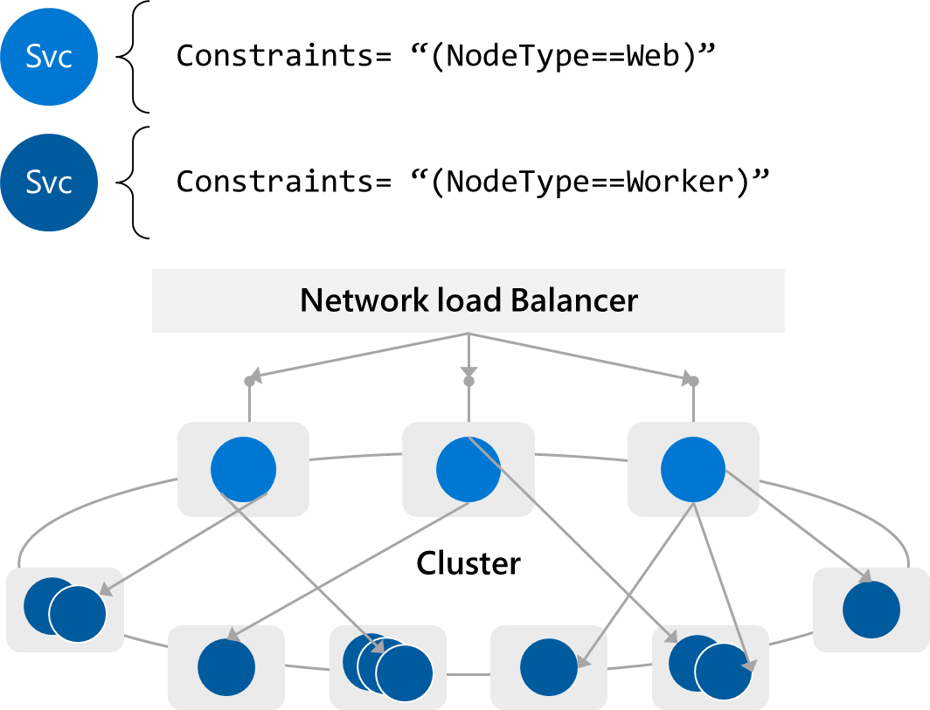
Placement constraints
Use placement constraints to:
Isolate workloads from each other
Lift and shift an existing N-tier application into Service Fabric
Run services on specific server configurations
Implementing placement constraints:
Add key-value pairs to cluster nodes
Add constraints statements to your service
Notes:
Placement constraints define where services should run. The set of constraints is extensible - any key/value pair can work. Use the example in the slide to describe how placement constraints can be used. You’ll add key-value pairs to cluster nodes. As in the diagram, you create a Web and Worker pool by creating two VM scale sets in the cluster and marking one VM as 'NodeType Web’. Then to create the service that must run on the Web pool, add the constraint statement 'NodeType == Web’.
Note: It’s important to ensure that your placement constraints are not too restrictive. If Service Fabric is unable to comply with a placement constraint, your service won't be able to run. Always create pools of multiple nodes when defining constraints.
For more information, see:
Node properties and placement constraints – https://docs.microsoft.com/en-us/azure/service-fabric/service-fabric-cluster-resource-manager-cluster-description#node-properties-and-placement-constraints

Slide 50
Configure monitoring and logging overview
Service Fabric Analytics
OMS plug-in designed specifically for diagnostics on Service Fabric clusters
Log Analytics provides drill-down of all captured diagnostics data
Review details of diagnostic events such as Event Trace for Windows (ETW)
Agent process for in-process logging
All event providers used in code must be registered on every cluster node
Register event sources in Azure Resource Manager templates
Microsoft Diagnostics EventFlow
Open source library designed for in-process log collection
Can send logs to many outputs, including Application Insights, OMS, Azure Event Hubs, and the console window
Notes:
Provide a brief overview of some of the diagnostics and monitoring options you can use with Azure Service Fabric.

Slide 51
Backup and recovery
Creating backups and performing restore requires code within a Reliable Service to handle data loss situations, like a node failure
Create a backup
Invoke the PostBackupCallAsync method to copy the local backup to a central storage location
Create a restore
On data loss being triggered, Reliable Service accesses the central storage location and downloads the contents to the local backup folder
Data can then be restored from the local back folder
Central Storage location should be in a different fault domain
Every primary replica of a Stateful Reliable Services needs to create and restore its own backups
Notes:
Use the code in the student content to explain the points on the slide.
Point out that you should consider your backup strategy carefully. The amount of data loss that is acceptable differs for every service. The size of the central store will grow quickly if too many full backups are created.

Slide 52
Demonstration docker compose deployment to service fabric
Part 1: Sample YAML definition for container to be deployed
version: ‘3’
service:
web:
image: microsoft/iis:nanoserver
ports:
– “80:80”
Network:
default:
external:
name: nat
Results in a single container based on an image, microsoft/iis:nanoserver
Container port is connected to host port 80, with a default nat network
Notes:
✔ You could have students do this walkthrough, but it may be easier to just demonstrate the procedure. That way if some students don’t already have a subscription, you avoid the issues associated with ensuring all students can meet the prerequisites to do the task.
This slide focuses on the YAML definition for the container to be deployed in the following slide, which focuses on the actual deployment.

Slide 53
Demonstration docker compose deployment to service fabric (Cont.)
Part 2: Deploy a Docker Compose file
1
Using Connect-ServiceFabricCluster, connect to the existing cluster
2
Using New-ServiceFabricComposeDeployment, deploy the docker-compose.yml file
3
Using Get-ServiceFabricComposeDeploymentStatus, check the deployment status
4
When deployment finishes, open a browser to navigate to the new Service Fabric cluster domain at port 80
5
Using Remove-ServiceFabricComposeDeployment, remove the deployment
Notes:
This slide lists the just the high-level steps for the Docker Compose walkthrough, using the YAML definition covered in the previous slide. You can use the code and steps provided in the content.

Slide 54
Lesson 07: Lab

Slide 55
Lab: Deploying a Dockerized Java app to Azure Web App for containers
In this lab, Deploying a Dockerized Java app to Azure Web App for Containers, you will learn:
Configuring a CI pipeline to build and publish Docker image
Deploying to an Azure Web App for containers
Configuring MySQL connection strings in the Web App
Notes:
Deploying a Dockerized Java app to Azure Web App for Containers - https://azuredevopslabs.com/labs/vstsextend/dockerjava/

Slide 56
Lesson 08: Module review and takeaways

Slide 57
What did you learn?
Describe deployment models and services that are available with Azure

Slide 58
Module review questions
1
Which of the following Azure products provides management capabilities for applications that run across multiple Virtual Machines, and allows for the automatic scaling of resources, and load balancing of traffic?
2
Availability sets are made up of which of the following?
3
Complete the following sentence. Azure App Service is an Azure Platform-as-Service offering that is used for ____________
4
Which of the following are features of Web App for Containers?
5
Which of the following statements is best practice for Azure Functions?
Notes:
Q1 Answer: Virtual Machine Scale Sets is the correct answer.
Q2 Answer: Update Domains and Fault Domains are the correct answers.
Q3 Answer: Hosting web applications, REST APIs, and mobile back ends, is the correct answer.
Q4 Answer: Web App for Containers from the Azure App Service allows customers to use their own containers, and deploy them to Azure App Service as a web app. Similar to the Azure Web App solution, Web App for Containers eliminates time-consuming infrastructure management tasks during container deployment, updating, and scaling to help developers focus on coding and getting their apps to their end users faster. Furthermore, Web App for Containers provides integrated CI/CD capabilities with DockerHub, Azure Container Registry, and VSTS, as well as built-in staging, rollback, testing-in-production, monitoring, and performance testing capabilities to boost developer productivity.
For Operations, Web App for Containers also provides rich configuration features so developers can easily add custom domains, integrate with AAD authentication, add SSL certificates and more — all of which are crucial to web app development and management. Web App for Containers provides an ideal environment to run web apps that do not require extensive infrastructure control.
Q5 Answer: Azure Functions should be stateless is the correct answer.

Slide 59
Module review questions, (cont.)
6
Which of the following features are supported by Azure Service Fabric?
7
Which of the following describe primary uses for Placement Constraints?
8
Which of the following are network models for deploying a clusters in Azure Kubernetes Service (AKS)?
9
True or false: Containers are a natural fit for an event-driven architecture?
10
Which of the following cloud service models provides the most control, flexibility, and portability?
Notes:
Q6 Answer: Reliable Services is a framework for creating services that use specific features provided by Azure Service Fabric. The two distinct types of Reliable Services you can create are stateless services and stateful services.
Reliable Actors is a framework built on top of Reliable Services which implements the Virtual Actors design pattern. An Actor encapsulates a small piece of a state or behavior. The state of an Actor can be volatile, or it can be kept persistent in a distributed store. This store can be memory-based or on a disk. Guest Executables are existing applications that you package and run as Service Fabric services (stateless). This makes the applications highly available, as Service Fabric keeps the instances of your applications running. Applications can be upgraded with no downtime, and Service Fabric can automatically roll back deployments if needed. Containers can be run in a way that is similar to running guest executables. Furthermore, with containers, Service Fabric can restrict resource consumption per container (by CPU processes or memory usage, for example). Limiting resource consumption per service allows you to achieve higher densities on your cluster.
Q7 Answer: The correct answers are: Isolate workloads from each other, control which nodes in a cluster that a service can run on, and ‘Lift and shift’ an existing N-tier application into Azure Service Fabric.
Q8 Answer: Basic Networking and Advanced Networking are correct answers.
Q9 Answer: False
Q10 Answer: Infrastructure-as-a-Service (IaaS) is the correct answer.

