Slide 1
AZ-400.00 Module 18: Implement compliance and security in your infrastructure

Slide 2
Lesson 01: Module overview

Slide 3
Module overview
Lesson1: Module Overview
Lesson 2: Security and Compliance Principles with DevOps
Lesson 3: Azure Security Center
Lesson 4: Lab
Lesson 5: Module Review and Takeaways

Slide 4
Learning objectives
After completing this module, students will be able to:
Define an infrastructure and configuration strategy and appropriate toolset for a release pipeline and application infrastructure
Implement compliance and security in your application infrastructure

Slide 5
Lesson 02: Security and compliance in the pipeline

Slide 6
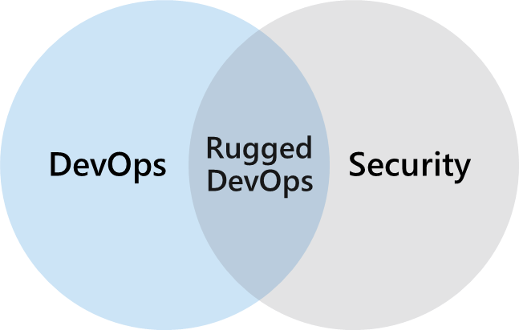
What is Rugged DevOps
Rugged DevOps is a set of practices designed integrate DevOps and security
Rugged DevOps is also sometimes referred to as DevOpsSec
The goal is to enable development teams to work fast without introducing unwanted vulnerabilities
Security strategy includes access control, environment hardening, perimeter protection, and more
Notes:
Rugged DevOps includes bigger questions such as:
Is my pipeline consuming third-party components, and if so, are they secure?
Are there known vulnerabilities within any of the third-party software we use?
How quickly can I detect vulnerabilities (time to detect)?
How quickly can I remediate identified vulnerabilities (time to remediate)?

Slide 7
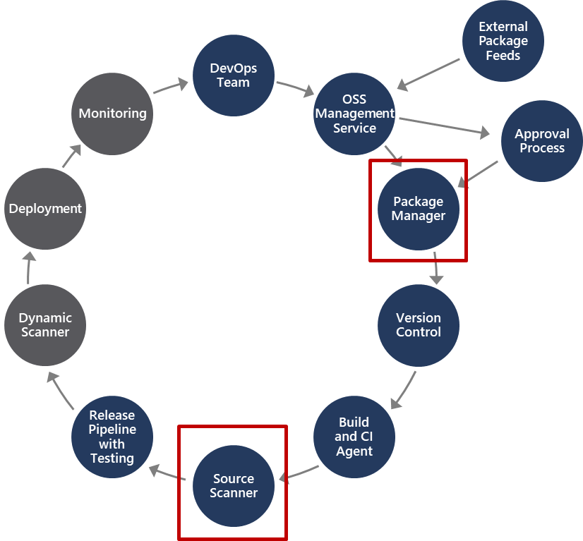
Rugged DevOps pipeline
Package Management, and the approval process associated with it, accounts for how software packages are added to the pipeline, and the approval process they need to go through
Source Scanner is for performing a security scan to verify certain security vulnerabilities are not present in our application source code
Notes:
There are two important areas in the pipeline that are part of Rugged DevOps and not other DevOps pipelines. Notice these two areas are in different parts of the pipeline.

Slide 8
Software Composition Analysis (SCA)
Package Management:
Unique source of binary components
Create a local cache of approved components
Use Azure Artifacts to share and organize your packages
Package types: NuGet, npm, Maven, Gradle, Universal, and Python
Open Source Software (OSS) Components:
Reused dependencies can have security vulnerabilities
Ensure you have the latest version
Check for the correct binaries
Promptly address vulnerabilities
Analyzing the software to determine its composition can help mitigate potential vulnerabilities

Slide 9
WhiteSource integration with Azure DevOps pipeline
Azure DevOps Marketplace is an important site for addressing rugged DevOps issues. From here you can integrate specialist security products into your Azure DevOps pipeline
Azure DevOps Marketplace can be access at https://marketplace.visualstudio.com/azuredevops
WhiteSource is one such example of an extension available on the Azure DevOps Marketplace
If consuming external packages, the WhiteSource extension specifically addresses the questions of open source security, quality, and license compliance. With WhiteSource you can:
Continuously detect all open-source components in your software
Receive alerts on open-source security vulnerabilities
Automatically enforce open-source security and license compliance

Slide 10
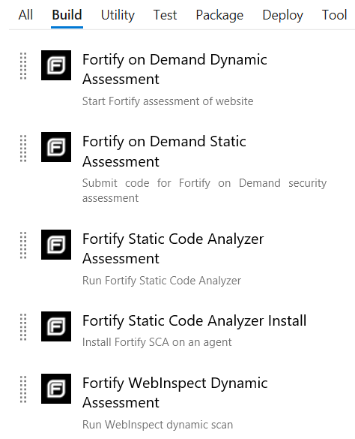
Micro focus fortify integration with Azure DevOps pipeline
Can add build tasks to CI/CD pipeline to help identify vulnerabilities in your source code
Provides a comprehensive set of software security analyzers
Fortify Static Code Analyzer: Identifies root causes of software security vulnerabilities
Fortify on Demand automatically submits static and dynamic scan requests
Notes:
Micro Focus Fortify is another example of an extension you can leverage from the Azure DevOops Marketplace and can integrate with your CI/CD pipeline to address Rugged DevOps security-related issues.

Slide 11
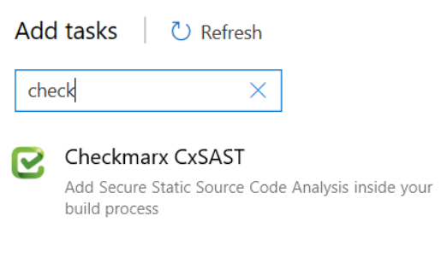
Checkmarx integration with Azure DevOps
Identifies, tracks, and fixes technical and logical security flaws:
Best fix location
Quick and accurate scanning
Incremental scanning
Seamless integration
Code portfolio protection
Easy to initiate Open Source Analysis with Checkmarx Open Source Analysis (CxOSA) and Checkmarx Static Application Security Testing (CxSAST)
Notes:
Static versus Dynamic Application Security Testing.
Static application security testing takes place while the application is not running and identifies flaws, vulnerabilities, back doors in the code while in that state. Static analysis can take place early in the dev cycle and help identify potential issues early on.
Dynamic application security testing takes place while the code is running, it will monitor memory usage, functional behaviours, performance, responses times and other items.

Slide 12
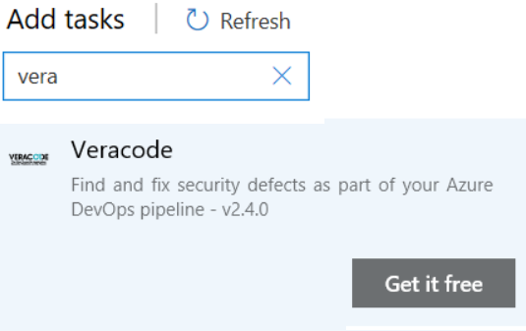
Veracode integration with Azure DevOps
Integrate application security into your development tools
Don’t stop for false alarms
Align your application security practices with your development practices
Don’t just find vulnerabilities, fix them
Onboarding process allows for scanning on day one

Slide 13
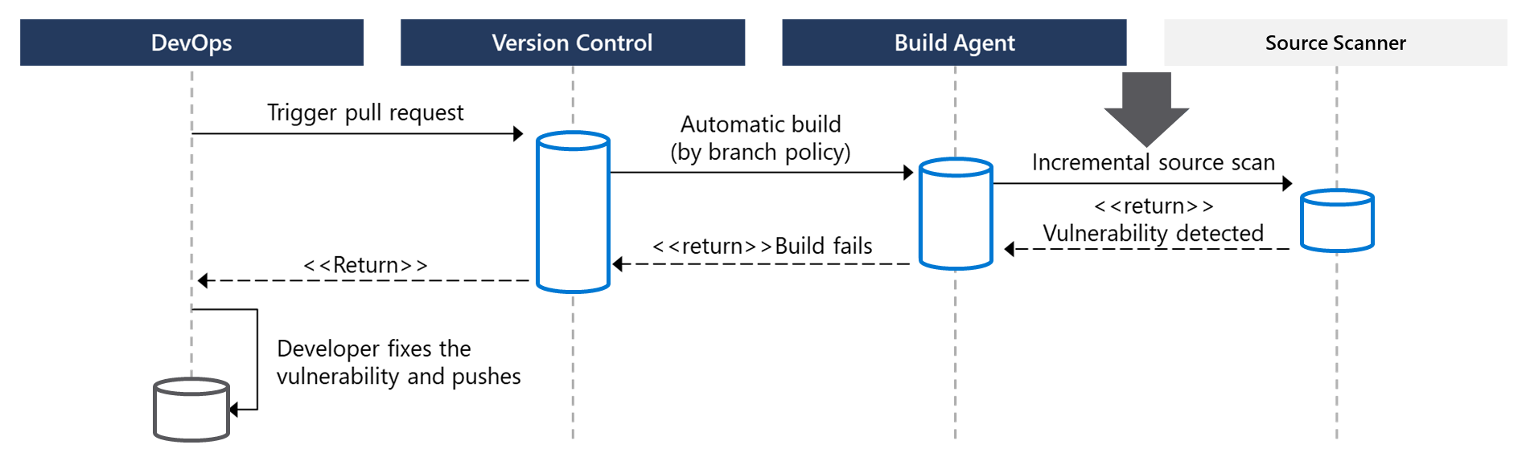
How to integrate software composition analysis checks into pipelines
Pull requests are the way DevOps teams submit changes
WhiteSource, Checkmarx, Veracode, and Black Duck by Synopsis can facilitate incremental scans
Integrate scanning into a team’s workflow at multiple points along the path

Slide 14
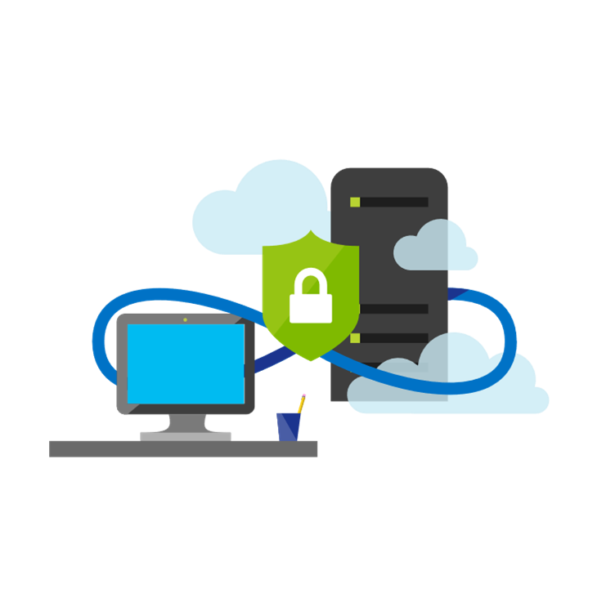
Ops and pipeline security
Use traditional operational methods for protecting identities and assets
Authentication and Authorization: Use Multi-Factor Authentication and Just enough Admin (JEA)
Use the CI/CD release pipeline: Use immutable infrastructure and only using your pipeline
Manage Permissions: Secure the pipeline using RBAC
Dynamic Scanning: Test running apps, such as penetration testing
Monitoring Production: Look for anomalies related to intrusion
Notes:
To improve security in general use Azure Resource Manager templates, or other code-based configurations, and Infrastructure as Code best practices, such as only making changes in templates, thereby making them traceable and repeatable. Also, use provisioning and configuration technologies such as Desired State Configuration, Azure Automation, and other third-party tools and products that integrate seamlessly with Azure.

Slide 15
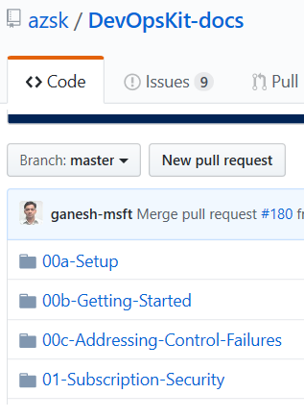
Secure DevOps kit for Azure (AzSK)
AzSK is a collection of scripts, tools, extensions, automations
Helps secure the subscription
Enables secure development
Integrates security into CI/CD
Provides continuous assurance
Assists with alerts & monitoring
Governing cloud risks
Available at: https://github.com/azsk/DevOpsKit-docs
Notes:
Consider going to the github site, https://github.com/azsk/DevOpsKit-docs, and showing the readme to call out some elements of the AzSK

Slide 16
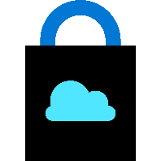
Lesson 03: Azure security center

Slide 17

Azure security center
Provide security recommendations
Monitor security settings
Monitor all your services
Use Azure Machine Learning
Analyze and identify potential attacks
Provide just-in-time (JIT) access control
Supports Windows and Linux operating systems
Available in two pricing tiers

Slide 18
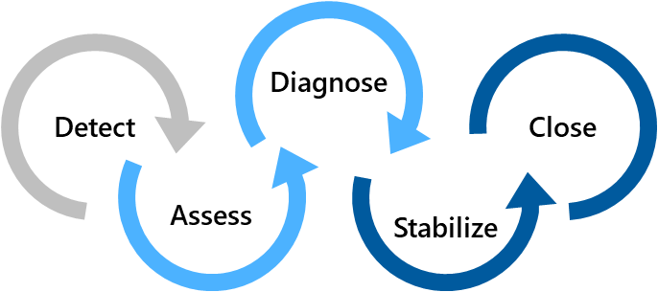
Azure security center usage scenarios
Scenario 1
Use Security Center for an incident response
Scenario 2
Use Security Center recommendations to enhance security
Security Policy
Recommendations
Detect – Verify a high security alert was raised
Configure a security policy
Access – Obtain information about the alert
Implement the recommendations for the security policy
Diagnose – Follow the remediation steps
Notes:
Scenario 1:
Many organizations learn how to respond to security incidents only after suffering an attack. To reduce costs and damage, it’s important to have an incident response plan in place before an attack occurs. You can use Azure Security Center in different stages of an incident response.
You can use Security Center during the detect, assess, and diagnose stages.
- Detect: Review the first indication of an event investigation. Example: Use the Security Center dashboard to review the initial verification that a high-priority security alert was raised.
- Assess: Perform the initial assessment to obtain more information about the suspicious activity. Example: Obtain more information about the security alert.
- Diagnose: Conduct a technical investigation and identify containment, mitigation, and workaround strategies. Example: Follow the remediation steps described by Security Center in that particular security alert.
Scenario 2:
You can reduce the chances of a significant security event by configuring a security policy, and then implementing the recommendations provided by Azure Security Center.
A security policy defines the set of controls that are recommended for resources within that specified subscription or resource group. In Security Center, you define policies according to your company's security requirements.
Security Center analyzes the security state of your Azure resources. When Security Center identifies potential security vulnerabilities, it creates recommendations based on the controls set in the security policy. The recommendations guide you through the process of configuring the needed security controls

Slide 19


Azure policy
Is a service in Azure that you use to create, assign, and, manage policies
Provides enforcement by using policies and initiatives
Runs evaluations on your resources and scans for those not compliant
Comes with several built-in policy and initiative definitions
Integrates with Azure DevOps by applying any continuous integration (CI) and continuous deployment (CD) pipeline policies
An example of an Azure policy that you can integrate with your DevOps pipeline is the Check Gate task
Notes:
Azure Policy Check Gate - https://docs.microsoft.com/en-us/azure/devops/pipelines/tasks/deploy/azure-policy-check-gate?view=vsts

Slide 20
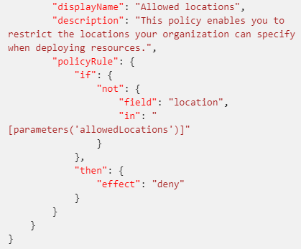
Policies
A policy definition expresses what to evaluate and what action to take
Policies are defined in JSON
You can assign policies in the Azure Portal, Azure CLI, or PowerShell
Use remediation for non-compliant resources
The screenshot is a section of a policy file defining allowed locations
Notes:
A policy definition expresses what to evaluate and what action to take. For example, you could prevent VMs from deploying if they are exposed to a public IP address. You also could prevent a particular hard disk from being used when deploying VMs to control costs.
Every policy definition has conditions under which it is enforced, and an accompanying effect that takes place if the conditions are met.
The process of applying a policy to your resources consist of the following steps:
1. Create a policy definition.
2. Assign a definition to a scope of resources.
3. View policy evaluation results.

Slide 21
Initiatives
An initiative definition is a set of policy definitions
Helps track your compliance state for a larger goal
Assigned to a specific scope
Reduces the need for individual scope assignments
Initiative Example:
Create an Initiative named “Enable Monitoring In Azure Security Center”. This would provide the following policies:
Monitor unencrypted SQL Database policy definition
Monitor OS vulnerabilities policy definition
Monitor missing Endpoint Protection policy definition
Even if you have a single policy, we recommend using initiatives if you anticipate increasing the number of policies over time

Slide 22

Azure key vault
Usage scenarios
Secrets management
Key management
Certificate management
Hardware security modules
Centralized cloud service for storing your applications’ secrets
Benefits
Centralized application secrets
Securely stored secrets and keys
Monitor access and use
Simplified administration of application secrets
Integrate with other Azure services

Slide 23
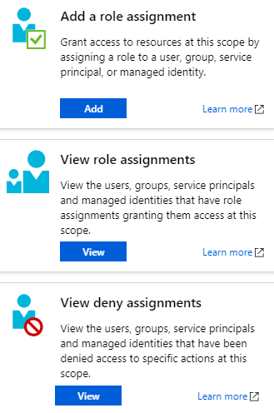
Role-based access control (RBAC)
Segregate duties within your team and grant only the amount of access to users that they need to perform their jobs
Fine-grained access management for Azure resources
Grant users the lowest privilege level that they need to do their work
No additional cost to all Azure subscribers
Built-in roles for an allow model
Notes:
Examples of when you might use RBAC include when you want to:
Allow one user to manage VMs in a subscription, and another user to manage virtual networks.
Allow a database administrator (DBA) group to manage SQL Server databases in a subscription.
Allow a user to manage all resources in a resource group, such as VMs, websites, and subnets.
Allow an application to access all resources in a resource group.

Slide 24
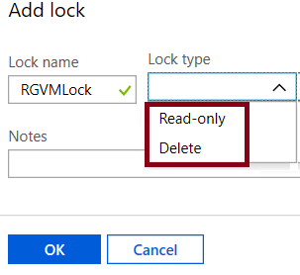
Locks
Prevent accidental deletion or modification of your Azure resources:
CanNotDelete – means authorized users can still read and modify a resource, but they can’t delete the resource
ReadOnly – means authorized users can read a resource, but they can't delete or update it. Applying this lock is like restricting all authorized users to the permissions granted by the Reader role
In the Azure portal, the locks are called Delete and Read-only respectively

Slide 25
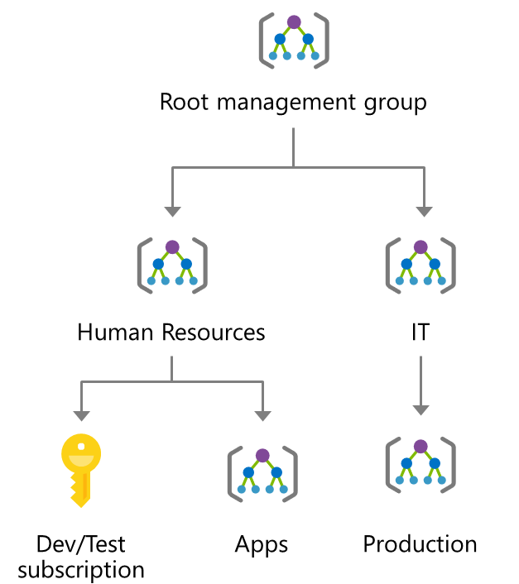
Subscription governance
Considerations for creating and managing subscriptions:
Billing
Access Control
Subscription Limits
Management groups manage access, policies, and compliance across multiple Azure subscriptions

Slide 26
Azure blueprints
Allows for the definition of a repeatable set of Azure resources that implement and adhere to an organization’s standards, patterns, and requirements
Can ensure a deployment meets an organization’s standards, patterns, and requirements
Is a declarative way to orchestrate deployment for various resource templates and other artifacts
Provides for traceability and auditing as well as adherence
The blueprint definition (what should be deployed) and the blueprint assignment (what is deployed) supports improved deployment tracking and auditing
1
2
3
Create an Azure blueprint
Assign the blueprint
Track the blueprint assignments
Discussion: How to Azure Blueprint policies differ from templates?
Notes:
Azure Blueprints is also useful in Azure DevOps scenarios where blueprints are associated with specific build artifacts and release pipelines, and can be tracked more rigorously.
Note: At the time of writing, Azure Blueprints is in preview and has not yet been released publicly.
Discussion: How to Azure Blueprint policies differ from templates?
Answer:
The blueprints in Azure Blueprints are different from Azure Resource Manager templates. When Azure Resource Manager templates deploy resources, they have no active relationship with the deployed resources (they exist in a local environment or in source control). By contrast, with Azure Blueprints, each deployment is tied to an Azure Blueprints package. This means that the relationship with resources will be maintained, even after deployment. In this way, maintaining relationships improves auditing and tracking capabilities.

Slide 27
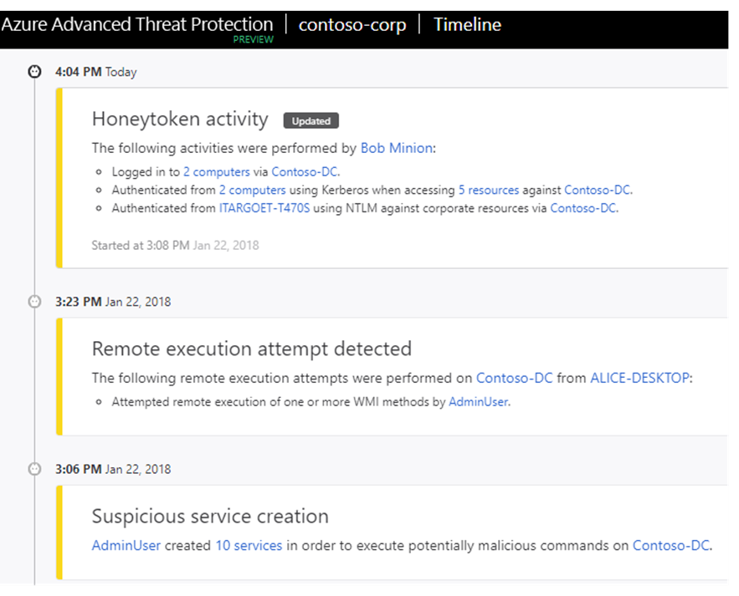
Azure Advanced Threat Protection (ATP)
Identifies, detects, and helps you investigate advanced threats, compromised identities, and malicious insider actions
Azure ATP portal monitors and responds to suspicious activity
Azure ATP sensor monitors domain controller traffic
Azure ATP cloud service connects to Microsoft Intelligent Security Graph
Notes:
Azure ATP portal. Azure ATP has its own portal, through which you can monitor and respond to suspicious activity. The portal allows you to create your Azure ATP instance, and view the data received from Azure ATP sensors.
You can also use the portal to monitor, manage, and investigate threats in your network environment. You sign in to the Azure ATP portal at https://portal.atp.azure.com. However, note that you must sign in with a user account that is assigned to an Azure AD security group that has access to the Azure ATP portal.
Azure ATP sensor. Azure ATP sensors are installed directly on your domain controllers. The sensor monitors domain controller traffic without requiring a dedicated server or configured port mirroring.
Azure ATP cloud service. Azure ATP cloud service runs on the Azure infrastructure, and is currently deployed in the United States, Europe, and Asia. The cloud service is connected to Microsoft Intelligent Security Graph

Slide 28
Lesson 04: Lab

Slide 29
Lab: Implement security and compliance in Azure DevOps pipelines
In this lab, Implement Security and Compliance in Azure DevOps pipelines, we will:
Implement various security techniques and solutions into an Azure DevOps pipeline
Notes:
Lab Steps in this course are available on GitHub at the below, under the Infrastructure as Code sections.
https://microsoft.github.io/PartsUnlimited
https://microsoft.github.io/PartsUnlimitedMRP

Slide 30
Lesson 05: Module review and takeaways

Slide 31
What did you learn?
Define an infrastructure and configuration strategy and appropriate toolset for a release pipeline and application infrastructure
Implement compliance and security in your application infrastructure

Slide 32
Module review questions
1
Rugged DevOps combines which two elements?
2
Which term broadly defines what security means in Rugged DevOps?
What component in Azure DevOps can you use to store, organize and share access to packages, and integrate those packages them with your continuous integration and continuous delivery pipeline?
3
4
Which of the following package types are available to use with Azure Artifacts?
5
What describes the term Software Composition Analysis?
6
From where can extensions be sourced from, to be integrated into Azure DevOps CI/CD pipelines and help provide security composition analysis?
Notes:
Q1 Answer: DevOps and Security
Q2 Answer: Securing the pipeline
With Rugged DevOps, security is more about securing the pipeline, determining where you can add security to the elements that plug into your build and release pipeline. For example, it's about how and where you can add security to you automation practices, production environments, and other pipeline elements while attempt to gain the speed of DevOps.
Rugged DevOps includes bigger questions such as: Is my pipeline consuming third-party components, and if so, are they secure? Are there known vulnerabilities within any of the third-party software we use? How quickly can I detect vulnerabilities (time to detect)? How quickly can I remediate identified vulnerabilities (time to remediate)?
Q3 Answer: Azure Artifacts
Q4 Answer: NuGet, npm and Maven
Q5 Answer: Analyzing open source software (OSS) to identify potential security vulnerabilities and provide validation that the software meets a defined criteria to use in your pipeline
Q6 Answer: Azure DevOps Marketplace

Slide 33
Module review questions, continued
7
Which products are available as extensions in Azure DevOps Marketplace, and can provide either OSS or source code scanning as part of an Azure DevOps pipeline?
8
Which Azure service is a monitoring service that can provide threat protection and security recommendations across all your services both in Azure and on-premises?
9
Which Azure service should you use from the below list to monitor all unencrypted SQL databases in your organization?
10
Which facility allows you to prevent accidental deletion of resources in Azure?
Notes:
Q7 Answer: Whitesource, CheckMarx, Micro Focus Fortify, Veracode
Q8 Answer: Azure Security Center
Q9 Answer: Azure Policy
Azure Policy is a service in Azure that you use to create, assign, and, manage policies. These policies enforce different rules and effects over your resources, which ensures they stay compliant with your corporate standards and service-level agreements (SLAs). A policy definition expresses what to evaluate and what action to take. For example, you could prevent VMs from deploying if they are exposed to a public IP address. You also could prevent a particular hard disk from being used when deploying VMs to control costs.
Q10 Answer: Locks
Locks help you prevent accidental deletion or modification of your Azure resources. You can manage these locks from within the Azure portal. To view, add, or delete locks, go to the SETTINGS section of any resource's settings blade. You may need to lock a subscription, resource group, or resource to prevent other users in your organization from accidentally deleting or modifying critical resources. You can set the lock level to CanNotDelete or ReadOnly.

