Slide 1
AZ-400.00 Module 19: Recommend and design system feedback mechanisms

Slide 2
Lesson 01: Module overview

Slide 3
Module overview
Lesson 5: Design processes to capture and analyze user feedback
Lesson 1: Module overview
Lesson 6: Design process to automate application analytics
Lesson 2: The Inner Loop
Lesson 3: Continuous experimentation mindset
Lesson 7: Lab
Lesson 4: Design practices to measure end-user satisfaction
Lesson 8: Module review and takeaways

Slide 4
Learning objectives
After completing this module, students will be able to:
Design practices to measure end-user satisfaction
Design processes to capture and analyze user feedback from external sources
Design routing for client application crash report data
Recommend monitoring tools and technologies
Recommend system and feature usage tracking tools

Slide 5

Lesson 02: The Inner Loop

Slide 6
The Inner Loop
The Inner Loop
Code
Build
Test

Slide 7
Lesson 03: Continuous experimentation mindset

Slide 8
Continuous delivery
Benefits:
Faster software development
Smaller and more frequent releases
Automated testing
Reduced development risk
Better development coordination
Quickly adapt to shifting markets
Benefits with Feature Flags:
Decouple rollout from code deployment
Releases with substantially mitigated risk
Customer feedback loop
Percentage rollouts and targeted releases
Feature rollbacks without redeploying
Configuration and long-term management

Slide 9
Using feature flags to safely get feedback on features
DEMO
Notes:
Take a moment to complete the demonstration, as defined in the student manual.

Slide 10
Lesson 04: Design practices to measure end-user satisfaction

Slide 11
Design practices to measure end-user satisfaction
1
Outline your goals and plan
2
Create a customer satisfaction survey
3
Choose your survey’s trigger and timing
4
Analyze the survey data
5
Adjust and repeat

Slide 12
In product feedback
Benefits | Weaknesses
Context-sensitive feedback | Not enough detail
Always on | Always on
High response rates | Too. Much. Feedback
 | Limited future follow up

Slide 13
Feedback on product roadmap
Pros | Cons
Customers feel that they’re an active part of building your product roadmap | Likely biased towards your highest-intent customers
Builds a sense of community and heightened loyalty | Low volume
Provides a channel through which you can make users feel appreciated

Slide 14
Lesson 05: Design processes to capture and analyze user feedback

Slide 15
For every customer who bothers to complain, 20 other customers remain silent

Slide 16
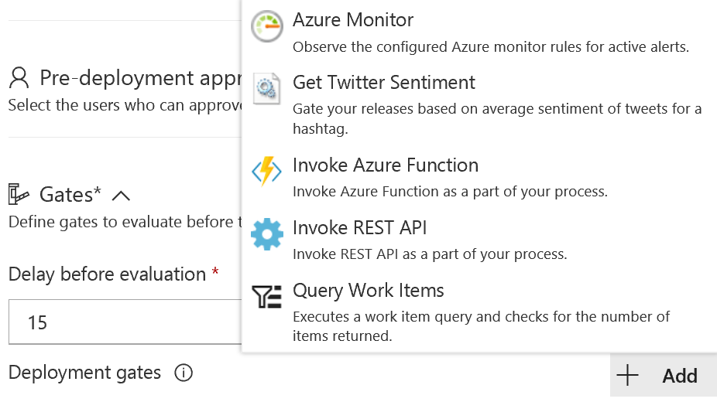
Release gates – Configure Twitter sentiment

Slide 17
Deploy with RM green light capabilities
DEMO
Notes:
Take a moment to complete the demonstration, as defined in the student manual.

Slide 18

Lesson 06: Design process to automate application analytics

Slide 19
Recommend system and feature usage tracking tools telemetry
Benefits:
Monitor an object while physically far removed from it
Challenges:
Do end users want it enabled?

Slide 20
Recommend monitoring tools and technologies
Synthetic monitoring
Alert management
Deployment automation
Analytics

Slide 21
Lesson 07: Lab

Slide 22

Lab: Integration between Azure DevOps and Teams
In this lab, Microsoft Teams with Azure DevOps Services (Collaborate, Communicate and Celebrate, learn about how Azure DevOps integrates with Microsoft Teams to provide a comprehensive chat and collaboration experience, across your Agile and development work
Note that you must have already completed the prerequisite labs in the Welcome section
Notes:
Microsoft Teams with Azure DevOps Services (Collaborate, Communicate and Celebrate - https://azuredevopslabs.com/labs/vsts/teams

Slide 23
Lesson 08: Module review and takeaways

Slide 24
What did you learn?
Design practices to measure end-user satisfaction
Design processes to capture and analyze user feedback from external sources
Design routing for client application crash report data
Recommend monitoring tools and technologies
Recommend system and feature usage tracking tools

Slide 25
Module review questions
1
What are some of the ways to measure end user satisfaction for your product?
2
True or False: Azure DevOps has a feature request board
3
Release Gates in Azure DevOps support following gates by default?
4
Describe feature flags
Notes:
Q1 Answer: CSAT, CES, NPM
Q2 Answer: True
Q3 Answer: Invoke Azure Function, Access Azure Policy Security & Compliance assessment, Query Azure Monitor Alerts
Q4 Answer: Feature Flags can be used to deploy changes with releasing them
Feature Flags can be used to control exposure to new product functionality
Feature Flags can be used to perform testing of new features in production

