Slide 1
Using AI to make practice more effective in general chemistry
Ryan Dwyer
October 29, 2026

Slide 2
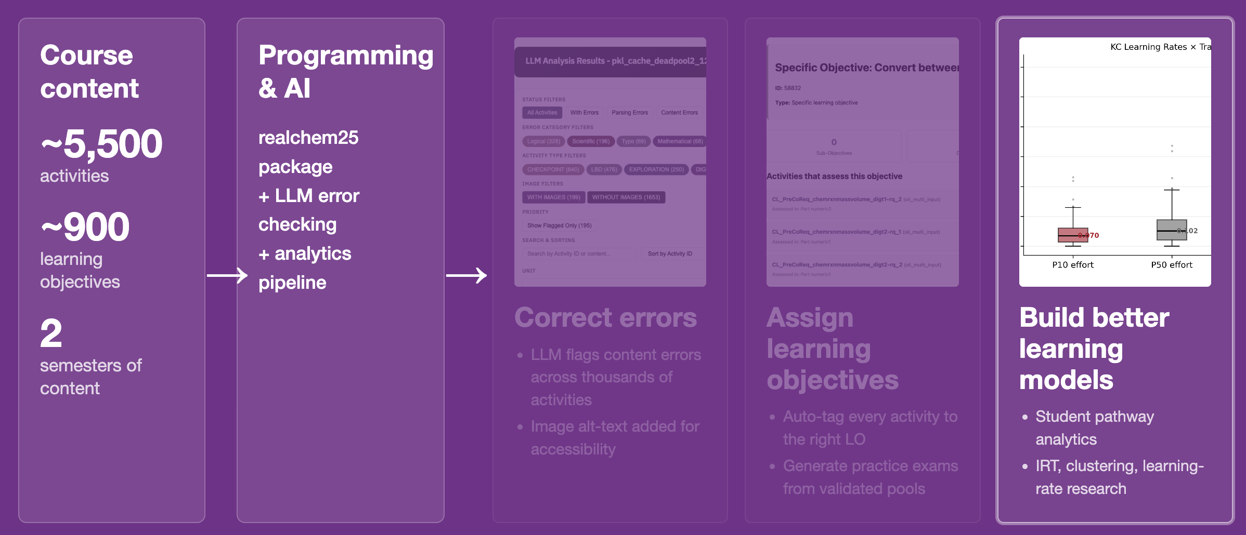
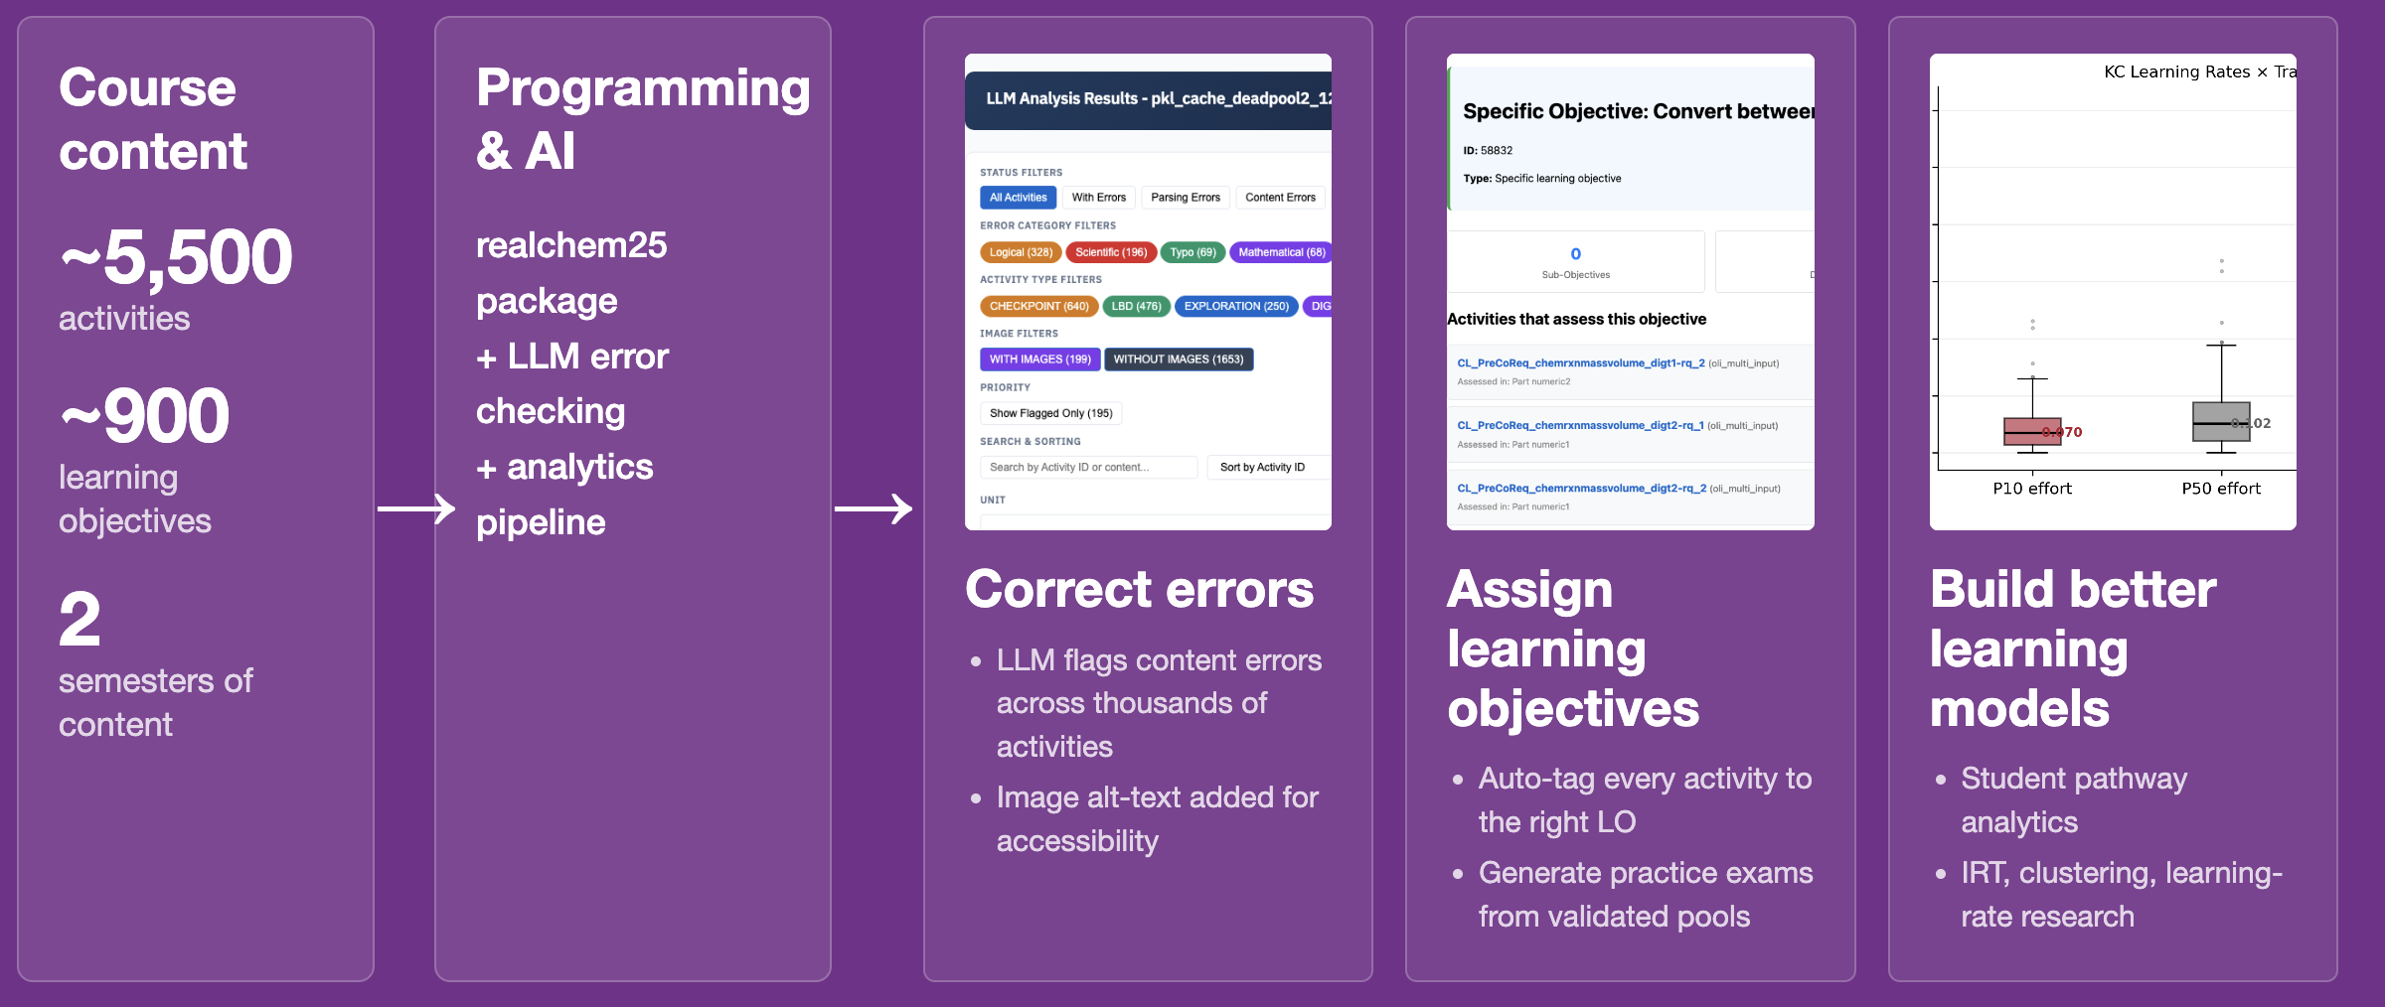
AI for educational data modeling
LLMs and AI coding tools dramatically lower barriers to educational data modeling
Notes:
This is the slide where you'll be tempted to over-explain. Don't. Trustees don't need the pipeline diagram explained. The headline is the bottom of the slide: AI dramatically lowers the barrier to this kind of analysis.
Just say: "5,500 activities, 900 learning objectives — that used to be a year of grad student labor to tag and analyze. With LLMs and modern tools, I can do this kind of analysis in weeks. That's what made the next finding possible."
Optional Mount Union beat: "And it means a faculty member at a place like Mount Union — without a research lab full of grad students — can do work that used to require a major research university."
Transition: "Here's what we found."

Slide 3
Prior work: how to maximize student learning?
1. Doer effect
practice produces more, faster learning than
reading or watching video (1.3 to 6×)
2. Surprisingly, students learn at similar rates!
3. Some students still need more practice
Koedinger, K. R. et al. Proc. Learning @ Scale 2015, 111–120. https://doi.org/10.1145/2724660.2724681
Van Campenhout, R. et al. Proc. LAK 2023. https://doi.org/10.1145/3576050.3576103
Notes:
n our first-semester general chemistry courses here at Mount Union, our DFW rate has historically been around 23% — better than the national 30%, but still students I want to reach. Recently it's been closer to 15%, which encourages me that the changes I've been making are working. The sabbatical was about understanding why they work, so I can do more of it deliberately. The same trend holds nationwide — about 30% of students don't succeed in general chemistry, and similar in calculus and statistics, the other gateway STEM courses my collaborators at Carnegie Mellon are working on.
A natural reaction to that is to think these students aren't capable of learning chemistry. And honestly, it's easy as an instructor to fall into the same trap — to look at the student getting things right and assume they're learning, and look at the struggling student and assume they're not. But work my collaborators did before my sabbatical showed that really isn't true.
This graph shows student performance against how many practice opportunities they've done on a particular skill. Some students come in with a lot less initial knowledge than others. But as they practice, they're actually learning at about the same rate. That's a surprising, counterintuitive result that has held up across many areas of education.
But just because they're learning at the same rate doesn't mean they're both succeeding. The higher-knowledge student comes in knowing more, and on average they practice more — so the performance gap actually widens over the semester. The natural response is: if we can get this lower-knowledge student a few more practice opportunities — in this case, from 7 to 11 — they can equalize that achievement gap. So one big question in improving general chemistry is how to get students the practice they need.
My sabbatical research extended this analysis to consider student engagement, and one of my key findings is that highly engaged students can learn up to 3 times faster than disengaged students. That's a second lever for improving outcomes — improving engagement.
These two factors are in tension, though. The natural thing to do is to give students more practice — but the more you assign, the more you risk pushing them toward shortcuts. Anytime students are working on chemistry, they might have a beautiful problem you've given them, but there's always the option of having their phone or another browser open with ChatGPT. Rather than doing the difficult work that helps them learn, there's always the chance they decide to copy the question into ChatGPT, paste the answer back in, and go do something else.
The two projects I want to talk about attack this problem from different angles.

Slide 4
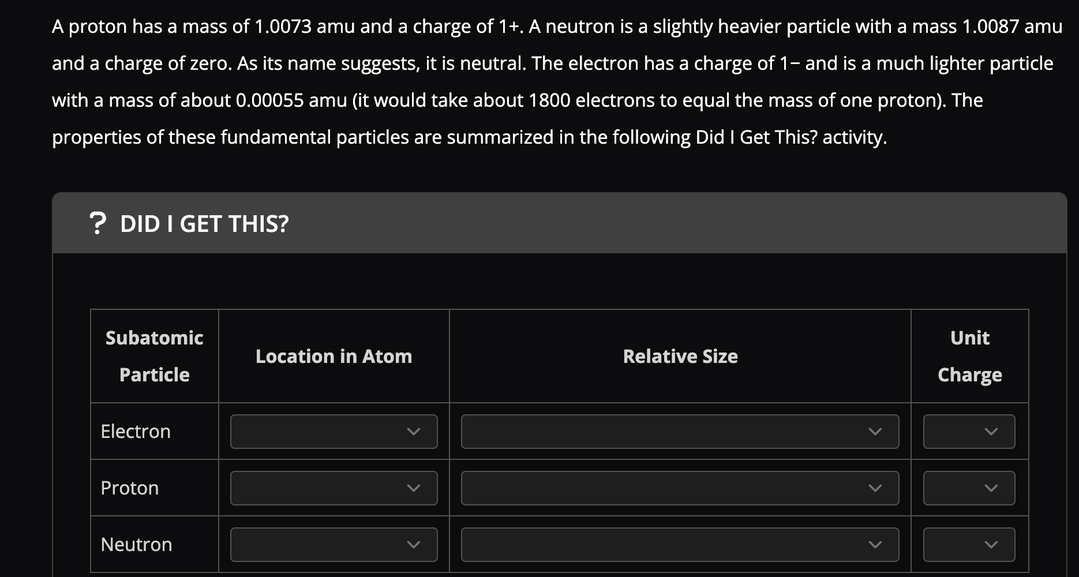
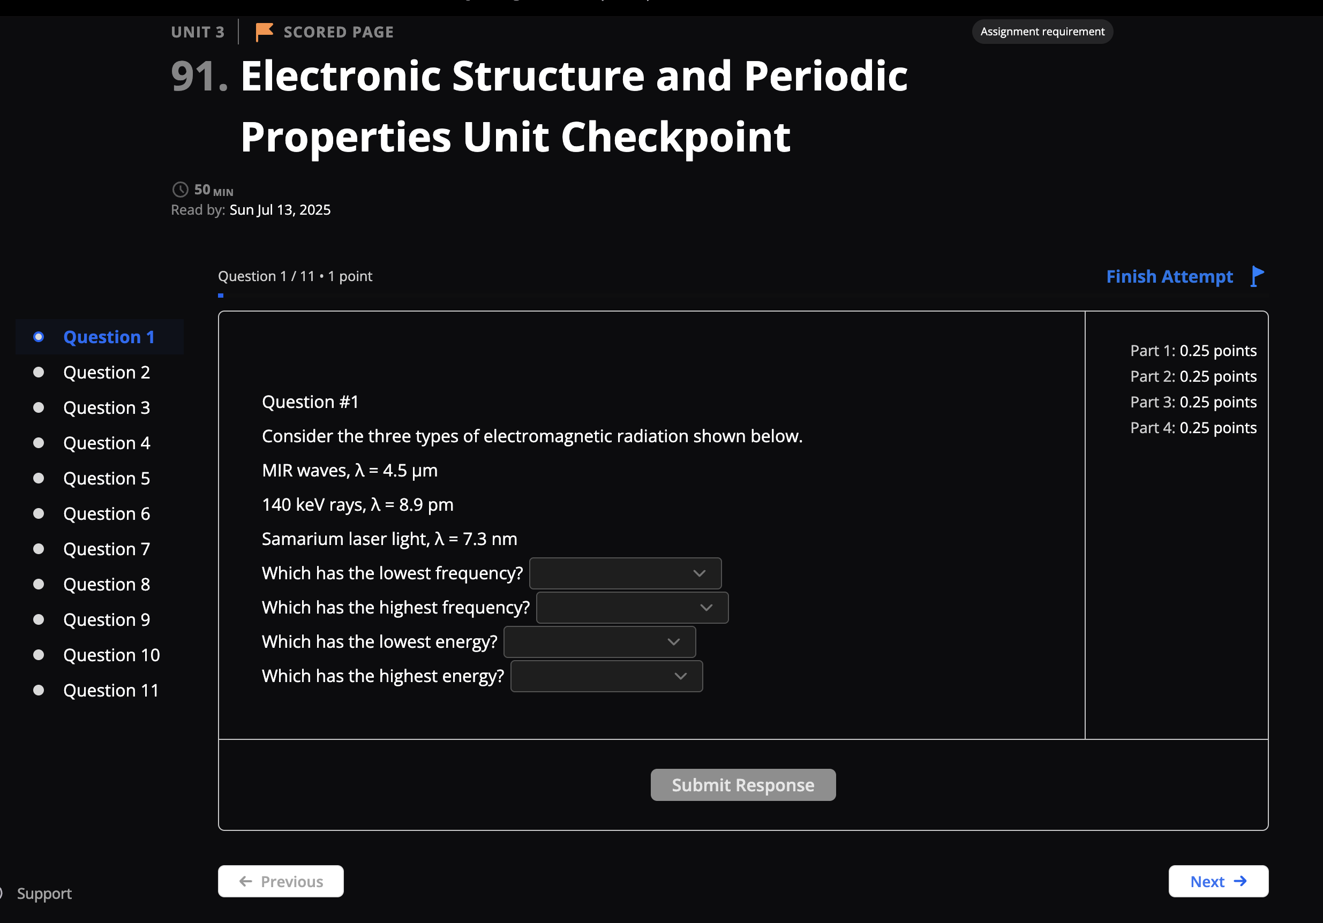
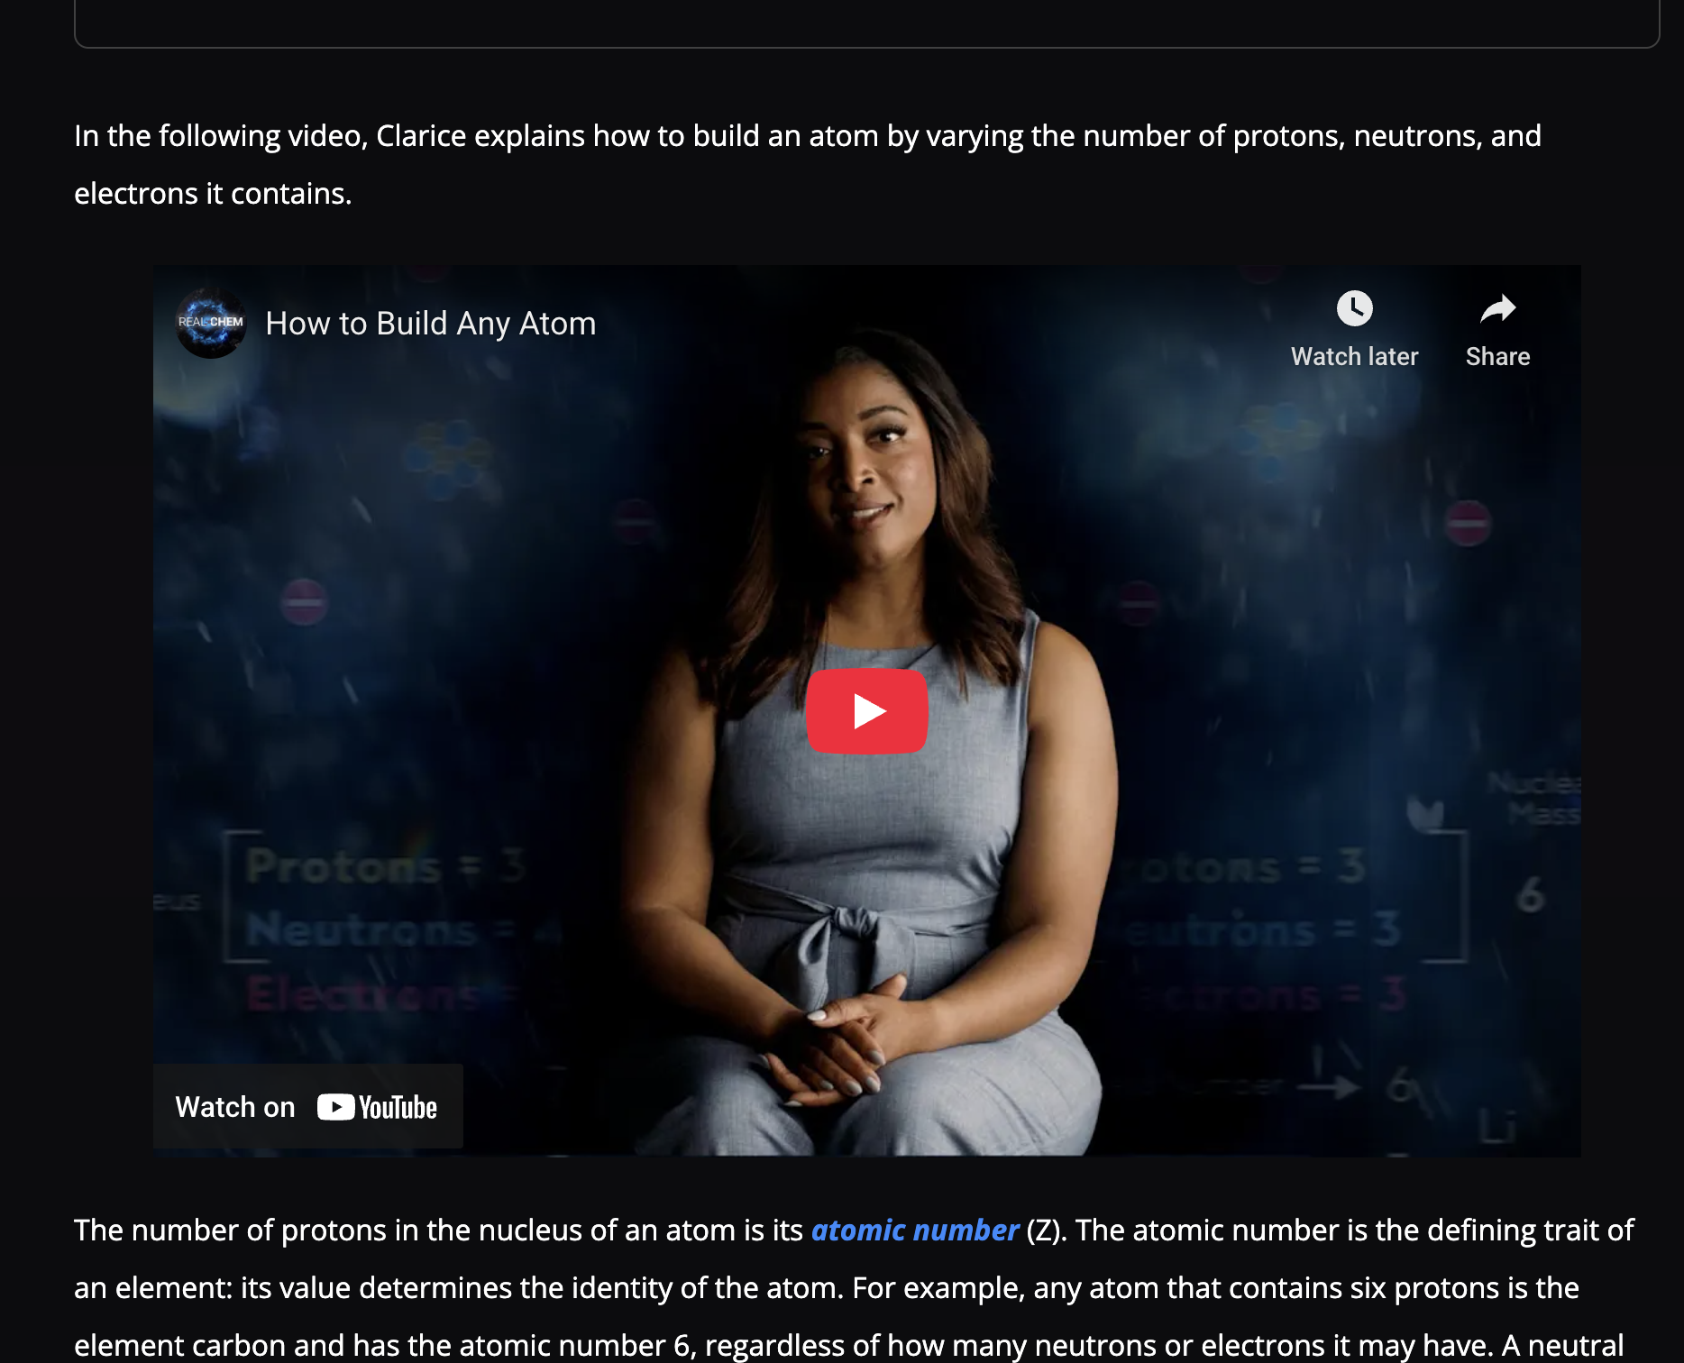
REAL CHEM: textbook & homework
Skill: Compare frequency, wavelength, and energy of photons
Notes:
The first takes advantage of RealChem — an online textbook and homework system developed by my collaborator Dr. Dave Yaron at Carnegie Mellon, funded by the Gates Foundation, with both general chemistry I and II.
What sets it apart is the research-driven design.

Slide 5
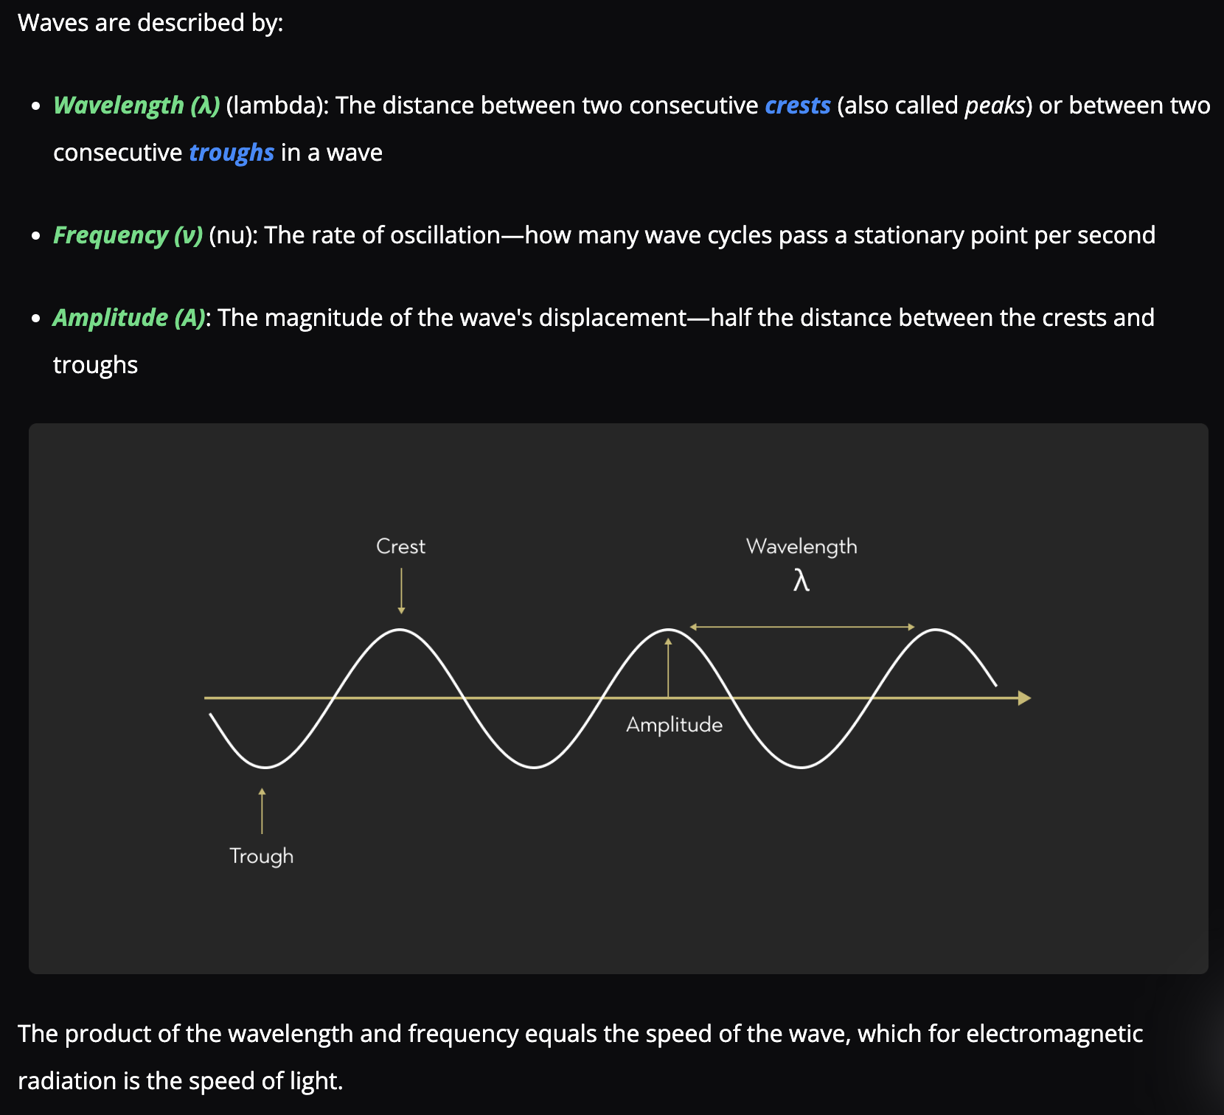
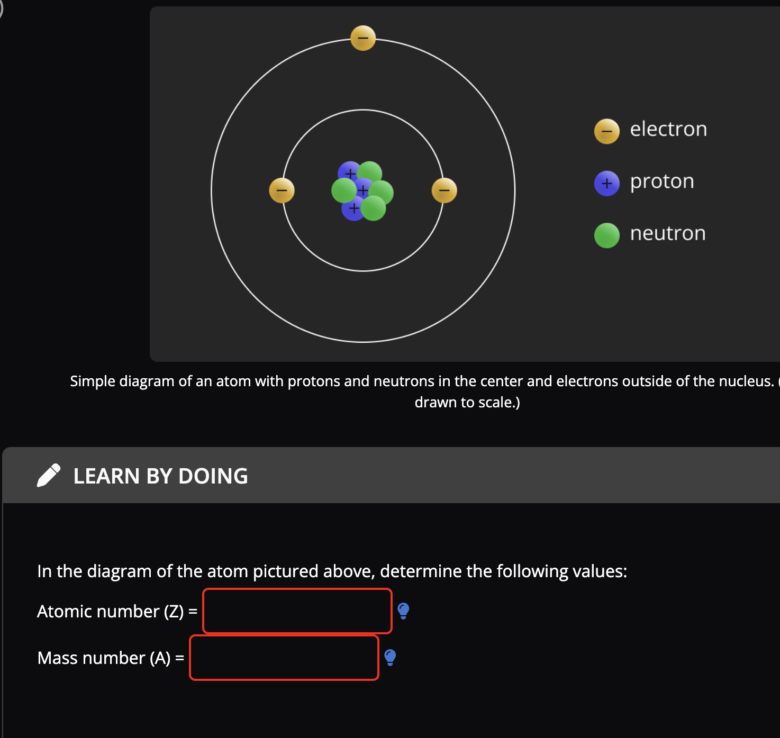
Module practice: Text with integrated practice
Text
Learn by doing
Student interactions tracked throughout
13 million interactions / semester at 40 institutions
Notes:
One minute overview of foundation pointing out features, videos, worked examples, visual organizers (what are those), worked examples, interactive examples and Many, Many activities

Slide 6
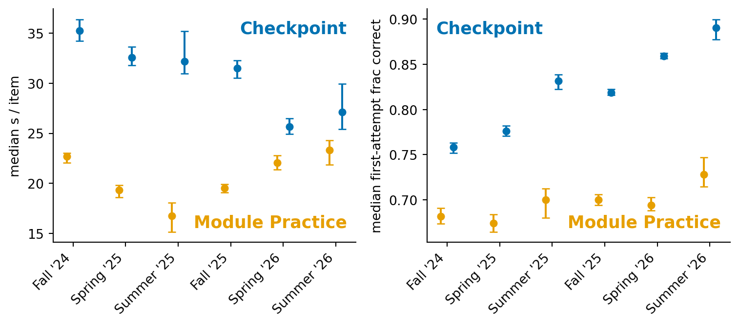
Checkpoint (homework) time and performance changes over time

Slide 7
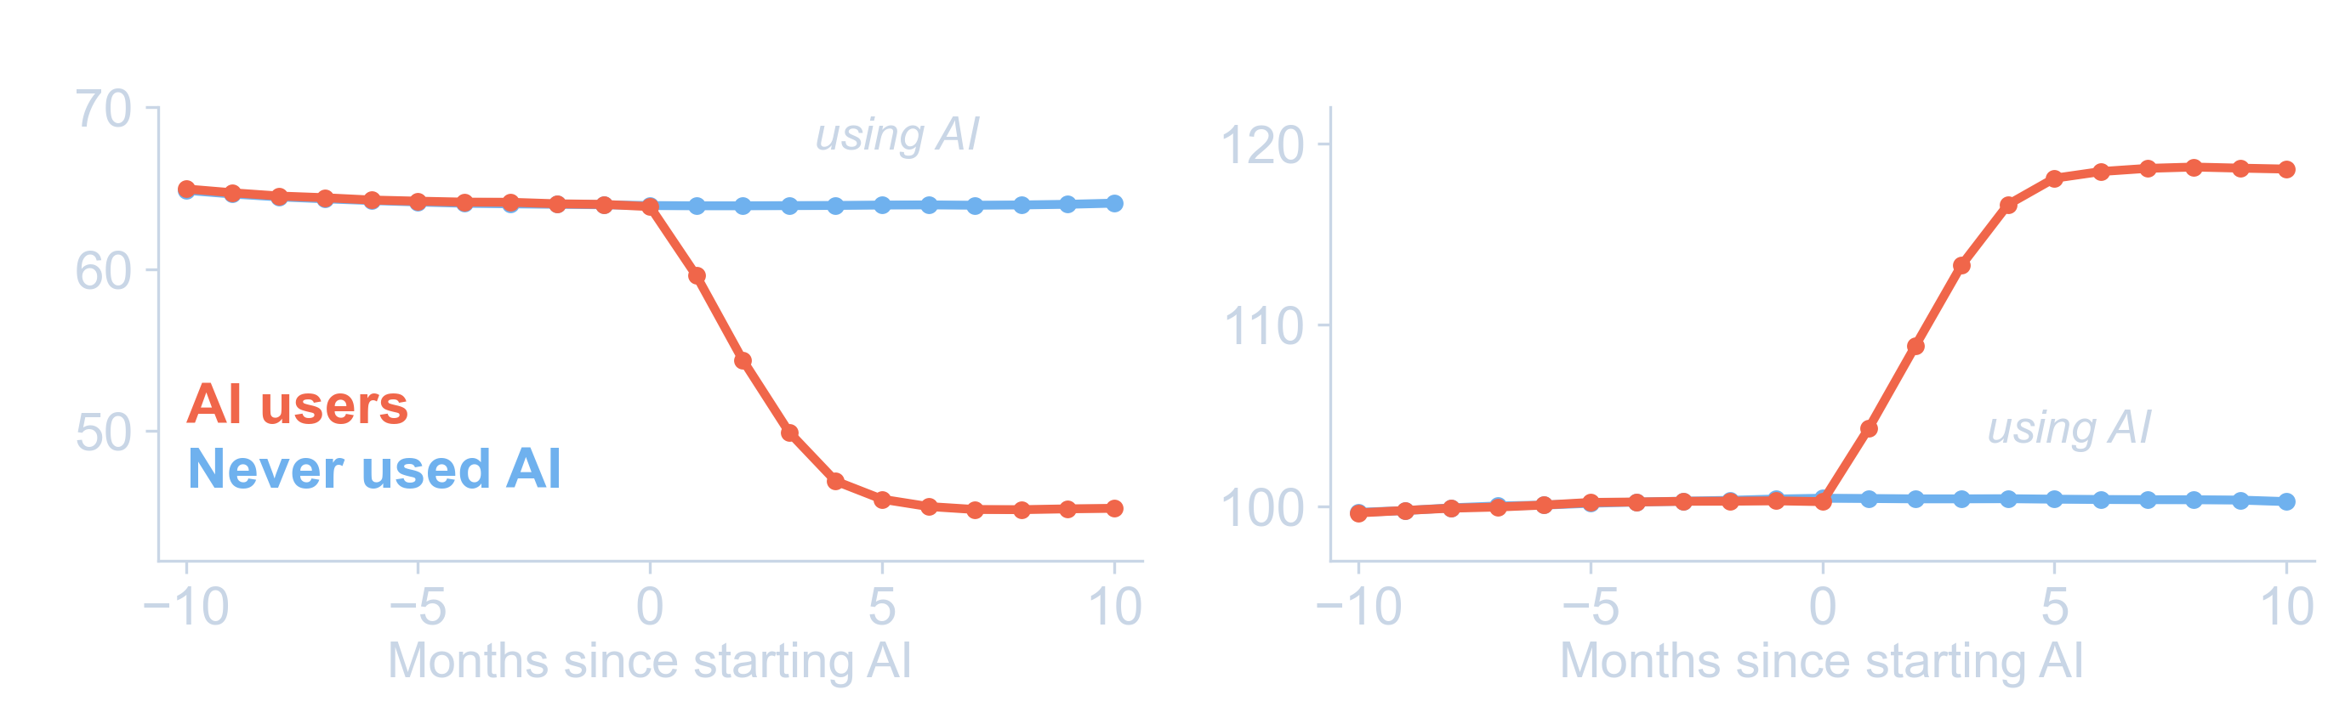
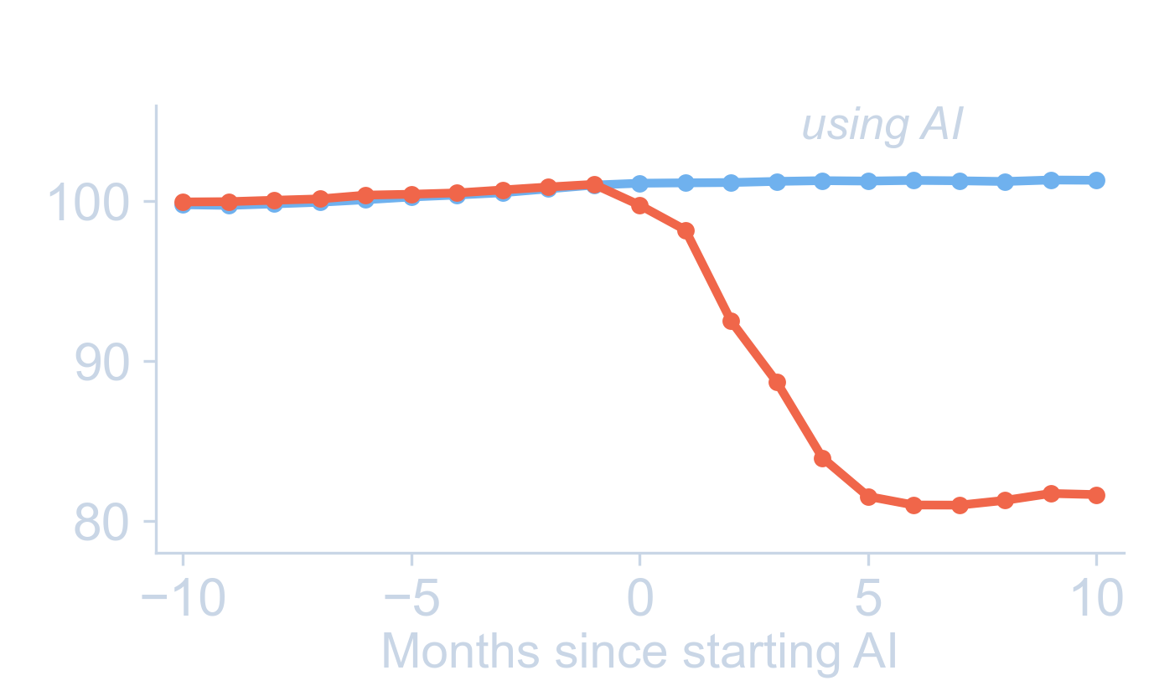
Matches AI use in other literature studies
26,811 Chinese students, grades 7–12
Scores scaled so the pre-AI average = 100
Strömberg, D.; Lei, V.; Wu, Y. SSRN 6868618, June 2026.

Slide 8
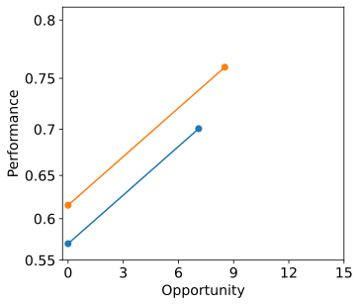
Additive factors model
P ~ (initial knowledge) + (learning rate) × opportunity
1. How to get students the practice they need?
high
initial knowledge
Performance gap widens despite equal learning rate
Not learning?
low initial knowledge
Koedinger, et al. An Astonishing Regularity in Student Learning Rate. PNAS, 2023, 120 (13), e2221311120. https://doi.org/10.1073/pnas.2221311120.
Koedinger, K. R. et al. Nov 12, 2024. https://doi.org/10.26434/chemrxiv-2024-bms6x.
Notes:
n our first-semester general chemistry courses here at Mount Union, our DFW rate has historically been around 23% — better than the national 30%, but still students I want to reach. Recently it's been closer to 15%, which encourages me that the changes I've been making are working. The sabbatical was about understanding why they work, so I can do more of it deliberately. The same trend holds nationwide — about 30% of students don't succeed in general chemistry, and similar in calculus and statistics, the other gateway STEM courses my collaborators at Carnegie Mellon are working on.
A natural reaction to that is to think these students aren't capable of learning chemistry. And honestly, it's easy as an instructor to fall into the same trap — to look at the student getting things right and assume they're learning, and look at the struggling student and assume they're not. But work my collaborators did before my sabbatical showed that really isn't true.
This graph shows student performance against how many practice opportunities they've done on a particular skill. Some students come in with a lot less initial knowledge than others. But as they practice, they're actually learning at about the same rate. That's a surprising, counterintuitive result that has held up across many areas of education.
But just because they're learning at the same rate doesn't mean they're both succeeding. The higher-knowledge student comes in knowing more, and on average they practice more — so the performance gap actually widens over the semester. The natural response is: if we can get this lower-knowledge student a few more practice opportunities — in this case, from 7 to 11 — they can equalize that achievement gap. So one big question in improving general chemistry is how to get students the practice they need.
My sabbatical research extended this analysis to consider student engagement, and one of my key findings is that highly engaged students can learn up to 3 times faster than disengaged students. That's a second lever for improving outcomes — improving engagement.
These two factors are in tension, though. The natural thing to do is to give students more practice — but the more you assign, the more you risk pushing them toward shortcuts. Anytime students are working on chemistry, they might have a beautiful problem you've given them, but there's always the option of having their phone or another browser open with ChatGPT. Rather than doing the difficult work that helps them learn, there's always the chance they decide to copy the question into ChatGPT, paste the answer back in, and go do something else.
The two projects I want to talk about attack this problem from different angles.

Slide 9
Additive factors Model (AFM) – learning curves
P ~ (initial knowledge) + (learning rate) × opportunity
Simplifying assumptions:
1. All items in a skill considered equal.
2. All practice opportunities are considered equal.
3. Students differences attributed to 1 prior skill only
Effenberger, T.; Pelánek, R.; Čechák, J. Exploration of the Robustness and Generalizability of the Additive Factors Model. In Proceedings of the Tenth International Conference on Learning Analytics & Knowledge; LAK ’20; Association for Computing Machinery: New York, NY, USA, 2020; pp 472–479. https://doi.org/10.1145/3375462.3375491.
Koedinger, K. R. et al. An Astonishing Regularity in Student Learning Rate. PNAS 2023, 120 (13), e2221311120. https://doi.org/10.1073/pnas.2221311120.

Slide 10
Modeling approach
70%
Training
Fit student, KC, item parameters
1.3 M student-
KC pairs
30%
Test
Evaluate – how well does the model predict test set?
Item difficulty
Split student, learning parameters based on practice type
Account for rushed practice with student and session-level time variables

Slide 11
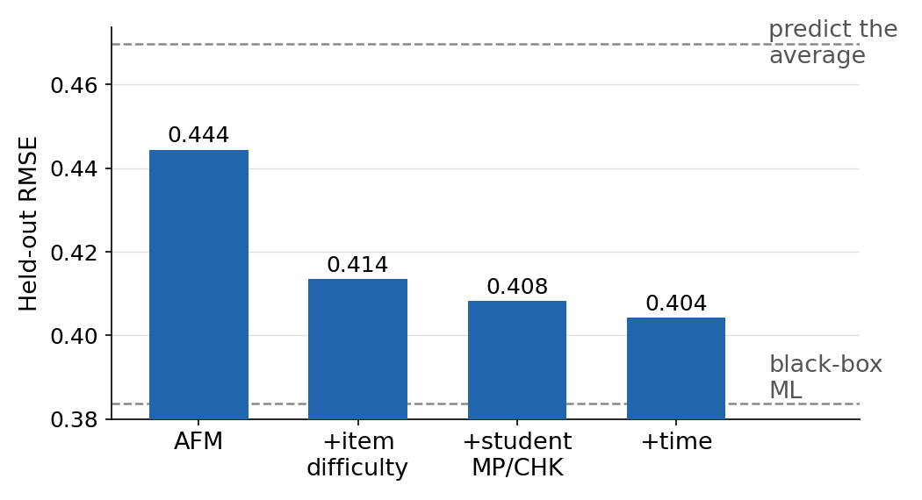
Accounting for item & practice variability improves predictions dramatically
Notes:
4.23M data points,

Slide 12
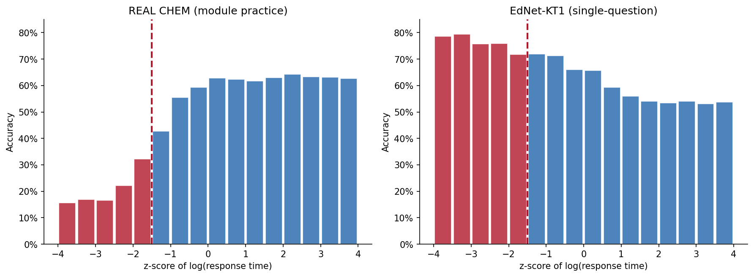
3. Practice performance depends strongly on time
EdNet tutoring data –
students pay per problem
REAL CHEM Practice
~20%
attempts
Fast slow
Scaled response time
Fast slow
Scaled response time

Slide 13
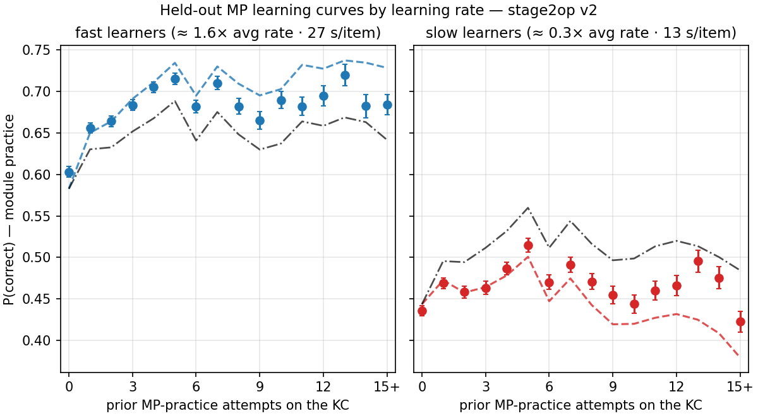
Learning rates on practice differ widely
Groups of students who learn significantly more or less from practice, in contrast to prior work

Slide 14
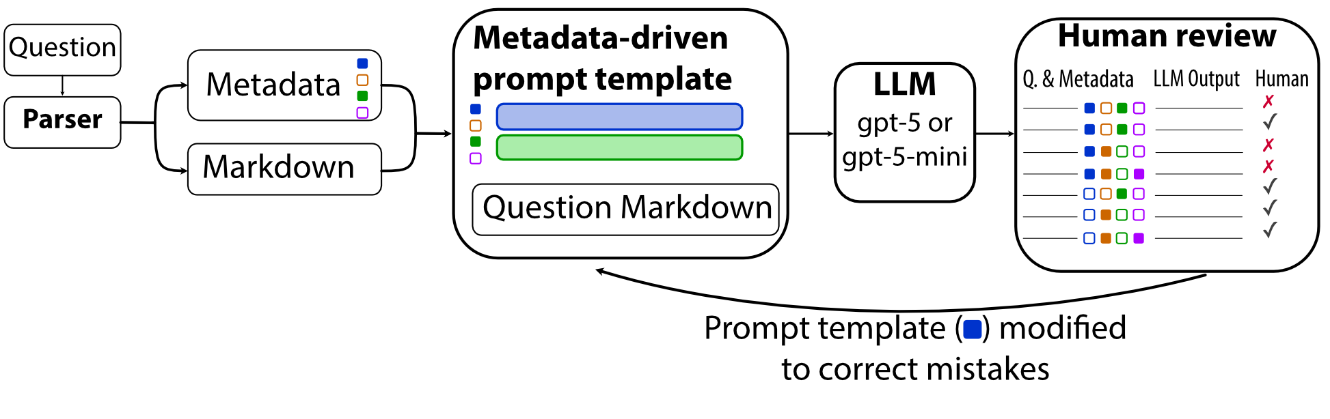
Shared tools: AI-powered tagging and error checking
Caught many errors in questions
Critical because effective strategies (“doer effect”) rely on feedback
What is effect on student learning of incorrect feedback?

Slide 15
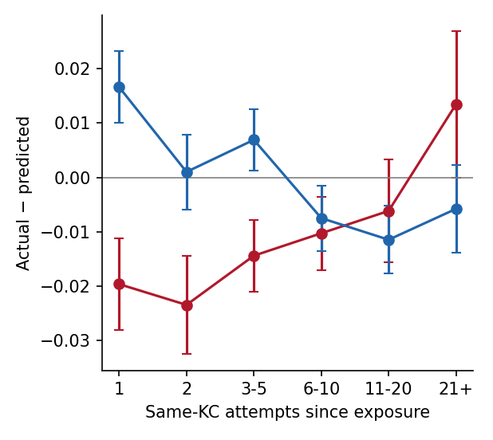
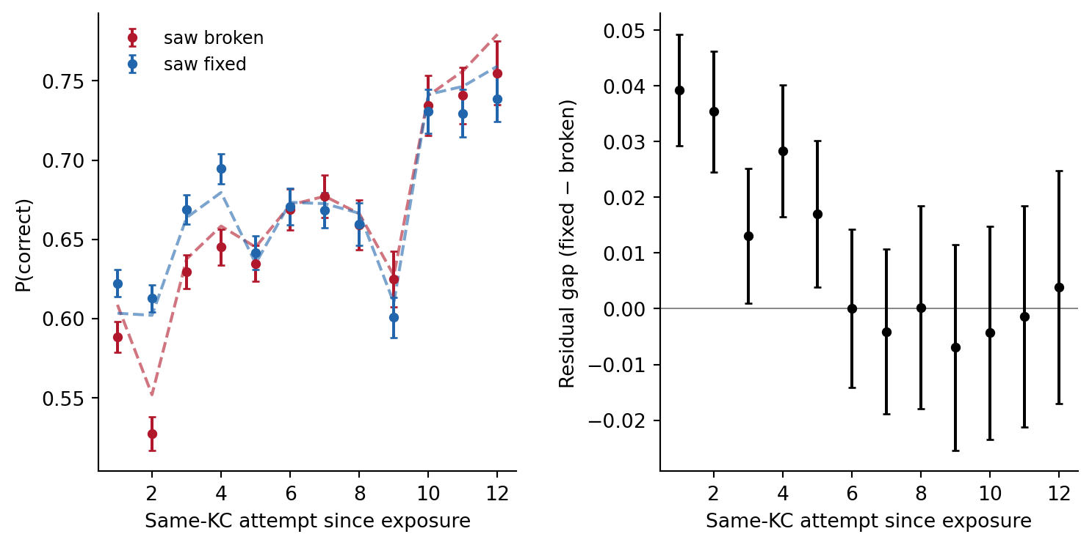
Learning improved substantially after fixing incorrect items
Fixed
Broken
Notes:
7 items initially graded incorrect, corrected = more learning for 5 attempts…

Slide 16

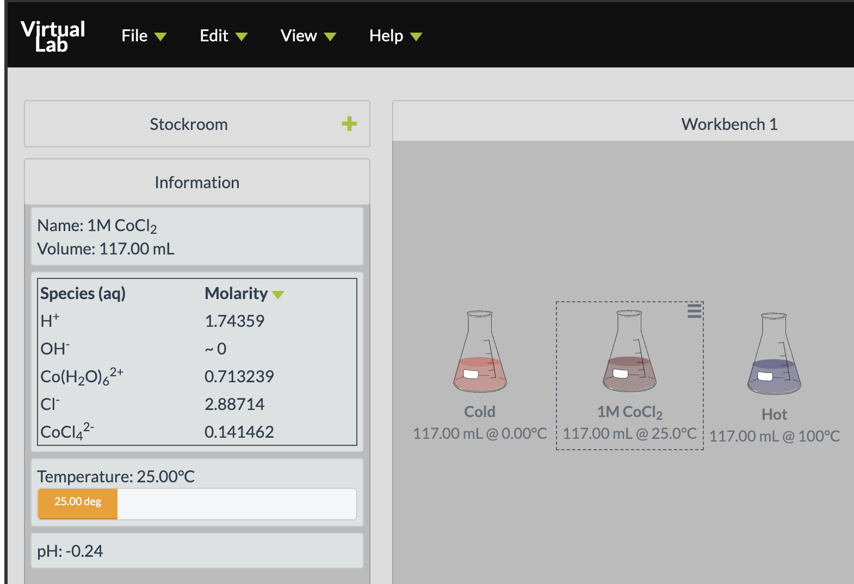
Virtual labs complement in-person lab
150,000 sessions / semester
Improved chemical reasoning and experimental design (within-teacher randomized control trial)
Difficult to scale – live instructor support typically needed
McCormick, S et al. J. Chem. Educ. 2023, 100 (6), 2116–2131. https://doi.org/10.1021/acs.jchemed.2c01106.
Notes:
Key point: ChemCollective is a virtual chemistry lab I've been developing since 2020. 150,000 sessions per semester worldwide. Published evidence (within-teacher RCT) that it improves chemical reasoning and experimental design.
Why it matters here: "You can't easily ChatGPT your way through a virtual experiment. The student has to actually decide what to mix, what to measure, what to conclude. That's authentic engagement by construction."
The challenge: It's hard to scale because students need an instructor to guide them through open-ended exploration.
Transition: "That's the problem AI might be able to solve."

Slide 17

Adding AI to the virtual lab
Started collaboration with leading AI language researcher Carolyn Rose
Nachiket Kotalwar integrated virtual lab into their peer / AI learning framework
Mount Union pilot provided student-reasoning traces for training AI peer
Notes:
Key point: New collaboration with Carolyn Rosé at CMU — one of the leading AI-in-education researchers in the country — to build AI peer/tutor agents into the virtual lab.
Mount Union beat — make this prominent: "Two of our students were part of the pilot that's training this system. Mount Union isn't just going to adopt this work; we're a research site contributing to it. Carnegie Mellon has put $250K of seed funding behind the next phase."
Be honest about the caution: "We're being careful with student-facing AI. The behind-the-scenes analytics are well-established. AI that talks directly to students is harder to get right, and we want to do it well."
Transition: "So what does all this add up to?"

Slide 18
Conclusions
AI for analysis: Better learning models show who learns from practice
AI for content: LLM error checks catch broken feedback; fixing it improves learning
AI for students: Tutors can now see the virtual lab and give short hints that keep students thinking
Next: Proctored assessments even more important, decoupling between homework and exam scores…

Slide 19



Thank you!
Supported in part by the Bill Gates Foundation and the National Science Foundation
Ryan Dwyer
dwyerry@mountunion.edu

Slide 20
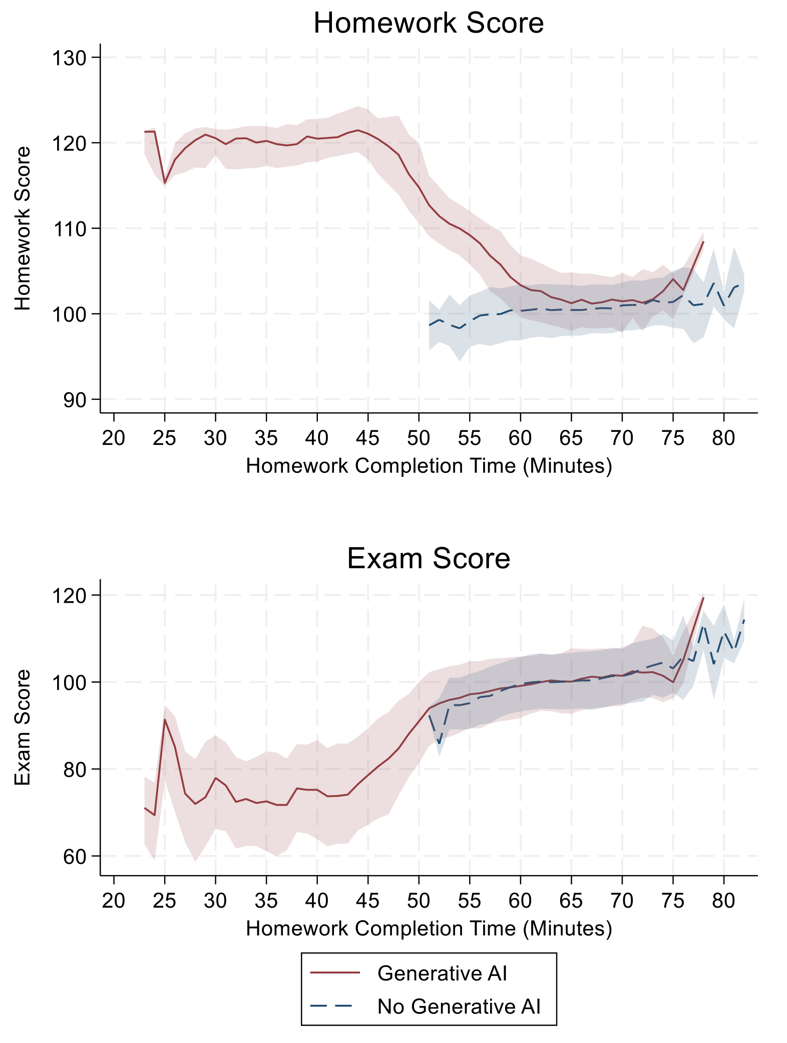
Learning losses concentrate among students who rush
Homework and exam scores by homework completion time (medians, IQR)
Strömberg, D.; Lei, V.; Wu, Y. SSRN 6868618, June 2026.

Slide 21
My work
student learn differently from different practice types
learning rates associated with engagement
2. What strategies foster earnest engagement with practice?
Koedinger, K. R. et al. Proc. Learning @ Scale 2015, 111–120. https://doi.org/10.1145/2724660.2724681
Van Campenhout, R. et al. Proc. LAK 2023. https://doi.org/10.1145/3576050.3576103
Notes:
n our first-semester general chemistry courses here at Mount Union, our DFW rate has historically been around 23% — better than the national 30%, but still students I want to reach. Recently it's been closer to 15%, which encourages me that the changes I've been making are working. The sabbatical was about understanding why they work, so I can do more of it deliberately. The same trend holds nationwide — about 30% of students don't succeed in general chemistry, and similar in calculus and statistics, the other gateway STEM courses my collaborators at Carnegie Mellon are working on.
A natural reaction to that is to think these students aren't capable of learning chemistry. And honestly, it's easy as an instructor to fall into the same trap — to look at the student getting things right and assume they're learning, and look at the struggling student and assume they're not. But work my collaborators did before my sabbatical showed that really isn't true.
This graph shows student performance against how many practice opportunities they've done on a particular skill. Some students come in with a lot less initial knowledge than others. But as they practice, they're actually learning at about the same rate. That's a surprising, counterintuitive result that has held up across many areas of education.
But just because they're learning at the same rate doesn't mean they're both succeeding. The higher-knowledge student comes in knowing more, and on average they practice more — so the performance gap actually widens over the semester. The natural response is: if we can get this lower-knowledge student a few more practice opportunities — in this case, from 7 to 11 — they can equalize that achievement gap. So one big question in improving general chemistry is how to get students the practice they need.
My sabbatical research extended this analysis to consider student engagement, and one of my key findings is that highly engaged students can learn up to 3 times faster than disengaged students. That's a second lever for improving outcomes — improving engagement.
These two factors are in tension, though. The natural thing to do is to give students more practice — but the more you assign, the more you risk pushing them toward shortcuts. Anytime students are working on chemistry, they might have a beautiful problem you've given them, but there's always the option of having their phone or another browser open with ChatGPT. Rather than doing the difficult work that helps them learn, there's always the chance they decide to copy the question into ChatGPT, paste the answer back in, and go do something else.
The two projects I want to talk about attack this problem from different angles.

Slide 22
REAL CHEM
Online textbook / homework system
General Chemistry I & II
Notes:
The first takes advantage of RealChem — an online textbook and homework system developed by my collaborator Dr. Dave Yaron at Carnegie Mellon, funded by the Gates Foundation, with both general chemistry I and II.
What sets it apart is the research-driven design.

Slide 23
REAL CHEM – Checkpoints provide assessment
Notes:
One minute overview of foundation pointing out features, videos, worked examples, visual organizers (what are those), worked examples, interactive examples and Many, Many activities

Slide 24
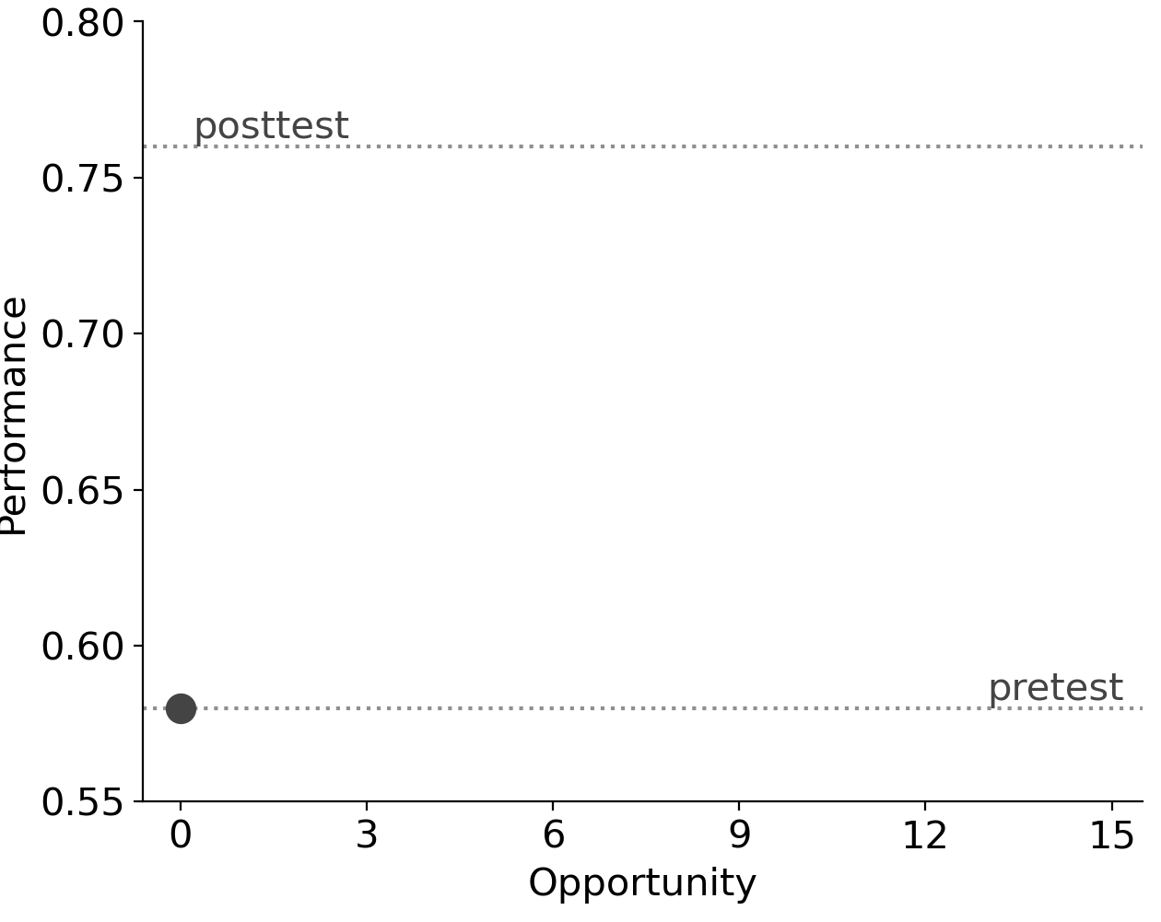
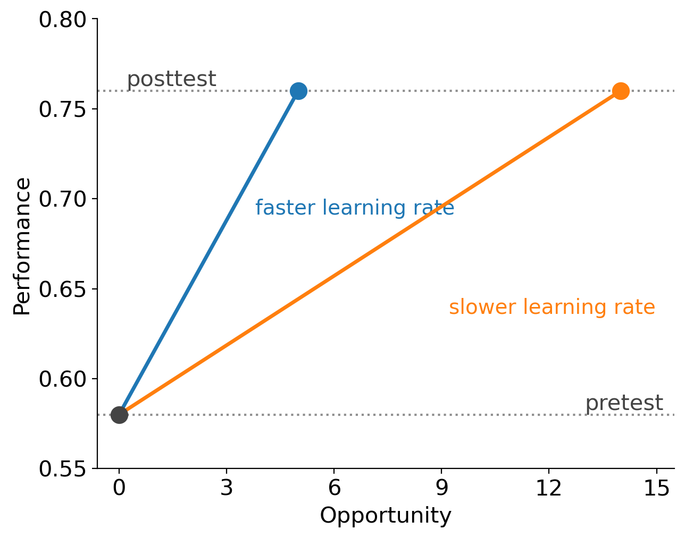
Instrumented Instruction
Pre-test Intervention Post-test
Data
Control
?
Data
Data
Treatment
?
Data
Our approach
Instrumented instruction
Gather data all
along the way
Notes:
Key point: Traditional education research is pretest–intervention–posttest. We have data on every single problem a student attempts. That lets us see learning happen, not just measure it before and after.
Keep this short — it's a setup slide.
Transition: "And the first thing the data tells us is that not all practice is the same."

Slide 25
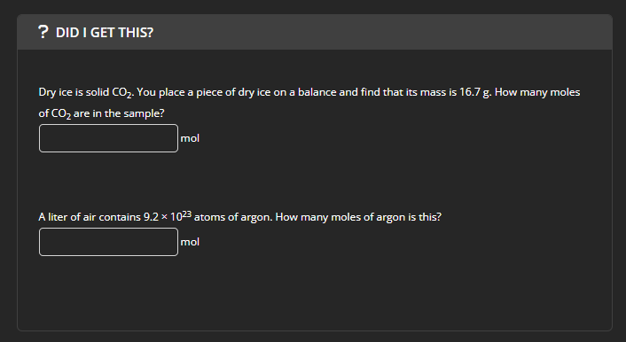
Instrumented instruction enables better analysis of learning
Skill: Convert between mass and moles.
Skill: Convert between particles (atoms, molecules or fm. un.) and moles.
Knowledge Mapping
Map of courseware questions to Knowledge Components (KCs or skills)
Notes:
Ray

Slide 26
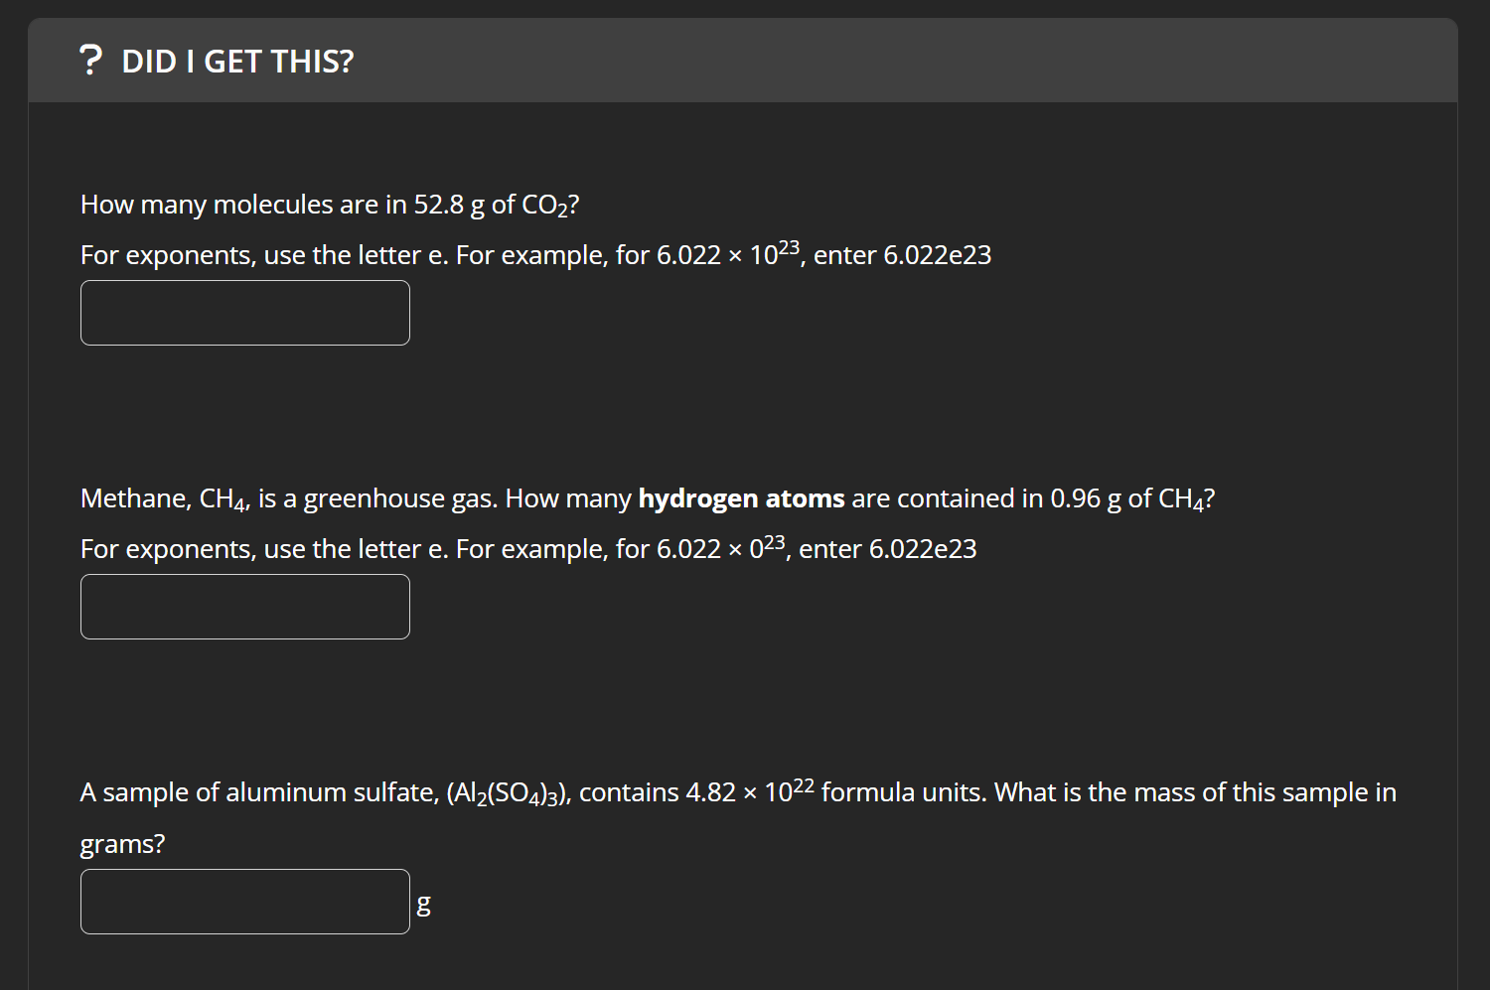
Continual data gathering maps student performance on each knowledge component
Timestamped student interactions with courseware
Skill: Convert between mass and particles (atoms, molecules or fm. un.).
Trace of student interactions with Knowledge Components (KCs)
Skill: Convert between mass and particles (atoms, molecules or fm. un.).
Skill: Convert between mass and particles (atoms, molecules or fm. un.).
Notes:
Ray

Slide 27
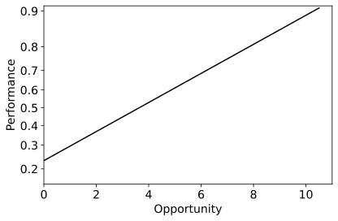
Learning curves
P = (initial knowledge) + (learning rate) × opportunity
Learning rate
Log odds of correct response without requesting a hint
Initial knowledge
Previous questions the learner has engaged with that KC
Koedinger, K. R. et al. An Astonishing Regularity in Student Learning Rate. PNAS 2023, 120 (13), e2221311120. https://doi.org/10.1073/pnas.2221311120.

Slide 28
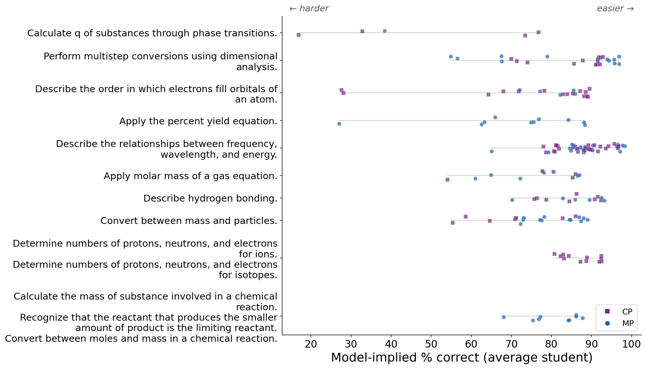
1. Items vary widely in difficulty within the same skill (KC)

Slide 29
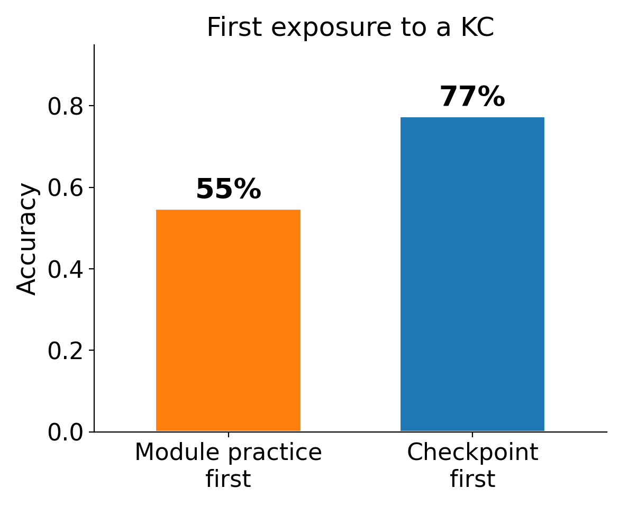
First-attempt accuracy is much higher on checkpoints
First exposure to skill (KC)

Slide 30
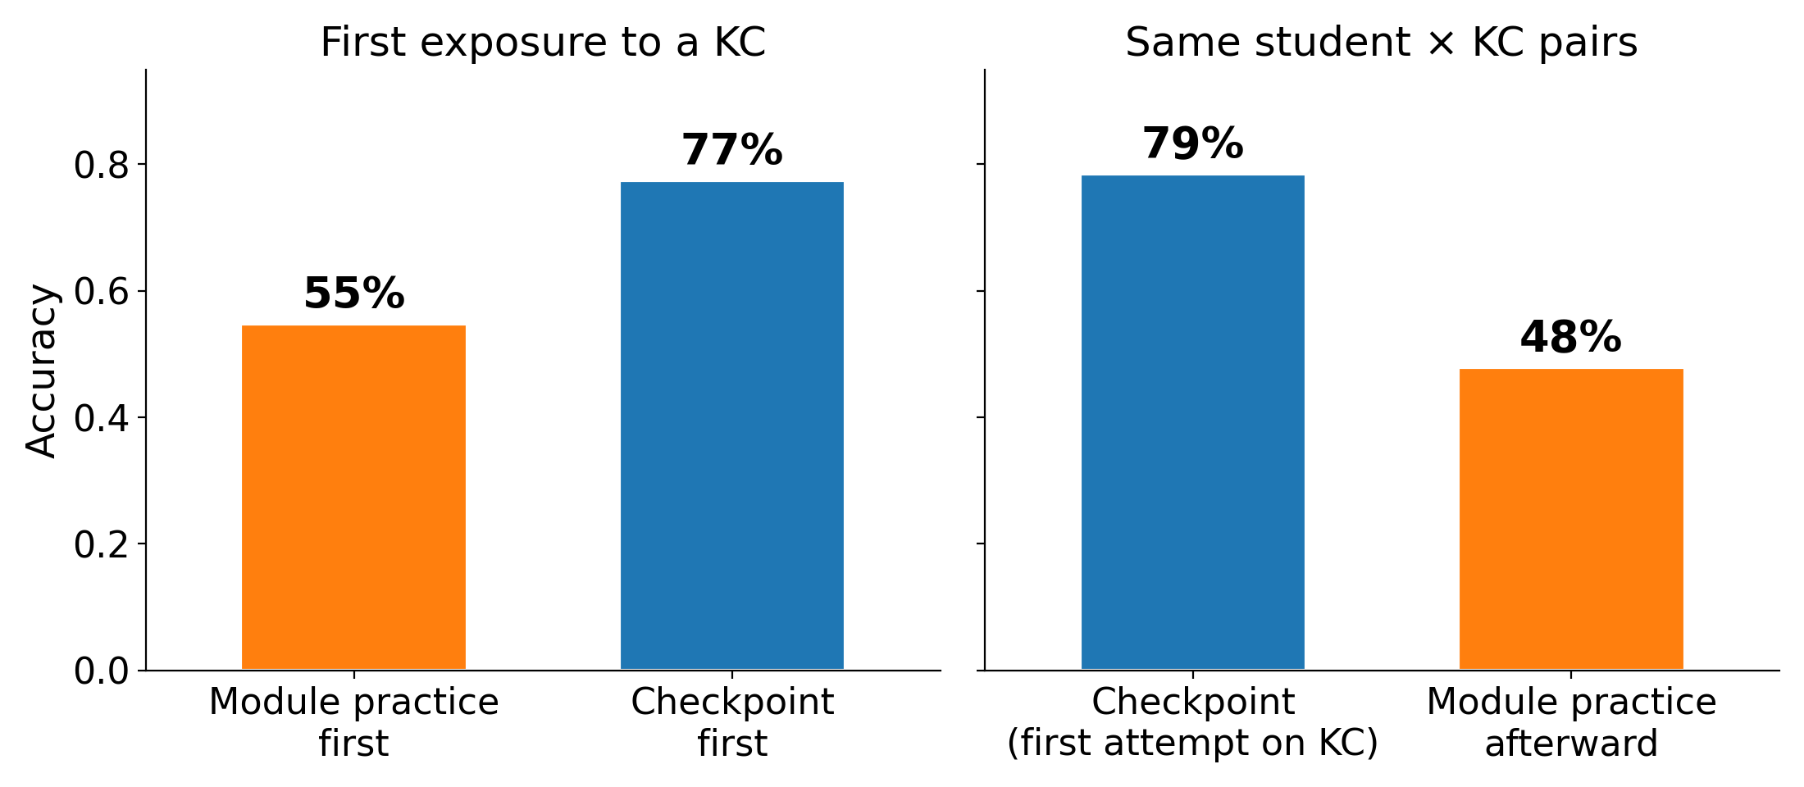
First-attempt accuracy is much higher on checkpoints
First exposure to skill (KC)
Students who go back to practice afterwards
Students still perform worse on practice after checkpoints

Slide 31
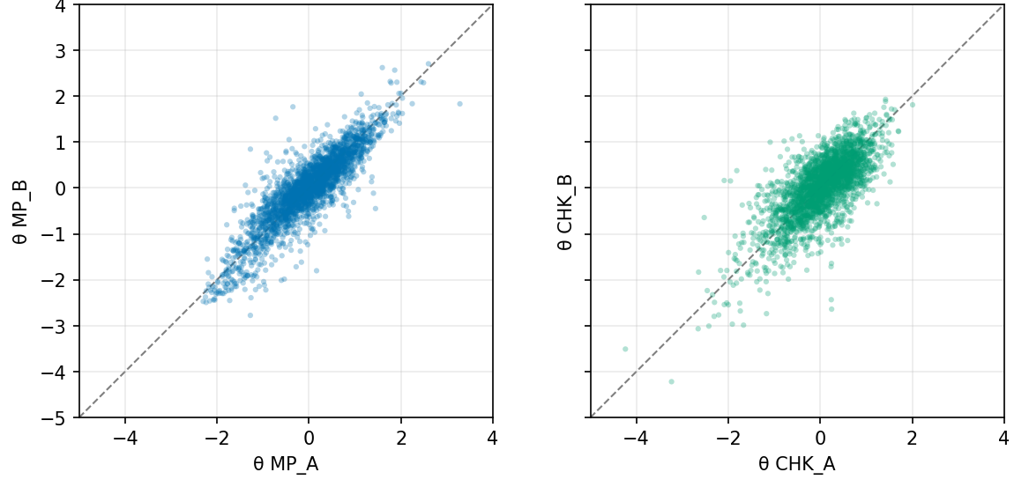
Students’ practice and checkpoint performance is consistent across the term
Units 1, 3, 6, 8, 9 = A
Split Practice &
Checkpoint
1 parameter IRT
4 student ability parameters (θ)
Units 2, 4, 5, 7, 10 = B
R = 0.88
R = 0.73
θ(Module practice B)
θ(Checkpoint B)
θ(Module practice A)
θ(Checkpoint A)

Slide 32
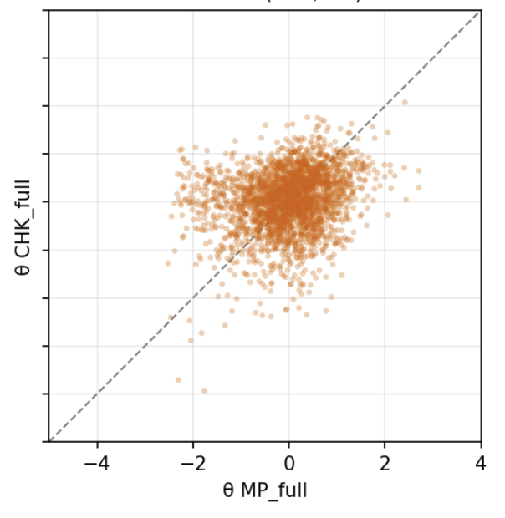
2. Little correlation between practice and checkpoint
All units
Split Practice &
Checkpoint
1 parameter IRT
2 ability parameters
R = 0.88
R = 0.23
R = 0.73
θ(Checkpoint)
θ(Module practice B)
θ(Module practice A)
θ(Module practice)
All module practice

Slide 33
Modeling approach
70%
Training
Fit student, KC, item parameters
1.3 M student-
KC pairs
30%
Test
Evaluate – how well does the model predict test set?
Item difficulty
Split student, learning parameters based on practice type
Account for rushed practice with student and session-level time variables

Slide 34
Models
Performance ~ (student-intercept) + (learning rate) × opportunity AFM
Performance ~ (student-intercept + item-intercept)
+ (learning rate) × log(opps + 1) +item-intercept
Performance ~ (student-intercept | practice-type + item-intercept)
+ (learning rate) × log(opps + 1) +practice-type-split
Performance ~ (student-intercept | practice-type +
item-intercept + session_time) +
(learning rate) × log(opps + 1) | practice-type +time

Slide 35
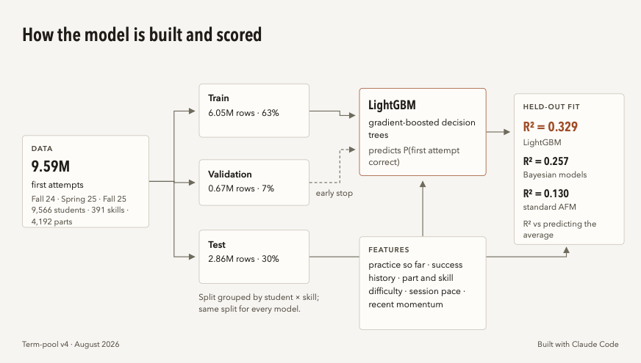
Black-box machine learning model

Slide 36
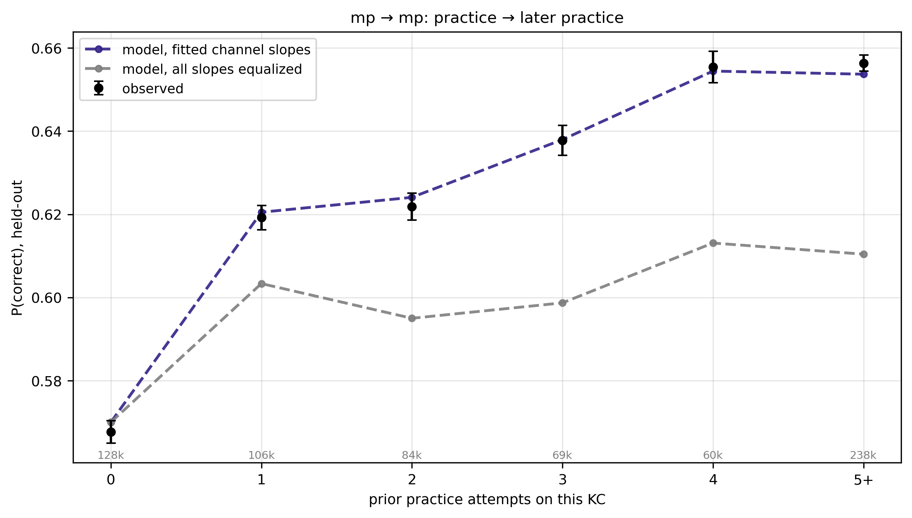
Module practice helps future module practice most

Slide 37
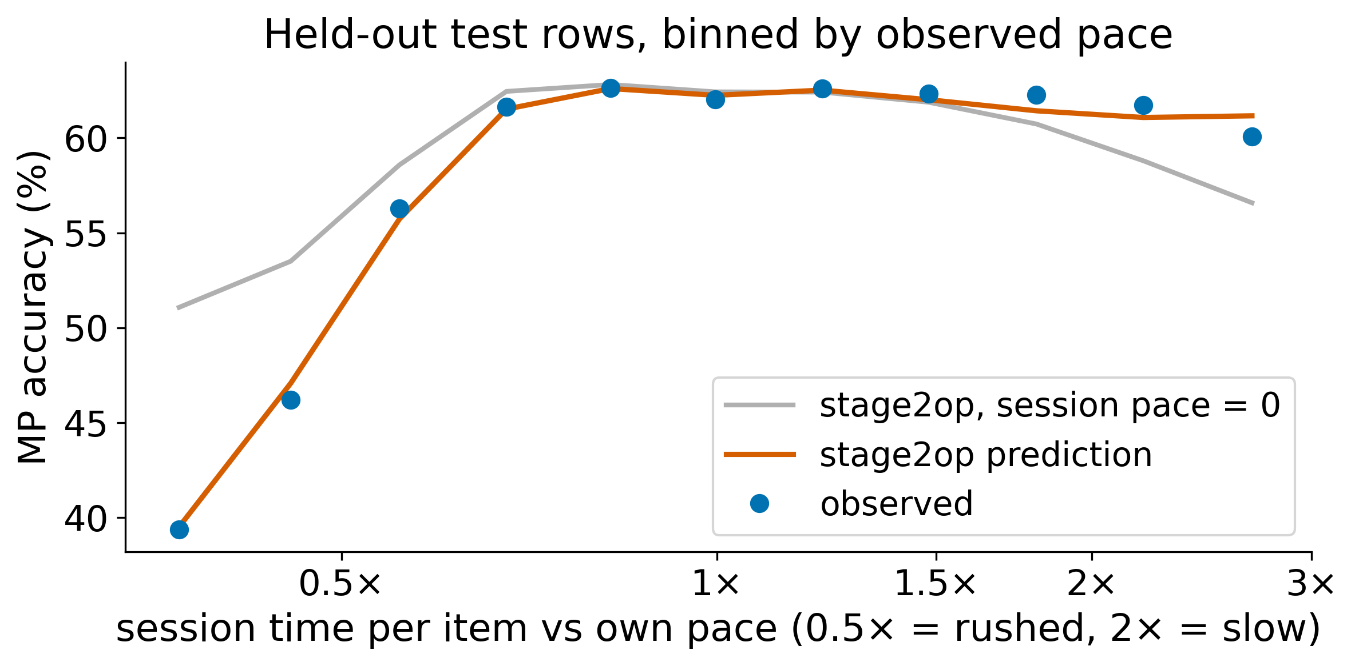
Incorporating response time fixes predictions for rushed sessions
Student’s average
pace prediction
Model prediction

Slide 38
Penalty vs learning signal, per attempt
Notes:
Equal to about 2 items…

Slide 39
Virtual labs complement in-person lab
150,000 sessions / semester
Improved chemical reasoning and experimental design (within-teacher randomized control trial)
Difficult to scale – live instructor support typically needed
McCormick, S et al. J. Chem. Educ. 2023, 100 (6), 2116–2131. https://doi.org/10.1021/acs.jchemed.2c01106.
Notes:
Key point: ChemCollective is a virtual chemistry lab I've been developing since 2020. 150,000 sessions per semester worldwide. Published evidence (within-teacher RCT) that it improves chemical reasoning and experimental design.
Why it matters here: "You can't easily ChatGPT your way through a virtual experiment. The student has to actually decide what to mix, what to measure, what to conclude. That's authentic engagement by construction."
The challenge: It's hard to scale because students need an instructor to guide them through open-ended exploration.
Transition: "That's the problem AI might be able to solve."

Slide 40
REAL CHEM – Research-driven design
Learn by doing
“doer effect” - interactive practice often 5x more effective than reading or watching video
Koedinger, K. R.; Scheines, R.; Schaldenbrand, P. Is the Doer Effect Robust Across Multiple Data Sets?

Slide 41
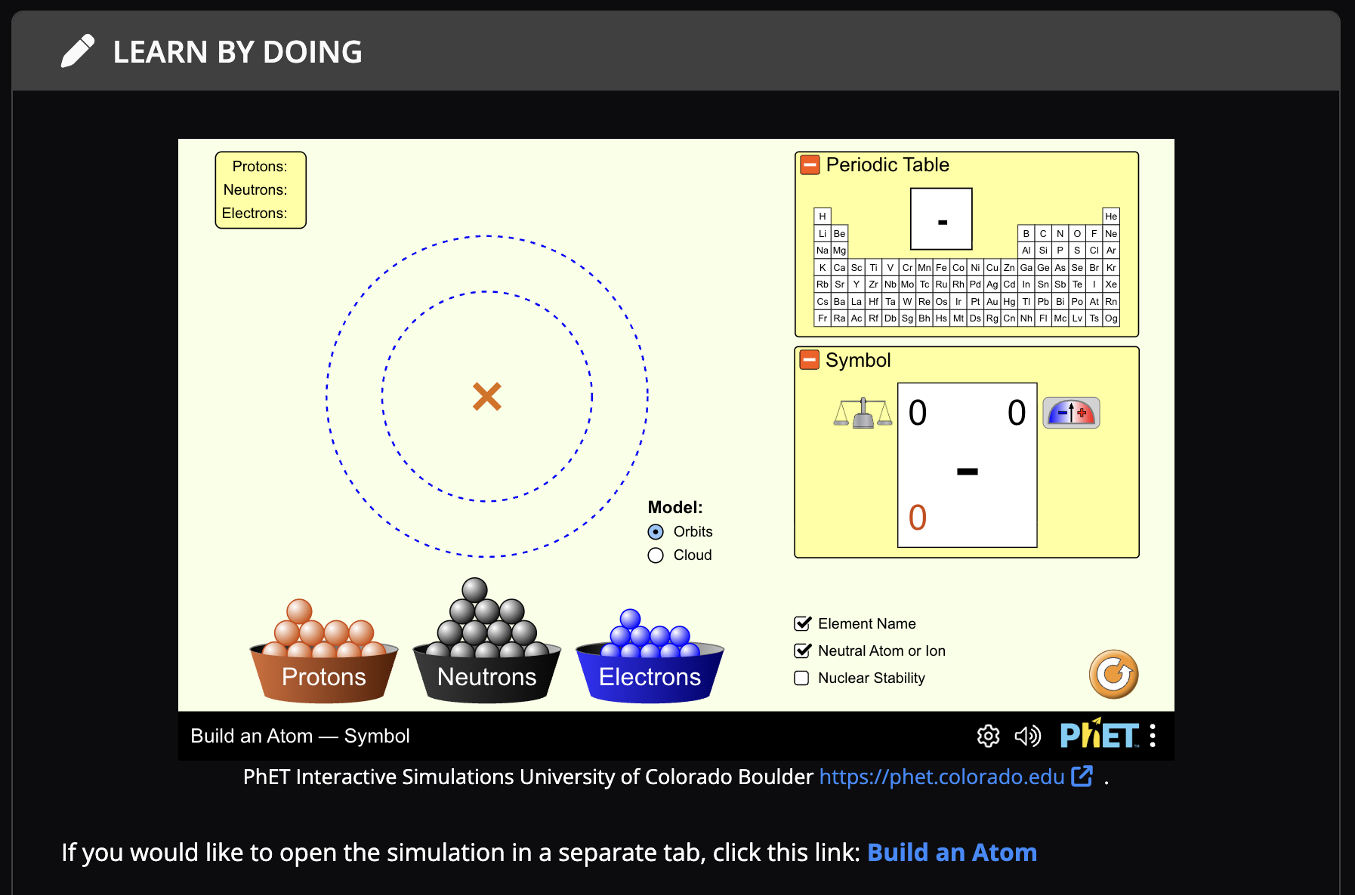
REAL CHEM – PhET simulations
Moore, E. B.; Chamberlain, J. M. et al. PhET Interactive Simulations: Transformative Tools for Teaching Chemistry. J. Chem. Educ. 2014, 91 (8), 1191–1197. doi: 10.1021/ed4005084

Slide 42
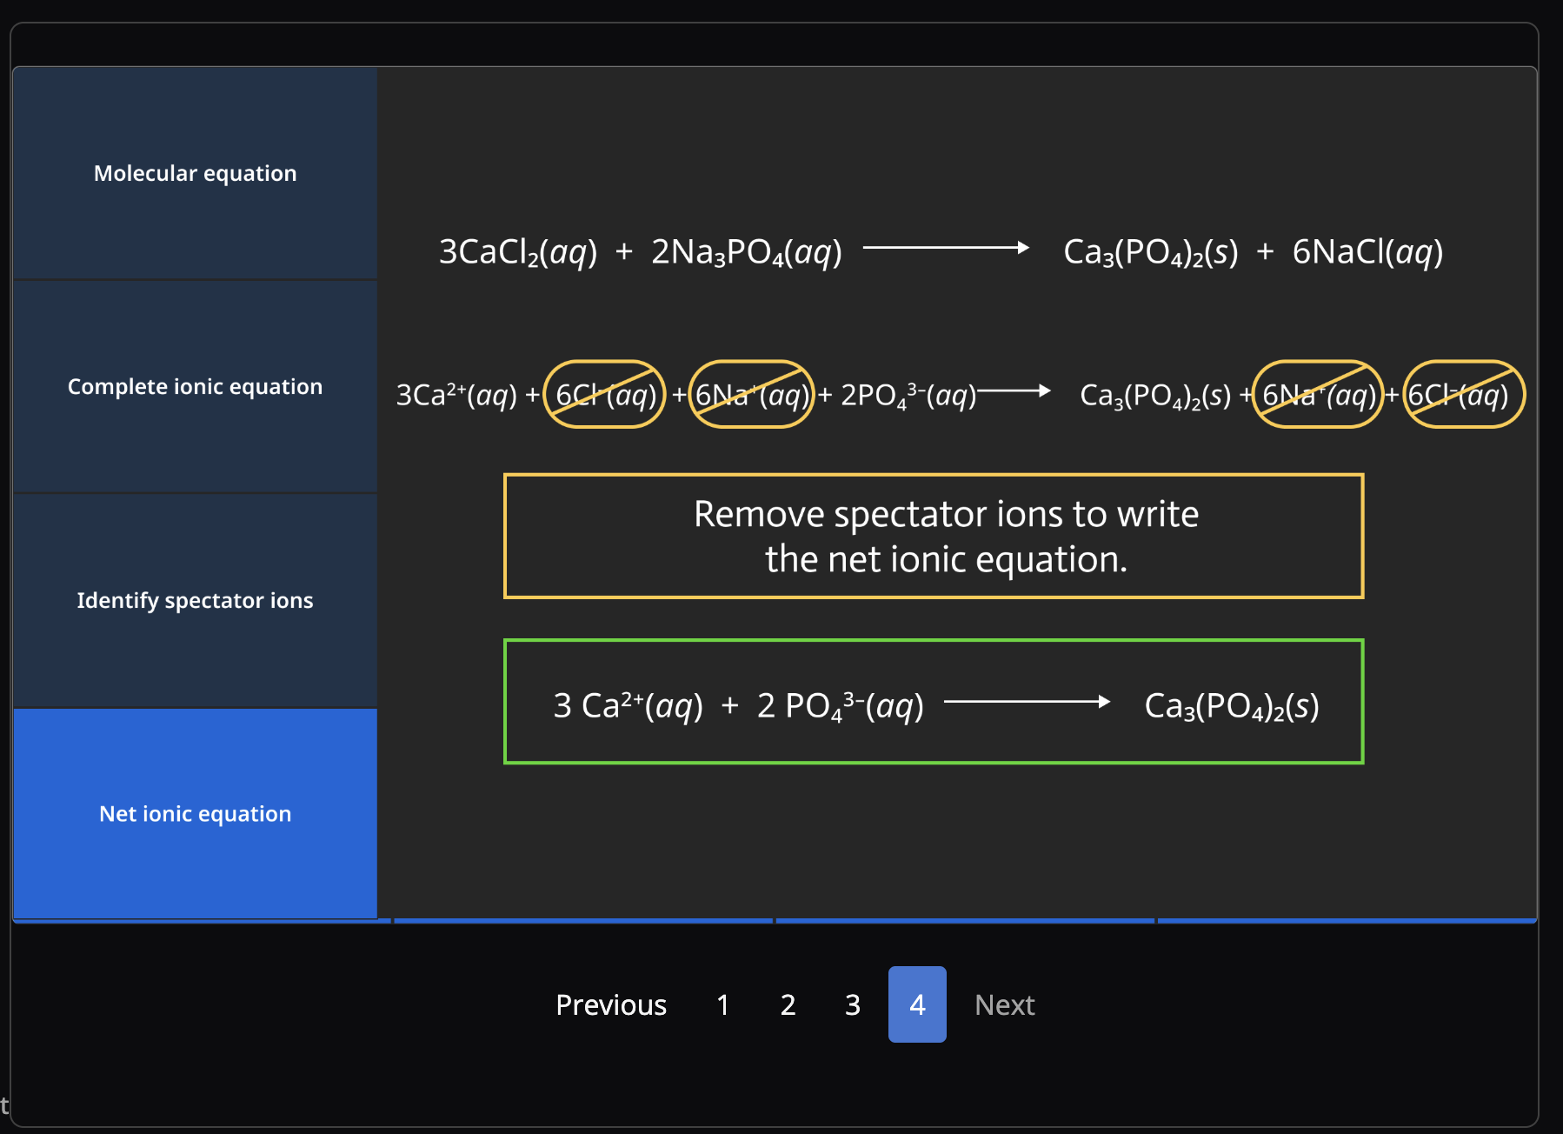
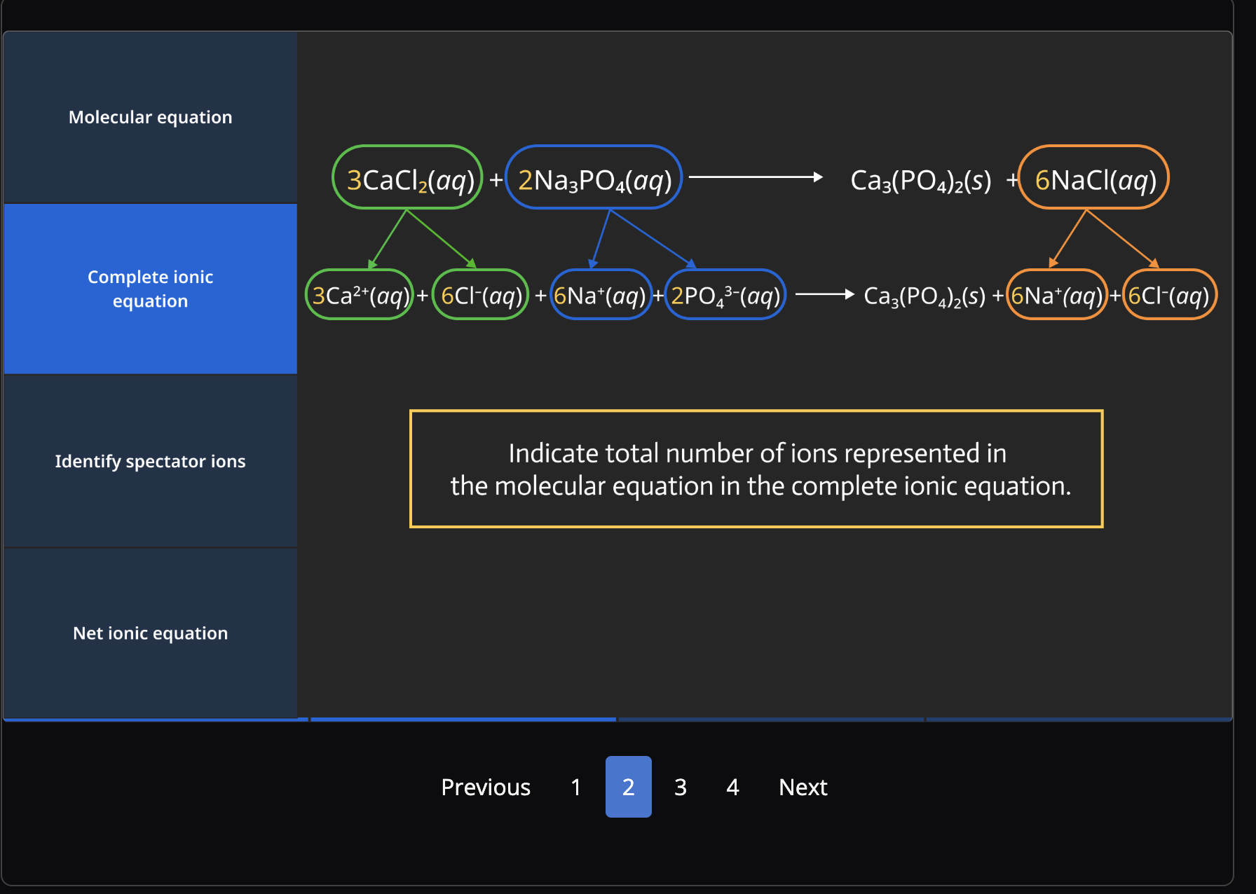
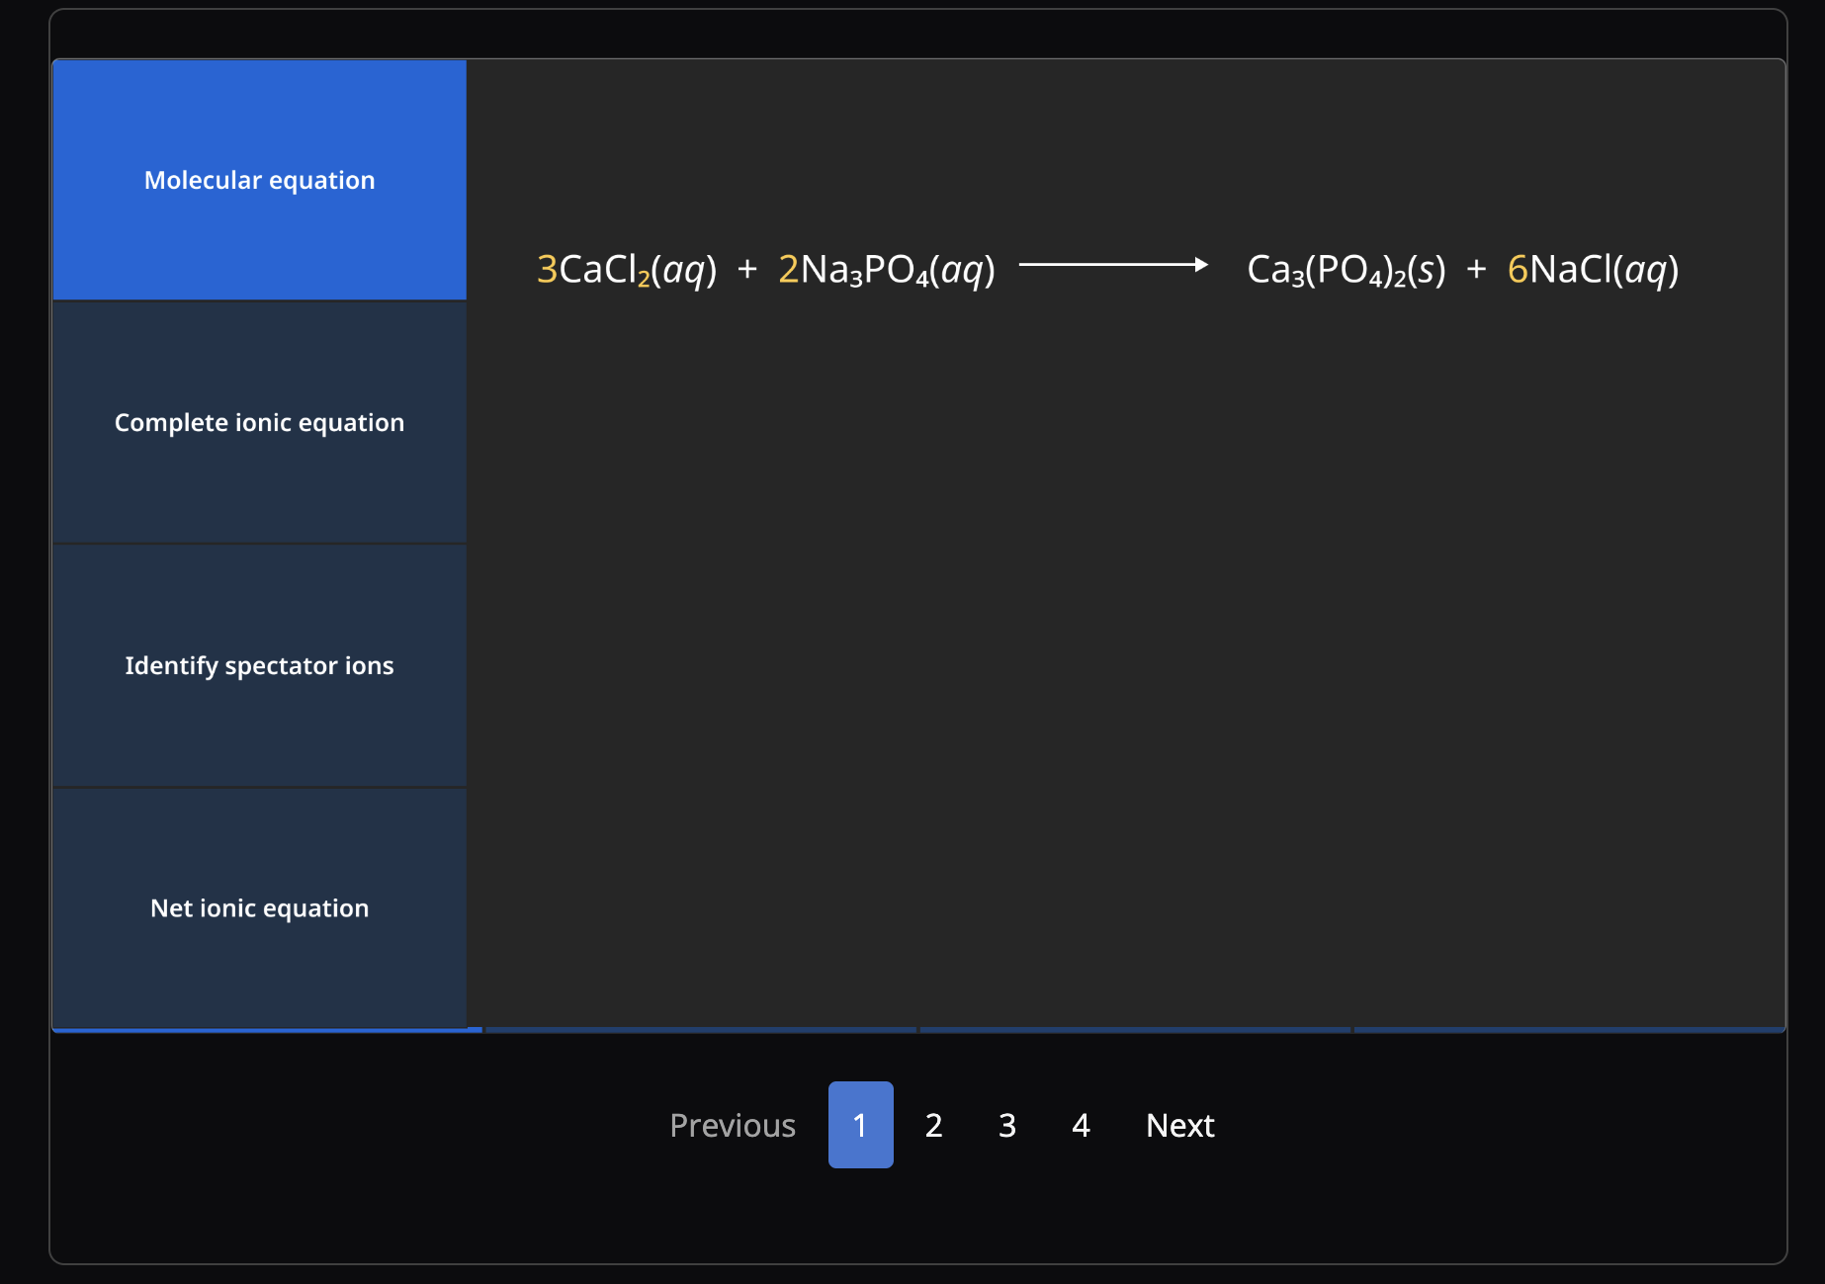
REAL CHEM – Worked examples
McLaren, B. M. et al. When and How Often Should Worked Examples Be Given to Students? Proceedings of the 30th Annual Conference of the Cognitive Science Society (pp. 2176-2181).

Slide 43



Explorations apply chemistry to real-world contexts

