Slide 1
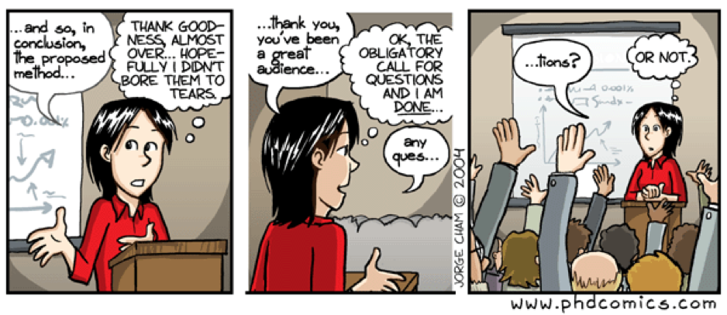
The Art of Creating Effective & Engaging
Oral Presentations in Chemistry
Christine Le
Assistant Professor
Dept. of Chemistry, York University

Slide 2



Presentation Pointers: The Content
Know your audience and tailor your talk
Experts in your field or a related field? Undergraduates? Non-scientists? A mix?
It’s your job to make the audience feel smart
Tell audience members up front why they should care
What problem will your work solve?
Be direct and don’t bury the lead
Convey your excitement
Maintaining your enthusiasm will keep the audience engaged
If relevant, share a brief anecdote, joke, or an “aha!” moment in your project

Slide 3

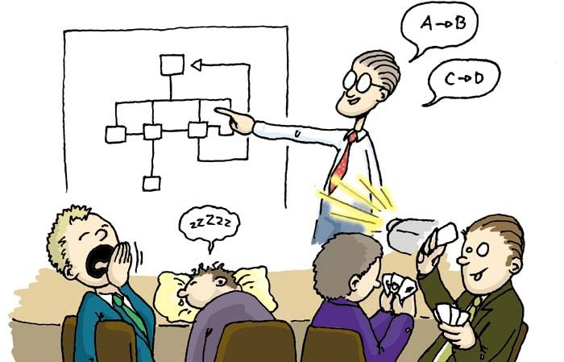

Presentation Pointers: The Content
Tell a story
Start with context
Frame the problem
Provide highlights
Conclude by summarizing key points
Keep it simple
Every field has its jargon and acronyms
Consider your audience and define if needed

Slide 4
Breaking Down a Talk
In general, length of the seminar (in minutes) = number of slides
Always save time for questions
Recommended breakdown:
Introduction & Background (~20%)*
Why are you doing this project?
How are you doing this project?
Results & Discussion (~70%)*
Conclusions, Future Work & Acknowledgements (10%)
What are the implications of this project?
*If you are presenting to a general audience (e.g., not organic chemists), spend more time on the introduction & background

Slide 5
Priming the Audience
Introduction & Background
Why are you doing this project?
Provide the necessary context to frame your research question
Example outline:
Importance of the field
Overarching project goal
Pertinent literature
What is the problem you want to solve?
How will you solve this problem?
What is your hypothesis?
Common mistakes:
Not introducing your project early enough
Providing too much or too little background
Not emphasizing how your project fits into (and potentially advances) the field
general
specific
ELEVATOR PITCH
Take-home exercise: Develop an “elevator pitch” for project (2-3 sentences max.)

Slide 6
Elements of a Good Story: The Quest, Hero & Villain
Present methods and determine if the experimental data support or reject your original hypothesis
Results & Discussion
How are you doing this project?
Common mistakes:
Too many (irrelevant) data points
Not acknowledging flaws in your experimental design or uncertainty in your results
Not using a balanced mix of text, tables, graphs, figures, etc.
Use of we vs. I
Example outline:
Experimental design
Present your data (usually in chronological order)
Discuss challenges encountered
Emphasize the most important findings
Link outcomes to research objectives & hypothesis
the quest = research objectives; hero = you; villain = challenges

Slide 7
The Take-Home Message
Conclusions, Future Work & Acknowledgments
What are the implications of
this project?
Summarize what the audience should have learned
Example outline:
Repeat and summarize key findings
Present current limitations of your method
Craft short- and long-term goals for your project
Outlook: how will your contributions impact the field?
Acknowledgments
Common mistakes:
Discussing new results & findings
Drawing conclusions that are not supported by the data
Not acknowledging and thanking key players (e.g., collaborators, funding, support staff, etc.)

Slide 8



Presentation Pointers: You
Set the stage
Make sure to test your equipment and run through your slides in the venue (or speaker ready room), if possible.
Get ready to perform
Know your lines and your main talking points
Memorizing may help, but don’t sound too rehearsed
Presence
Stand or sit up tall
Smile! Facial expressions keep the audience engaged

Slide 9



Presentation Pointers: You
Talk to the audience, not the screen
Making eye contact with one or more friendly faces can relax you and help you connect to the audience.
Take your time
Speak at a reasonable pace. It’s okay to take a moment to gather your thoughts as you move on to a different topic.
PRACTICE, PRACTICE, PRACTICE
If you are frequently stumbling or forgetting your lines, the audience can become easily distracted and lose the main message.

Slide 10
Some Common Pitfalls
Overly complicated content (i.e., not tailored to the audience)
Too much data on a single slide
Consider appropriate animations (appear/disappear), highlighting key information using boxes or different colours
Including information on a slide that you never discuss (or vice versa)
Poor representation of data (e.g., dense optimization tables)
Consider all options: table, graph, line plot, pie chart, etc.
Monotone delivery
Speaking too quickly
Saying “um” too frequently
Distracting use of laser pointer
Not paying attention to the time

Slide 11
How to Field Questions from the Audience
When handling questions…
Listen to the question carefully (OK to ask them to repeat it)
Be polite and gracious
If you don’t know the answer right away, tell them you need a moment to think about it
Avoid saying I don’t know; answer to the best of your ability, ask them if you are on the right track (they may guide you through the question again)
If it’s on your slide, it’s fair game
e.g., know the mechanism for every reaction scheme you present, the structure of every reagent you used, etc.
If you anticipate a particular question being asked, have backup slides prepared
If you are asked to go to a particular slide: hit the number on your keypad + ENTER

Slide 12

Slide Aesthetics: What Not to Do
Inconsistencies in font type, size, and formatting
Text or images are too small (or too big)
Not enough contrast between text and background
Use of harsh colours
Too much or too little colour (pick a set of 3 to 5 complimentary colours and stick to that palette throughout the talk)
Free colour scheme generator: https://coolors.co/
Text-to-image ratio too high (this slide is a bad example)
Distracting animations
Text and images are not aligned or distributed properly

Slide 13
Declarative slide titles are better than descriptive ones
Sub-title:
Schemes / Figures
(Should take up 60-70% of the slide; avoid too much or too little white space)
Bullet points summarize the key points of the scheme or figure
Full sentences not required; serve as prompts for the presenter

Slide 14
ChemDraw Tips: Reaction Schemes
Do not copy and paste ChemDraw Schemes directly from papers
Use the Le Group ChemDraw template (preferred) or ACS 1996 (acceptable). Never use the default!
Paste at the same scale to ensure all schemes are consistent in size
Catalysts or reagents on top of the arrow (if you have too many lines, move some reagents below the arrow, but put it above solvent, temperature & time
Make sure reagents don’t spill over the arrow
Solvent, reaction temperature & time below the arrow
Yield here or here
(if relevant, include regio- or stereoselectivities)

Slide 15
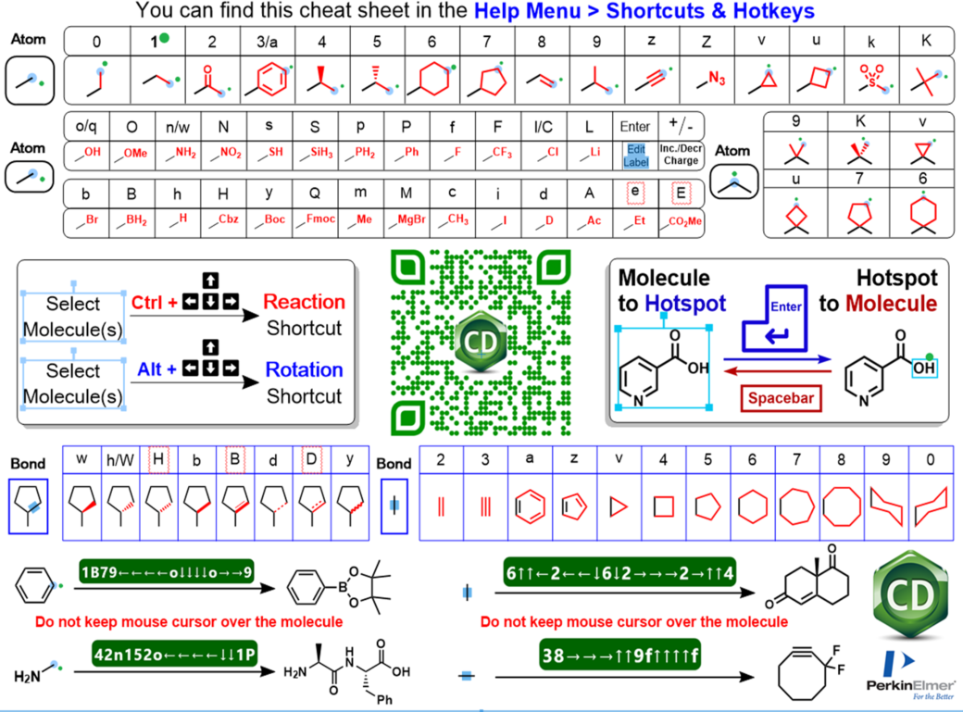
ChemDraw Hotkeys & Shortcuts
In ChemDraw, File → Open Samples → Magic hotkeys cheat sheet
Learning these tricks will save you a lot of time!
More resources:
Cambridge (Appendix D)
University of Zurich Shortcut Manual to ChemDraw
YouTube videos by ChemDraw Wizard
ChemDraw Infographics by Roman Valiulin

Slide 16
My Favourite ChemDraw Shortcuts
SHORTCUTS (for Windows)
Subscript/Superscript | F9/F10
Center justify text | Ctrl + shift + c
Clean up structure | Highlight object, then ctrl + shift + k
Clean up reaction | Double-click arrow, then ctrl + shift + x
Align objects: | Highlight objects, then…
Top Bottom Left Right Center Middle | ctrl + shift + alt + t ctrl + shift + alt + b ctrl + shift + alt + l ctrl + shift + alt + r ctrl + shift + alt + c ctrl + shift + alt + m
Group objects | Highlight objects, then ctrl + g
Move object(s) only X/Y planes only | Highlight object, then shift + drag
Copy & paste objects and move in X/Y plane only | Highlight object, then ctrl + shift + drag

Slide 17


ChemDraw Pet Peeves
Inconsistency in structures
Incorrect bond angles or lengths

Slide 18
ChemDraw Pet Peeves
Not aligning and centering reaction schemes
Center imine
double bond
Fix reaction: Double-click arrow, then ctrl + shift + x

Slide 19
ChemDraw Pet Peeves
Not distributing structures evenly in substrate tables
Colour can be used to highlight key changes in structure or new bonds being formed

Slide 20
ChemDraw Pet Peeves
Unnecessary reorientation of product relative to reactant
e.g., Mitsunobu reaction
Very clear that inversion occurred
Hard to tell if inversion occurred without mental gymnastics
Using uncommon acronyms without defining them

Slide 21
ChemDraw Demo: Reaction Mechanisms
e.g., Friedel-Crafts Acylation
Do not use default curly arrow in ChemDraw!
Start with a straight reaction arrow and then modify accordingly
Using a different colour for curly arrows can help distinguish them from reaction arrows

Slide 22
ChemDraw Demo: Drawing Perfect Catalytic Cycles
e.g., Suzuki cross-coupling
Step 1. Start with a circular or oval arrow, which will set template for your catalytic cycle

Slide 23
ChemDraw Demo: Drawing Perfect Catalytic Cycles
Step 2. Place all catalytic intermediates on the template and paste it into PowerPoint to check scale. If necessary, increase or decrease the size of the catalytic cycle so that it scales nicely with the slide.

Slide 24
ChemDraw Demo: Drawing Perfect Catalytic Cycles
Step 3. Convert single circular arrow into multiple arrows using the established template. This is easier to show than to describe, so I’ll do a ChemDraw demo now. You can also watch this YouTube video by ChemDrawWizard.
Re-align intermediates if necessary.

Slide 25
ChemDraw Demo: Drawing Perfect Catalytic Cycles
Step 4. Add reagents coming in and by-products coming out of the catalytic cycle. All arrows have the same curvature.

Slide 26
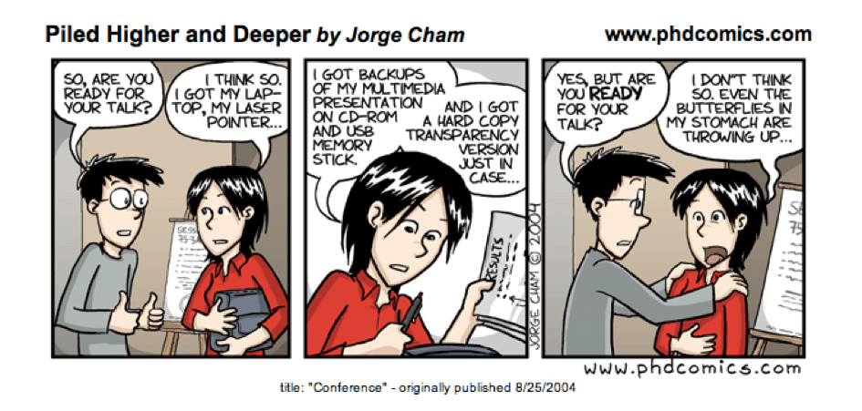
Summary
Giving effective and engaging presentations takes a lot of practice
Make sure that your visuals aids emphasize (as opposed to detract from) the quality of your work
There is always room for improvement
Strong oral communication skills are highly desired by future employers

