Slide 1
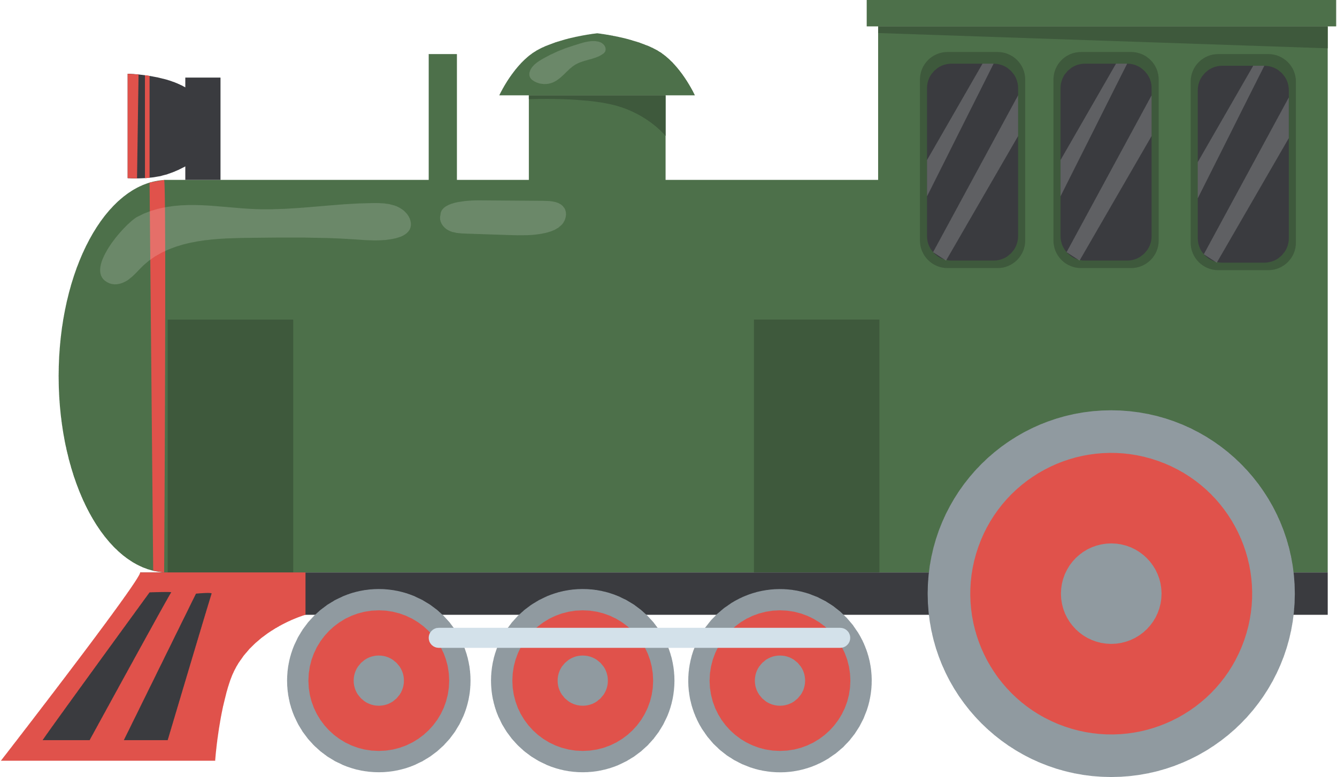

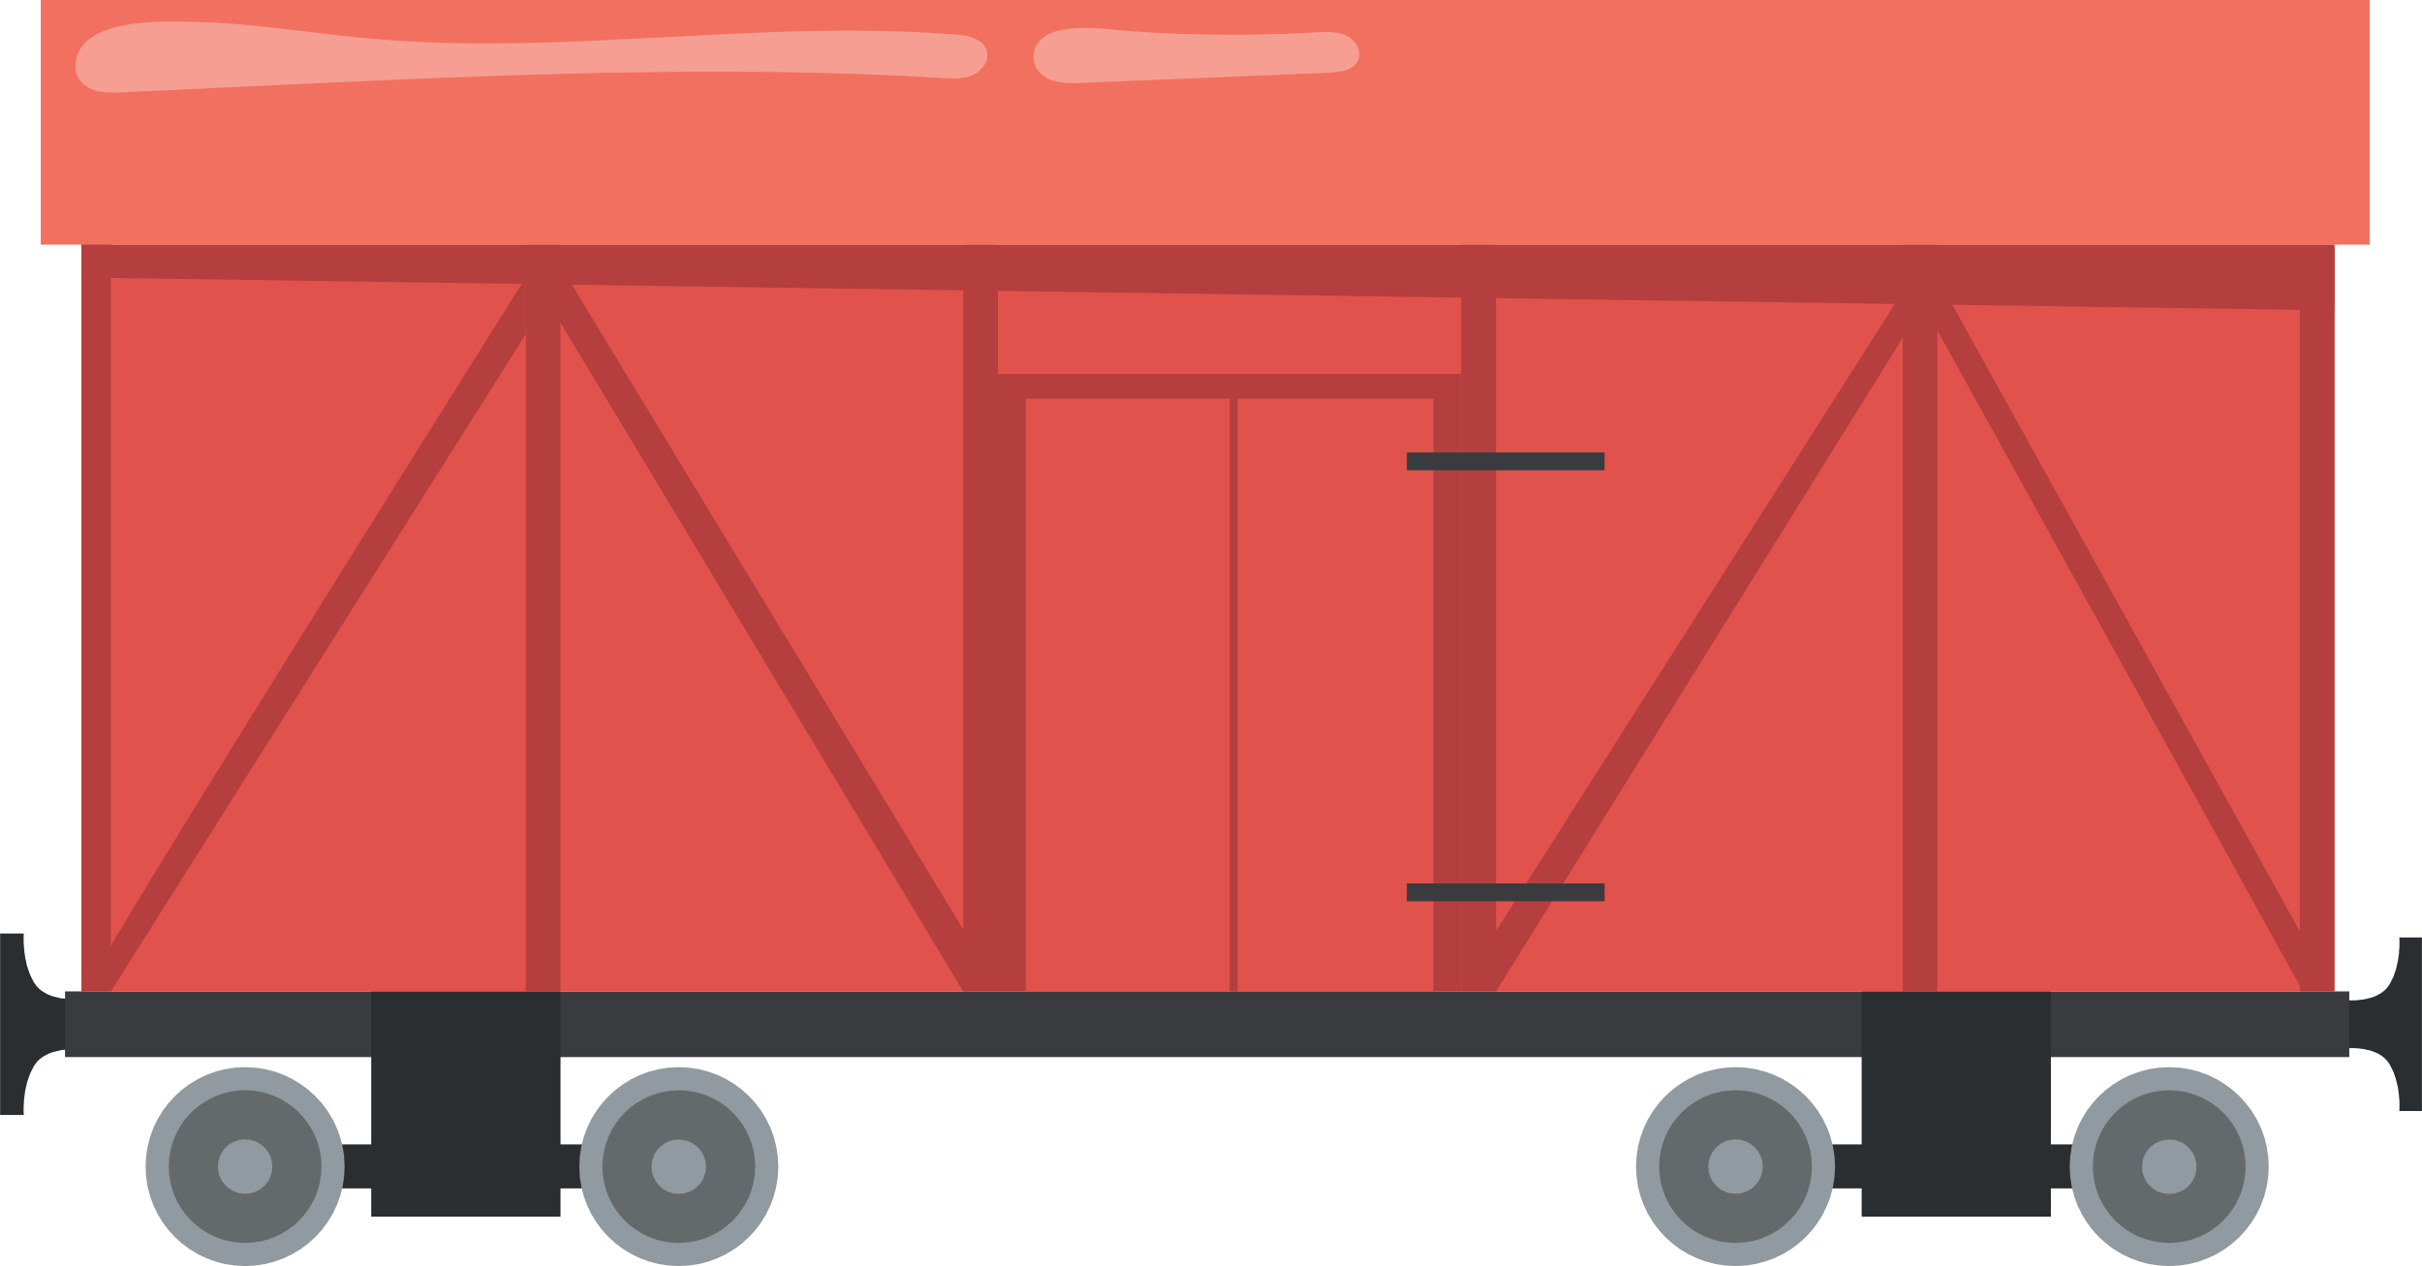

Vector 1
Vector 2
Vector 3

Slide 2

[Observation 1]
[Observation 2]
[Observation 3]
[Observation 4]
$Variable1
Tibble
$Variable2
$Variable3

Slide 3
Vector 1
8.1
7.3
7.1
8.6
Vector 2
"a"
"b"
"c"
"d"
Vector 3
TRUE
TRUE
FALSE
FALSE

Slide 4
[Observation 1]
[Observation 2]
[Observation 3]
[Observation 4]
8.1
7.3
7.1
8.6
$Variable1
Tibble
"a"
"b"
"c"
"d"
$Variable2
TRUE
TRUE
FALSE
FALSE
$Variable3

