Slide 1
Lending Club Loan Analysis
Chong Vang
Eric Mayer
Shawn Nowak
Ryan Porritt
Veneta Bebrevska

Slide 2
Motivation and Questions
Hypothesis: Lending Club DTI ratios per state differ from the national average
Questions asked:
Does higher income correlate to higher loan amount?
What was the purpose use of the loan?
What is the average DTI?
What is the correlation between each States Avg DTI and States Avg Annual Income?
Does low income correlate to debt to income ratio?
Does low debt to income correlate to annual income?
Does States area determine the higher interest rates for individuals?
What are the total loans per state?

Slide 3
Data
Loan.csv – 1.11GB, , found on www.Kaggle.com
Loan data for all loans issued 2007 through 2015
A Matrix of about 890 thousand observations and 75 variables
Scrubbed the csv file from 145 columns down to 9
Grouped income in 7 tiers based on tax brackets
Columns used for the analysis:
Annual Income
Loan Amount
Loan Term
Interest Rate
Total Payment
Issue Date
State
Zip Code

Slide 4

Initial Challenges
Change Topics Due to Private Data
Data Clean-Up and Exploration
Electric vs Combustible
Loan.csv – 1.11GB
Initial approach – separate into smaller csv files
Second approach – installed LFS and uploaded the complete file

Slide 5
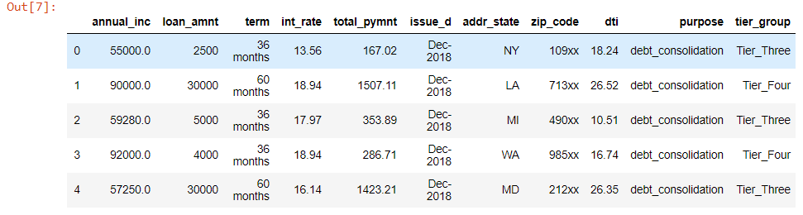
Dataframe

Slide 6
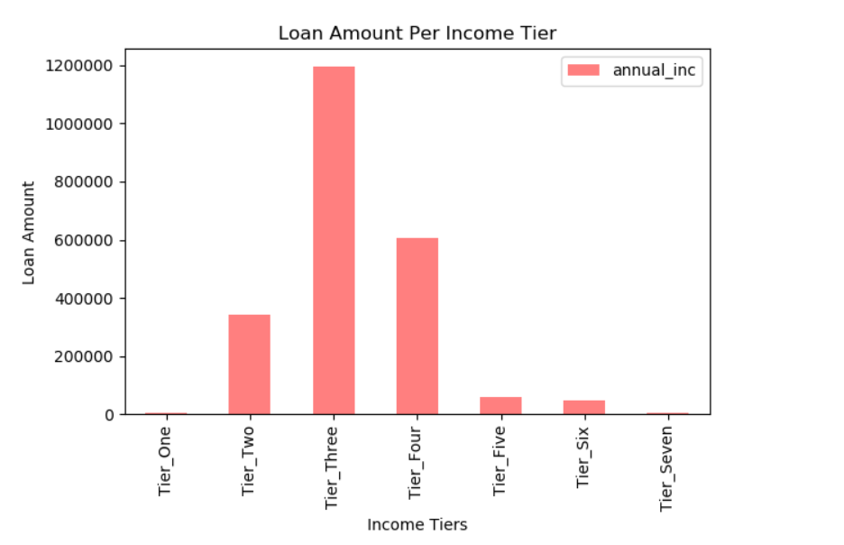
Data Analysis
Correlation between income and loan amount
Income Tier Tax Bracket Total Loans
Tier One $0 - $9,700 $2,954
Tier Two $9,701 - $39,475 $343,095
Tier Three $39,476 - $84,200 $1,296,274
Tier Four $84,201 - $160,725 $604,591
Tier Five $160, 726 - $204,100 $59,806
Tier Six $204,101 - $510,300 $48, 894
Tier Seven $510,301 - $110,000,000 $3,383

Slide 7
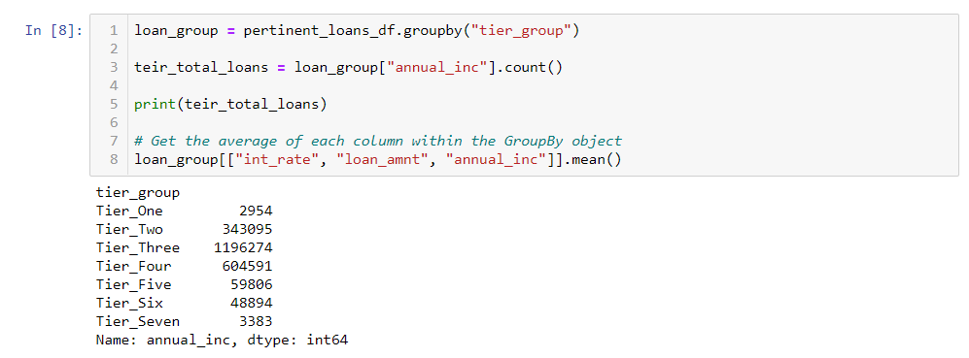
Binning

Slide 8
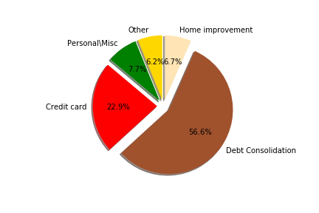
Data Analysis
Purpose of loans
Debt Consolidation | 1,277,877
Credit Card | 516,971
Home Improvement | 150,457
Other | 139,440
Personal/Misc | 175,923

Slide 9
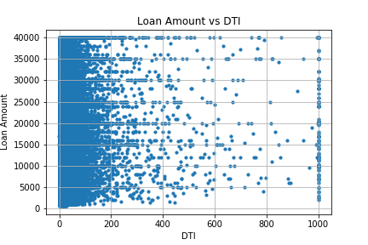
Data Analysis
Average DTI
Debt-to-Income
Debt / Income = DTI
Determine Good or Bad score
40% or lower is good
Average =18.82%

Slide 10
Compare states Avg DTI to states Avg Annual Income
Had to battle idea that data was for states applicants (not entire population)
Created bar graphs showing all 50 states – Tried to do line graphs but had issues
Passed on idea of all 50 states – tough to read into data
Took data and worked with states with Lowest 10 avg annual income and DTI and states with Highest 10 avg annual income and DTI

Slide 11
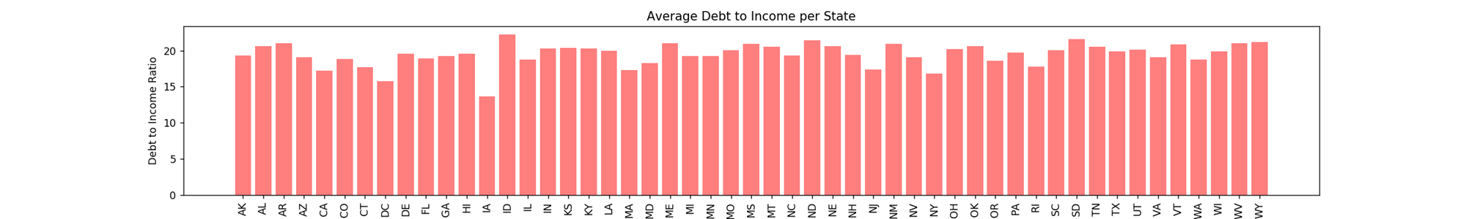
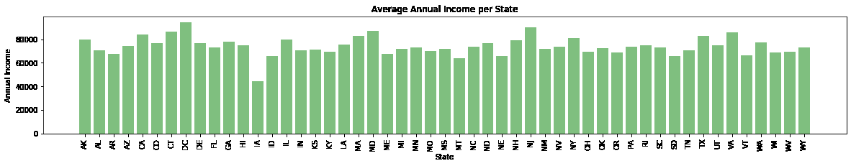
Initial graphs

Slide 12
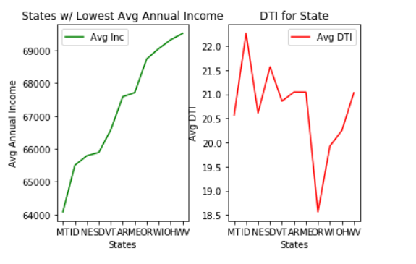
Data Analysis
Average Income to DTI
(lowest)
State Debt to Income Ratio Annual Income
MT 20.56% $64,079.48
ID 22.26% $65,500.36
NE 20.61% $65,789.44
SD 21.57% $65,890.03
VT 20.86% $66,577.67
AR 21.04% $67,588.15
ME 21.04% $67,713.61
OR 18.56% $68,737.99
WI 19.93% $69,053.08
OH 20.25% $69,322.61
Graph here shows Avg Annual Income for bottom 10 states and relative DTI. Oregon customers may show lower tolerance for holding debt.

Slide 13
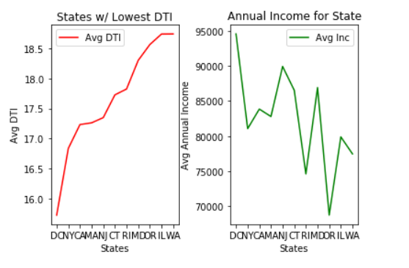
Data Analysis
Average Income to DTI
(highest)
State Debt to Income Ratio Annual Income
DC 15.73% $94,553.07
NY 16.84% $81,057.05
CA 17.23% $83,847.98
MA 17.26% $82,788.66
NJ 17.35% $89,920.51
CT 17.73% $86,531.03
RI 17.83% $74,607.28
MD 18.30% $86,919.01
OR 18.56% $68,737.99
IL 18.74% $79,884.92
Graph here shows 10 states with lowest Avg DTI and relative Avg Annual Income.
Again, Oregon stands out when compared to other states w/ similar Avg Annual Income

Slide 14
Data I would have liked to explore Avg Loans per State (based on pop. Ratio)
Look at loans per state based on ratio of general population of nation
If CA has 12% of entire US pop – are 12% of applications of Lending Club from CA
Would have had to import census data

Slide 15
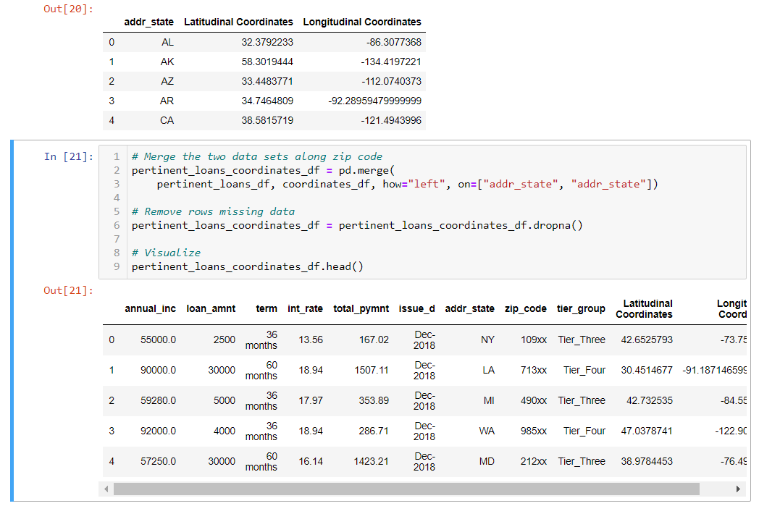
Merging

Slide 16
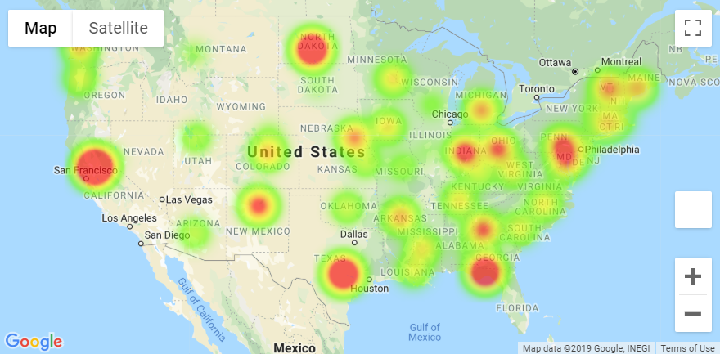
Data Analysis
Heatmap
Total loans per state
Top Five States
CA
ND
TX
FL
IN
Lowest Five States
ID
NV
IL
SD
WY

Slide 17
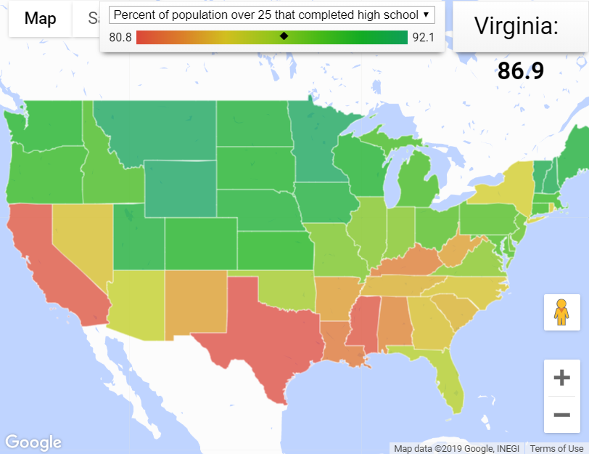
Data Analysis
Create a map based on Percentages
Clean
To the point
Simple

Slide 18
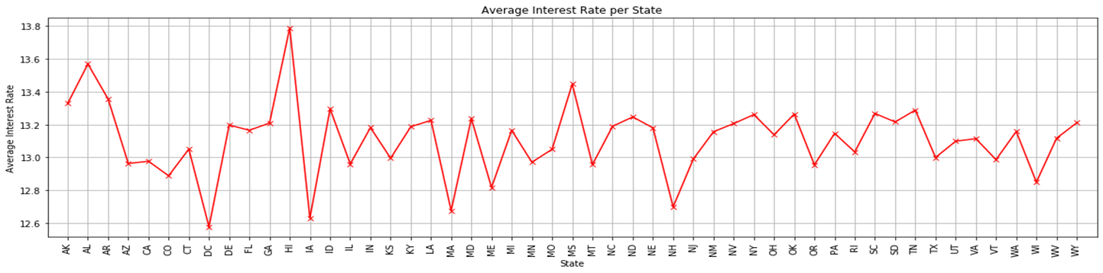
Data Analysis
Does States area determine the higher interest rates for individuals?

Slide 19
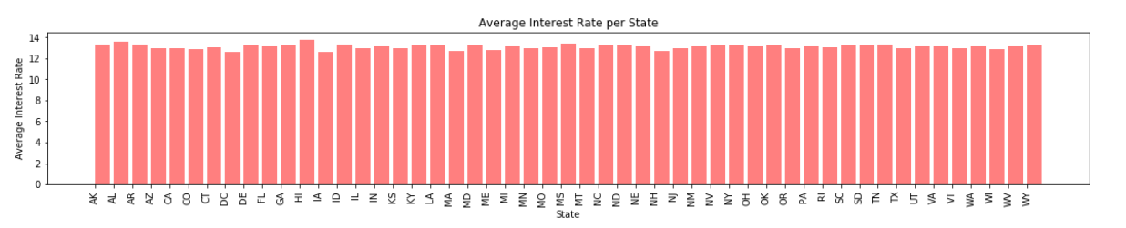
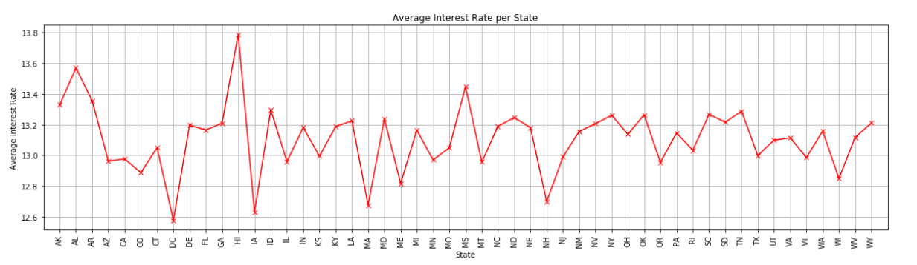
Constraints
The Bar graph does not clearly present the differences between states.
The Line graph gives a clearer representation of the differences between states.

Slide 20
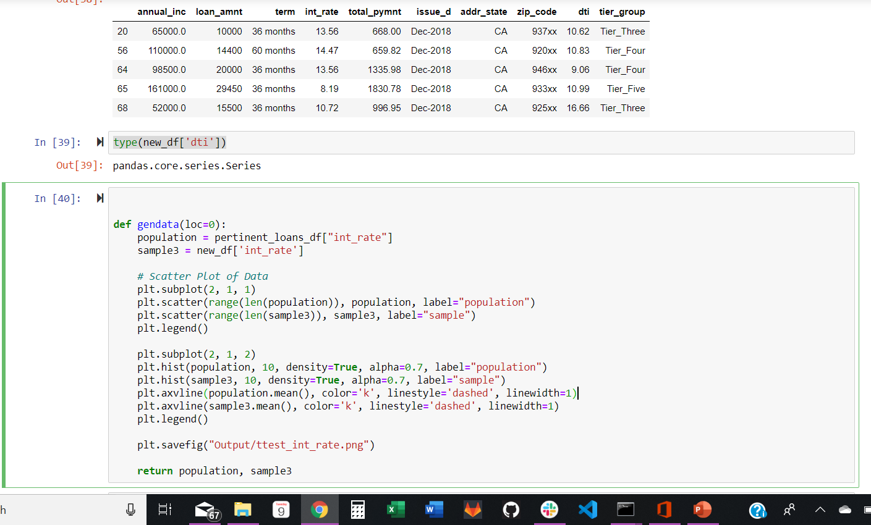
Student’s t-test
Issues we faced when looking at Student’s t-test:
Compare DTI’s from individual state’s applications to nationwide population
Issues with NaN
Had to insert .dropna() to drop rows that were potentially empty
Using gendata function, our first
test-group “CA” came back with a p-value of 0

Slide 21
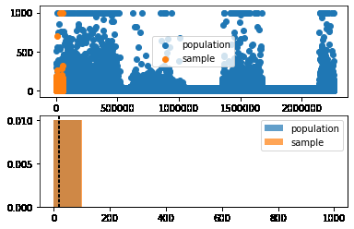
Student’s t-test
Null Hypothesis:
States debt to income ratios are different from the nationwide population?
Ran state with high DTI (ID)
This t-test rejects the null hypothesis with an extremely low p-value
Results of ID t-test:
stats.ttest_1samp(sample3, population.mean())
ttest_1sampResult(statistic=6.742665654997196,
p-value=1.7616666080725723e-11)

Slide 22
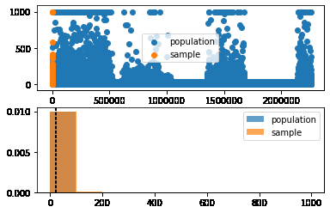
Student’s t-test
Comparatively,
Looked to run test on states w/ low DTI
Ran t-test on the 4 states w/lowest DTI
First three (DC, CA & NY) all produced a p-value of 0
Believe results of DC, CA & NY were rounding to 0
Results for MA:
stats.ttest_1samp(sample3, population.mean()
Ttest_1sampResult(statistic=-30.87744554960345,
p-value=1.8518320835181722e-207

Slide 23
Constraints

Slide 24
Questions.

