Slide 1
SERVICE FABRIC:
A PRATICAL DEMOSTRATION
(ANALYTICS SYSTEM)
BY: RYAN PRATHER

Slide 2
Agenda
Style
COST
01
A cost comparison for Development, Staging and Production.
Design
02
A guide to scalability and performance.
DEVELOPMENT
03
A how to guide on development (for analytics).
GUIDE
04
How to get us from here to there.

Slide 3
COST (overview)
 | CURRENT
 | Production
 | Our current analytics system has a variable cost that is ever increasing for compute and storage the last full month of data has our current compute cost @
 | $3,557.67
 | SERVICE FABRIC
 | Production
 | This is the cost estimate of a microservice implementation of our analytics system this is a fixed price that includes 8 x 4 core machines.
 | $2,573.44
 | DEVELOPMENT
 | Sadeh Resource Group
 | Our current development and technology stack only really allows for development in azure.
 | $5,374.85
 | SERVICE FABRIC
 | Development
 | By moving our Analytics System to a Service Fabric implementation, we could greatly reduce our cost per project and allow for quicker development.
 | ~$0.00

Slide 4
COST (break down)
Name | Estimated Cost | Estimated Cost (Per Year) | Cost Savings Per Month | Cost Savings Per Year
Production (OG) | ~$3500.00 (variable cost) | ~$42,000.00
Production (SF) | $2573.44 (estimated cost) | $30,881.28 | $926.56 | $11,118.72
Staging (OG) | ~$3500.00 (variable cost) | ~$42,000.00
Staging (SF) | $2573.44 (estimated cost) | $30,881.28 | $926.56 | $11,118.72
Development (OG) | $2500.00 (estimated cost for analytics per project only) | $60,000.00 (est. cost x 2 analytics projects per month) ** actual analytics projects this year is 31
Development (SF) | $0.00 | $0.00 | $5000.00 | $60,000.00
TOTALS SAVINGS |  |  | $6,853.12 | $82,237.44

Slide 5
Design
Service Fabric Analytics

Slide 6
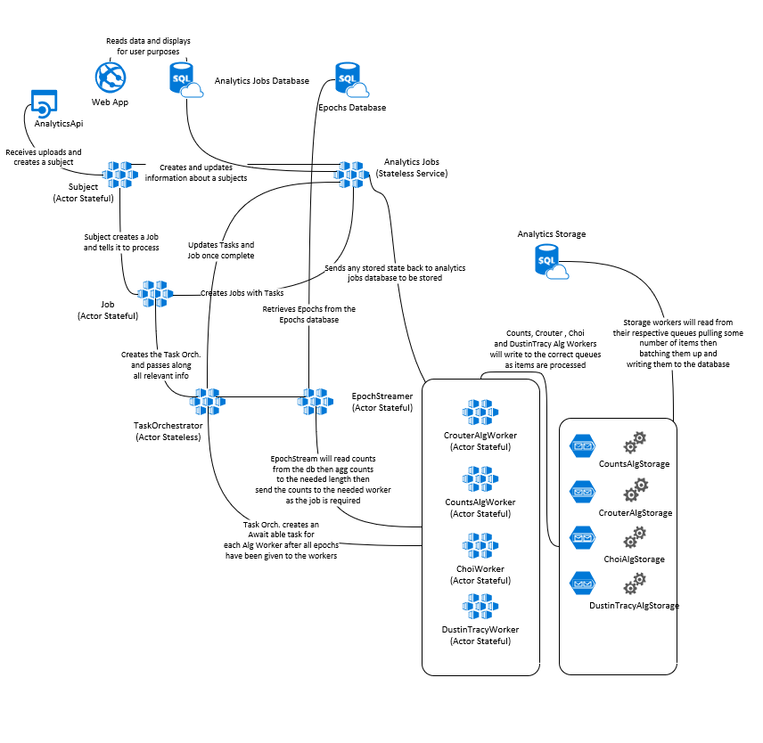
Design
Overview
Service Fabric
Processing chain is created for each subject.
Foreach subject upload a chain of services is created to process the data
Once data has been processed the chain is removed
Storage is separated from calculation.
Alg. state is stored separate from calculated values
Data is streamed from worker to worker
Input data is never retrieved from the analytics storage
Individual algorithms can be called separately through an API
Developers can only test the code that they care about if needed
Developers can execute the and run the entire application at scale locally if needed
Entire system can be ran locally on your computer
Development can/could be executed faster
Environment setup time is greatly reduced

Slide 7
Design In Depth
When to use what Service
Actor
Stateless Service
Stateful Service
Web API
Actor
Used as a short term in memory process that can have state (think Azure Function, but with state if needed)
Stateless Service
Used as a data layer for a database
Stateful Service
Used as a queued based service
Web API/Web App
Used as an API or Web App as well

Slide 8
Development
Service Fabric Analytics

Slide 9
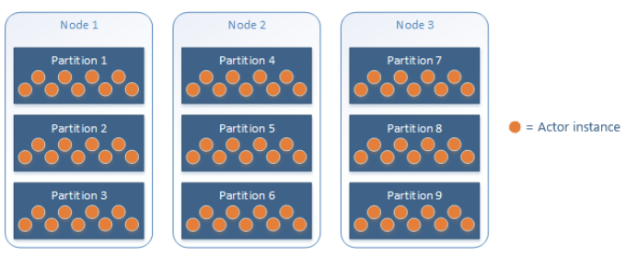
Fabric Services
Overview
Actors
Github example
State persistence can be set
Actors can be created and garbage collected
Actors are single threaded
Use multiple actors to complete an entire task
Actors are microservices
Smallest amount of compete work

Slide 10

Fabric Services
Overview
Stateful Service
Github example
Best used when queuing items to disconnect services
Standard background worker
Can be used as a cache or data storage
Can be multi-threaded
Best practice is to keep it as a microservice

Slide 11

Fabric Services
Overview
Stateless Service
Github example
Many use cases for these services
By default it will create one service per node
In my example I used it a data access service
Can be multi-threaded
Best practice is to keep it as a microservice

Slide 12
Development Style
Quicker Development
Less Azure
With less configuration and a framework to use development can and should be faster than our current implementation.
By using the Microsoft Service Fabric, a developer can execute and run the entire system at “scale” on their computer with little to no azure resources needed.
Saving
Time
Local Development
Contents
Performance
Development Testing
Entire system can be debugged or published locally for development and development testing.

Slide 13
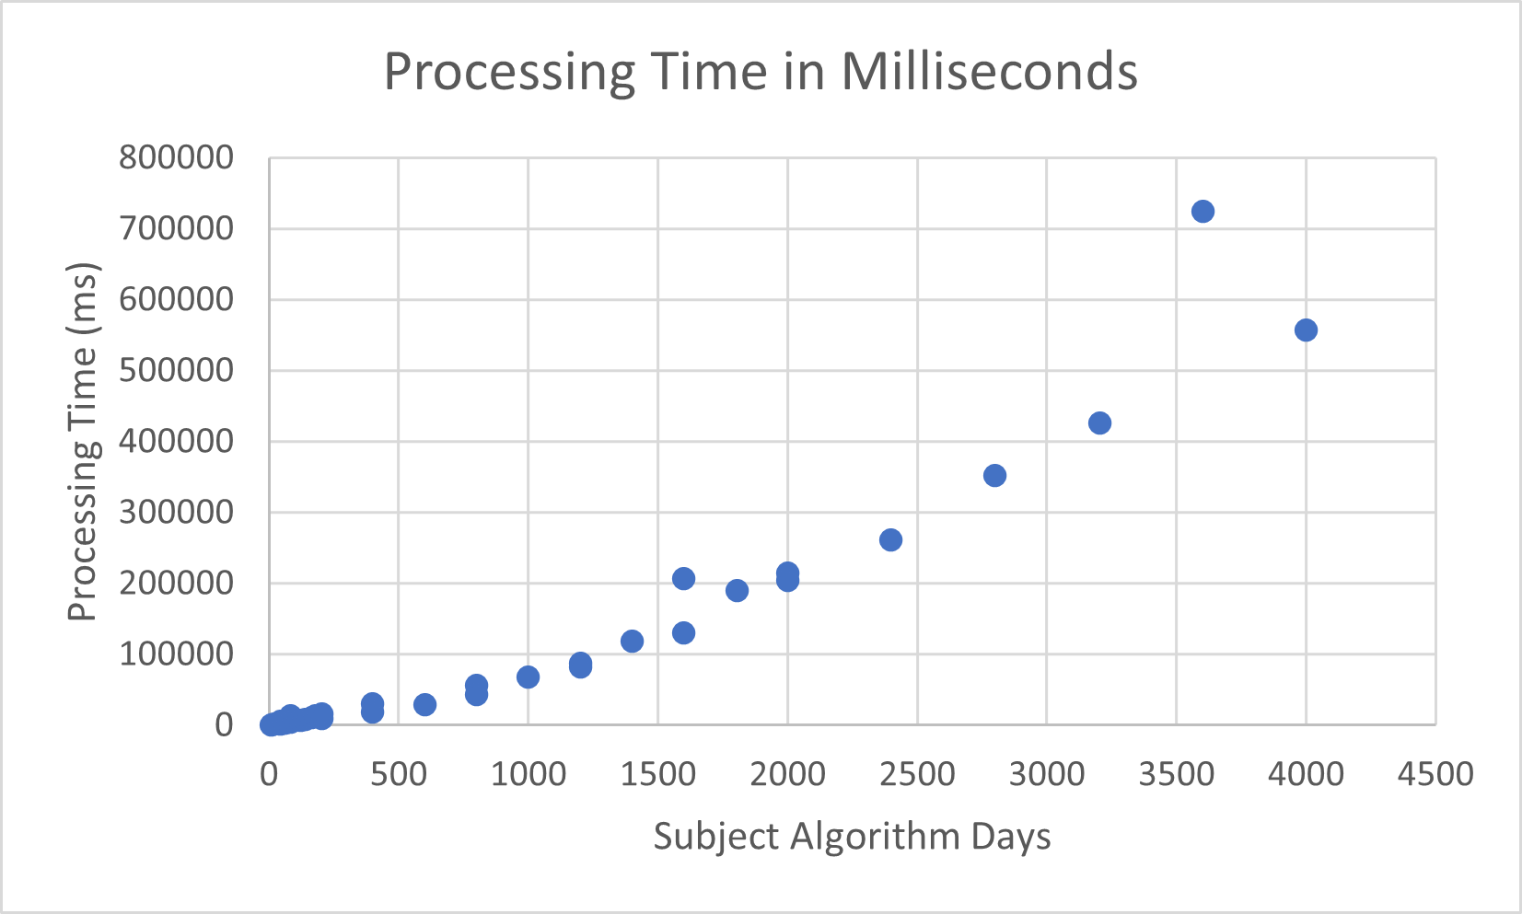
Local Execution (Results)
Algorithms Used
Choi Wear Time (vector magnitude)
Dustin Tracy (adult)
Counts (60 sec)
Crouter Child cut points

Slide 14
Local Execution (Results)
Subject Count | Number Of Days | Subject Days | Subject Algorithm Days | Processing Time in Milliseconds | Processing Time in Seconds | Processing Time In Minutes | Subject Days Per Second
1 | 1 | 1 | 4 | 756 | 0.756 | 0.0126 | 1.322751323
1 | 10 | 10 | 40 | 5540 | 5.54 | 0.092333333 | 1.805054152
1 | 20 | 20 | 80 | 13493 | 13.493 | 0.224883333 | 1.482250056
5 | 1 | 5 | 20 | 1447 | 1.447 | 0.024116667 | 3.455425017
5 | 10 | 50 | 200 | 9357 | 9.357 | 0.15595 | 5.343593032
5 | 20 | 100 | 400 | 30394 | 30.394 | 0.506566667 | 3.290123051
10 | 1 | 10 | 40 | 2426 | 2.426 | 0.040433333 | 4.122011542
10 | 10 | 100 | 400 | 18790 | 18.79 | 0.313166667 | 5.321979776
10 | 20 | 200 | 800 | 55686 | 55.686 | 0.9281 | 3.591567001
15 | 1 | 15 | 60 | 3464 | 3.464 | 0.057733333 | 4.330254042
15 | 10 | 150 | 600 | 29203 | 29.203 | 0.486716667 | 5.136458583
15 | 20 | 300 | 1200 | 87887 | 87.887 | 1.464783333 | 3.41347412
20 | 1 | 20 | 80 | 4607 | 4.607 | 0.076783333 | 4.341219883
20 | 10 | 200 | 800 | 43873 | 43.873 | 0.731216667 | 4.558612358
20 | 20 | 400 | 1600 | 206473 | 206.473 | 3.441216667 | 1.937299308
25 | 1 | 25 | 100 | 6540 | 6.54 | 0.109 | 3.822629969
25 | 10 | 250 | 1000 | 67613 | 67.613 | 1.126883333 | 3.697513792
25 | 20 | 500 | 2000 | 215094 | 215.094 | 3.5849 | 2.324565074
30 | 1 | 30 | 120 | 6640 | 6.64 | 0.110666667 | 4.518072289
30 | 10 | 300 | 1200 | 82784 | 82.784 | 1.379733333 | 3.623888674
30 | 20 | 600 | 2400 | 260750 | 260.75 | 4.345833333 | 2.30105465
35 | 1 | 35 | 140 | 8800 | 8.8 | 0.146666667 | 3.977272727
35 | 10 | 350 | 1400 | 118616 | 118.616 | 1.976933333 | 2.950698051
35 | 20 | 700 | 2800 | 351764 | 351.764 | 5.862733333 | 1.989970548
40 | 1 | 40 | 160 | 10846 | 10.846 | 0.180766667 | 3.687995574
40 | 10 | 400 | 1600 | 130620 | 130.62 | 2.177 | 3.062318175
40 | 20 | 800 | 3200 | 426480 | 426.48 | 7.108 | 1.875820672
45 | 1 | 45 | 180 | 13453 | 13.453 | 0.224216667 | 3.344978815
45 | 10 | 450 | 1800 | 189627 | 189.627 | 3.16045 | 2.373079783
45 | 20 | 900 | 3600 | 725120 | 725.12 | 12.08533333 | 1.241173875
50 | 1 | 50 | 200 | 16636 | 16.636 | 0.277266667 | 3.005530176
50 | 10 | 500 | 2000 | 204563 | 204.563 | 3.409383333 | 2.444234783
50 | 20 | 1000 | 4000 | 556697 | 556.697 | 9.278283333 | 1.796309303

Slide 15
GUIDE
Service Fabric Analytics

Slide 16
Timeline
4
3
2
1
Deconstruct Minute Aggs/Summary
Deconstruct Processor
Move Task Orch.
Move Cloud Service
Break Algorithm workers into separate services and update the Task Orch. to use the new services.
Move Task Orchestrator into the service fabric as a service and preform minor destruction of worker roles into services.
Move the worker roles in the service fabric as stateless services that read from the service bus.
Break minute aggregation / summary workers into services.
5
6
7
Deconstruct Daily Aggs/Stat
Move Job Scheduling
Deconstruct Job Scheduling
Full Implementation
Move job scheduling functions into the service fabric.
Full implementation is complete.
Break daily aggregation / summary workers into services.
Deconstruct job scheduling into individual micro services better suited for microservices.

Slide 17
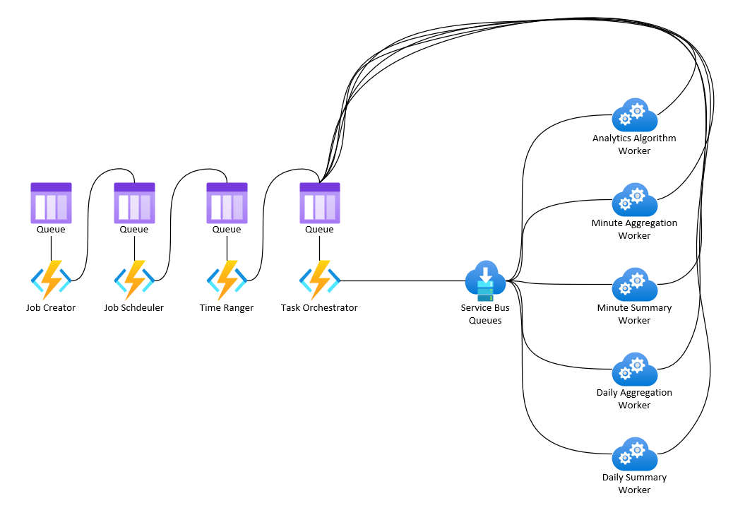
OG Analytics (simplified)

Slide 18
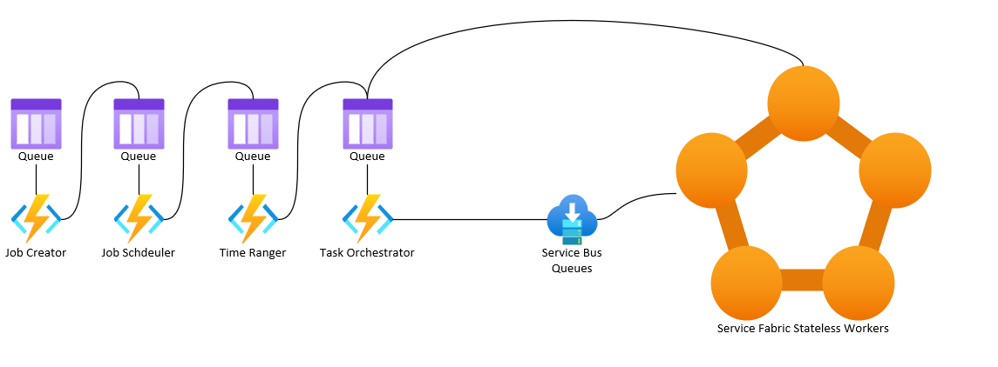
Step 1 Analytics

Slide 19
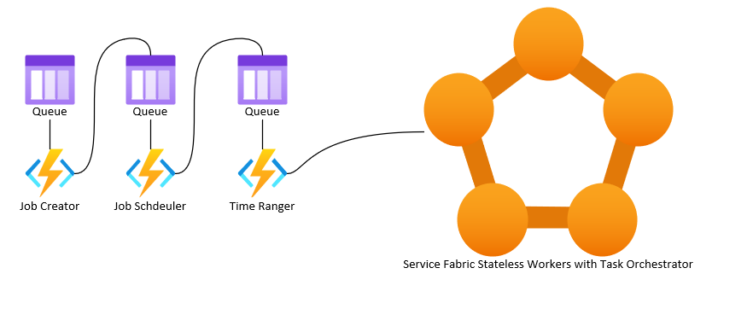
Step 2 Analytics

Slide 20
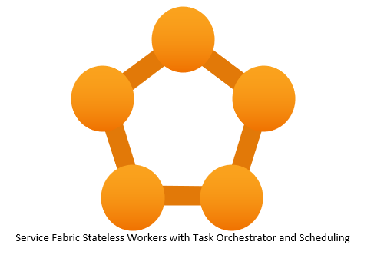
Step 6 Analytics

Slide 21
Analytics Guide Estimations
DONE
11 months of work time months total estimate
Refactor Scheduling Components | Deconstruct Scheduling Components
3 week (implementation) | 3 week (design)
Implement the redesigned scheduling | A design / redesign of job scheduling to better utilize the new framework
Deconstruct Minute Summary
3 week (design & implementation)
Minute summary worker will be decomposed into services
Deconstruct Daily Aggregation
3 week (design) indeterminant implementation
Each will need to be estimated, designed and implemented according to its best fit and use
Deconstruct Daily Summary
3 week (design & implementation)
Daily summary worker will be decomposed into services
Move Job Scheduling
3 week (design) indeterminant implementation
Each job scheduling function will need to be moved into a service.
Deconstruct Minute Aggregation
3 week (design) indeterminant implementation
Each aggregation will need to be estimated, designed and implemented according to its best fit and use
Move Task Orch.
3 week (design & implement)
Move the Task Orch. Into service fabric remove the service bus and allow the Task Orch. Call the services directly
Deconstruct Processor
3 week (design) indeterminant implementation
Each algorithm will need to be estimated and moved designed according to its best fit and use
Move Cloud Service
3 week (design) & 3 week (implement)
Move the cloud service as it is into a stateless service in a service fabric cluster

Slide 22
THANK YOU
Everyone

