Slide 1


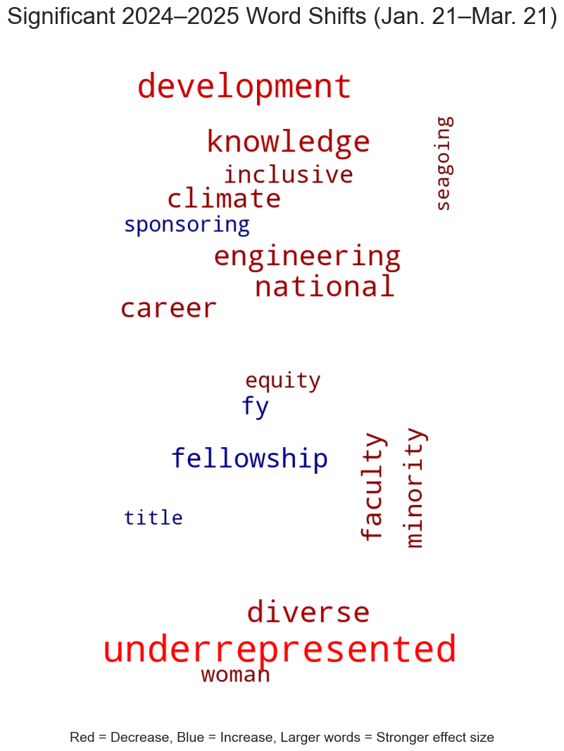
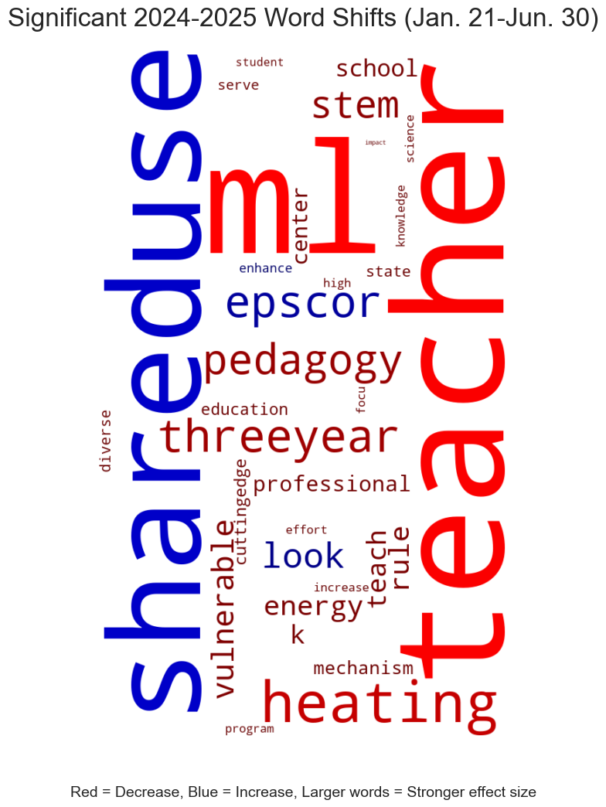
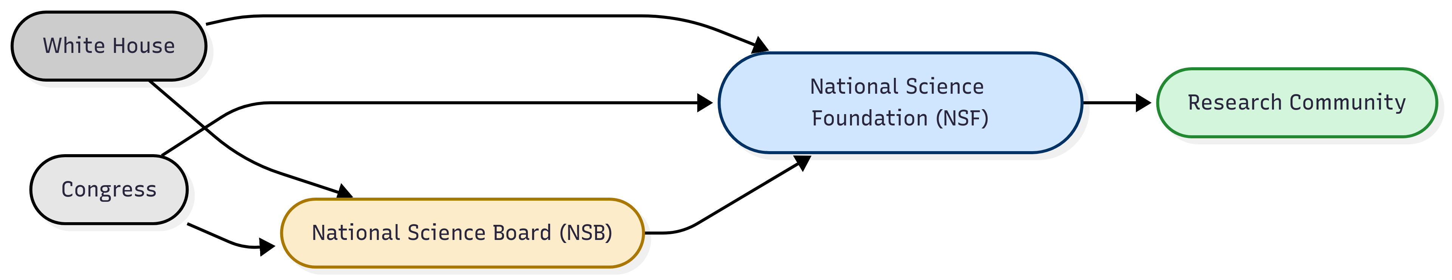
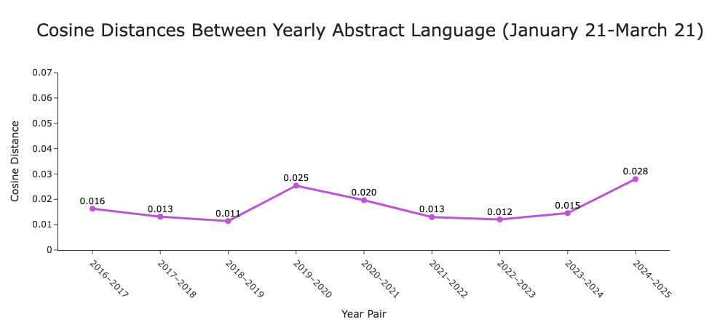
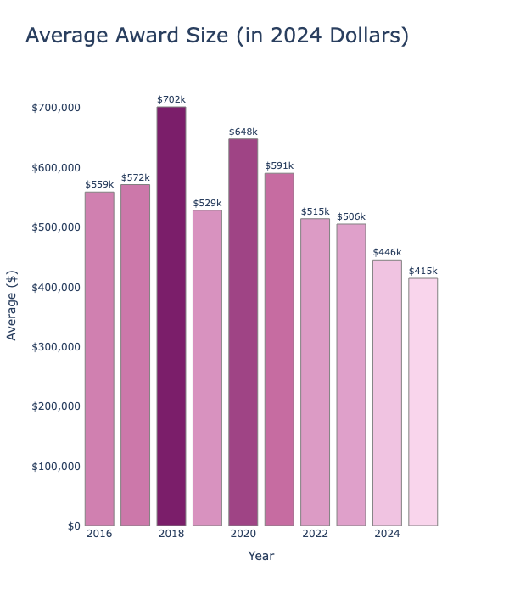
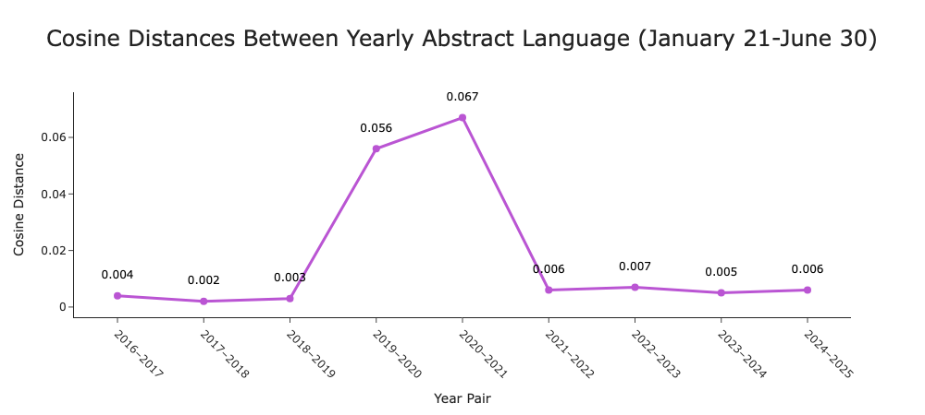
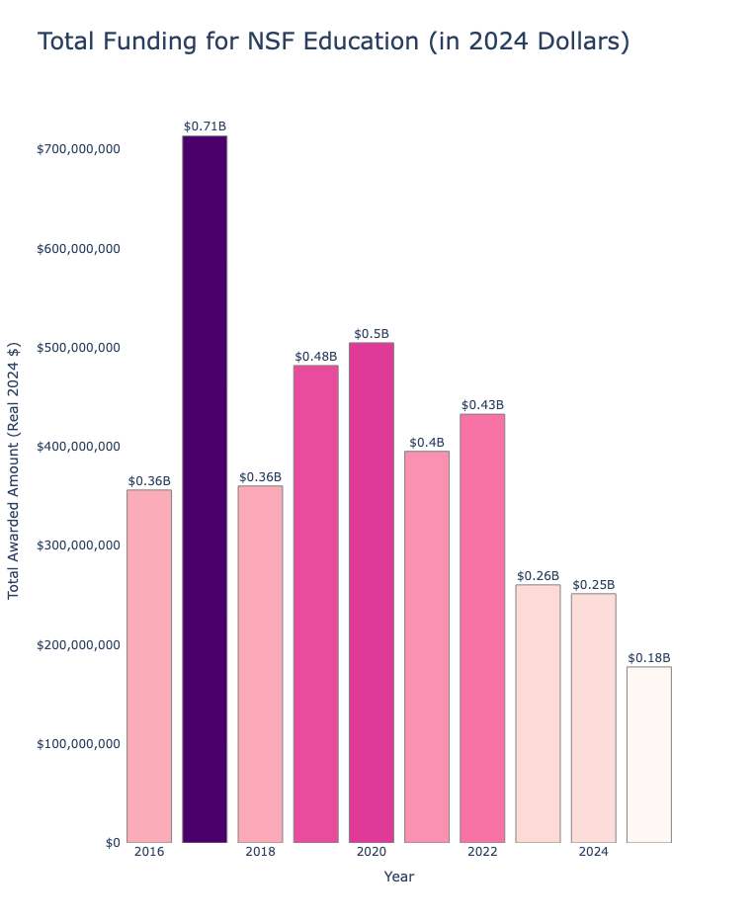
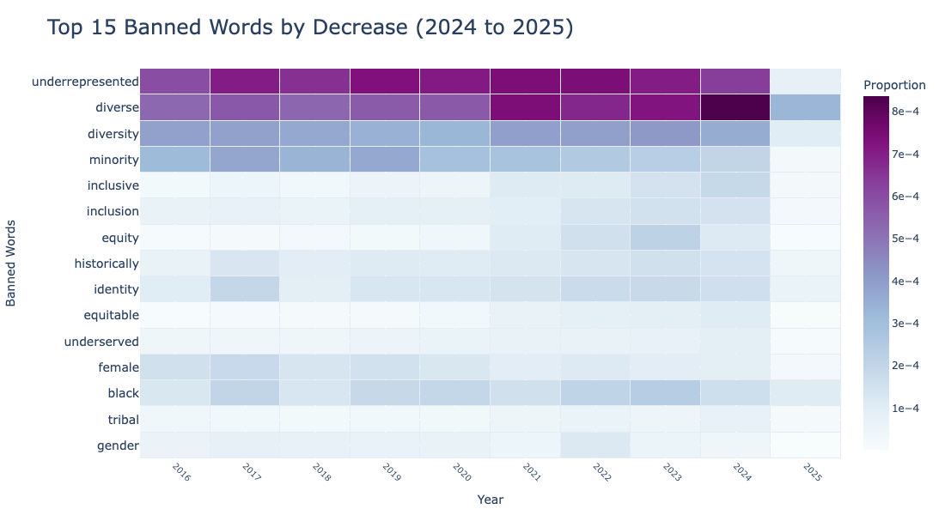
Reading Between the Abstracts: A Textual Analysis of the Political Impacts on NSF-Funded Research
Ryan Seely, advised by Dr. Jeffrey Stanton
School of Information Studies – Research Experience for Undergraduates
Context
Significant Word Usage Changes
Discussion
The second Trump presidency has brought sweeping changes to the administrative state using executive orders, with a particular focus on curbing the role of diversity, equity, and inclusion policies.
With respect to the NSF, this included a new layer of political influence over federally funded research, in addition to budget cuts and layoffs that cut 10 percent of NSF staff (168 employees).
Changes in federally funded research by narrowing priorities stand to have big impacts on more than just academia. Jasanoff (2004) posits that science and society are mutually constitutive, such that scientific research and social norms are intertwined. By cutting DEI-related research projects, there will very likely be disruptions in social phenomena.
Hess (2015) finds that gaps in research are systematically produced by dominant political actors to uphold power imbalances. This supports the idea that these changes to NSF research priorities are neither harmless nor unintentional.
To track changes in word importance from 2024 to 2025, I calculated TF-IDF scores for all words across both years for direct comparison. Using Mann–Whitney U-Tests and applying the FDR-BH correction, I identified significant changes across the 49,974 word distributions.
First two months: 13 words decreased significantly in their TF-IDF scores. These words are more narrowly targeted to DEI topics. This indicates that at the beginning of the year, the administration was most focused on rejecting grant proposals to research that involved DEI.
Six months: 29 words decrease significantly (adjusted p-value < 0.05) in the distribution of their TF-IDF scores, relating to education, DEI, and the environment, which are three areas in which the Trump administration is restricting funding, for the NSF and across the federal government.
Findings
1. There is strong evidence the NSF’s research priorities have been narrowed by the Trump Administration
There are four analyses that provide evidence for significant impacts on changing research priorities; 1) funding differences in the beginning of the year, 2) statistically significant word use changes, 3) lexical change in the beginning of the year, and 4) drop in “banned” word usage. Together, they support the finding that the administration has been successful in altering what types of research the NSF supports and reducing the role of the federal government in promoting equity through science.
2. Changes to NSF awards in the beginning of the year strongly reduced funding and targeted DEI
When analyzing only the first two months of 2024 and 2025, there is a significant drop in the average award amount compared to the same period in 2024, as well as a clear spike in cosine distance between years. This signals that there was a swift disruption in the types of research funded. This period also contained a greater concentration of significant TF-IDF reductions in DEI-related words. These findings indicate that the strongest cuts and topic shifts took place early in the second Trump administration.
3. Changes to the NSF’s research priorities and funding have stabilized relative to the beginning of the year
While the first two months of 2025 show significant changes, average award differences and cosine distance (as a measure of lexical shifts) over the full six-month periods do not have the same level of significance. The Trump administration’s policy shift appears to have had its strongest influence early in the year, before settling into a new, but less volatile, funding landscape for the remainder of the year.
Future Research
Why do changes vary in significance throughout the first six months? Are protests and pushback effective?
It is unclear why the strength of the changes at the NSF were significantly stronger at the beginning of the year. Further research could link other data sources with these analyses to explain why changes are occurring at varying rates, and how the guidance from the White House filters down to the NSF Program Officers.
Are the changes in abstract language reflected in projects, or are researchers adjusting language?
The significant decreases in DEI related language may reflect how researchers write their grants and not just the content of their projects. Researchers could still be incorporating these topics within their research without explicitly informing the NSF. It is worth exploring how these changes are reflected in research outputs outside of the funding applications.
Lexical Change
Funding Changes
Measurement: To measure the lexical shifts of all abstracts between years, I use the cosine distances as between average TF-IDF score vectors for the first two and six months of each consecutive year pair from 2016-2025.
First two months: When examining the cosine distances from January 21 to March 21 of each year from 2016 to 2025, there are large spikes…
from 2019 to 2020 that can be attributed to research topics related to the COVID-19 pandemic
from 2024 to 2025 that can be attributed to the change in research priorities driven by the Trump administration
Six months: However, when examining the cosine distances from January 21 to June 30 from 2016 to 2025, the 2024-2025 cosine distance is, relatively, not as large, especially when being compared to the massive changes in the 2019-2020 and 2020-2021 distances.
From this, two inferences can be gleaned:
The changes in research priorities, as well as the impacts on the NSF, from the COVID-19 pandemic are significantly greater than that of the changes in NSF research priorities driven by the Trump administration.
Actions taken to limit research on environmental justice, DEI, and education were fast and front-loaded, and have somewhat stabilized from the early year changes.
Funding per Award
From January 21 to June 30 of 2024 and 2025, average funding per award is not significantly different (two-sample t-test with unequal variances, p = 0.9996).
However, for only the first two months:
2025 mean: $366,197.94
2024 mean: $545,383.90
Difference is statistically significant (p=0.0001)
Terminated Awards
1,667 awards were cancelled when the Trump administration took office, totaling $1.3 billion in NSF-funded research.
Cancelled awards were deemed “not aligned with program goals or agency priorities,” for DEI, environmental justice, and misinformation related research.
Cancelled award types included 22 REU programs, 191 NSF Career awards, 18 fellowships, and 65 conferences
Education
The NSF Education Directorate is now at its lowest funding level across the 10 years of data.
From 2024 to 2025, the education directorate saw a 29.4% decrease in funding, representing a 73.4 million dollar cut.
Presence of “Banned Words”
The “list of banned words” consists of words that were included in Trump administration guidance to remove (or use cautiously) from public-facing federal government media.
I compare this list of 197 words and phrases, compiled by the New York Times, with language in NSF abstracts as another measure of lexical change, more narrowly focused on DEI topics.
From 2024 to 2025, there was a 61.7 percent reduction in the use of the terms across abstracts.
Between 2016 and 2024, these words make up an average 0.43% of all words in the abstracts for each year. In 2025, these terms make up only 0.19%.
References
Jasanoff, S. (2004). Ordering knowledge, ordering society. In States of
knowledge (pp. 13-45). Routledge.
Hess, D. J. (2015). Undone science and social movements: A review and
typology. Routledge international handbook of ignorance studies, 141-154.
Lambert, J. (2025). National Science Foundation fires roughly
10 % of its workforce. NPR.
National Science Foundation. (2025). Updates on NSF priorities.
Yourish, K., Daniel, A., Datar, S., White, I., & Gamio, L. (2025, March 7). These
words are disappearing in the new Trump administration. The New York Times.

