Slide 1
Gov-TechThon 2020 Team(METIOR) Dr Rajesh R Dr Saneep J Dr Nismon R Dr Sivakumar R CHRIST(Deemed to be University)

Slide 2
Introduction
Conducting online exam is challenging mainly because of two factors.
Lack of invigilation and costly online platform
Currently in market, there are good online platform available to use and conduct the online examination like mettl.
But these platforms are high cost to use and also does not prevent complete malpractice.

Slide 3
Problem Statement
How to conduct online examination without live proctoring.
Proctoring should be done automatically
System should take care

Slide 4
Our model addresses the issues in the following categories
Invigilation
Components of assessment
Preparation of question bank
Normalization

Slide 5
Functionalities
Authentication of the student
Identification of presence of third parties
Identification of usages of malpractices like internet searching during examination

Slide 6
Innovative features
Students will be asked to speak out the answers
The eye movement will be captured by the system while they answer
This will be analyzed to find out whether they are reading from a note or from recollecting the answers

Slide 7
Feasibility
To implement this feature we do not require any additional tools.
The camera of laptop/ mobile which is required for authenticating the student can be used to record eye movements.
Start and stop of camera can be controlled by the system.
Audio message can be recorded at the server side so that there is no need of sending the answers separately.
Couple of face images also can be saved at server side.
A simple headphone is enough to record their audio answers.

Slide 8
Challenges
Video recording.
The eye movement can be effectively analyzed only when we have good pictures and for this we require reasonable camera and proper lighting in the room

Slide 9
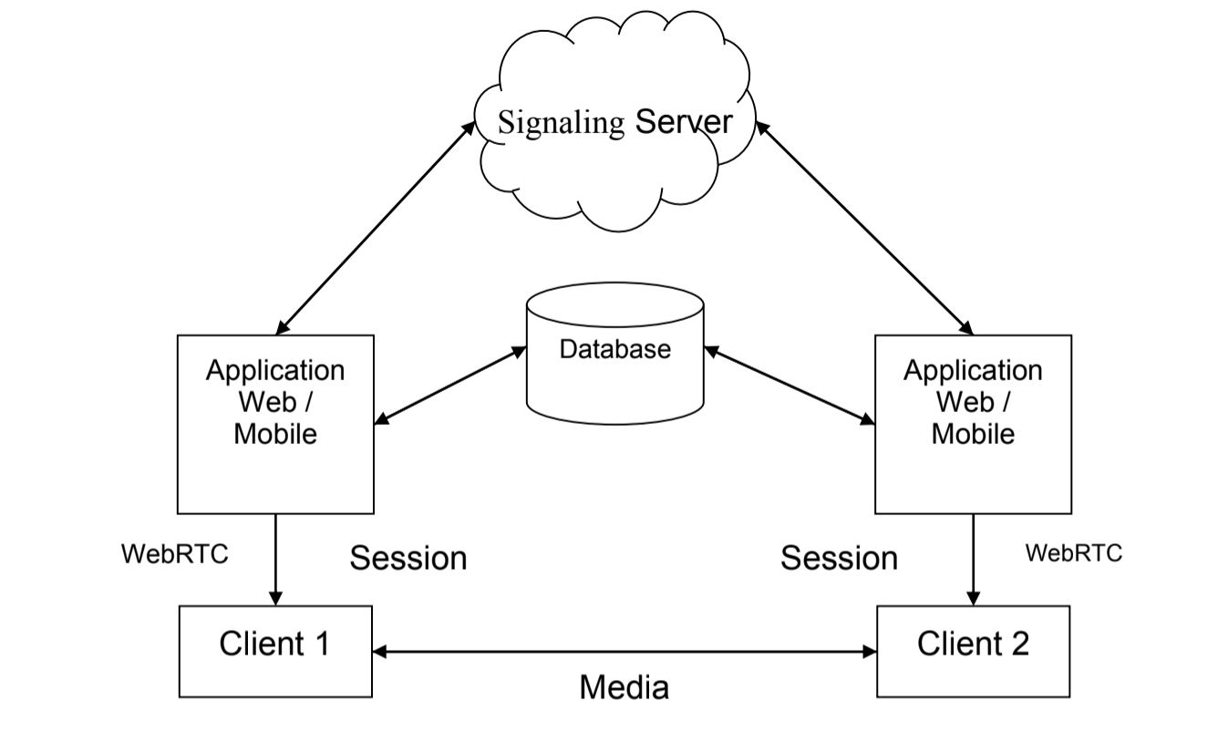
Architect - Design Assessments
Application Architecture

Slide 10
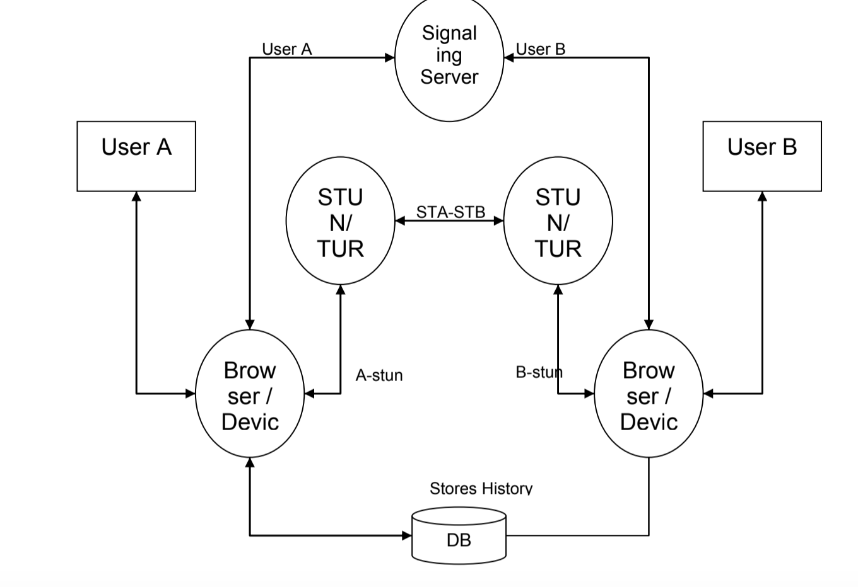
Functional Architecture

Slide 11
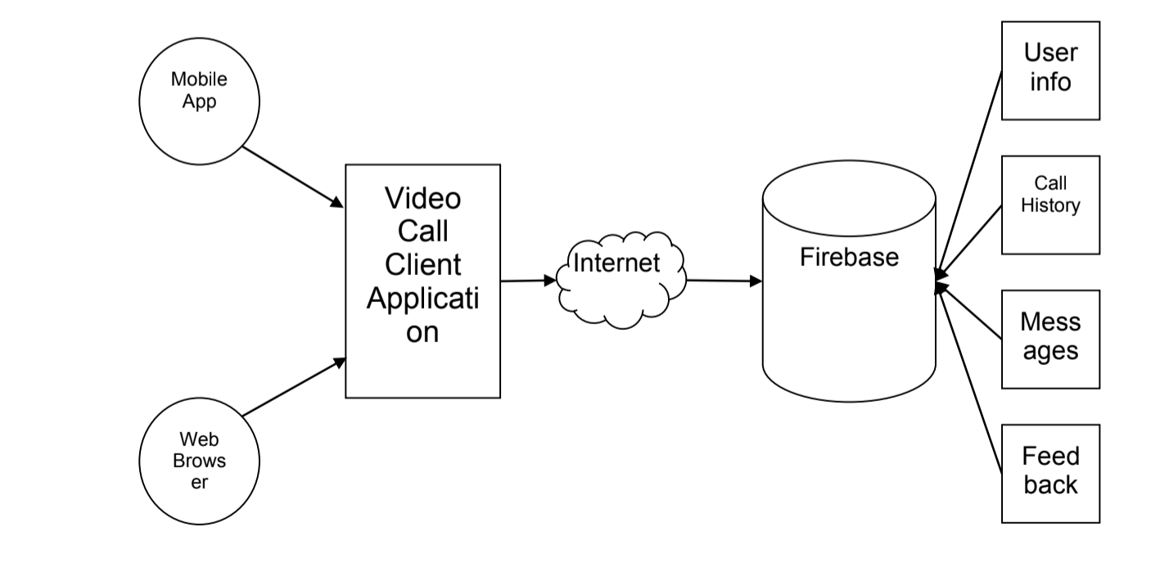
Technical Architecture

Slide 12
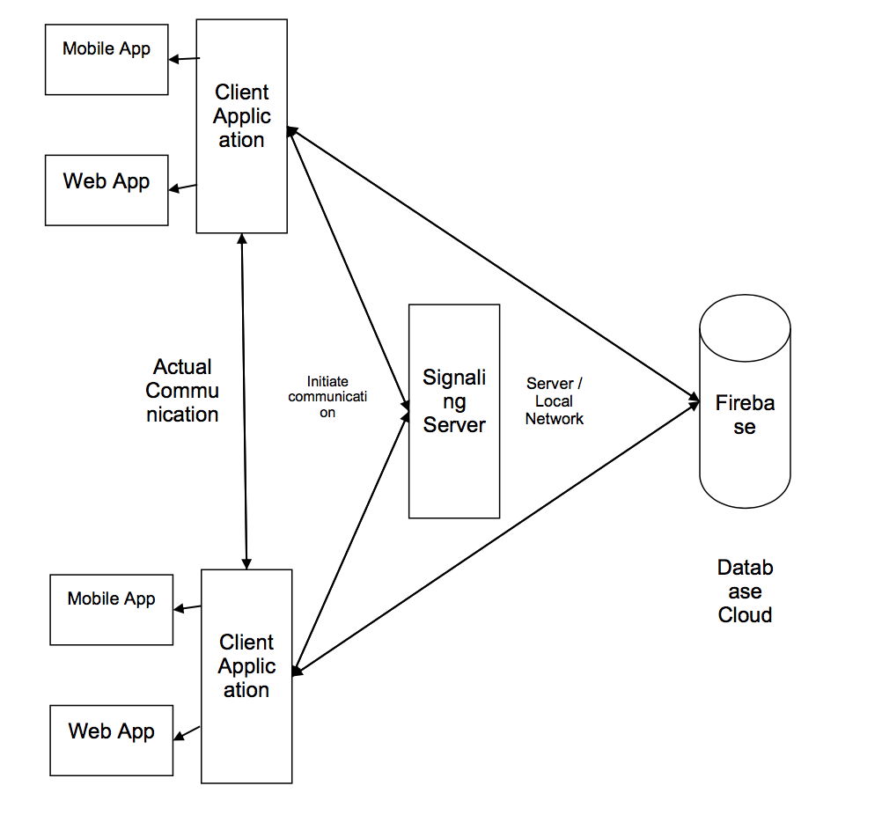
Deployment Architecture

Slide 13
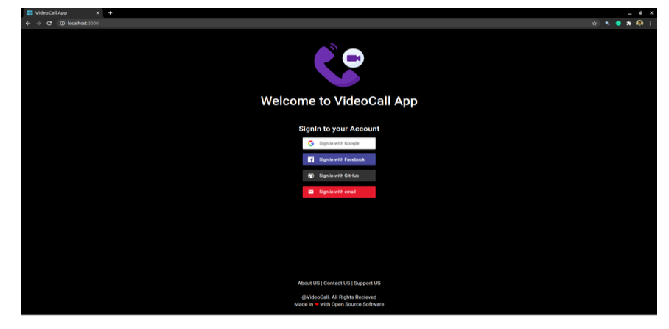

Slide 14
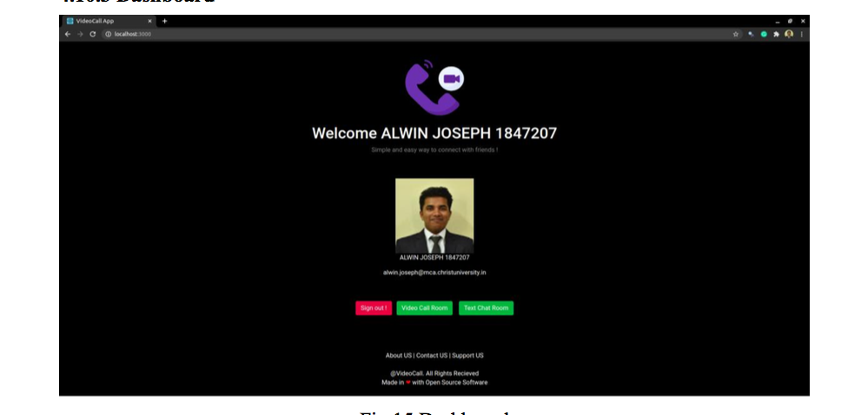
Dashboard

Slide 15
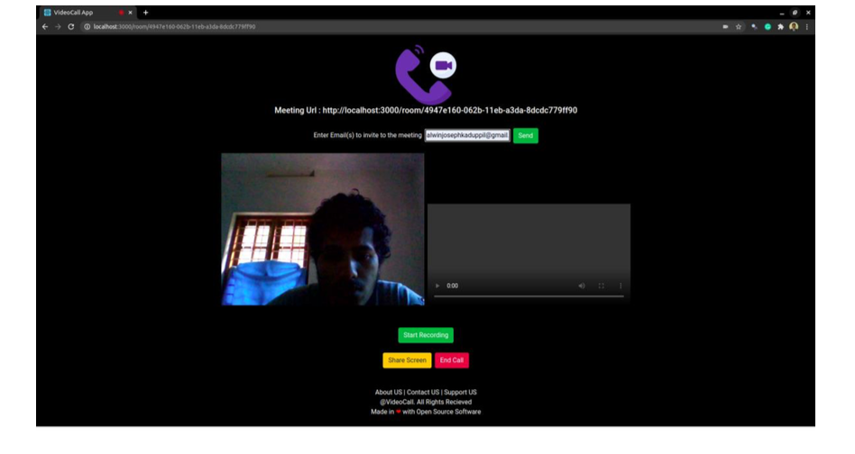

Slide 16
Tools Required
Web based application using python

Slide 17
Overall Assessment
Invigilation
Components of assessment
Preparation of question bank
Normalization

Slide 18
Assessment Components
Here we recommend the following components with respective weightage
Viva- 20 %
Multiple choice questions- 20 %
Descriptive- 60 %
The viva component will give a complete assessment of the student and will normalize the mark automatically
The multiple choice questions and descriptive questions should not be given as such, instead can be provided as an image.

Slide 19

For example
This will prevent a student to copy the content from the question paper and paste in a search engine to search for answers. If they want to do then they have to type the complete question which will be a time consuming one.

Slide 20
Question bank preparation
There should be enough questions in the question bank for which almost unique question should be given to every individual students. The questions are also of different levels like basic, moderate, complex etc.

Slide 21
Normalization
To eliminate the malpractice attempts we recommend to reduce the examination duration drastically. This methodology will give pressure to students and they may not get time to switch between answer window and to other malpractice options. If they try to copy then obviously they can very less time and will be not be able to complete not even 50 %.
This will affect the good students’ performance also and will not be the actual representation of a student assessment. To address this we recommend normalize the marks received by all the students to higher grade if required.
Our model consist of parent invigilation, appropriate assessment components like viva and proper question bank and also method of normalization

Slide 22
Thank You

