Slide 1

The Future of NFTs and the Pros and Cons to Ownership

Slide 2
What are NFTs?
NFTs (non-fungible tokens) are unique cryptographic tokens that exist on a blockchain and cannot be replicated.
NFTs can represent digital or real-world items like artwork and real estate.
"Tokenizing" these real-world tangible assets makes buying, selling, and trading them more efficient while reducing the probability of fraud.
NFTs can represent individuals' identities, property rights, and more.
Collectors and investors initially sought NFTs after the public became more aware of them, but their popularity has since waned.

Slide 3
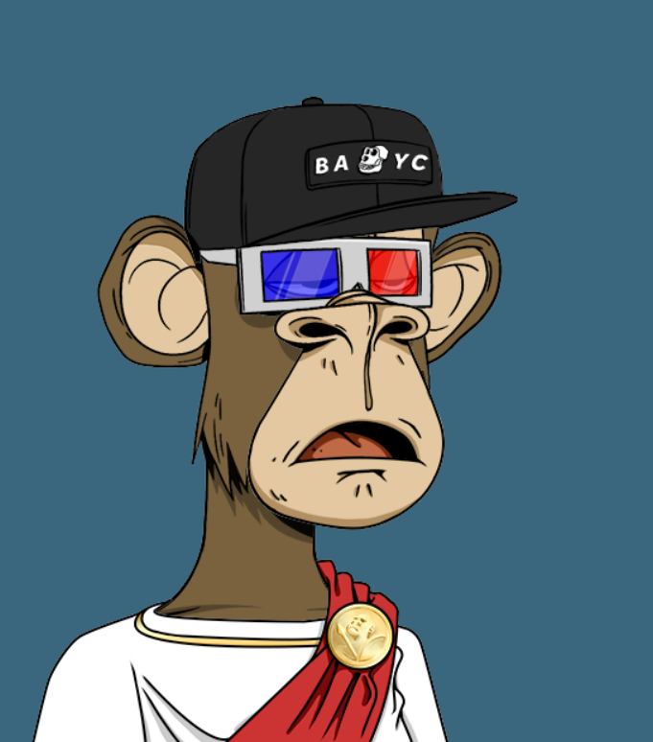
NFT Examples
Collectibles and NFT Art
Music, videos media
Video Game assets
Virtual Event tickets
Metaverse Assets
Blockchain Identity
Memes
Domain Names
Charitable Funds

Slide 4
Market volatility
The schemes
Pump and dumps
FOMO
Stats statistics
Plots, etc

Slide 5
Why not to buy NFTs

Slide 6
Why buy NFTs?
Buy what you like and enjoy
How long has the project been around?
What partnerships do they have?
Does the NFT have utility
The market is driven my sentiment and culture.
No one cared about twitter ten years ago, when tweeting about lunch. Now World leaders depend on twitter. The NFT market is in it infancy stage.

