Slide 1
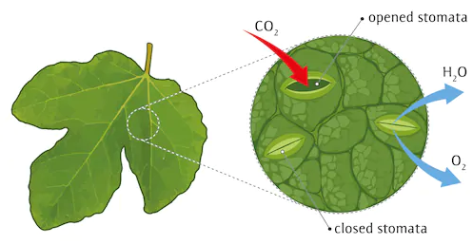

Slide 2
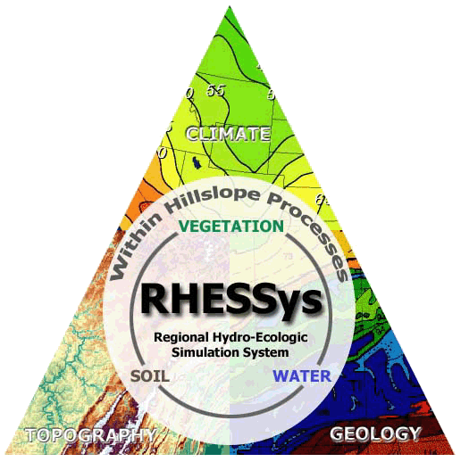
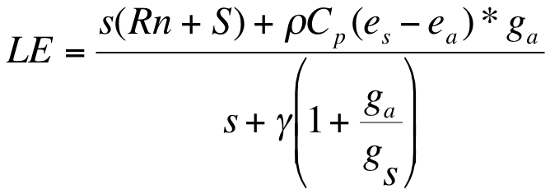
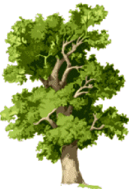
Transpiration (Penman-Monteith)
Photosynthesis (Farquhar)
F(Ac,Aj) - both of which include Ci (concentration of carbon in leaves) which depends on gs
Stomatal Conductance (Jarvis Model)
gs = f(Tmax,Tmin,LWP, atm C02, Radiation, VPD)
gs_canopy = gs*LAI
LWP (leaf water potential)
SWP (soil water potential) linked with distributed hydrologic model and its parameterization

Slide 3
