Slide 1
Carbon allocation, turnover, and mortality

Slide 2

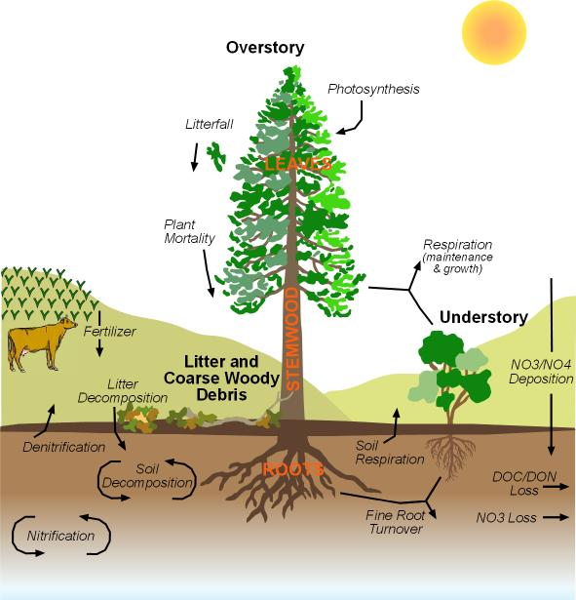
Carbon and Nitrogen cycling in RHESSys

Slide 3
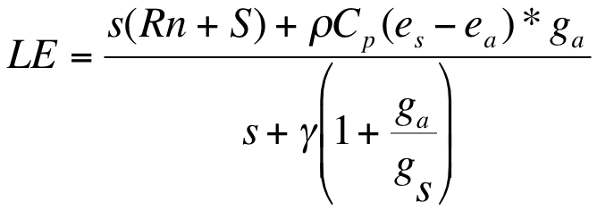

Transpiration (Penman-Monteith)
Photosynthesis (Farquhar)
F(Ac,Aj) - both of which include Ci (concentration of carbon in leaves) which depends on gs
Stomatal Conductance (Jarvis Model)
gs = f(Tmax,Tmin,LWP, atm C02, Radiation, VPD)
gs_canopy = gs*LAI
LWP (leaf water potential)
related to soil water availability linked with distributed hydrologic model and it’s parameterization

Slide 4
Gross PSN f(light, nutrient availability, conductance), and leaf area
Respiration maintenance and growth f(T, N and biomass)
varies with type and size of plant components
=
NPP Allocated to leaves, stems, roots and carbohydrate storage; which impact photosynthetic capacity and respiration costs
Potentially complex dynamics because you have a system with feedbacks and multiple controls
That carbon cycling models give you “reasonable” forest biomass for particular sites is not trivial; suggests that carbon cycling (rather than structural or some other mechanism) can explain growth and equilibrium size of stands

Slide 5
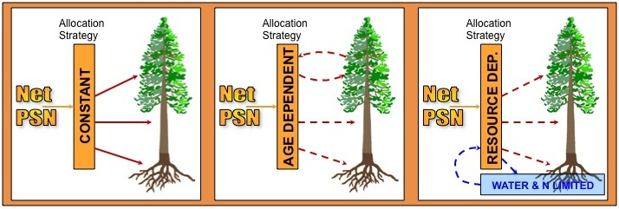
CONSTANT
DICKENSON
WARING
New allocation strategy: COMBINED

Slide 6
Allocation parameters
New fine root C to new leaf C
New stem C to new leaf C
New coarse root C to new stem C
New live wood C to new total wood C
epc.alloc_prop_day_growth

Slide 7
Other carbon parameters
Epc.livewood_turnover
Epc.branch_turnover
Epc.froot_turnover
Epc.leaf_turnover
CN ratios
Mortality
Background
Non-structural carbohydrates

Slide 8
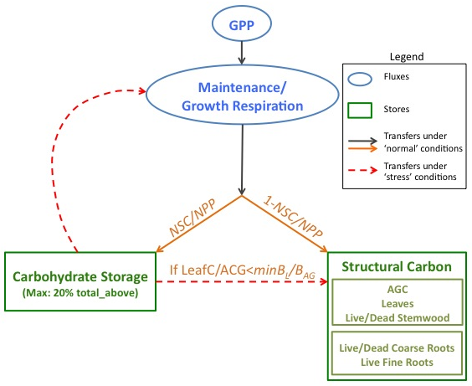

Allocation to and use of non-structural carbohydrate storage (NSC)(aka cpool)
Two new parameters: (NSC/NPP proportion of NPP allocation to NSC; minL/AGC)

Slide 9
Key NSC variables & parameters
Parameters
Epc.storage_transfer_prop
percent of storage allocated in a given year
Epc.max_storage_percent
Epc.cpool_mort_fract
net carbohydrate store proportion of total biomass below which mortality occurs
Epc.min_leaf_carbon
kgC minimum leaf carbon before death
Variables
cpool

