Slide 1
“I Don’t Want To Shoot The Android”
——Players Translate Real-Life Moral Intuitions to In-Game DBH

Slide 2
1、What’s the problem?
- Whether
-Whether players translate their real life morality into in-game decisions.。
- Why
- Understand why players make decisions and their reasoning behind those decisions

Slide 3
2、What’s new
- Previous work：
- have only focused on quantitative analysis
- have not examined the motivations and reasoning behind players’decision-making processes
- The Challenge：
- the design of games with the intention of eliciting specifc emotions or experiences.
- Fills the Gaps：
- by examining player choice and motivations in more complex and multilinear CCAG environments.。

Slide 4
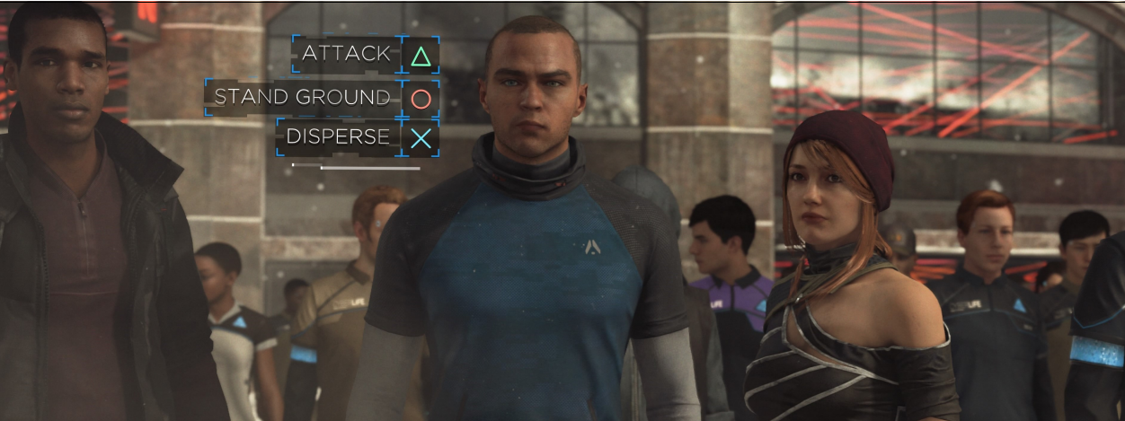
2、What’s new
- CCAG？
- cinematic choice-based adventure games
- DBH
- the core mechanic is decision-making
- moral dilemmas are implemented to advance the narrative.

Slide 5
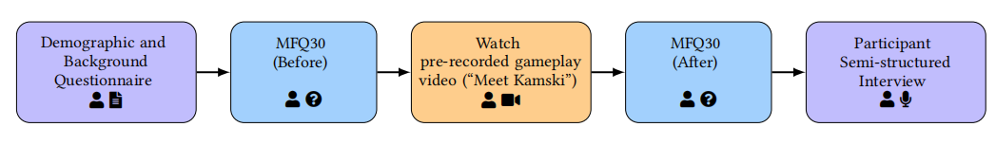
3、How they did it
- Both a qualitative and quantitative analysis
- Participants completed two sets of the Moral Foundations Questionnaire (MFQ30).
- identify the moral foundations
- Interviewed participants about their experience with the game in general
- explore factors that players associate with morality-driven choices

Slide 6
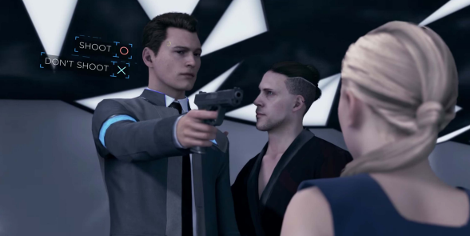
3、How they did it: Video
- Shoot or Spare?

Slide 7
3、How they did it ：MFQ30
The questionnaire was applied twice：
1、 Before
- focused on the perceived real life morality of the participants.
2、 After
- based on the perceived morality of the playable character Connor after watching the scene in the pre-recorded video in which he spared an android’s life

Slide 8
3、How they did it ：Interviews
Qualitative interview data were collected via one-on-one remote semi-structured interviews.
- Questions
- How would you describe your self interms of morality? Do you follow the same morality in all story driven games and why or why not? ……
- Aim
- Collect participants' moral perception of themselves and game characters.
- Refect on how participants apply their
morality in interactive narrative games

Slide 9
4、How they evaluated their method
Thematic Analysis + Refexive Thematic Analysis
- Phase1 Familiarization with the collected data
- Phase2 Initial codes generation
- Phase3 Themes search
- Phase4 Themes review
- Phase5 Themes titles and defnitions
- Phase6 Report

Slide 10
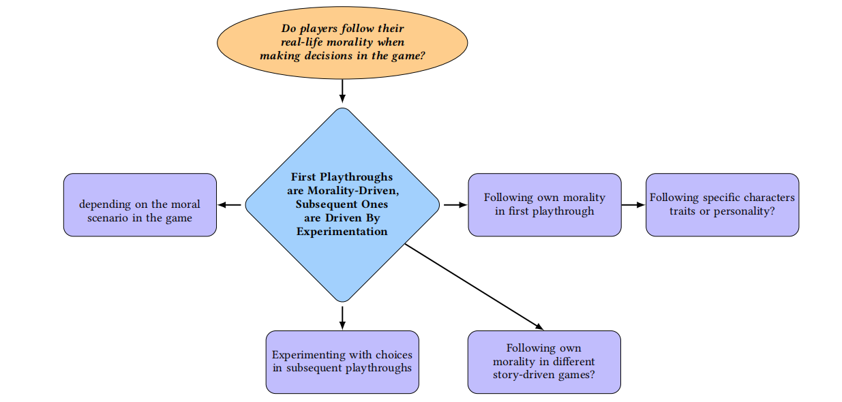
4、How they evaluated their method

Slide 11
4、How they evaluated their method：Result
First Playthroughs ：Morality-Driven
Subsequent Ones ：Experimentation-Driven
- Analyze
- 1. Feel the game is personalized。
- 2. The narrative presented in the game allowed them to connect with the characters
- 3. Avoid Negative Emotions
- 4. Realism of the narrative

Slide 12
4、How they evaluated their method：Result
Perception of Moral Foundations for
In-Game Decisions
- “Harm/Care”
- “Fairness/Reciprocity”
- “Ingroup/Loyalty”
- “Authority/Respect,”
- “Purity/Sanctity”

Slide 13
5、Is the problem solved? What’s the future?
- Whever?
- that participants mobilize their moral intuitions to make in-game decisions
- How?
- participants 's moral intuitions
- how much participants cared about their game characters
- Significance?
- The findings can be used as the basis to develop games

Slide 14
5、Is the problem solved? What’s the future?
- FUTURE WORK
- Data analysis implementing other types of validated questionnaires
- The use of a bigger sample size（ n=19）
- Integrating participants that have no previous experience with the game
- Other types of media could be analyzed to compare the results

Slide 15
Report
Thanks！

