Slide 1
Hacking for Defense: An Effort to Create a Cybersecurity Risk Evaluation Metric
Data Science II: Applied Statistical Learning - Spring 2022 - Georgetown University Ryan Ripper 05/10/2022

Slide 2
Introduction
Is there a way to systematically identify a company as being a potential cybersecurity target from online attacks?
Address the complexity of the problem posed by the NSA in identifying companies that would benefit from additional cybersecurity support
Critical technology suppliers that would pose as financial, political, technical, and/or military targets

Slide 3
Data
USAspending – Official open data source of federal spending information
All contracts awarded in CY 2021
Focus on hypersonic subawards
Duns & Bradstreet Application Programming Interface (API) – Unsuccessful in supplementing USAspending data
Dataset of past cybersecurity attacks – Ability to create supervised machine learning models to predict probability of occurrence

Slide 4
MAIN Results and analysis

Slide 5
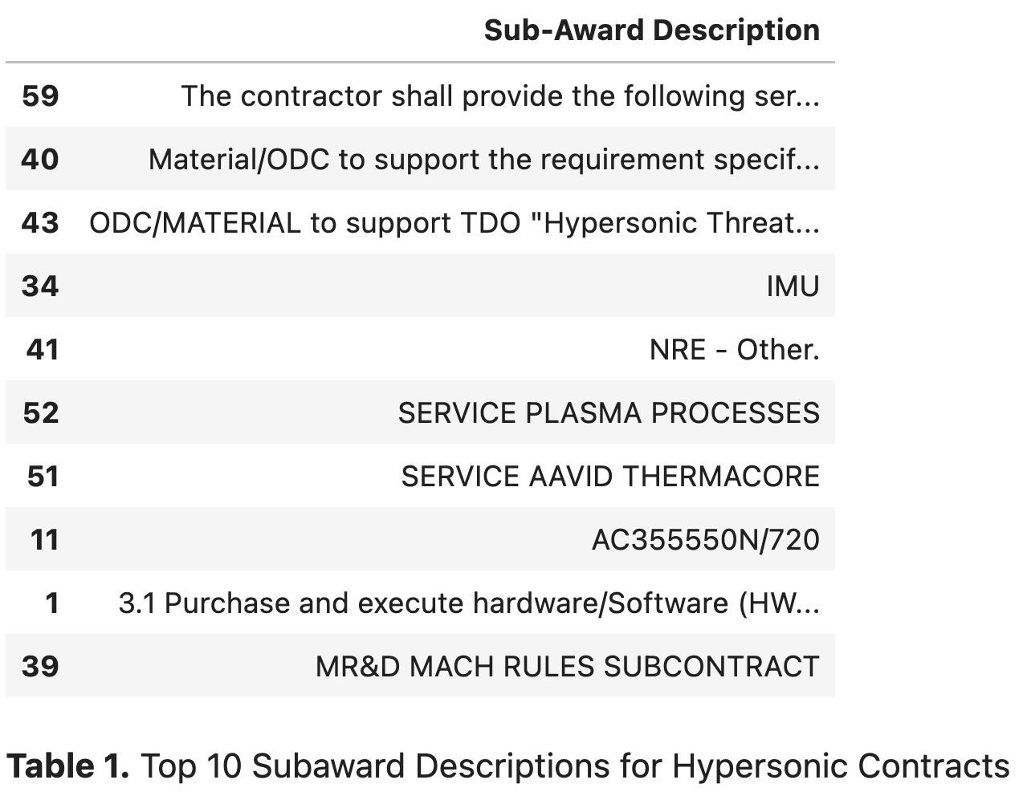

Slide 6
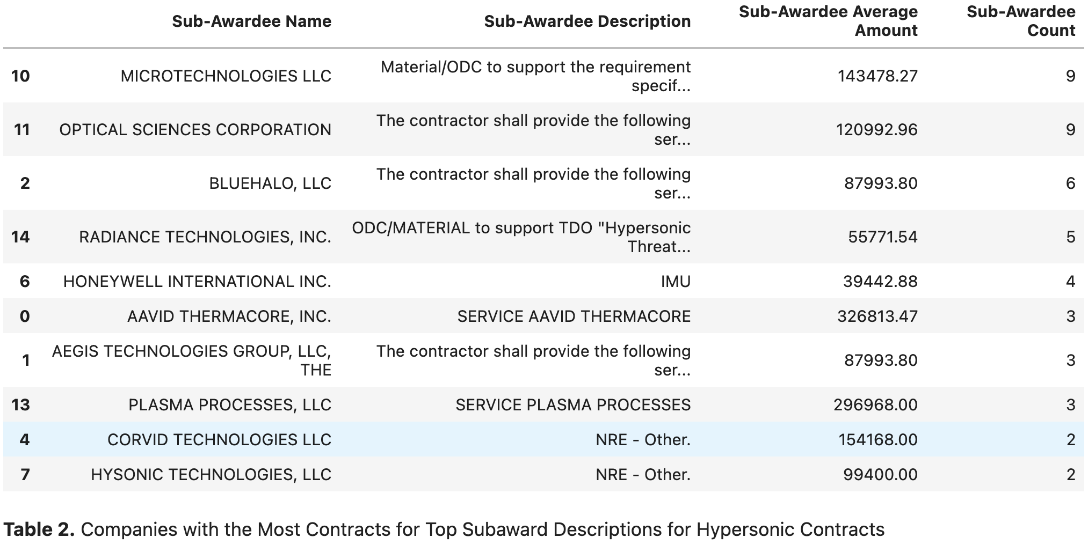

Slide 7
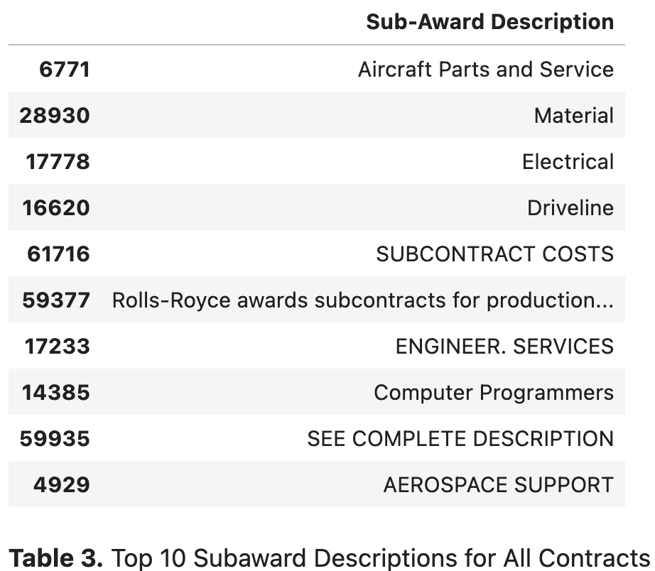

Slide 8
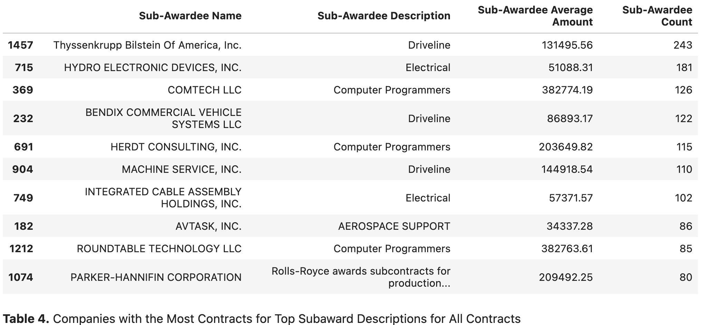

Slide 9
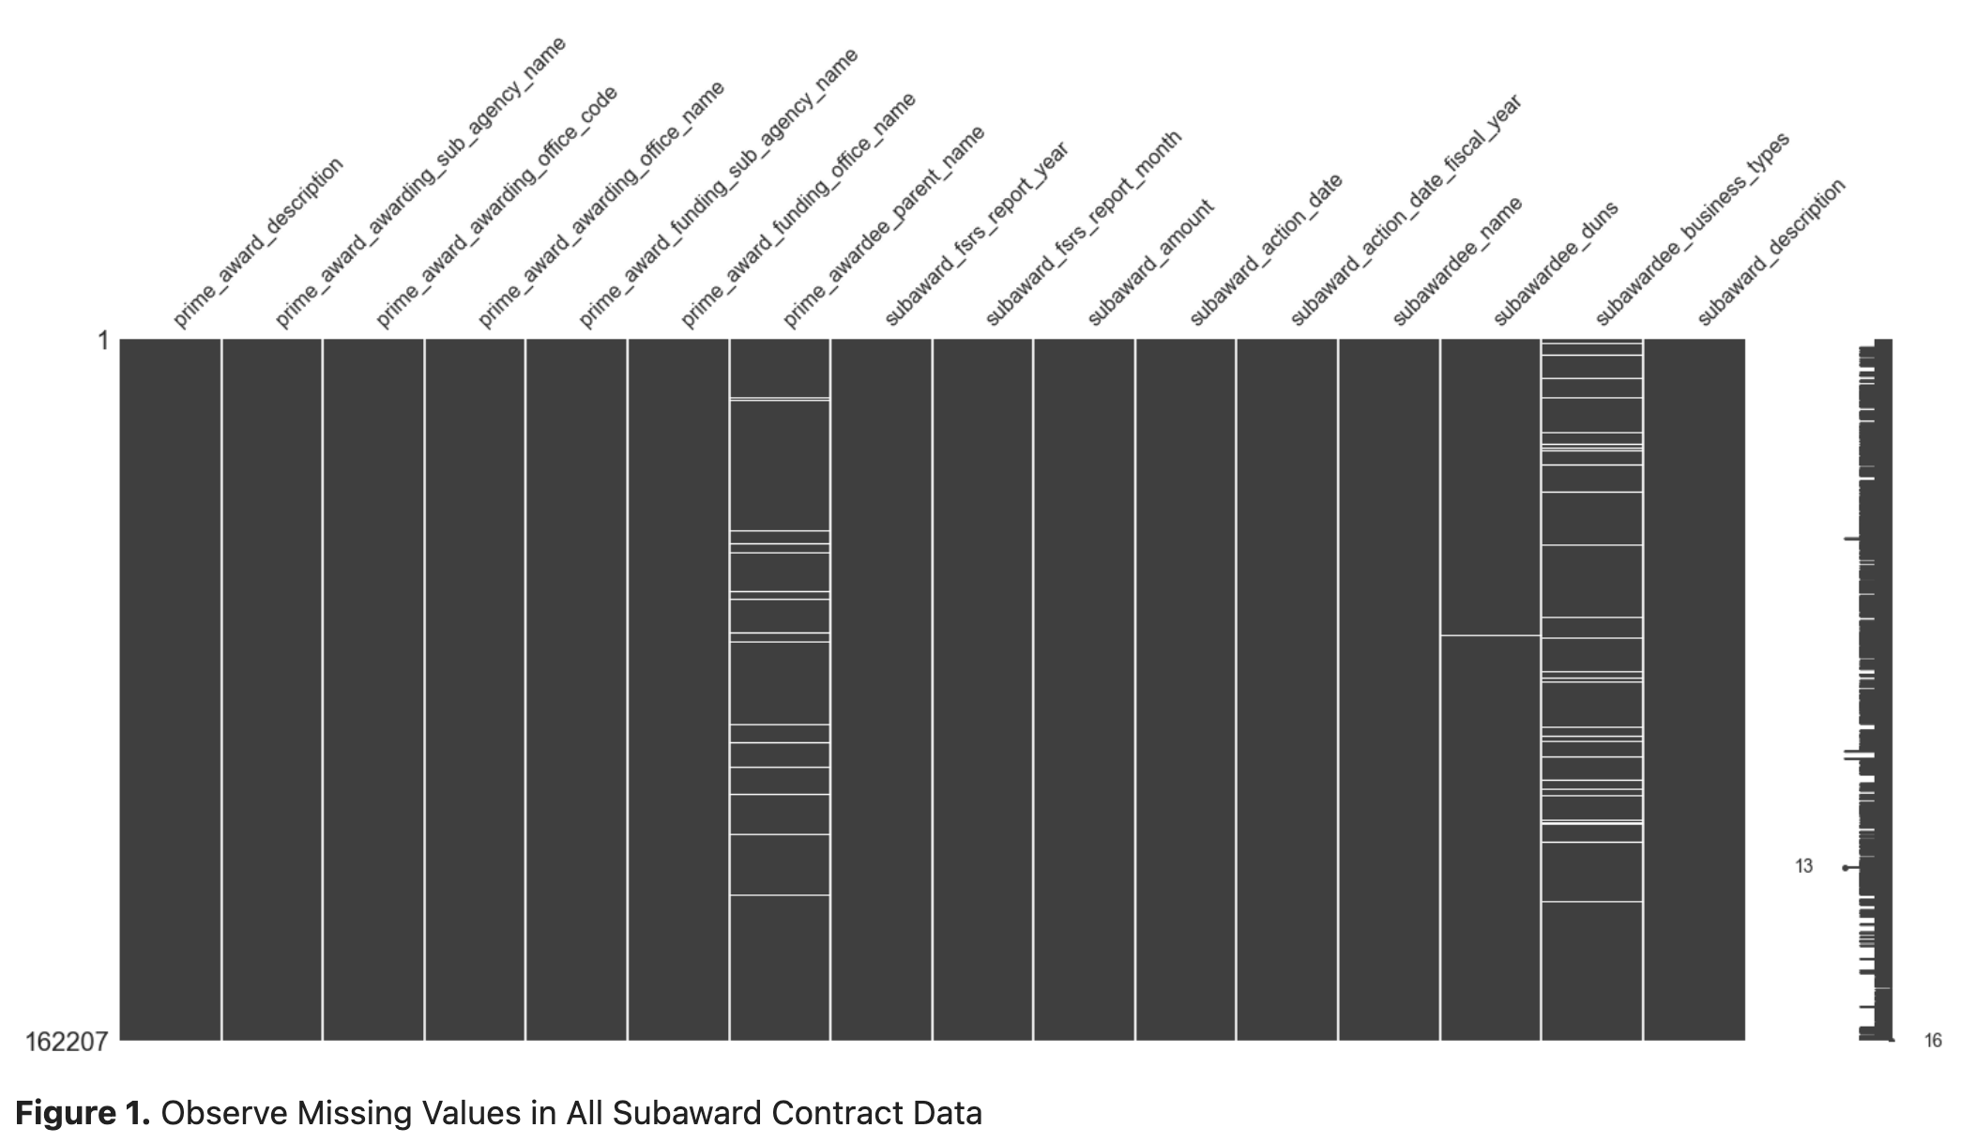

Slide 10
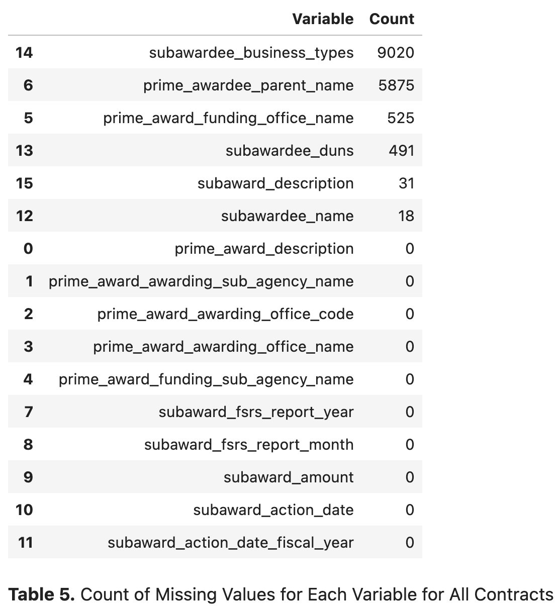

Slide 11
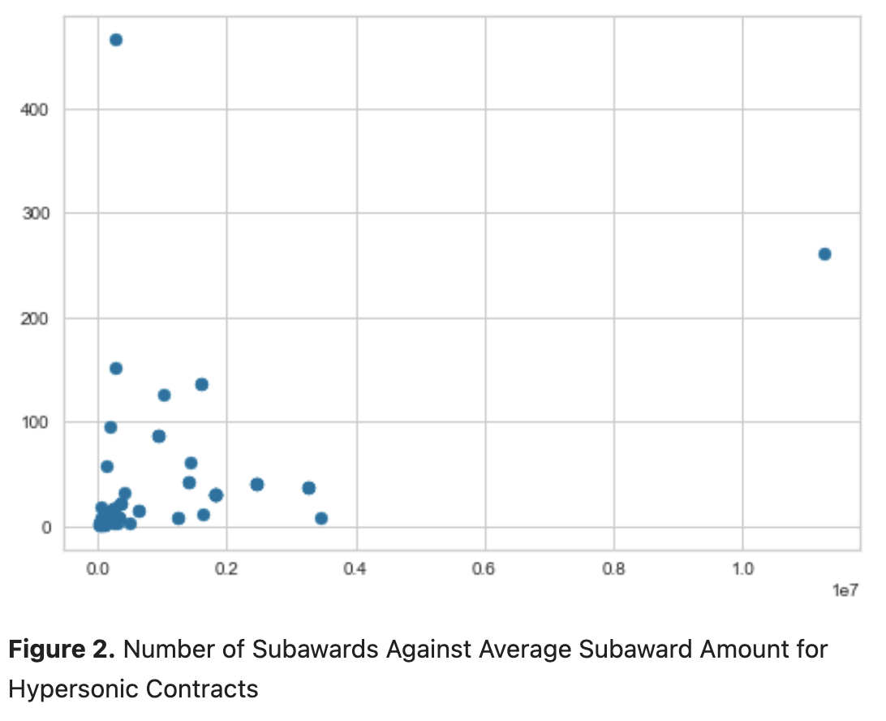

Slide 12
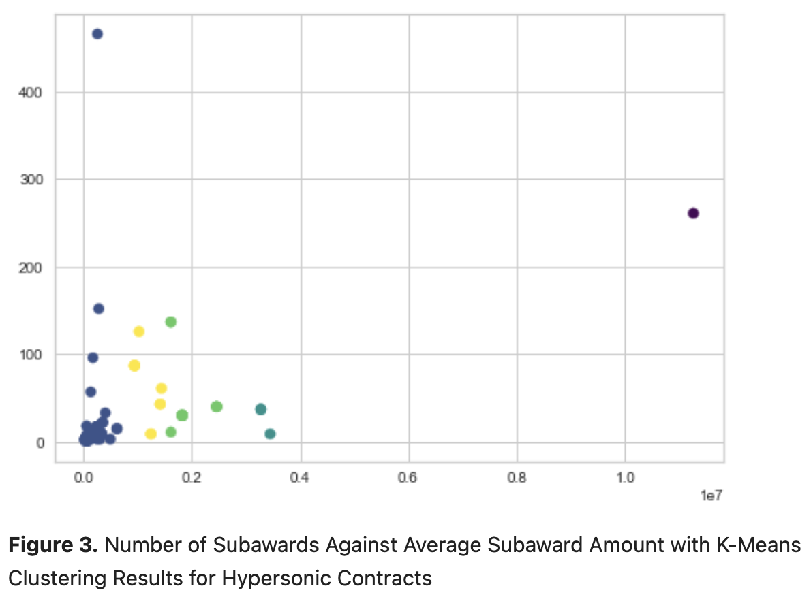

Slide 13
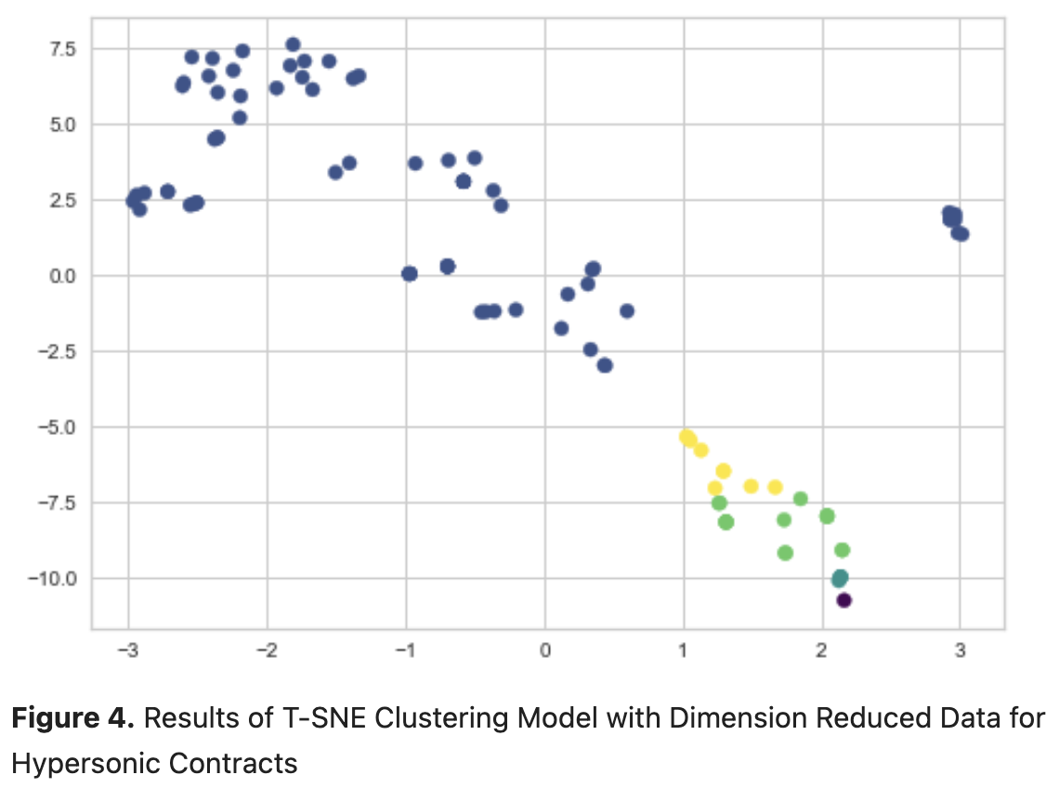

Slide 14
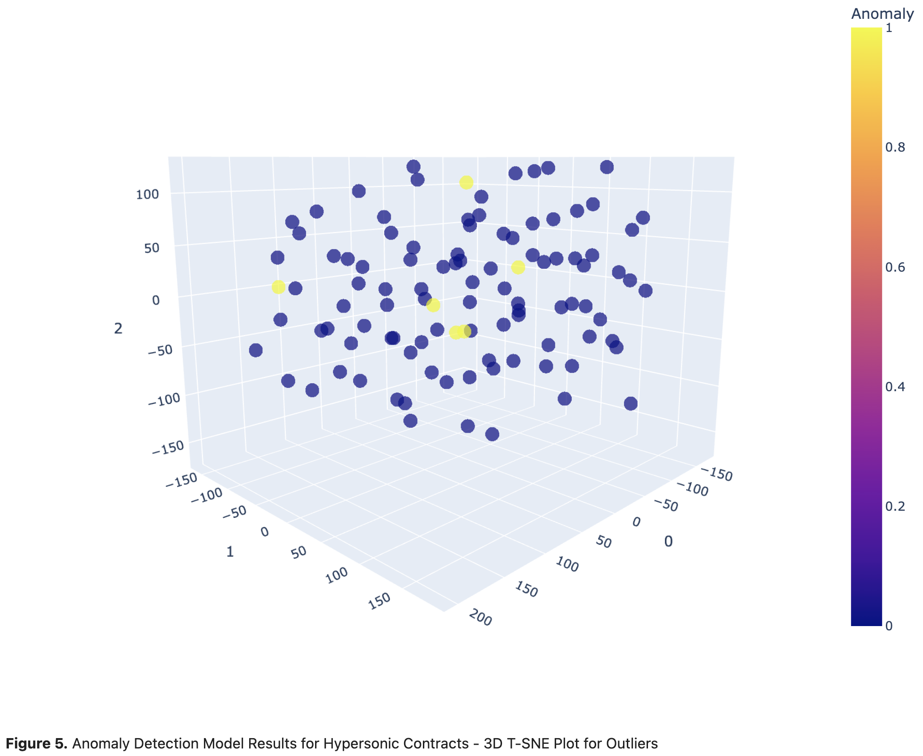

Slide 15
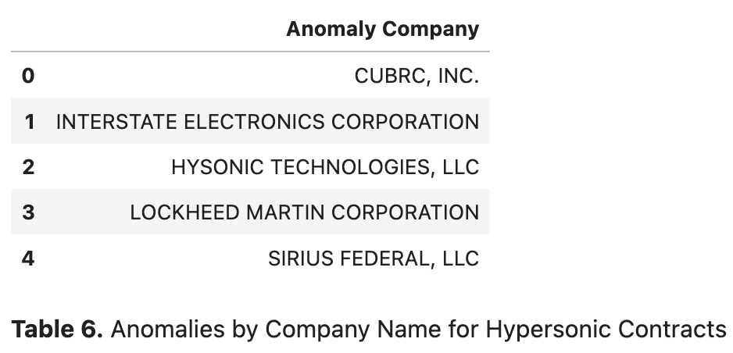
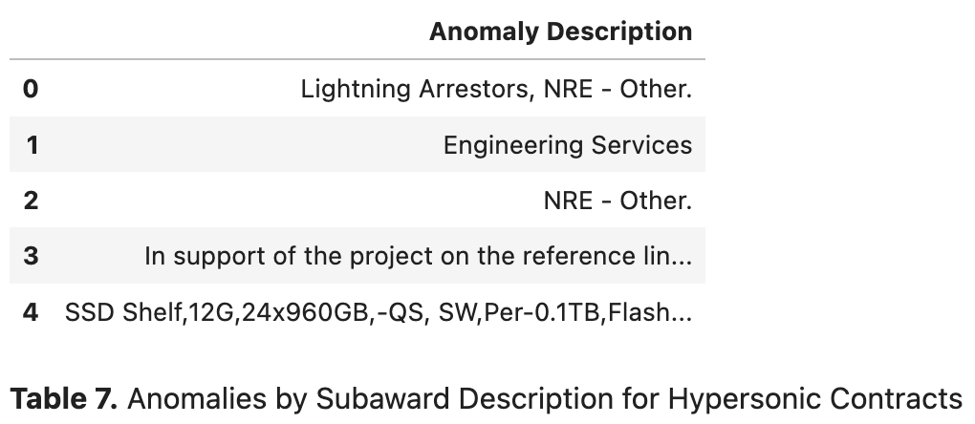

Slide 16
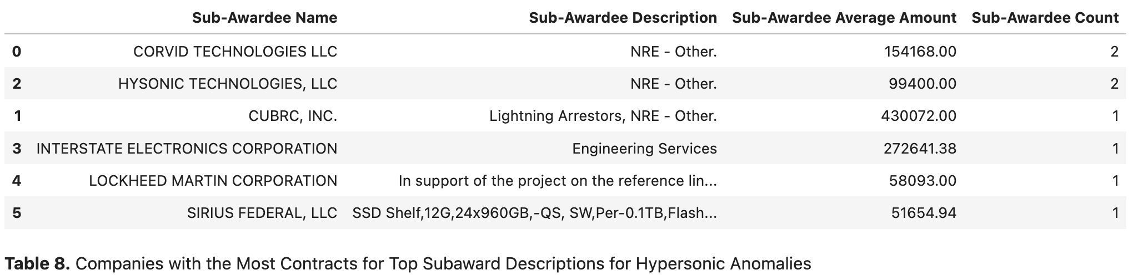

Slide 17
conclusions

Slide 18
Limitations
Small number of observations we used in our unsupervised machine learning algorithms (~103 subawards for hypersonic contracts)
Lack of past attacks – If we did have this data, how would we address class imbalance?
Whether or not the results are truly tied to cybersecurity issues – Coincidence?

Slide 19
Main Takeaways
Able to identify DIB companies that could be cybersecurity targets
Companies that could benefit from additional support
Companies that should have cybersecurity measures since they represent large portions of the respective market
Approach can be extended to any other emerging technology
Pivoting from original research question when data is not available
Other ways to supplement the USAspending data
Explore other venues of analysis

Slide 20
Thank you

