Slide 1
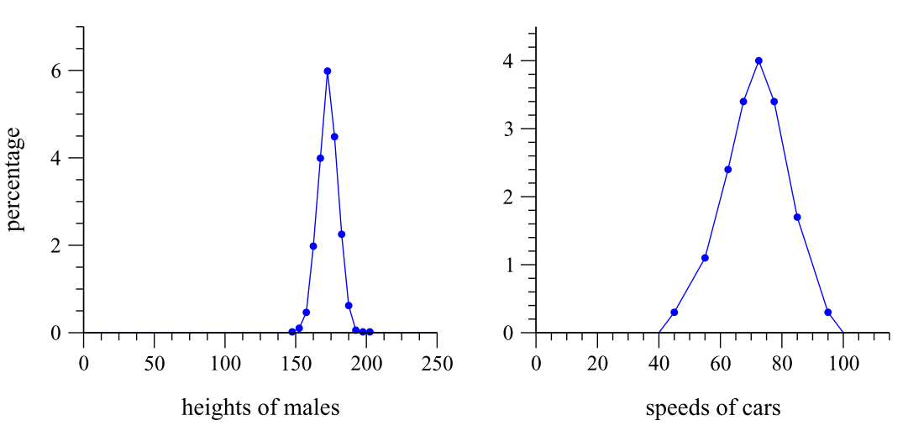
Newman (2005)

Slide 2
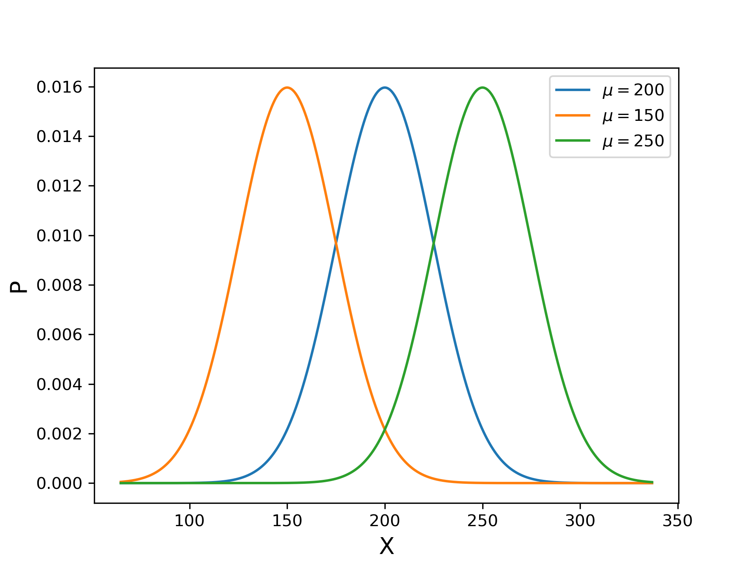
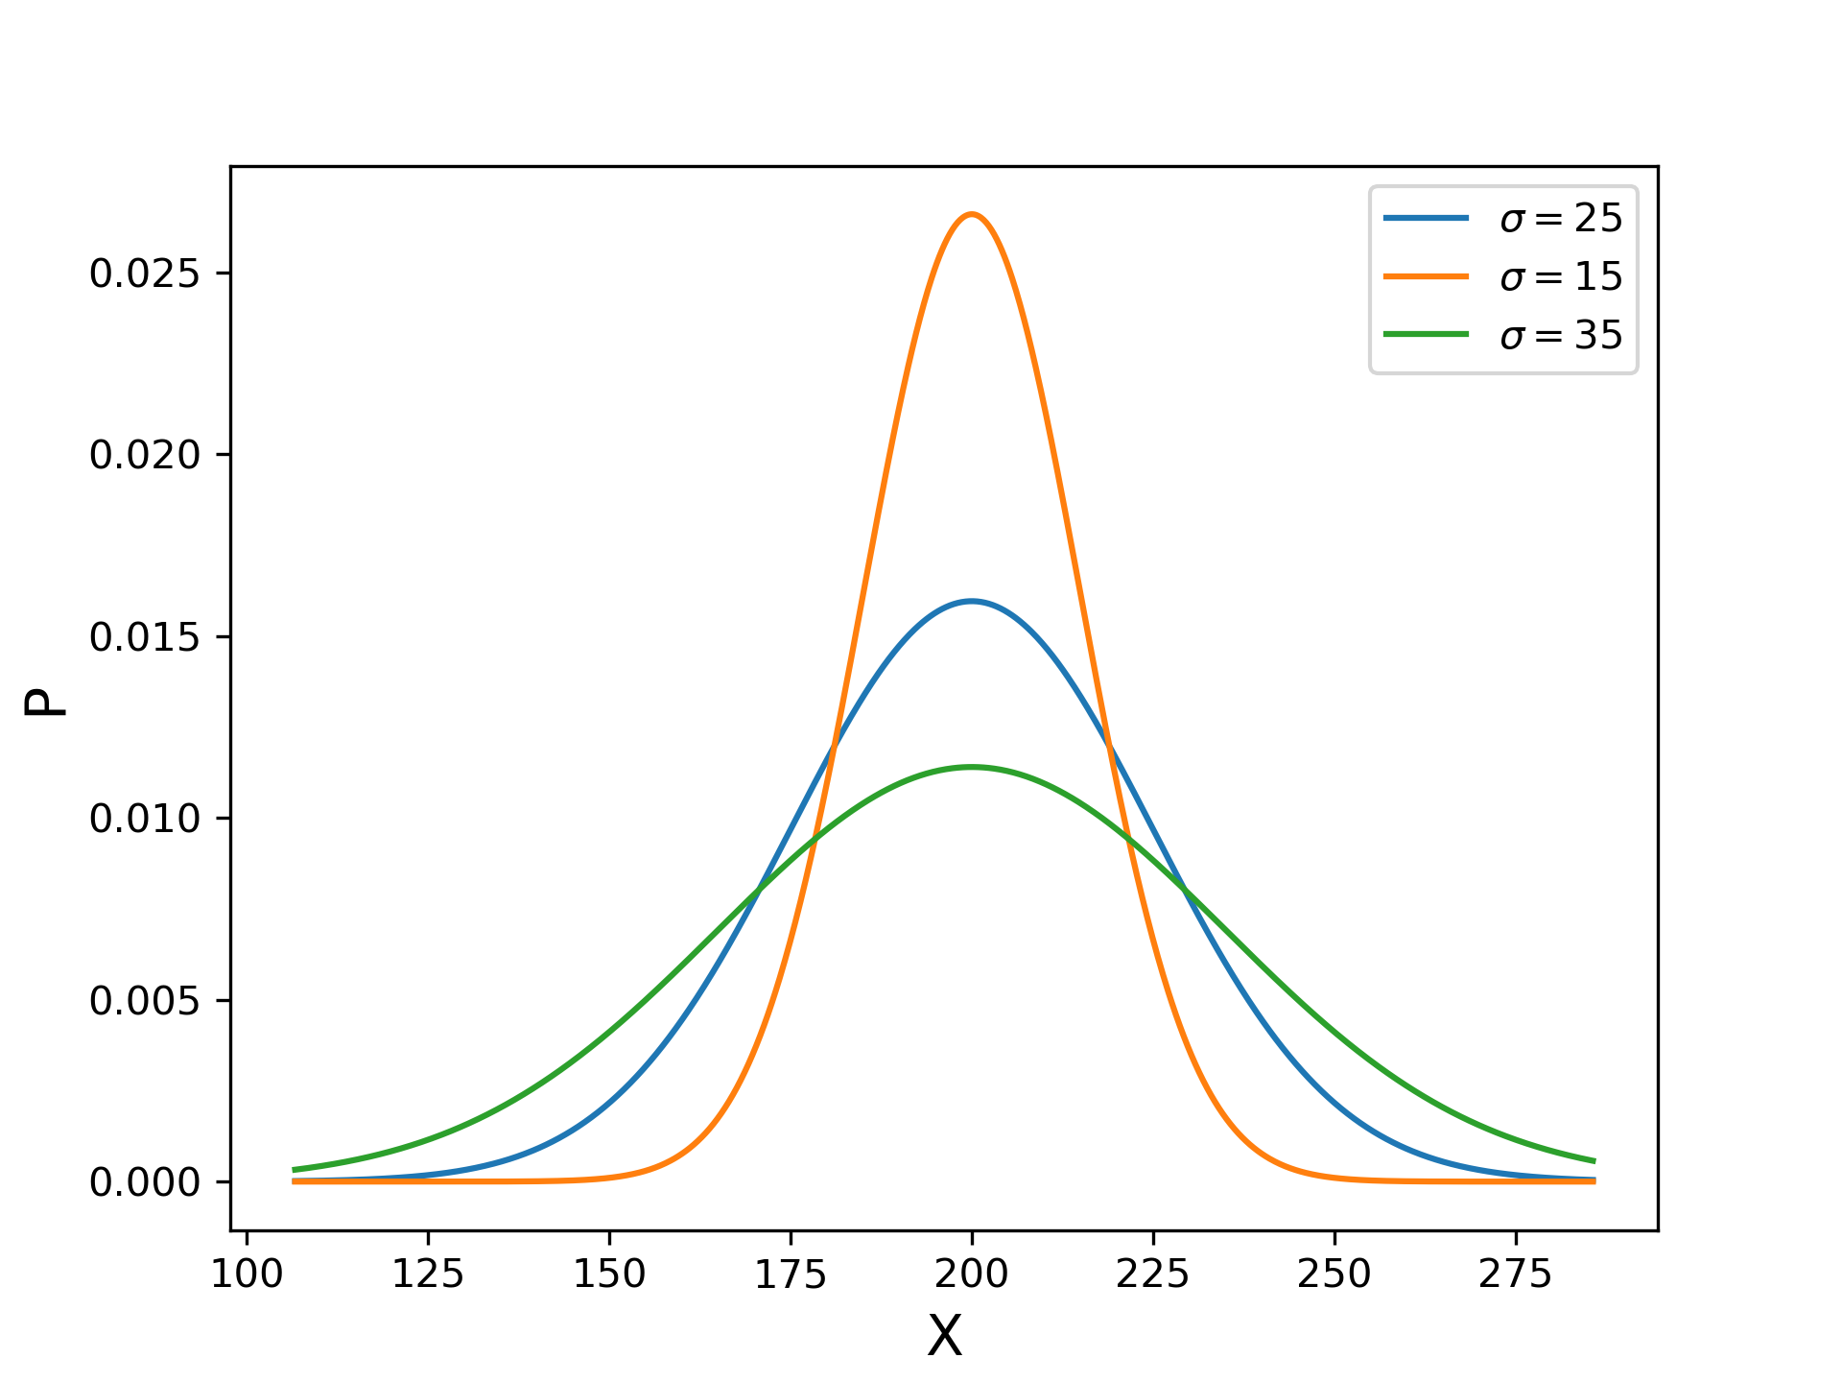
Changes in mean shift the distribution left or right
Smaller standard deviations narrow the distribution

Slide 3
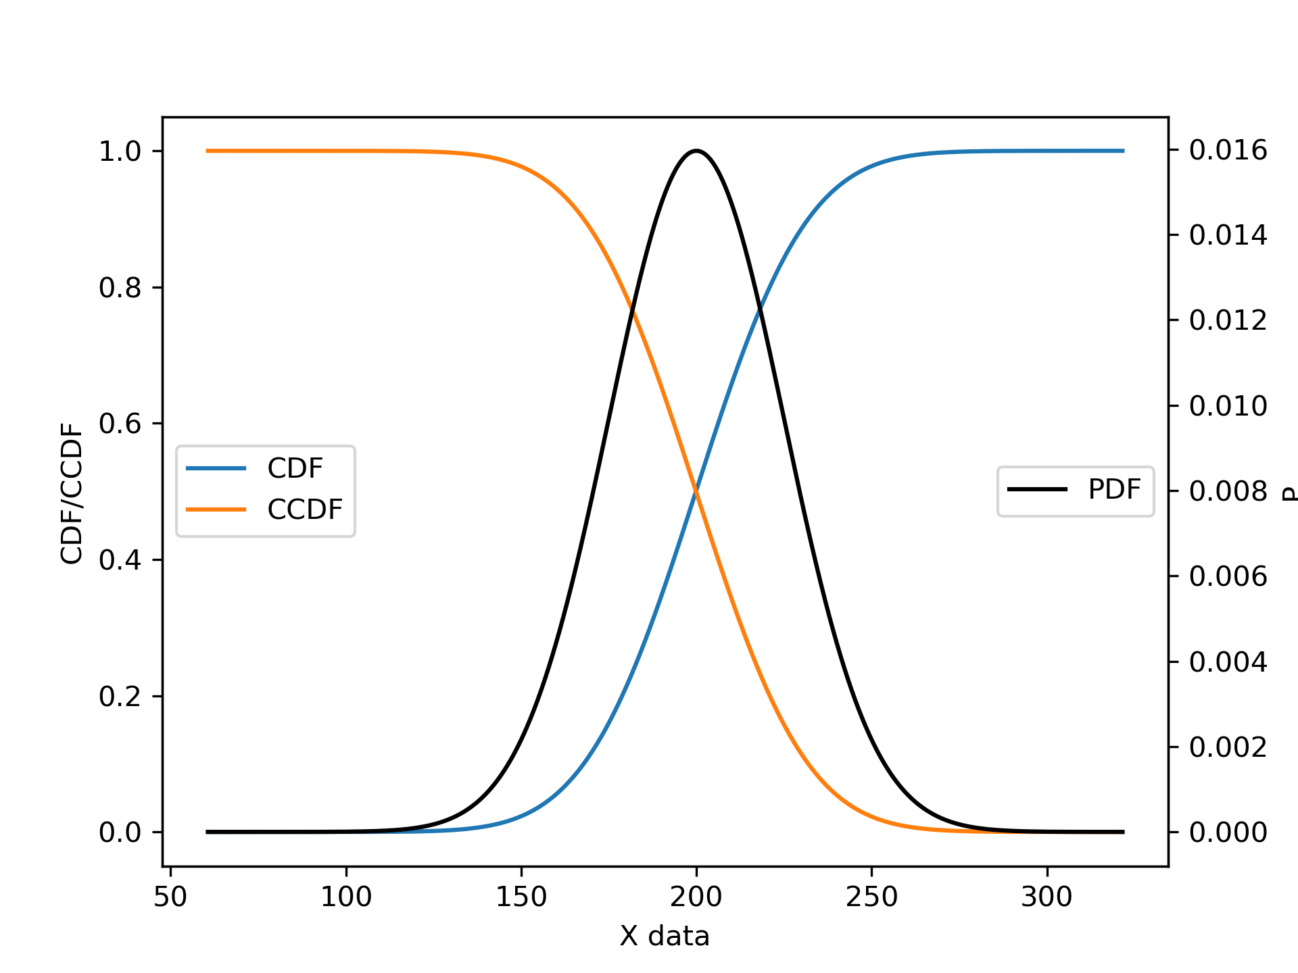
Cumulative Distribution Function (CDF)
Complementary Cumulative Distribution Function (CCDF)

Slide 4
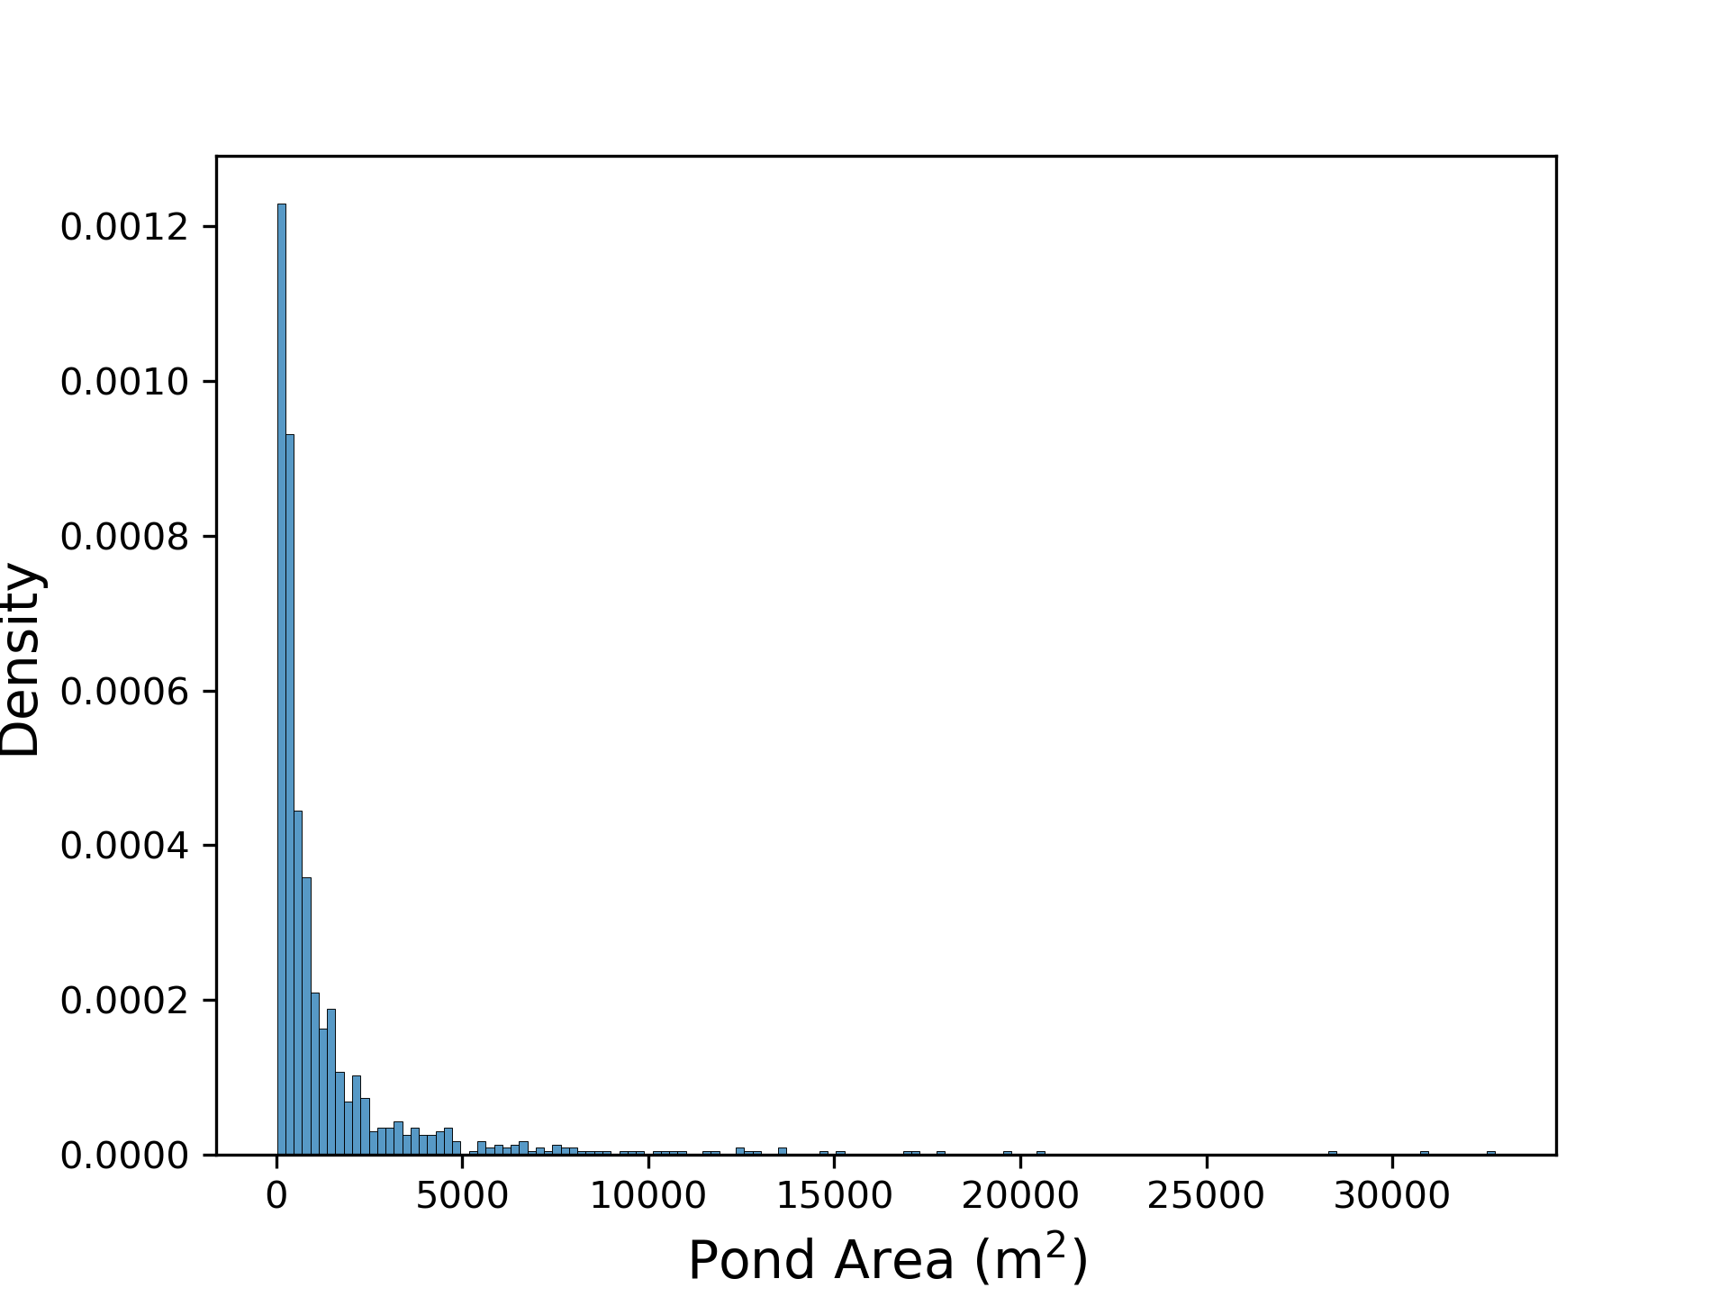
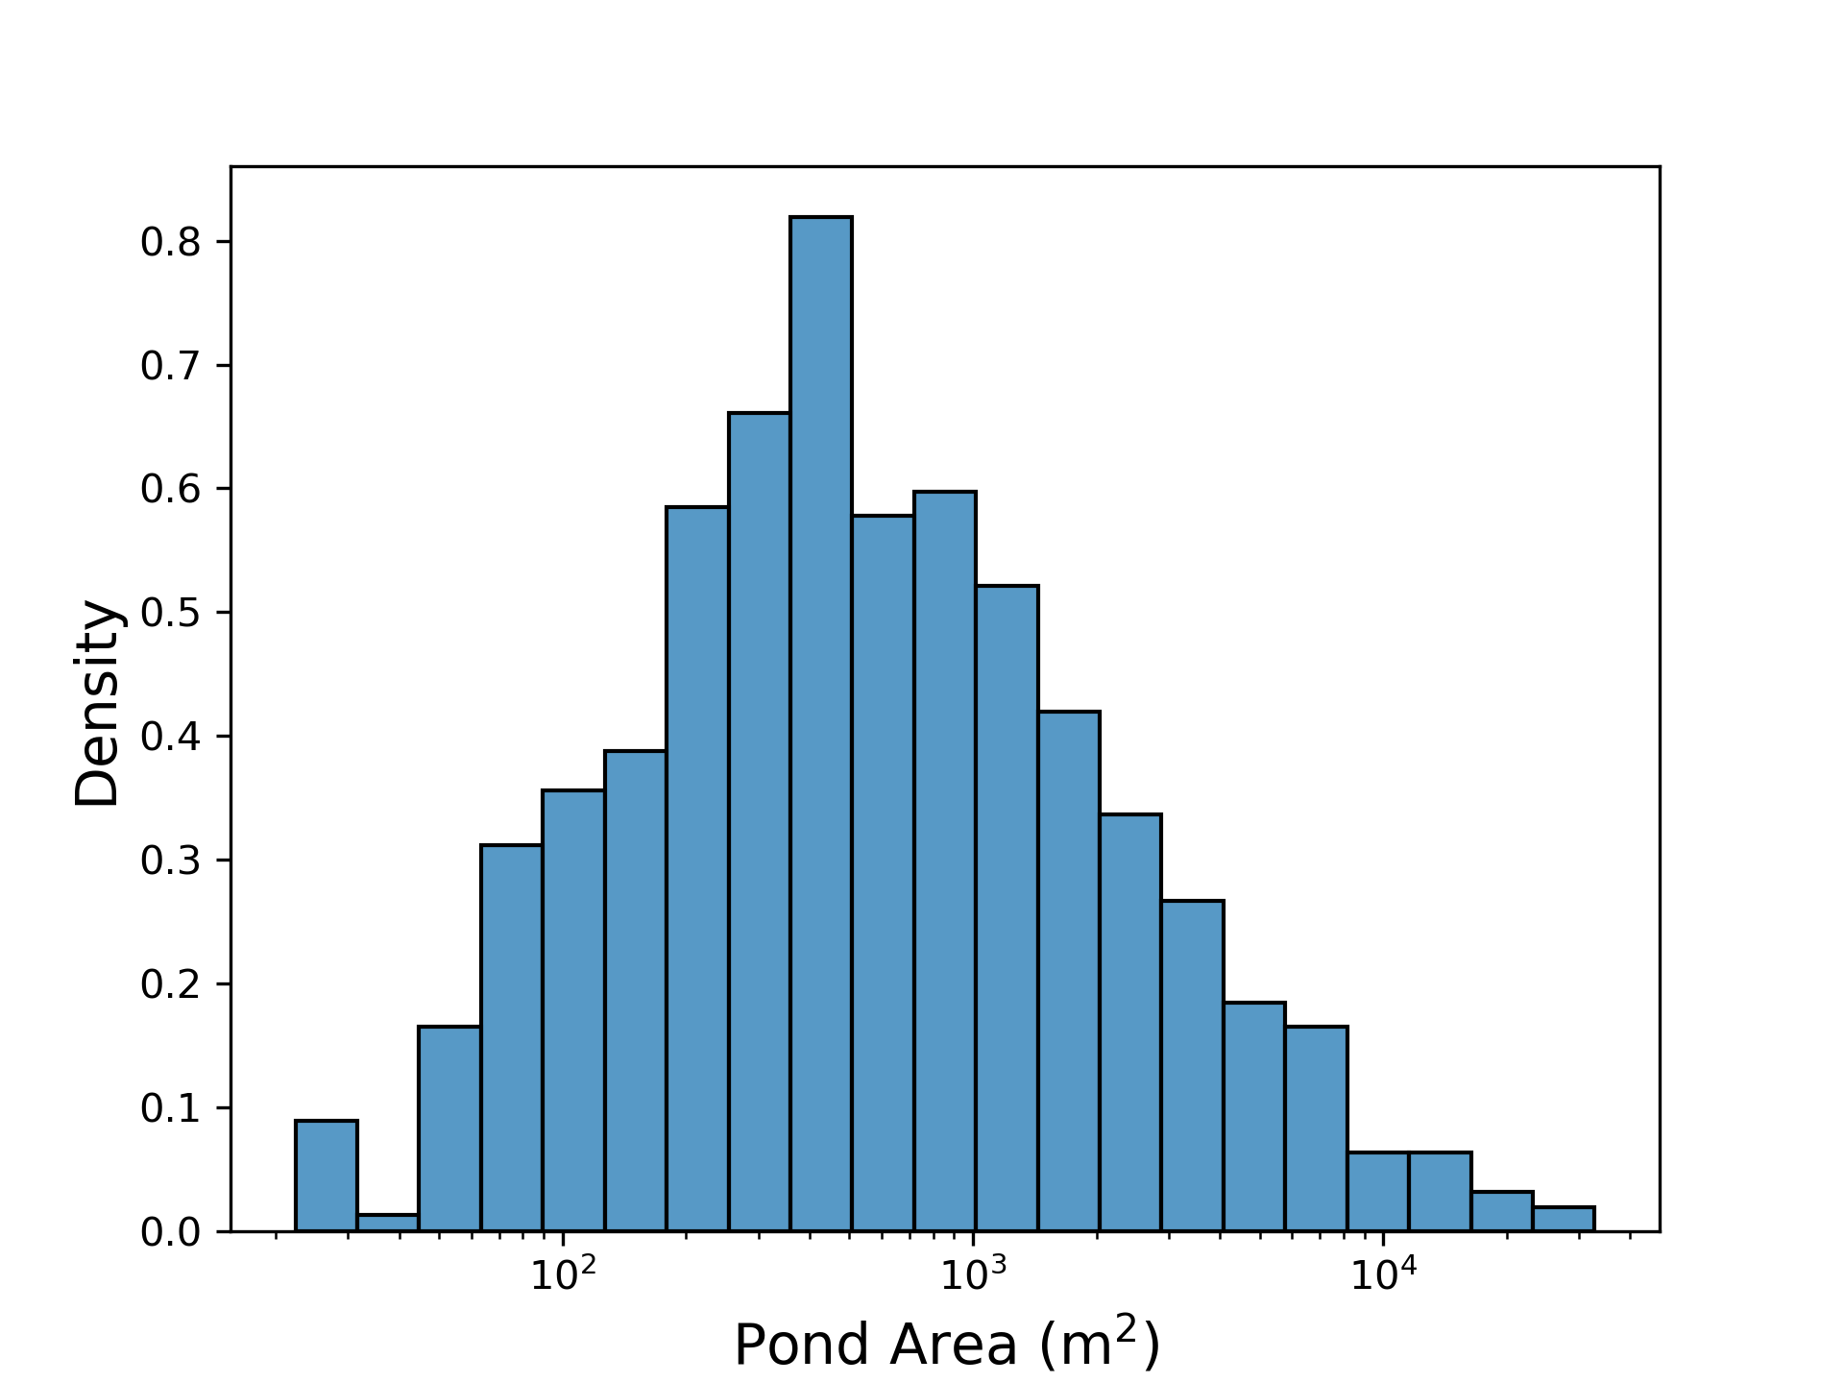
Distribution of supraglacial pond areas in the Langtang catchment, Nepal

Slide 5
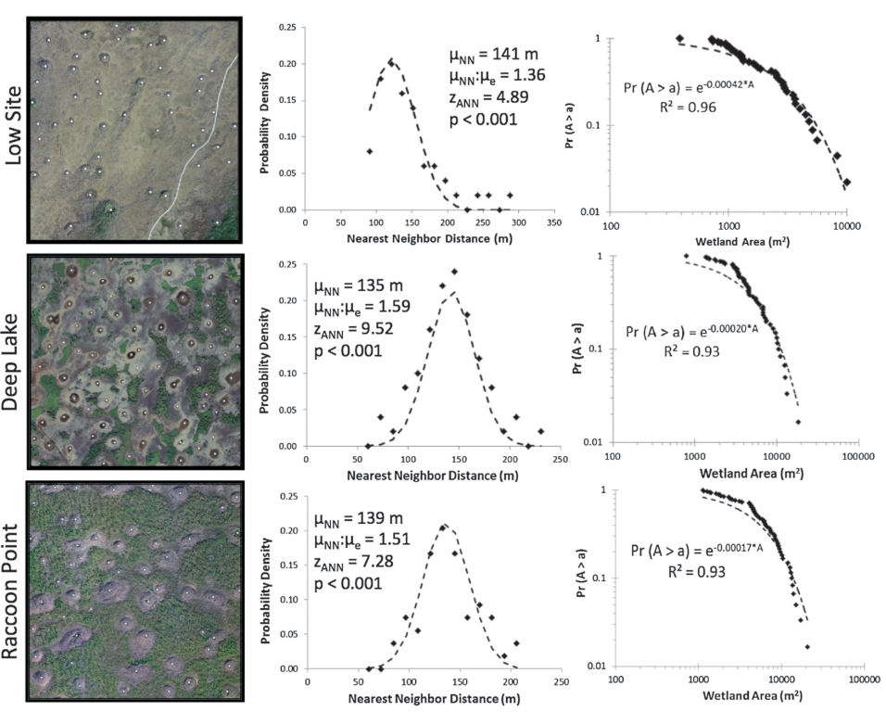
Watts et al. (2014)

Slide 6
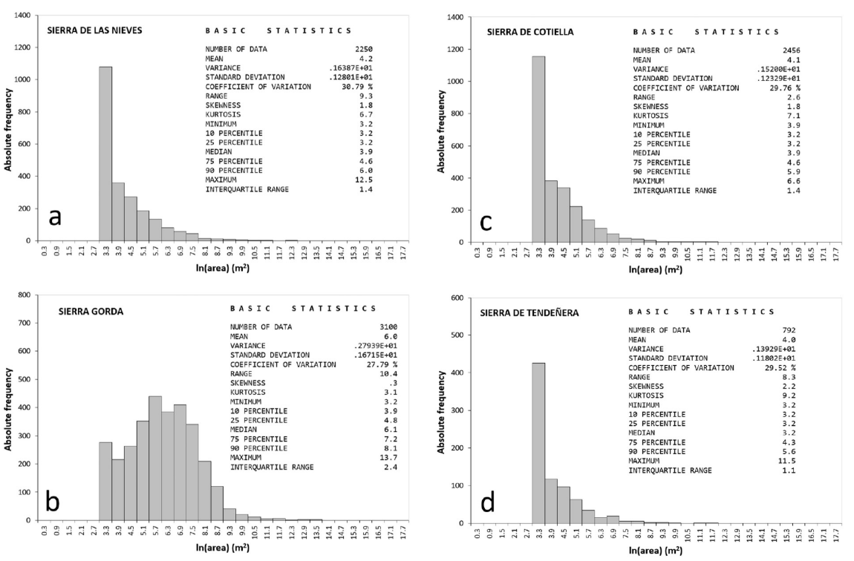
Pardo-Igúzquiza (2020)

Slide 7
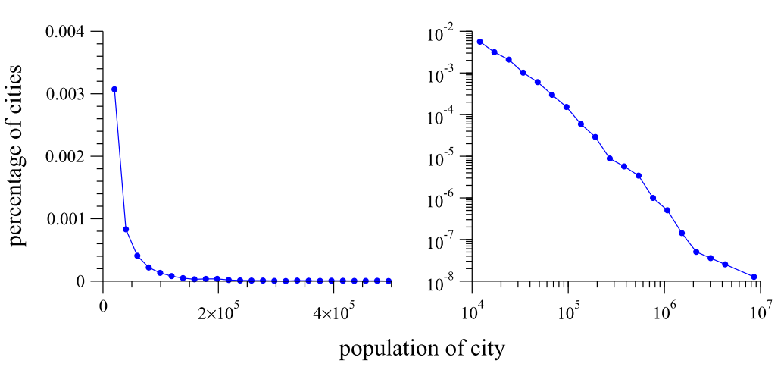
Newman (2005)

Slide 8
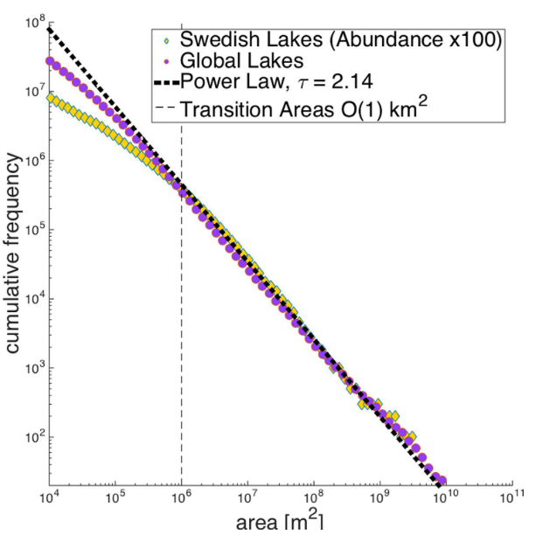
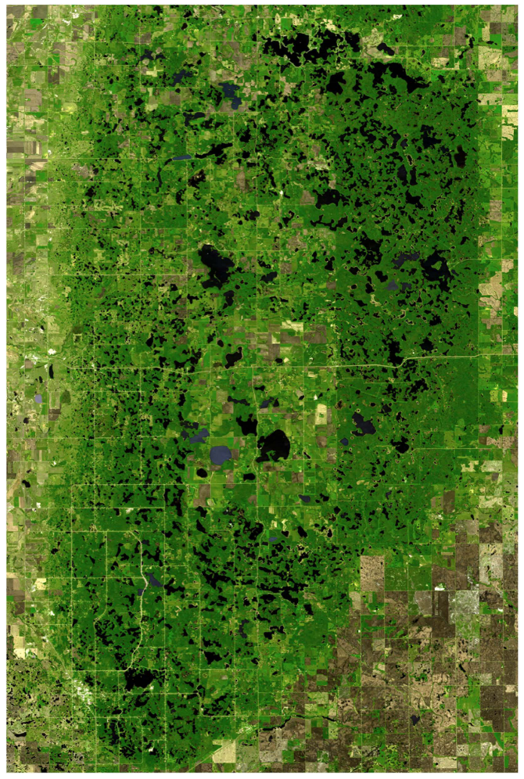
Cael and Seekell (2016)

Slide 9
